Slide 1
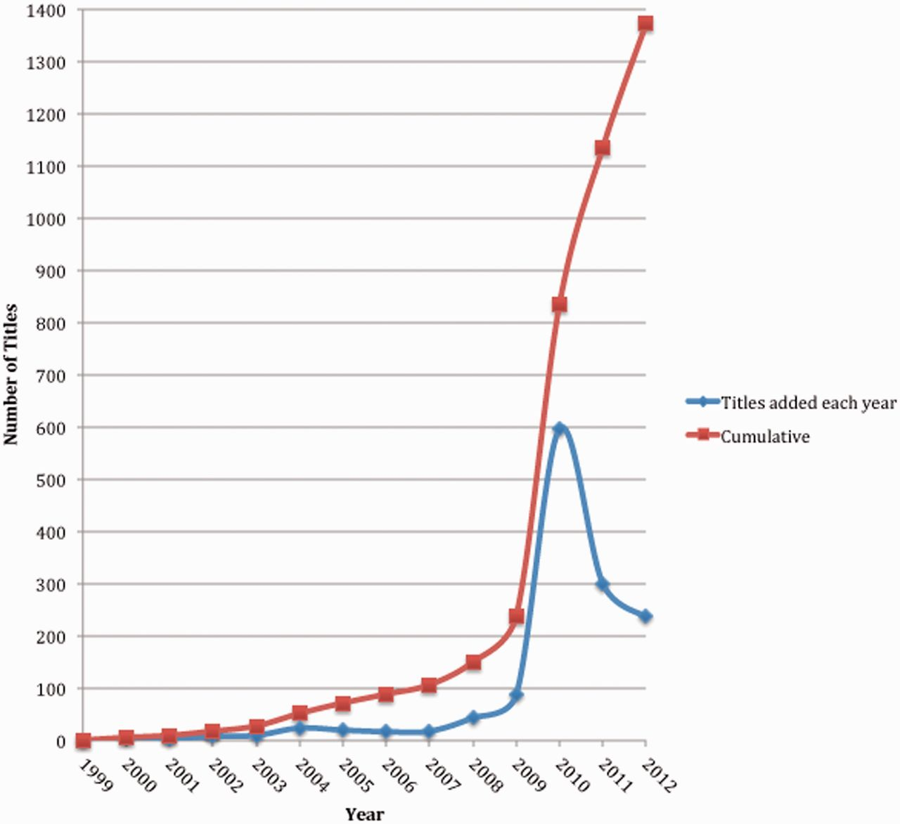
Figure 1. Growth of Bookshelf. The term ‘title’ represents a book in the database. The spike in the book title count in ...
Notes:
Figure 1. Growth of Bookshelf. The term ‘title’ represents a book in the database. The spike in the book title count in 2010 was due to data restructuring of the Health Services/Technology Assessment Texts (HSTAT; http://www.ncbi.nlm.nih.gov/books/NBK16710/) database content. Previously, reports in this database were not counted as individual titles.
Unless provided in the caption above, the following copyright applies to the content of this slide: Published by Oxford University Press 2012.This is an Open Access article distributed under the terms of the Creative Commons Attribution License (http://creativecommons.org/licenses/by-nc/3.0/), which permits non-commercial reuse, distribution, and reproduction in any medium, provided the original work is properly cited. For commercial re-use, please contact journals.permissions@oup.com.

Slide 2
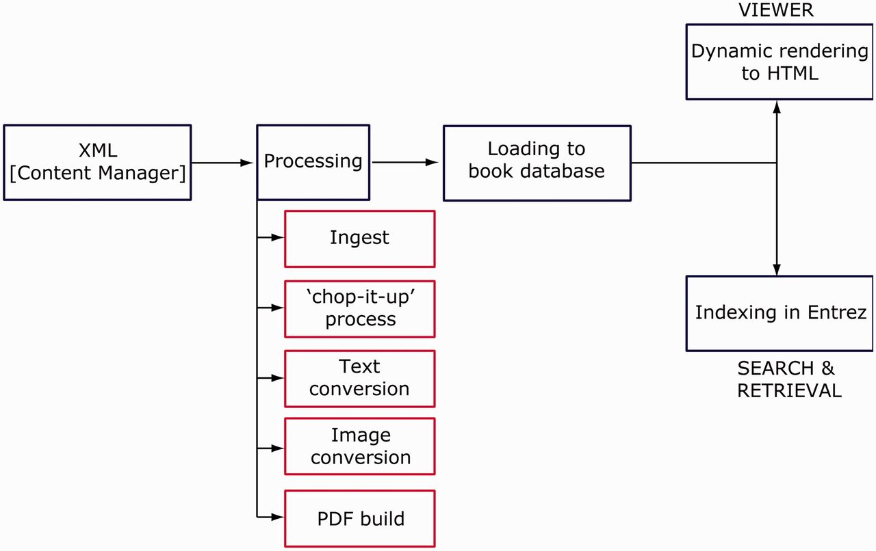
Figure 2. Data processing workflow. XML stored in the Bookshelf CMS goes through several stages of data processing ...
Notes:
Figure 2. Data processing workflow. XML stored in the Bookshelf CMS goes through several stages of data processing before loading into the book database. Ingest, the first stage of data conversion results in the creation of a tar file package, containing XML, PDF, image and supplementary files. During the ‘chop-it-up’ process, the single book XML document with root element is chunked into multiple article-like book-part XML documents with root element . Text and image conversion processing occurs concurrently. XML files loaded into the book database are dynamically rendered to HTML for viewing in the book viewer application and are indexed in Entrez for search and retrieval.
Unless provided in the caption above, the following copyright applies to the content of this slide: Published by Oxford University Press 2012.This is an Open Access article distributed under the terms of the Creative Commons Attribution License (http://creativecommons.org/licenses/by-nc/3.0/), which permits non-commercial reuse, distribution, and reproduction in any medium, provided the original work is properly cited. For commercial re-use, please contact journals.permissions@oup.com.

Slide 3
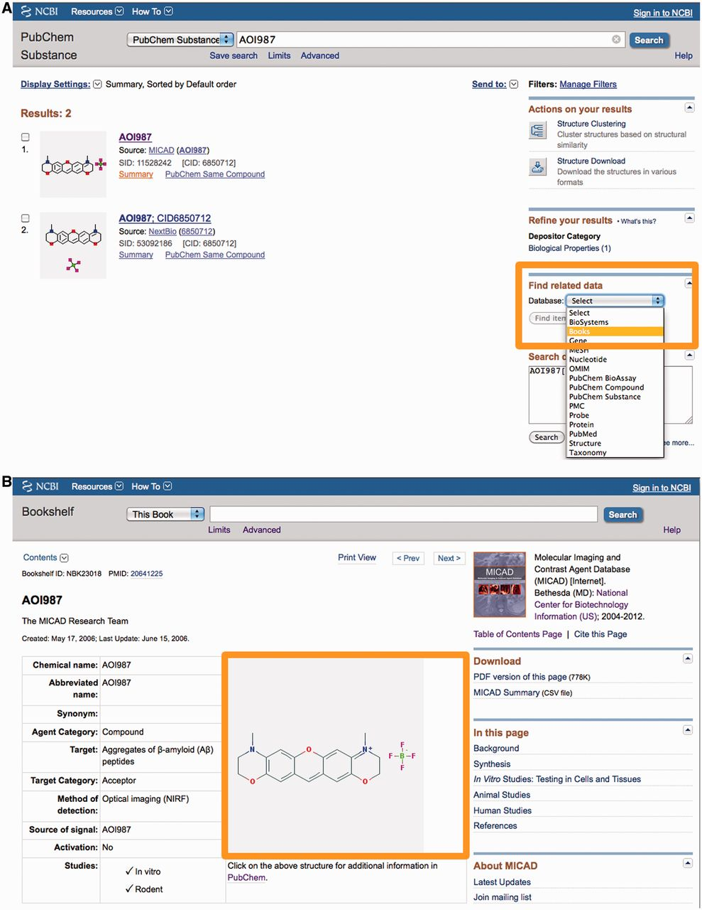
Figure 3. Reciprocal linking between Bookshelf and PubChem. (A) A search in PubChem for a substance AOI987 reveals ...
Notes:
Figure 3. Reciprocal linking between Bookshelf and PubChem. (A) A search in PubChem for a substance AOI987 reveals links to book content under ‘Find related data’. (B) The relevant record in Bookshelf shows the chemical structure for the PubChem substance. This structure renders dynamically in the Bookshelf page from PubChem database. Clicking on the image links to the record in PubChem.
Unless provided in the caption above, the following copyright applies to the content of this slide: Published by Oxford University Press 2012.This is an Open Access article distributed under the terms of the Creative Commons Attribution License (http://creativecommons.org/licenses/by-nc/3.0/), which permits non-commercial reuse, distribution, and reproduction in any medium, provided the original work is properly cited. For commercial re-use, please contact journals.permissions@oup.com.

Slide 4
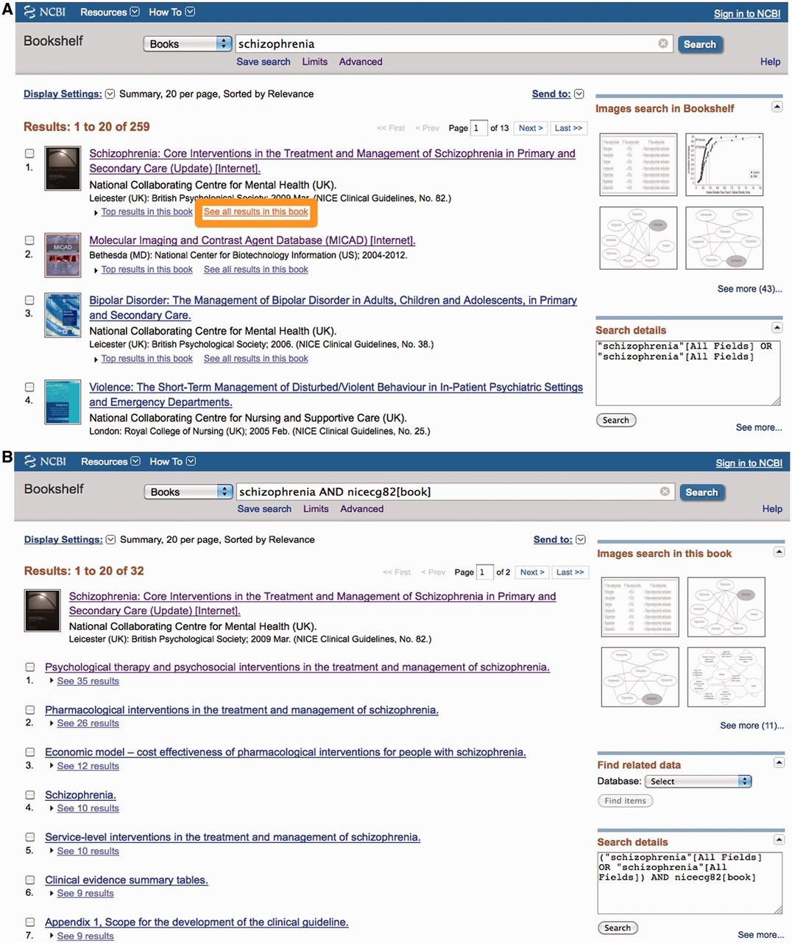
Figure 4. Searching, browsing and reading books. (A) Search in Entrez across Bookshelf. Clicking on ‘See all results ...
Notes:
Figure 4. Searching, browsing and reading books. (A) Search in Entrez across Bookshelf. Clicking on ‘See all results for this book’ leads to view shown in B. (B) Search within a book. (C) Browse tool. Titles can be viewed using term filters or by selection of categories (see highlighted areas). (D) Content can be read in the viewer, which displays the citation (orange) and allows for navigation (red) and alternate views (blue).
Unless provided in the caption above, the following copyright applies to the content of this slide: Published by Oxford University Press 2012.This is an Open Access article distributed under the terms of the Creative Commons Attribution License (http://creativecommons.org/licenses/by-nc/3.0/), which permits non-commercial reuse, distribution, and reproduction in any medium, provided the original work is properly cited. For commercial re-use, please contact journals.permissions@oup.com.

Slide 5
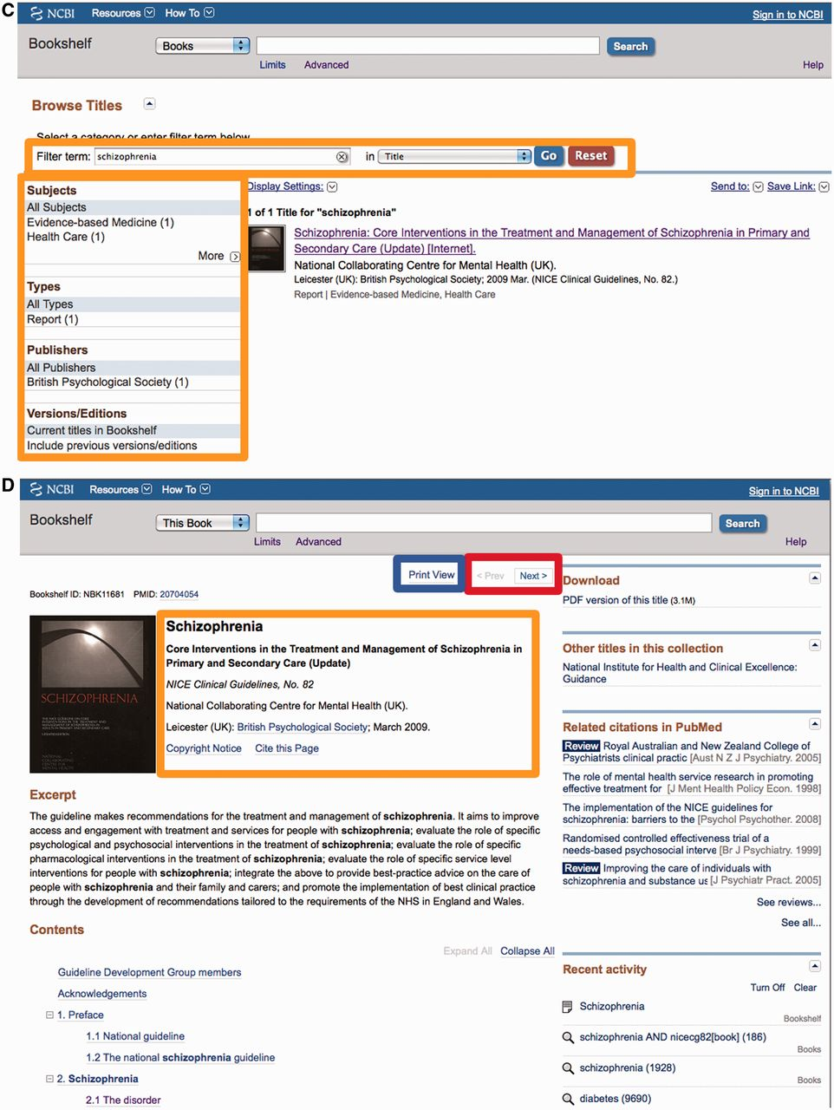
Figure 4. Searching, browsing and reading books. (A) Search in Entrez across Bookshelf. Clicking on ‘See all results ...
Notes:
Figure 4. Searching, browsing and reading books. (A) Search in Entrez across Bookshelf. Clicking on ‘See all results for this book’ leads to view shown in B. (B) Search within a book. (C) Browse tool. Titles can be viewed using term filters or by selection of categories (see highlighted areas). (D) Content can be read in the viewer, which displays the citation (orange) and allows for navigation (red) and alternate views (blue).
Unless provided in the caption above, the following copyright applies to the content of this slide: Published by Oxford University Press 2012.This is an Open Access article distributed under the terms of the Creative Commons Attribution License (http://creativecommons.org/licenses/by-nc/3.0/), which permits non-commercial reuse, distribution, and reproduction in any medium, provided the original work is properly cited. For commercial re-use, please contact journals.permissions@oup.com.

Slide 6
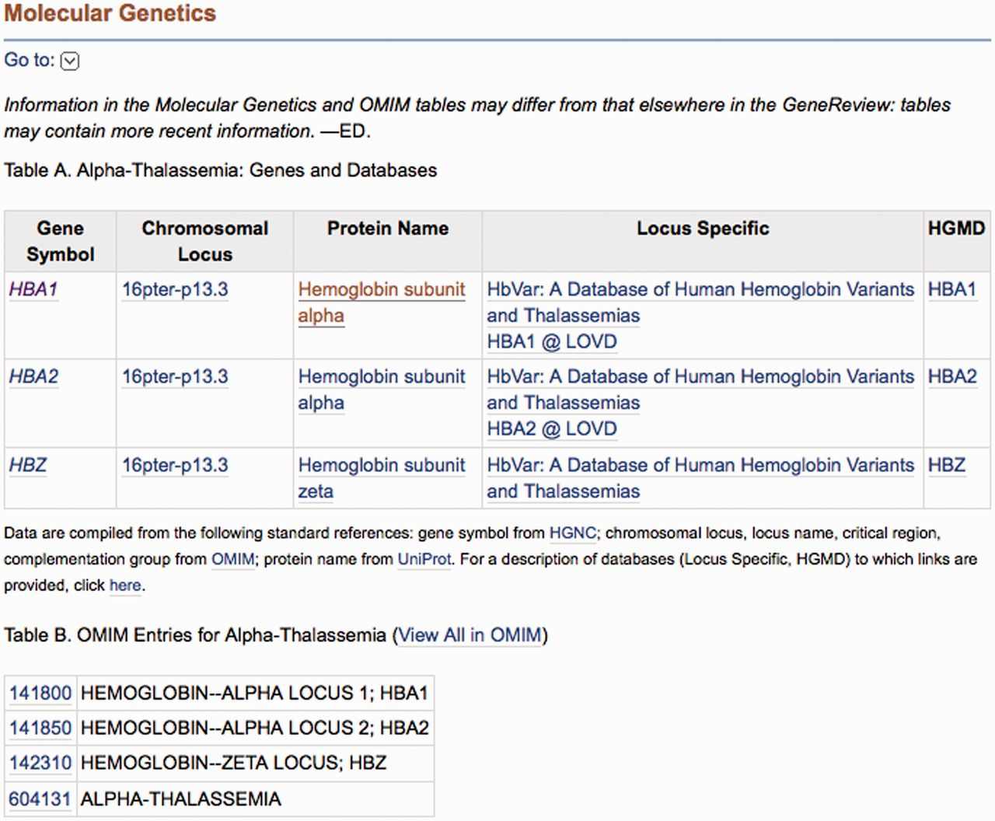
Figure 5. Integration of molecular genetic information in books. Data for Table A and B in the Molecular Genetics ...
Notes:
Figure 5. Integration of molecular genetic information in books. Data for Table A and B in the Molecular Genetics section of a GeneReviews article are computed based on OMIM entries in a specialized database. The information is dynamically pulled into the text at run time.
Unless provided in the caption above, the following copyright applies to the content of this slide: Published by Oxford University Press 2012.This is an Open Access article distributed under the terms of the Creative Commons Attribution License (http://creativecommons.org/licenses/by-nc/3.0/), which permits non-commercial reuse, distribution, and reproduction in any medium, provided the original work is properly cited. For commercial re-use, please contact journals.permissions@oup.com.

