Slide 1
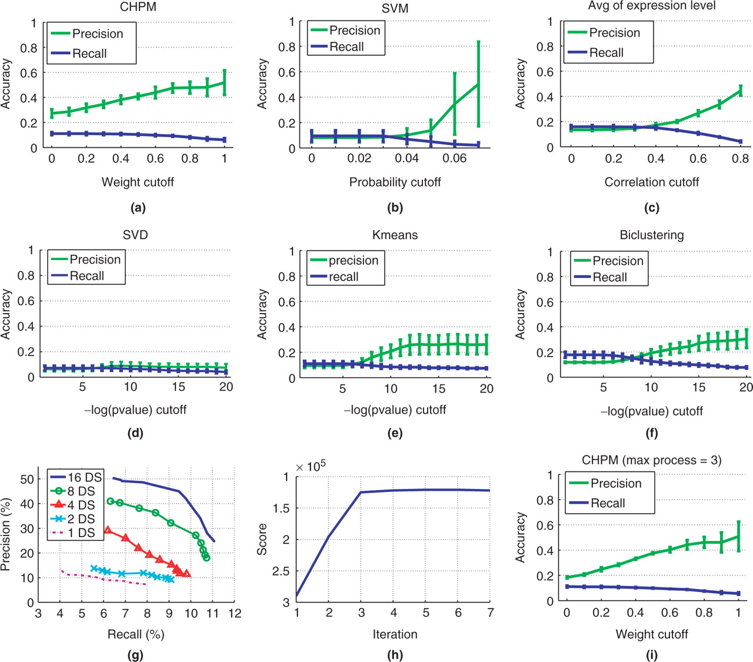
Fig. 3. (a–f) The precision and recall curves and error bars of methods tested using yeast expression data. (g) The ...
Notes:
Fig. 3. (a–f) The precision and recall curves and error bars of methods tested using yeast expression data. (g) The precision-recall curves as a function of the number of expression datasets used for CHPM, ranging from 1 to 16 datasets (DS). (h) The penalized likelihood score curve for CHPM versus the number of iterations. (i) Precision and recall curves and error bars for CHPM when setting the maximum number of processes associated with each gene to 3.
Unless provided in the caption above, the following copyright applies to the content of this slide: © 2007 The Author(s)This is an Open Access article distributed under the terms of the Creative Commons Attribution Non-Commercial License (http://creativecommons.org/licenses/by-nc/2.0/uk/) which permits unrestricted non-commercial use, distribution, and reproduction in any medium, provided the original work is properly cited.

