Slide 1
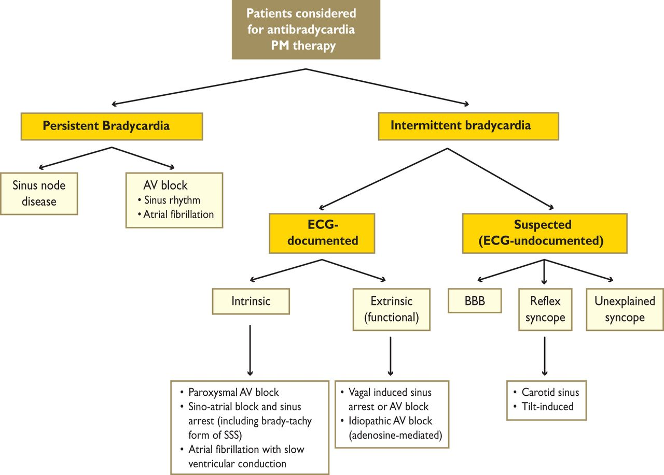
Figure 2 Classification of bradyarrhythmias based on the patient's clinical presentation. AV = atrioventricular; BBB = ...
Notes:
Figure 2 Classification of bradyarrhythmias based on the patient's clinical presentation. AV = atrioventricular; BBB = bundle branch block; ECG = electrocardiogram; PM = pacemaker; SSS = sick sinus syndrome.
Unless provided in the caption above, the following copyright applies to the content of this slide: © The European Society of Cardiology 2013. All rights reserved. For permissions please email: journals.permissions@oup.com

Slide 2
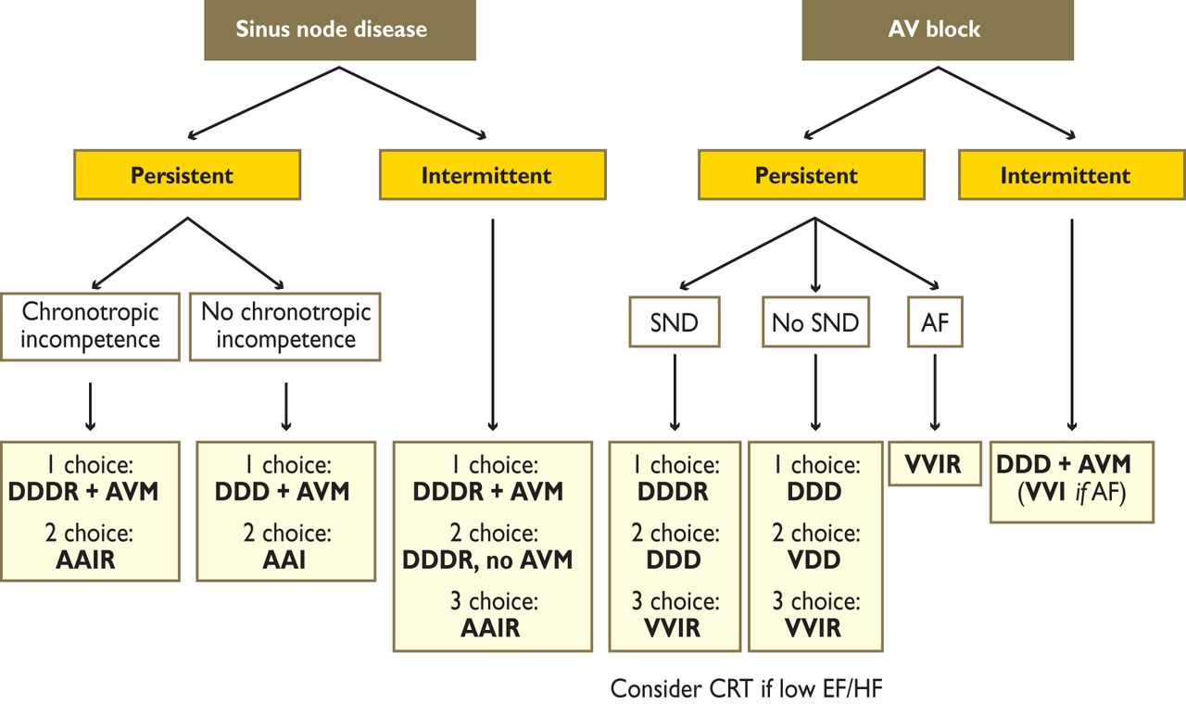
Figure 3 Optimal pacing mode in sinus node disease and AV block. AF = atrial fibrillation; AV = atrioventricular; AVM ...
Notes:
Figure 3 Optimal pacing mode in sinus node disease and AV block. AF = atrial fibrillation; AV = atrioventricular; AVM = AV delay management, i.e. to prevent unnecessary right ventricular pacing by means of manual optimization of AV interval or programming of AV hysteresis; SND = sinus node disease.
Unless provided in the caption above, the following copyright applies to the content of this slide: © The European Society of Cardiology 2013. All rights reserved. For permissions please email: journals.permissions@oup.com

Slide 3
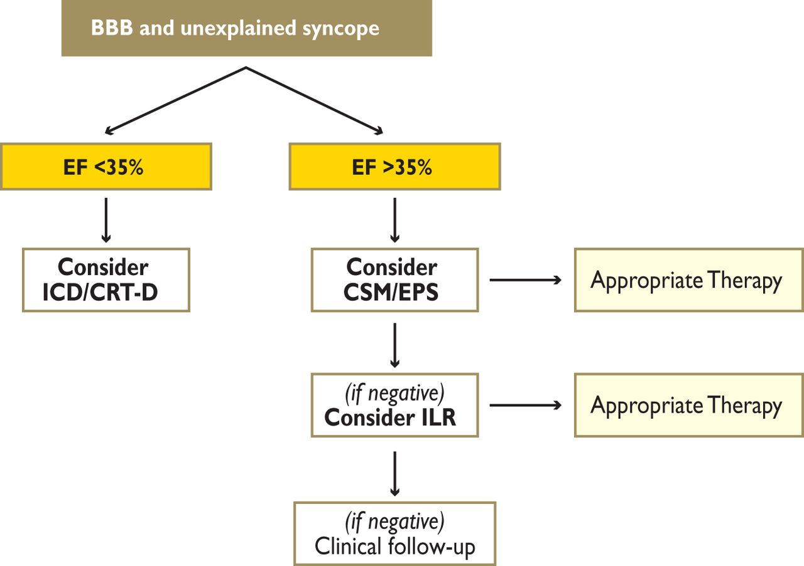
Figure 4 Therapeutic algorithm for patients presenting with unexplained syncope and bundle branch block (BBB). CRT-D = ...
Notes:
Figure 4 Therapeutic algorithm for patients presenting with unexplained syncope and bundle branch block (BBB). CRT-D = cardiac resynchronization therapy and defibrillator; CSM = carotid sinus massage; EF = ejection fraction; EPS = electrophysiological study; ICD = implantable cardioverter defibrillator; ILR = implantable loop recorder.
Unless provided in the caption above, the following copyright applies to the content of this slide: © The European Society of Cardiology 2013. All rights reserved. For permissions please email: journals.permissions@oup.com

Slide 4
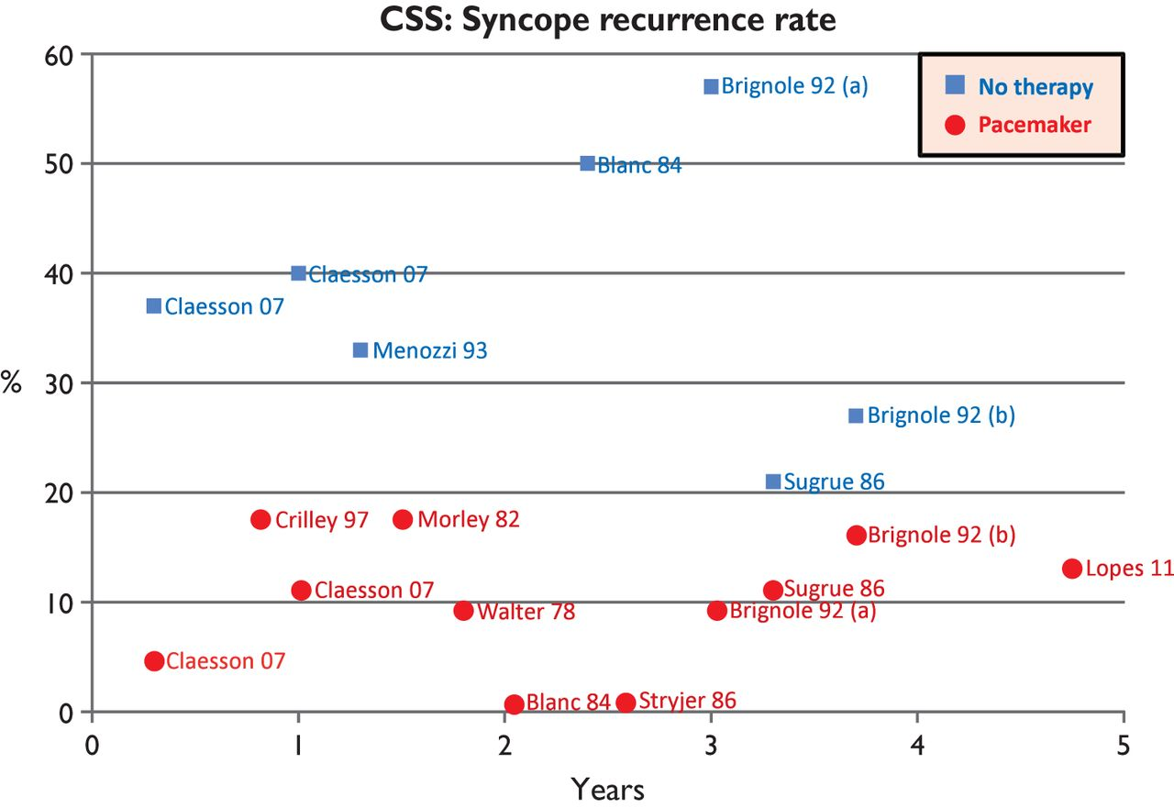
Figure 5 Recurrence of syncope in untreated and paced patients affected by carotid sinus syndrome (CSS). Reproduced ...
Notes:
Figure 5 Recurrence of syncope in untreated and paced patients affected by carotid sinus syndrome (CSS). Reproduced with permission from Brignole et al.35
Unless provided in the caption above, the following copyright applies to the content of this slide: © The European Society of Cardiology 2013. All rights reserved. For permissions please email: journals.permissions@oup.com

Slide 5
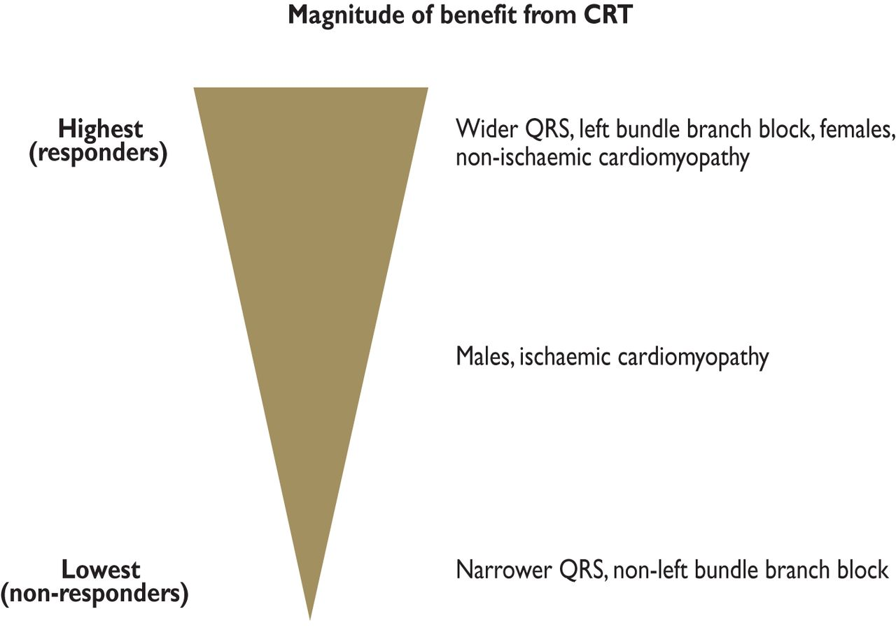
Figure 8 Clinical factors influencing the likelihood to respond to CRT.
Notes:
Figure 8 Clinical factors influencing the likelihood to respond to CRT.
Unless provided in the caption above, the following copyright applies to the content of this slide: © The European Society of Cardiology 2013. All rights reserved. For permissions please email: journals.permissions@oup.com

Slide 6
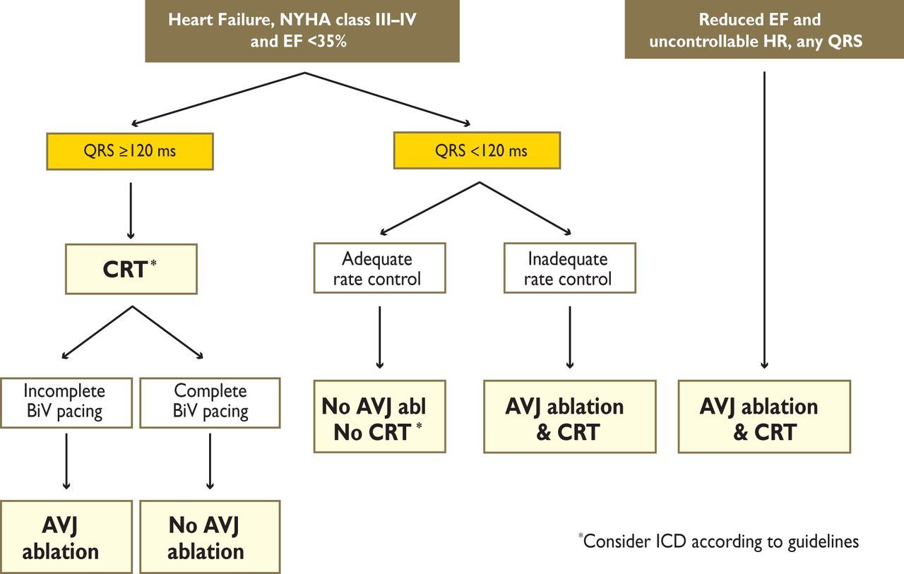
Figure 10 Indication for atrioventricular junction (AVJ) ablation in patients with symptomatic permanent atrial ...
Notes:
Figure 10 Indication for atrioventricular junction (AVJ) ablation in patients with symptomatic permanent atrial fibrillation (AF) and optimal pharmacological therapy. BiV = biventricular; CRT = cardiac resynchronization therapy; EF = ejection fraction; HR = heart rate; ICD = implantable cardioverter defibrillator; NYHA = New York Heart Association.
Unless provided in the caption above, the following copyright applies to the content of this slide: © The European Society of Cardiology 2013. All rights reserved. For permissions please email: journals.permissions@oup.com

Slide 7
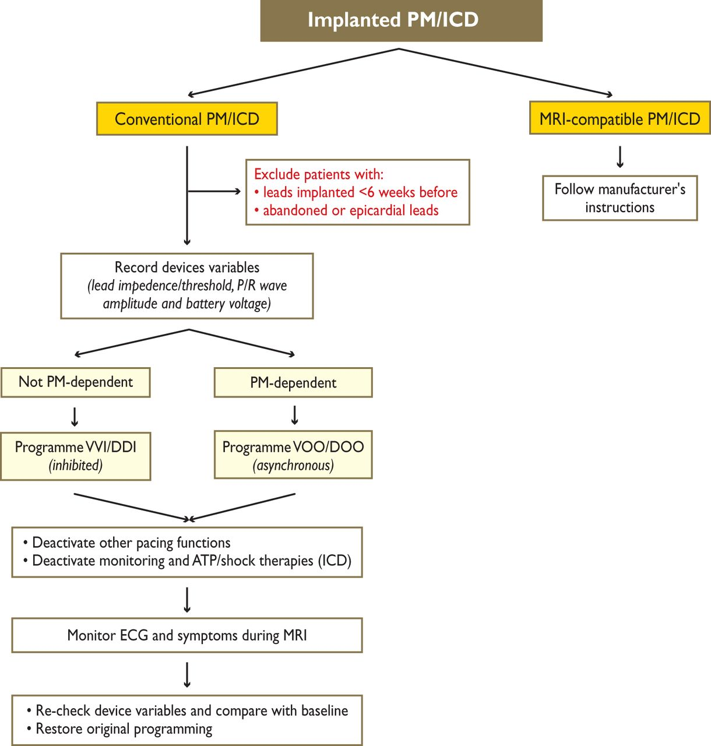
Figure 12 Safety precautions for magnetic resonance imaging (MRI) in patients with conventional cardiac devices. ATP = ...
Notes:
Figure 12 Safety precautions for magnetic resonance imaging (MRI) in patients with conventional cardiac devices. ATP = anti-tachycardiac pacing; ECG = electrocardiogram; ICD = implantable cardioverter defibrillator; PM = pacemaker. Adapted from Nazarian et al.170
Unless provided in the caption above, the following copyright applies to the content of this slide: © The European Society of Cardiology 2013. All rights reserved. For permissions please email: journals.permissions@oup.com

