Slide 1
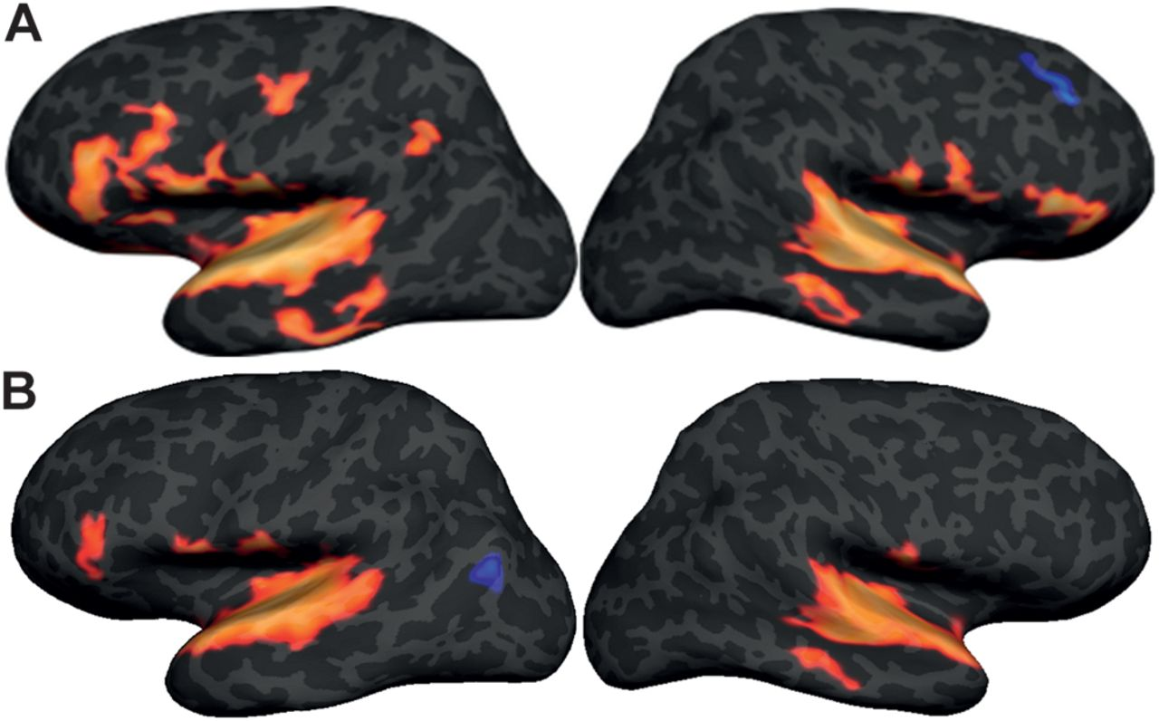
Figure 1. (A) Between-subjects surface-based average showing greater response for song versus nonstimulus baseline. (B) ...
Notes:
Figure 1. (A) Between-subjects surface-based average showing greater response for song versus nonstimulus baseline. (B) Between-subjects surface-based average showing greater response for speech versus nonstimulus baseline.
Unless provided in the caption above, the following copyright applies to the content of this slide: © The Author 2012. Published by Oxford University Press. All rights reserved. For permissions, please e-mail: journals.permissions@oup.com

Slide 2
Figure 2. Between-subjects surface-based average showing greater response for song versus speech stimuli.
Notes:
Figure 2. Between-subjects surface-based average showing greater response for song versus speech stimuli.
Unless provided in the caption above, the following copyright applies to the content of this slide: © The Author 2012. Published by Oxford University Press. All rights reserved. For permissions, please e-mail: journals.permissions@oup.com

