Slide 1
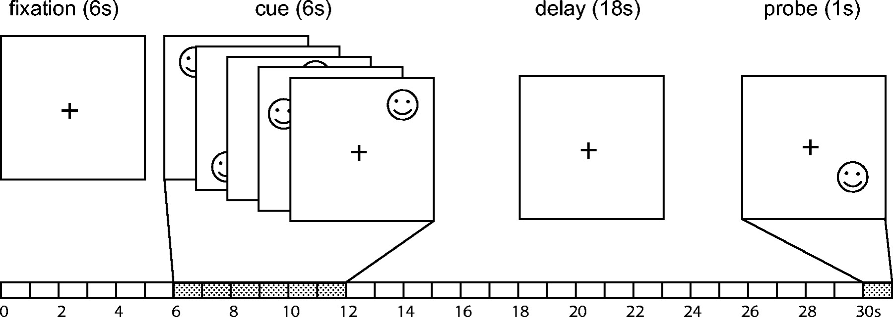
Figure 1. A schematic diagram for a task trial. Both memory and control trials have the same time line. Each visual ...
Notes:
Figure 1. A schematic diagram for a task trial. Both memory and control trials have the same time line. Each visual stimulus lasts for 1 s and the gap between two adjacent stimuli is 250 ms. The delay interval is 18 s. The ITI is 14 s (not indicated in the figure).
Unless provided in the caption above, the following copyright applies to the content of this slide: © The Author 2005. Published by Oxford University Press. All rights reserved. For permissions, please e-mail: journals.permissions@oupjournals.org

Slide 2
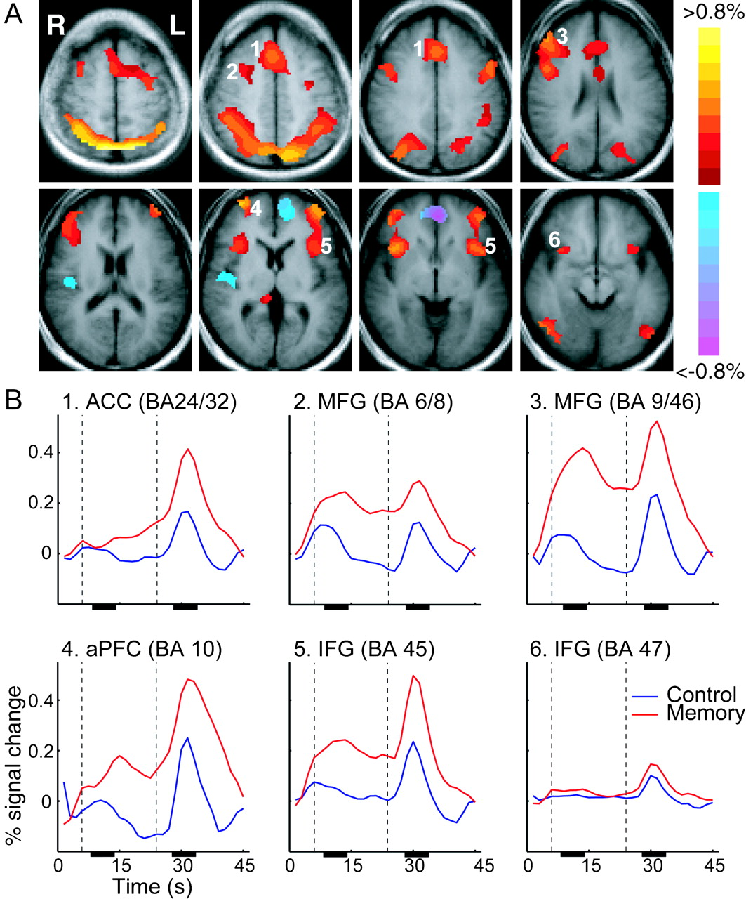
Figure 2. Contrast maps and time courses. (A) Composite maps of response-related activations were generated by ...
Notes:
Figure 2. Contrast maps and time courses. (A) Composite maps of response-related activations were generated by contrasting signals from the response phases of the memory and control tasks. Red/yellow and blue/purple indicate percent signal change above and below threshold, respectively. Cluster filter is set at 20 contiguous voxels and activation threshold is set at P < 0.005, uncorrected. R, right; L, left. (B) Time courses for memory (red line) and control (blue line) tasks of the ROIs selected from the activation maps (numbers shown in A). Cue onset starts at the first time point. The first vertical line marks the end of the cue presentation and the second line marks the onset of the response probe presentation. The time between the two lines is the delay period (18 s). The black bars on the x-axes mark the times of which hemodynamic responses were used to calculate the encoding/early-delay and response-related signals. Baseline was calculated using the first and last two time points. See Table 1 for abbreviations.
Unless provided in the caption above, the following copyright applies to the content of this slide: © The Author 2005. Published by Oxford University Press. All rights reserved. For permissions, please e-mail: journals.permissions@oupjournals.org

Slide 3
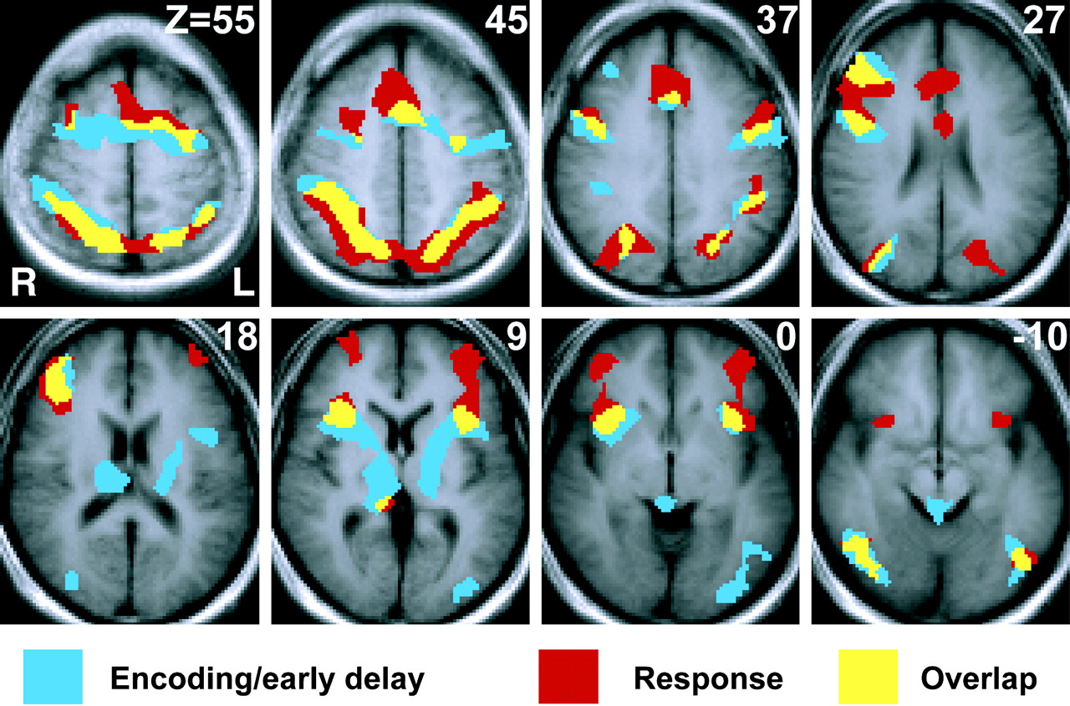
Figure 3. Comparisons of supra-threshold activations for encoding/early-delay and response phases of the memory task. ...
Notes:
Figure 3. Comparisons of supra-threshold activations for encoding/early-delay and response phases of the memory task. Early-delay or encoding-related activations above control are shown in blue and recognition-related activations above control are shown in red. Areas that showed activations during both phases are in yellow. Only positive activations are shown.
Unless provided in the caption above, the following copyright applies to the content of this slide: © The Author 2005. Published by Oxford University Press. All rights reserved. For permissions, please e-mail: journals.permissions@oupjournals.org

Slide 4
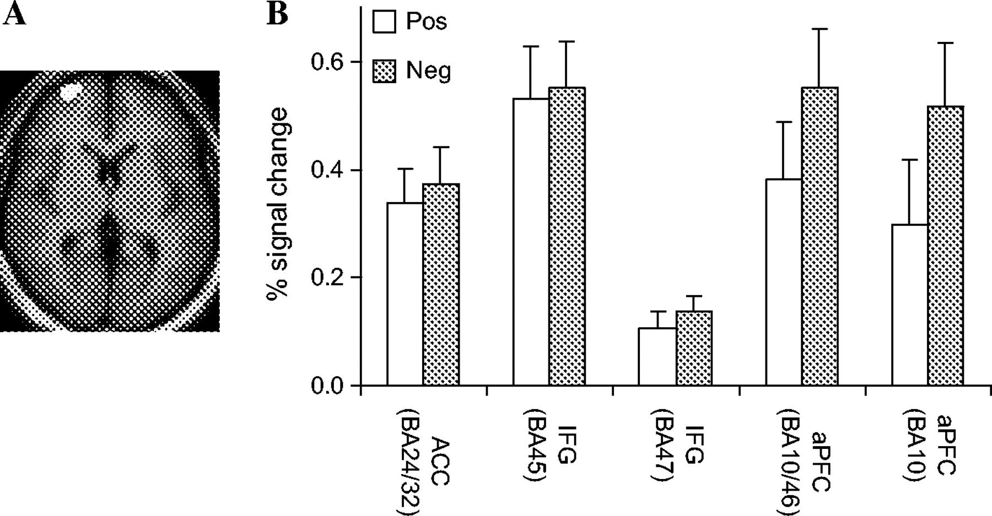
Figure 4. (A) Activation differences between the negative and positive probe conditions. The right ventral aPFC (x = ...
Notes:
Figure 4. (A) Activation differences between the negative and positive probe conditions. The right ventral aPFC (x = 30, y = 52, z = 9) showed greater activation in response to the negative probes than to the positive probes. (B) Average percentage changes of signal from baseline are plotted for responses to positive probes (white bars) and negative probes (gray bars). All ROIs are in the right hemisphere. Standard error bars are shown in the figure. See Table 1 for abbreviations and Talairach coordinates.
Unless provided in the caption above, the following copyright applies to the content of this slide: © The Author 2005. Published by Oxford University Press. All rights reserved. For permissions, please e-mail: journals.permissions@oupjournals.org

