Slide 1
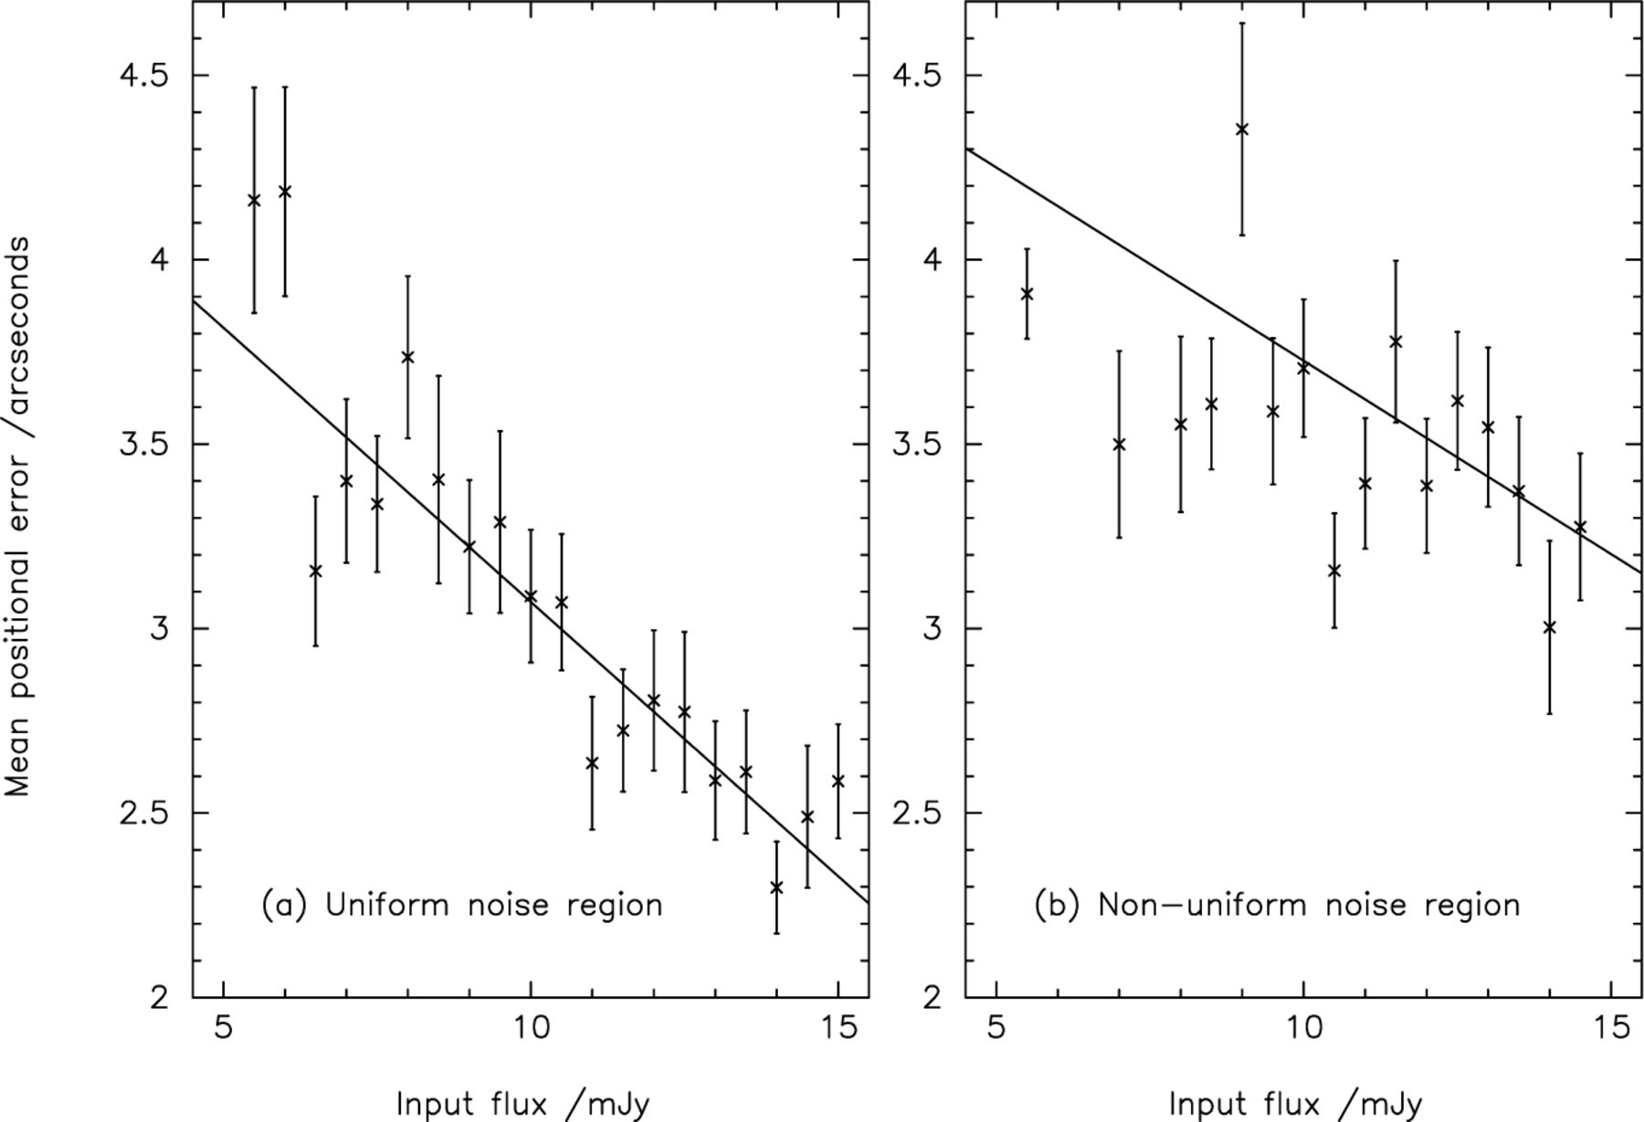
Figure 1. The dependence of positional error on input source flux density in the range 5–15 mJy, based on a single ...
Notes:
Figure 1. The dependence of positional error on input source flux density in the range 5–15 mJy, based on a single template source repeatedly being added into and then retrieved (<3.50σ) from the real unconvolved signal maps. The error bars give the standard error on the mean. Plot (a) gives the results from the uniform noise region, whereas plot (b) gives the results for the non-uniform edge regions which have not received the full integration time. The solid lines are a best fit to the plotted data points.
Unless provided in the caption above, the following copyright applies to the content of this slide: © 2002 RAS

Slide 2
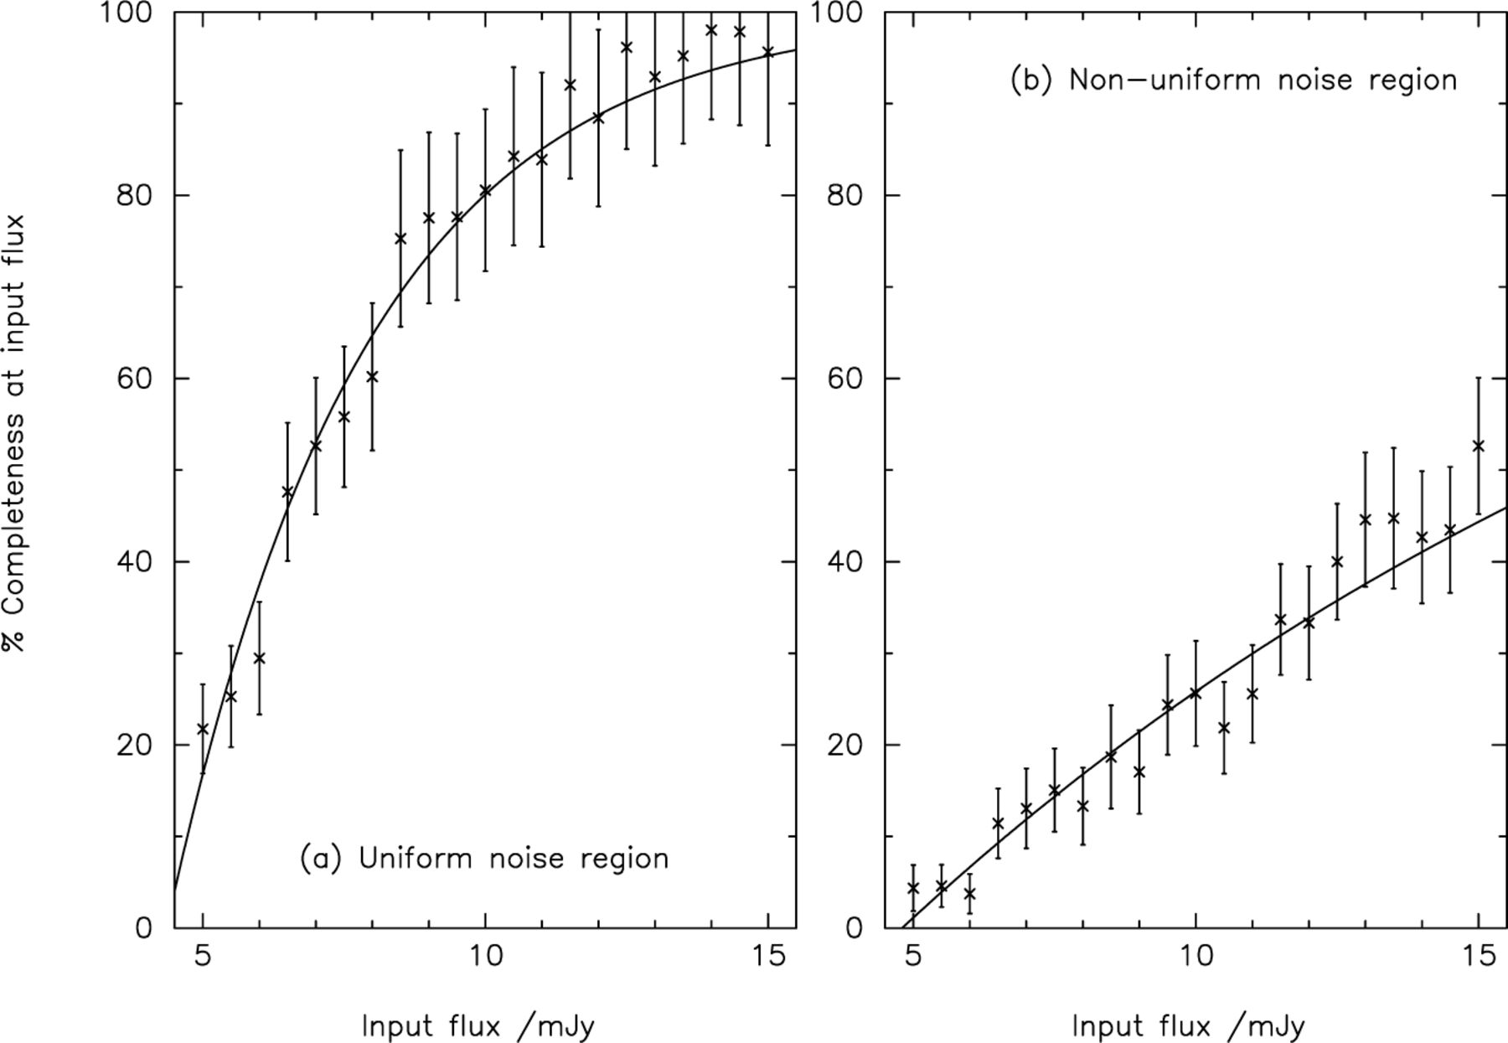
Figure 2. The percentage of sources returned against input source flux density in the range 5–15 mJy, based on a single ...
Notes:
Figure 2. The percentage of sources returned against input source flux density in the range 5–15 mJy, based on a single template source repeatedly being added into and retrieved (<3.50σ) from the real unconvolved signal maps. The error bars give the standard error on the mean. Plot (a) gives the results from the uniform noise region, whereas plot (b) gives the results for the non-uniform edge regions which have not received the full integration time. The solid curves show a best-fitting exponential-based model to the plotted data points.
Unless provided in the caption above, the following copyright applies to the content of this slide: © 2002 RAS

Slide 3
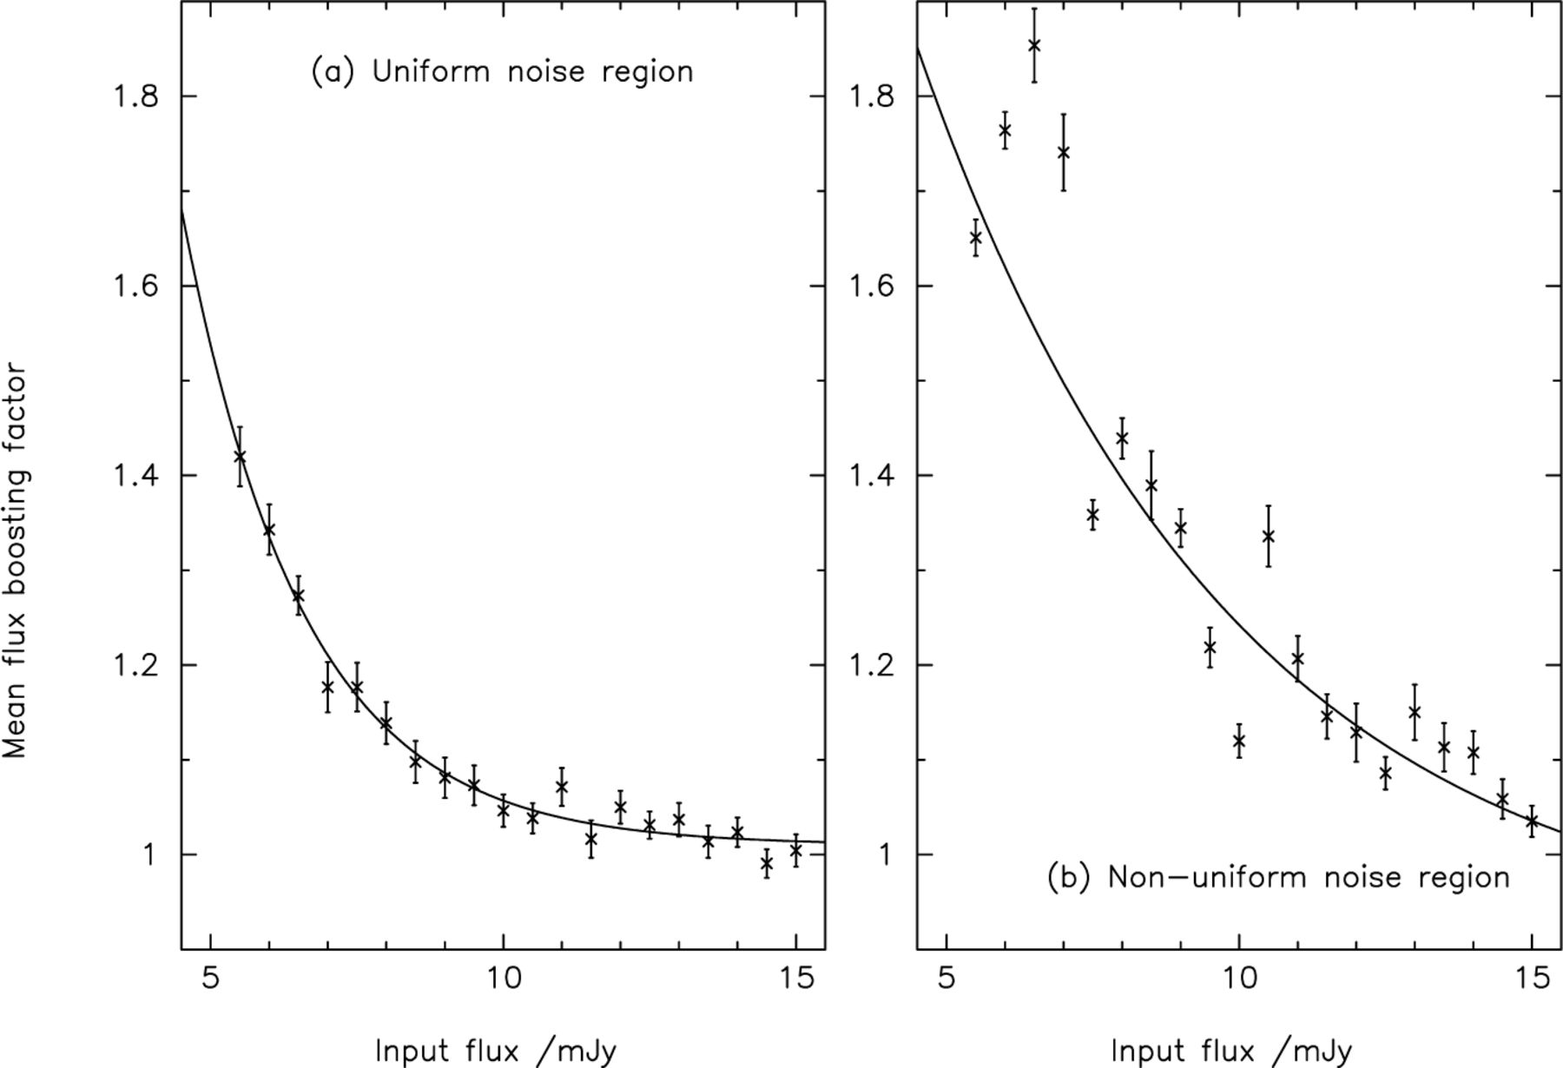
Figure 3. The factor by which the input source flux is boosted (when retrieved from the submm map) plotted against ...
Notes:
Figure 3. The factor by which the input source flux is boosted (when retrieved from the submm map) plotted against input source flux density in the range 5–15 mJy, based on a single template source repeatedly being added into and retrieved (<3.50σ) from the real unconvolved signal maps. The error bars give the standard error on the mean. Plot (a) gives the results from the uniform noise region, whereas plot (b) gives the results for the non-uniform edge regions which have not received the full integration time. The solid curves show a best-fit exponential-based model to the plotted data points.
Unless provided in the caption above, the following copyright applies to the content of this slide: © 2002 RAS

Slide 4
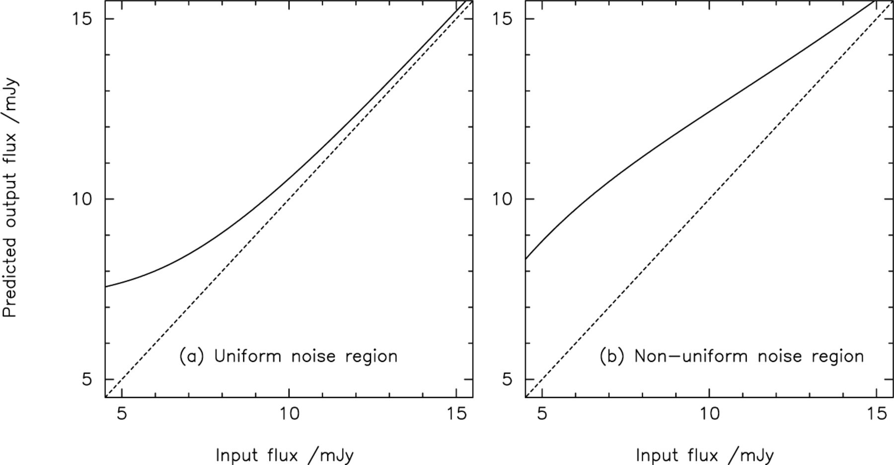
Figure 4. Based on the fitted flux-density boosting curves shown in the preceding figure, these plots show the ...
Notes:
Figure 4. Based on the fitted flux-density boosting curves shown in the preceding figure, these plots show the predicted output flux density against input flux density in the range 5–15 mJy. Plot (a) gives the results from the uniform noise region, whereas plot (b) gives the results for the non-uniform edge regions which have not received the full integration time. The dashed line in both cases delineates the ideal case of output flux density equal to input flux density.
Unless provided in the caption above, the following copyright applies to the content of this slide: © 2002 RAS

Slide 5
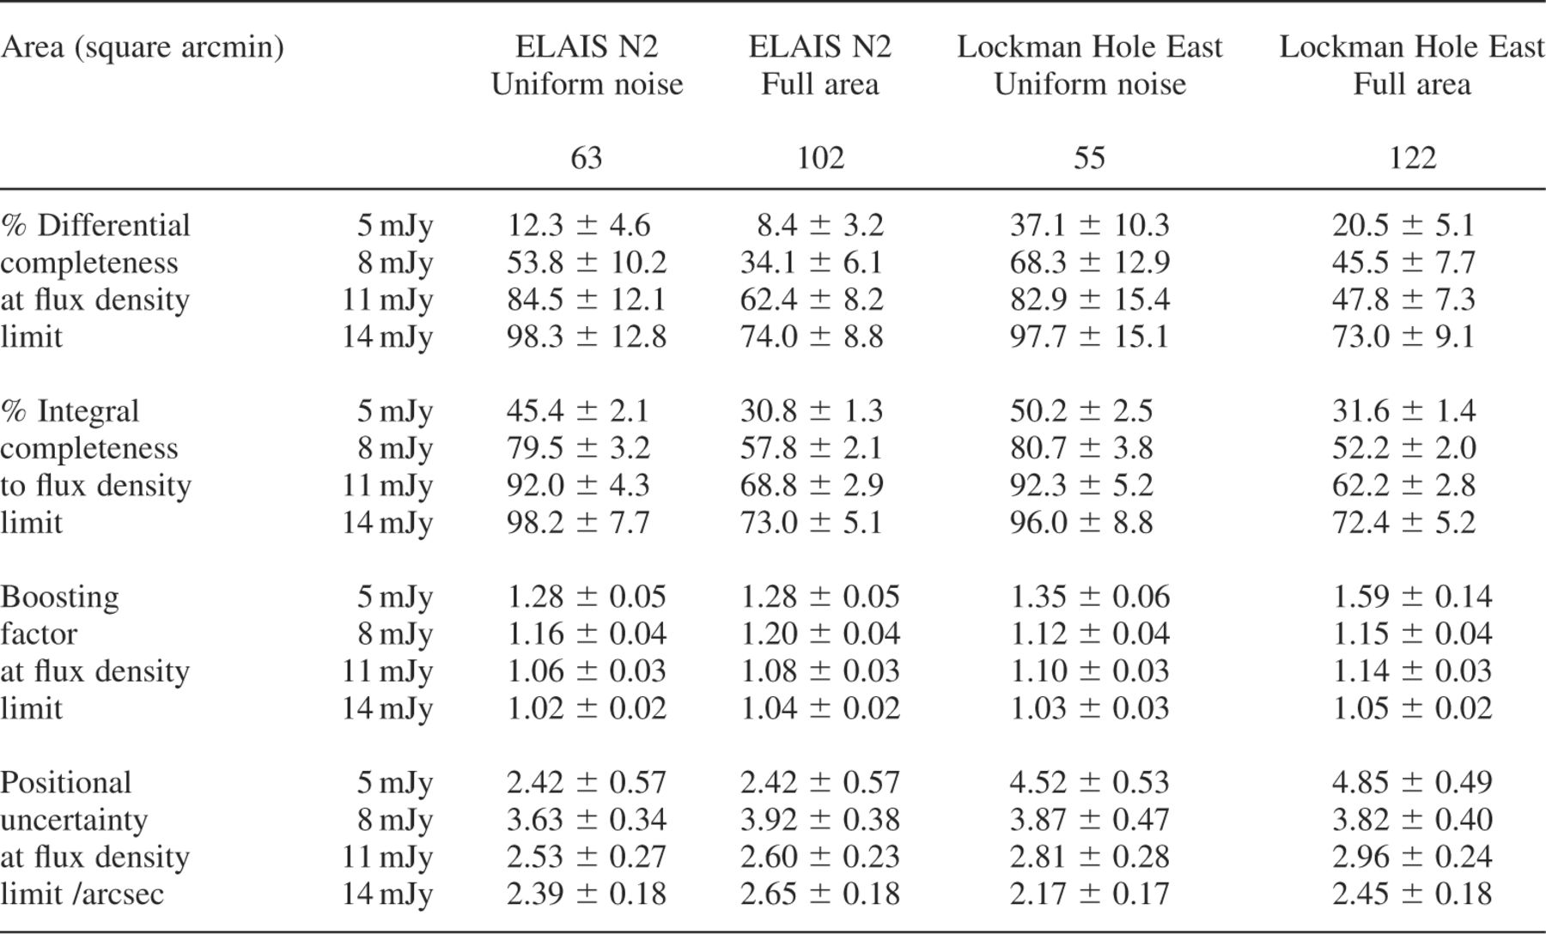
Table 1. Results of the completeness simulations at the 3.50σ significance level, in which individual sources of the ...
Notes:
Table 1. Results of the completeness simulations at the 3.50σ significance level, in which individual sources of the specified flux density given in column 2 were added into the unconvolved survey data taken up to and including 2000 August 16, and retrieved by means of the source extraction algorithm outlined in Section 4.
Unless provided in the caption above, the following copyright applies to the content of this slide: © 2002 RAS

Slide 6
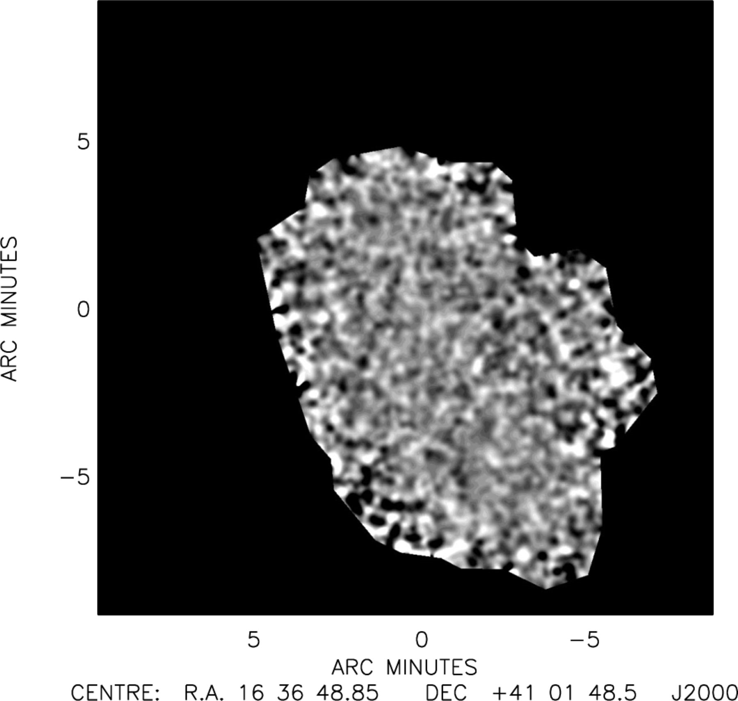
Figure 5. A pure noise image of the ELAIS N2 region, created from the real data by corrupting the astrometry of the ...
Notes:
Figure 5. A pure noise image of the ELAIS N2 region, created from the real data by corrupting the astrometry of the individual jiggle maps to produce a ‘scrambled’ map. This image includes the jiggle maps taken up to and including 2000 August 16. There are no source detections at <3.50σ.
Unless provided in the caption above, the following copyright applies to the content of this slide: © 2002 RAS

Slide 7
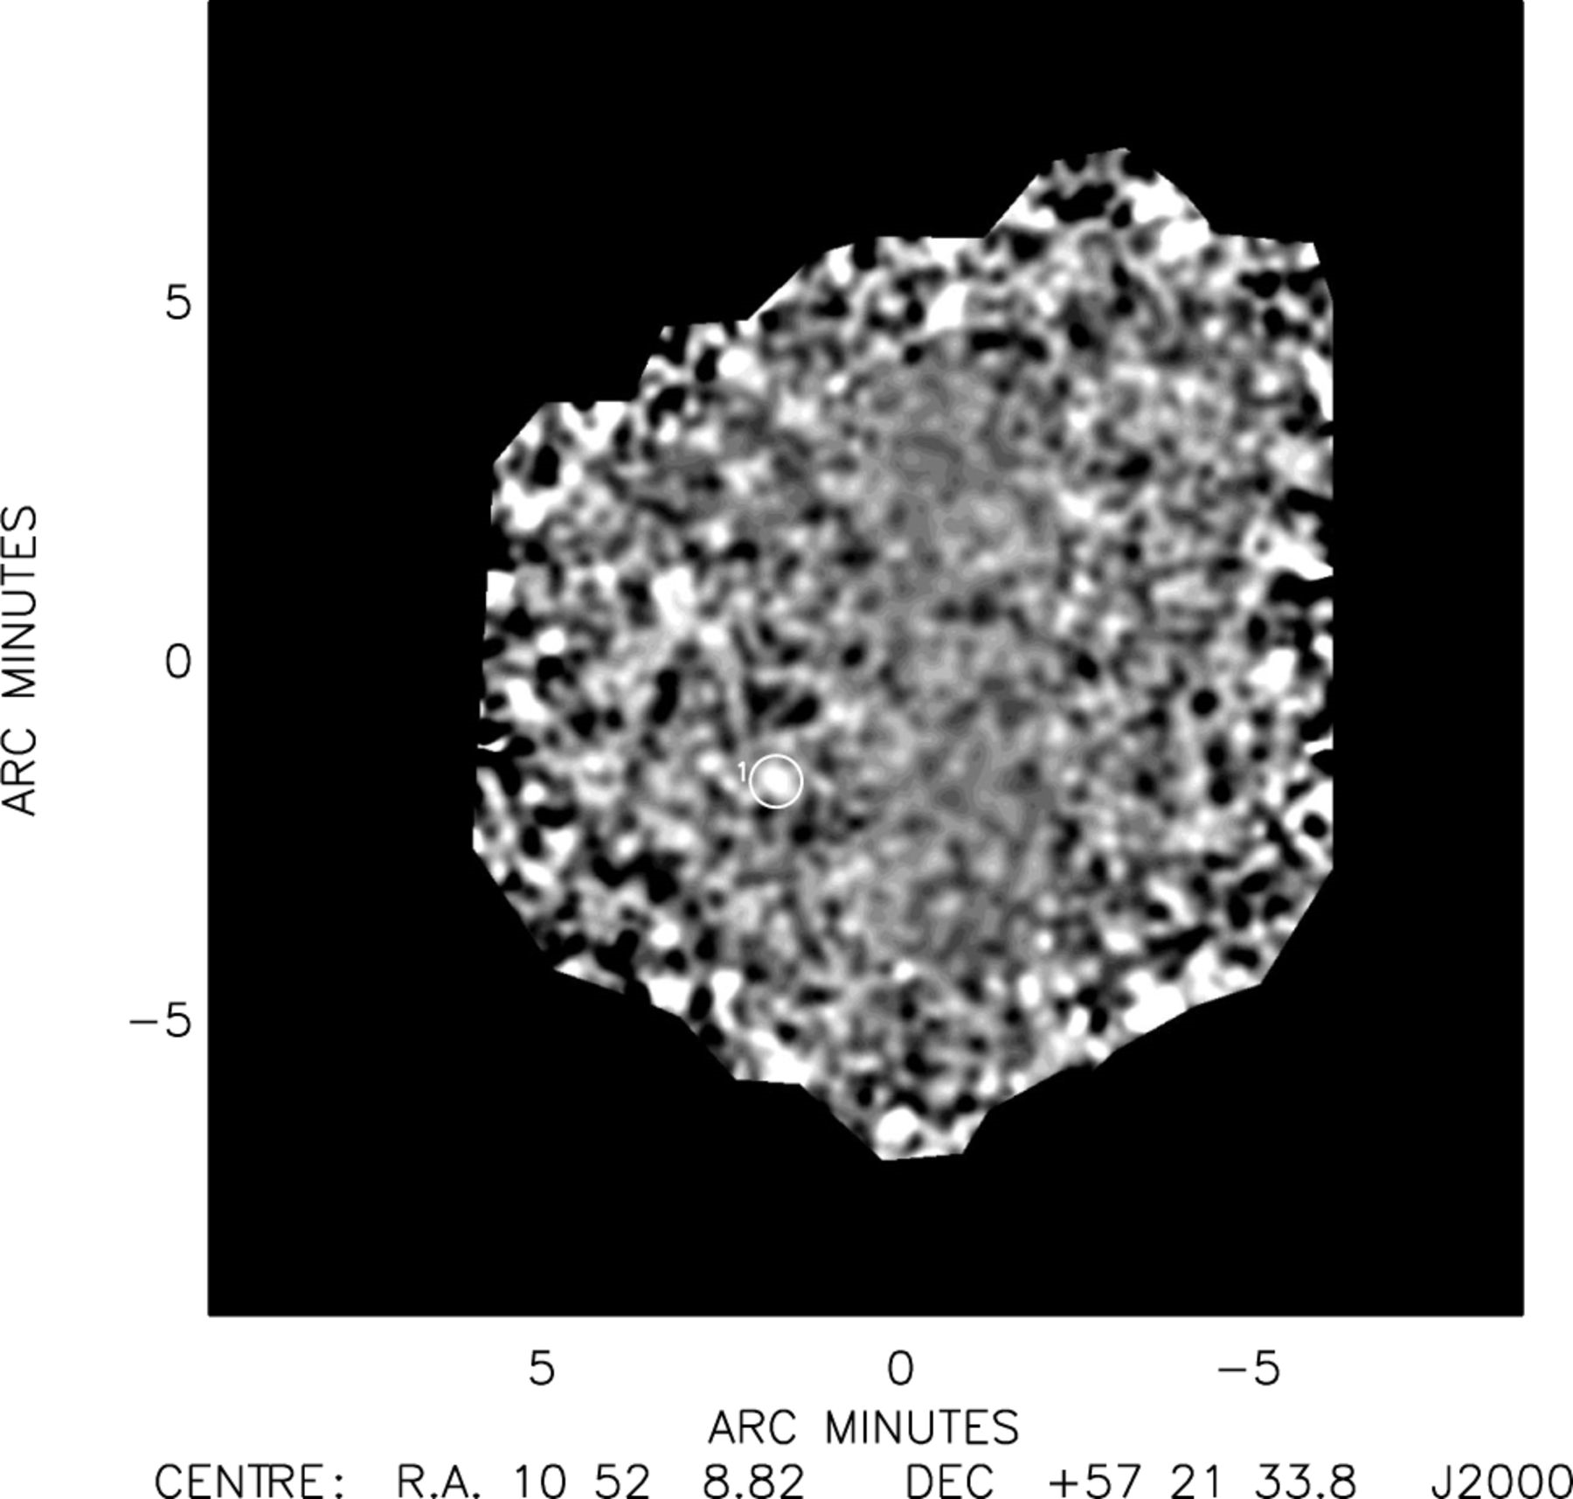
Figure 7. A pure noise image of the Lockman Hole East region, created from the real data by corrupting the astrometry ...
Notes:
Figure 7. A pure noise image of the Lockman Hole East region, created from the real data by corrupting the astrometry of the individual jiggle maps to produce a ‘scrambled’ map. This image includes the jiggle maps taken up to and including 2000 August 16. There is one spurious source detection at <3.50σ, which is circled on the image.
Unless provided in the caption above, the following copyright applies to the content of this slide: © 2002 RAS

Slide 8
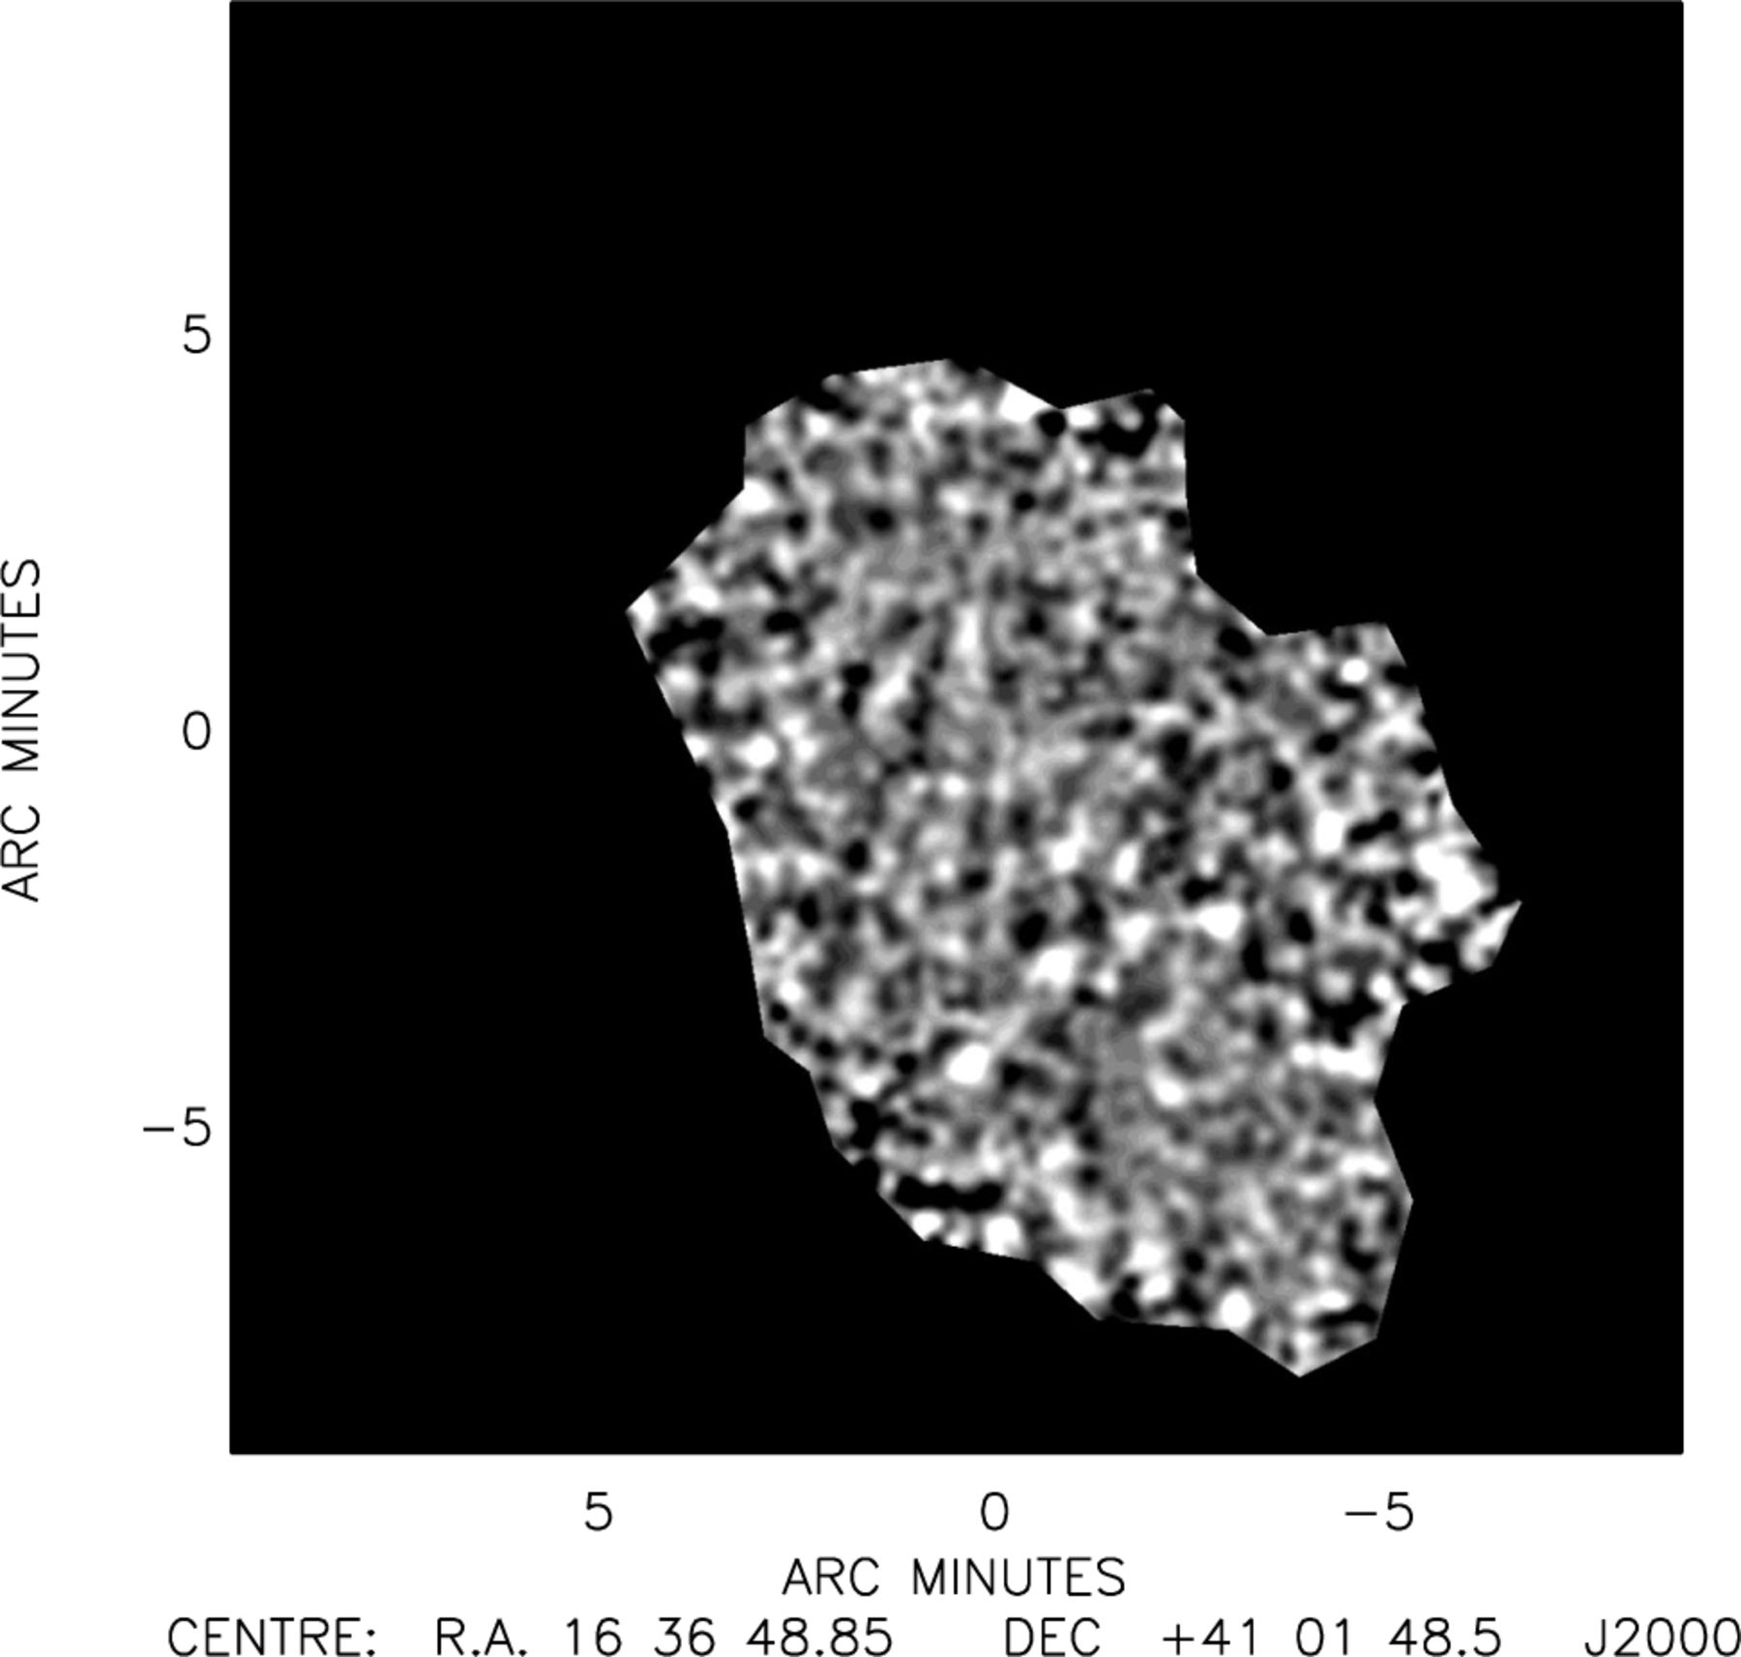
Figure 6. Fully simulated ELAIS N2 SCUBA 850 μm map, using the adopted counts model given in Section 5.2. The image ...
Notes:
Figure 6. Fully simulated ELAIS N2 SCUBA 850 μm map, using the adopted counts model given in Section 5.2. The image noise was simulated using the scrambled map shown in Fig. 5.
Unless provided in the caption above, the following copyright applies to the content of this slide: © 2002 RAS

Slide 9
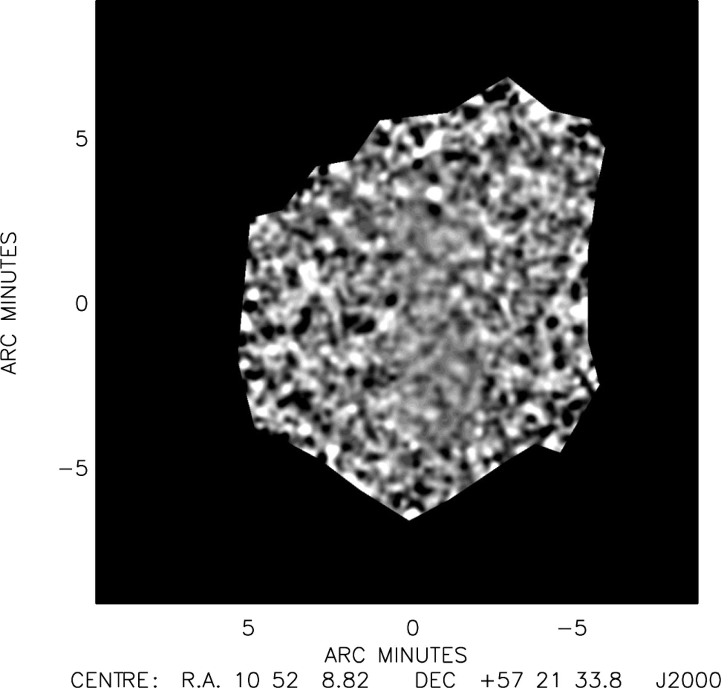
Figure 8. Fully simulated Lockman Hole East SCUBA 850-μm map, using the adopted counts model given in Section 5.2. The ...
Notes:
Figure 8. Fully simulated Lockman Hole East SCUBA 850-μm map, using the adopted counts model given in Section 5.2. The image noise was simulated using the scrambled map shown in Fig. 7.
Unless provided in the caption above, the following copyright applies to the content of this slide: © 2002 RAS

Slide 10
Table 2. Results of the completeness simulations at the 4.00σ significance level, in which each field was fully ...
Notes:
Table 2. Results of the completeness simulations at the 4.00σ significance level, in which each field was fully simulated four times using an adopted counts model consistent with the measured source counts. The sources were then retrieved by means of the maximum-likelihood estimator outlined in Section 4.
Unless provided in the caption above, the following copyright applies to the content of this slide: © 2002 RAS

Slide 11
Table 3. Results of the completeness simulations at the 3.50σ significance level, in which each field was fully ...
Notes:
Table 3. Results of the completeness simulations at the 3.50σ significance level, in which each field was fully simulated four times using an adopted counts model consistent with the measured source counts. The sources were then retrieved by means of the maximumlikelihood estimator outlined in Section 4.
Unless provided in the caption above, the following copyright applies to the content of this slide: © 2002 RAS

Slide 12
Table 4. Results of the completeness simulations at the 3.00σ significance level, in which each field was fully ...
Notes:
Table 4. Results of the completeness simulations at the 3.00σ significance level, in which each field was fully simulated four times using an adopted counts model consistent with the measured source counts. The sources were then retrieved by means of the maximumlikelihood estimator outlined in Section 4.
Unless provided in the caption above, the following copyright applies to the content of this slide: © 2002 RAS

Slide 13
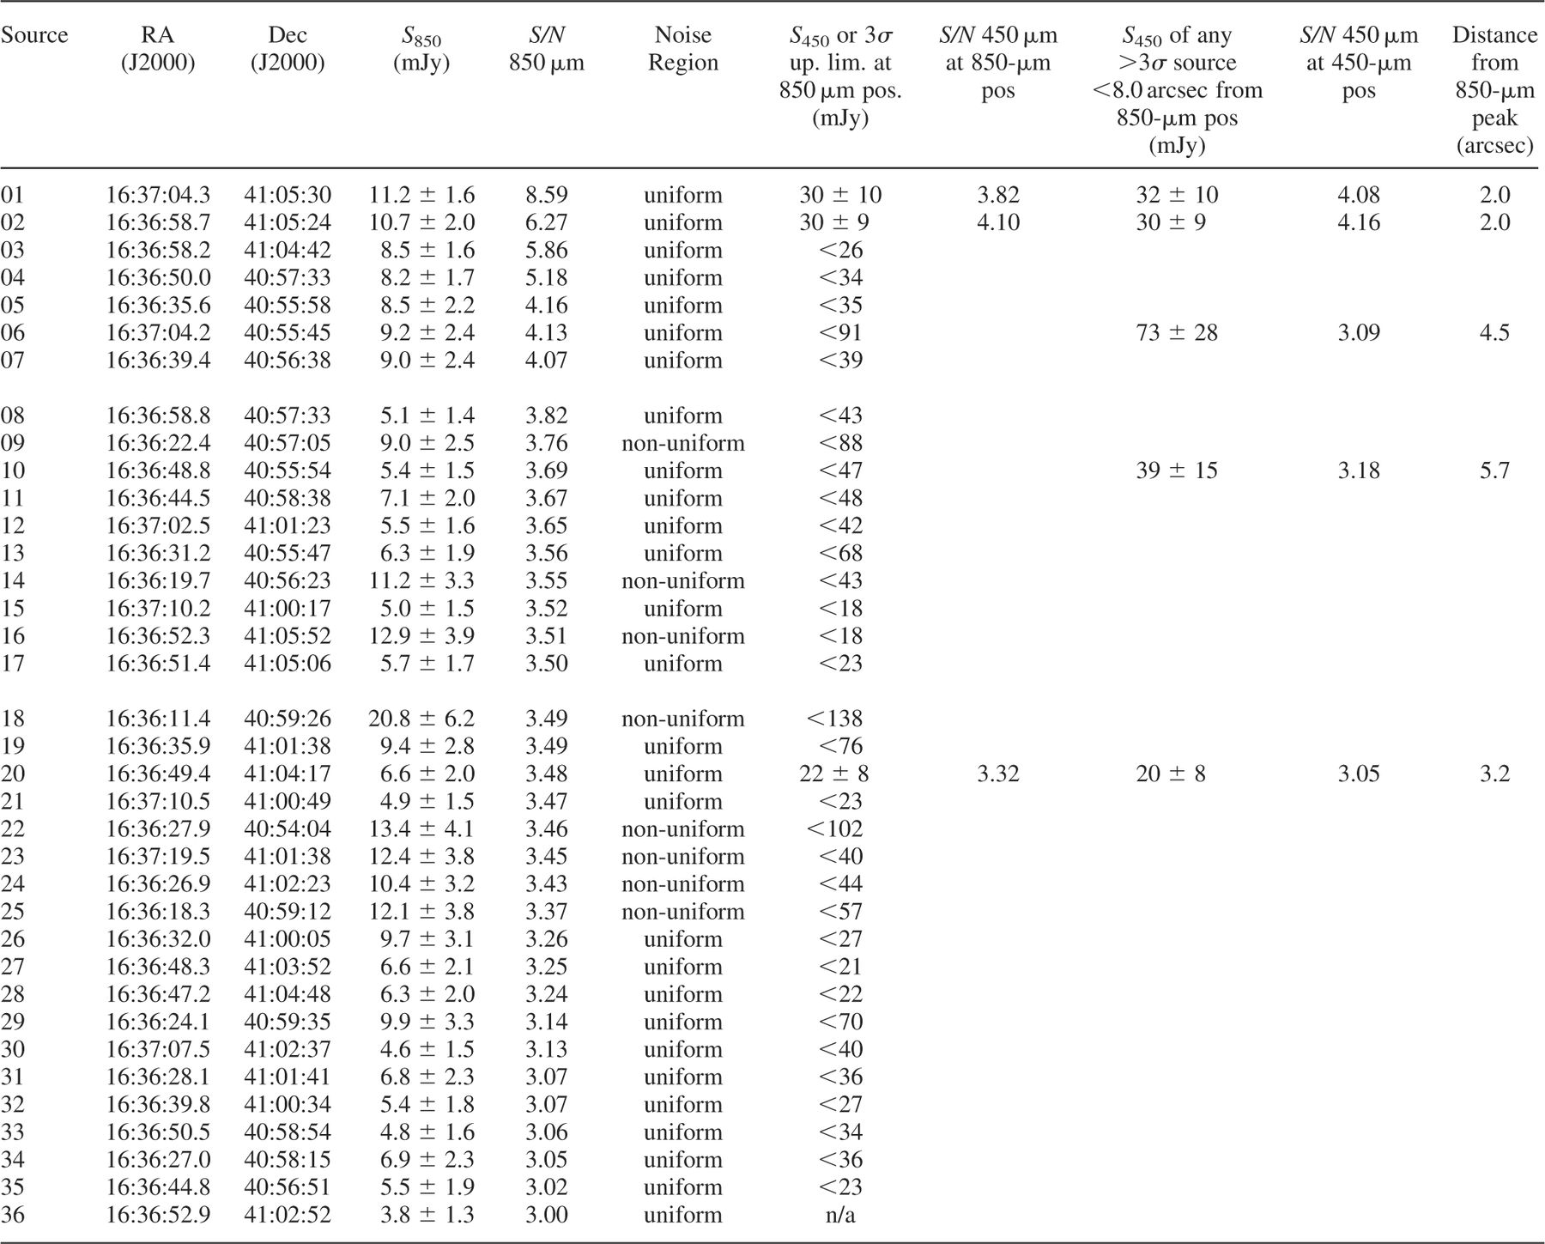
Table 5. Sources retrieved in the long-wavelength ELAIS N2 image above the 3.00σ significance level using the ...
Notes:
Table 5. Sources retrieved in the long-wavelength ELAIS N2 image above the 3.00σ significance level using the source-extraction algorithm outlined in Section 4. We used a peak-normalized calibrator beam-map as a source template, and constructed a basic model by centring a beam map at the positions of all peaks >3 mJy as found in the 14.5-arcsec FWHM Gaussian convolved maps. The heights of each of the positioned beam maps were allowed to vary simultaneously such that the final model satisfied a minimized χ2 fit.We suggest that follow-up observations be confined to those detections >3.50σ given the serious problem of contamination by spurious sources at the 3.00σ level. Calibration errors of 9 per cent and 20 per cent at 850μm and 450μm, respectively, are included in the error on the flux densities.
Unless provided in the caption above, the following copyright applies to the content of this slide: © 2002 RAS

Slide 14
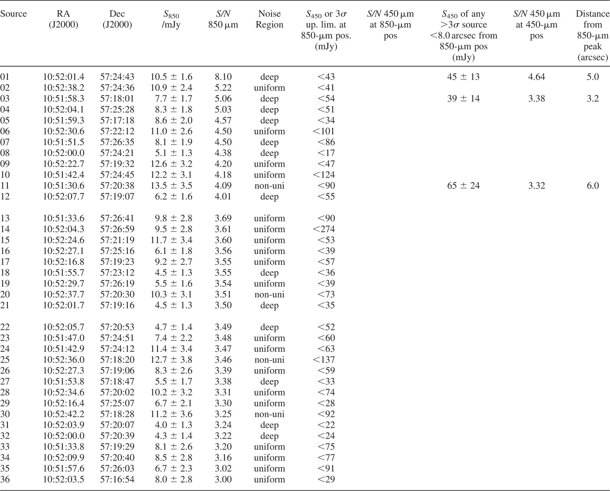
Table 6. Sources retrieved in the Lockman Hole East field above the 3.00σ significance level using the source ...
Notes:
Table 6. Sources retrieved in the Lockman Hole East field above the 3.00σ significance level using the source extraction algorithm outlined in Section 4.We used a peak-normalized calibrator beam-map as a source template, and constructed a basic model by centring a beam-map at the positions of all peaks >3 mJy as found in the 14.5-arcsec FWHM Gaussian convolved maps. The heights of each of the positioned beam maps were allowed to vary simultaneously such that the final model satisfied a minimized χ2 fit. We suggest that follow-up observations are confined to those detections >3.50σ given the serious problem of contamination by spurious sources at the 3.00σ level. Calibration errors of 9 per cent and 20 per cent at 850μm and 450μm, respectively, are included in the error on the flux densities.
Unless provided in the caption above, the following copyright applies to the content of this slide: © 2002 RAS

Slide 15
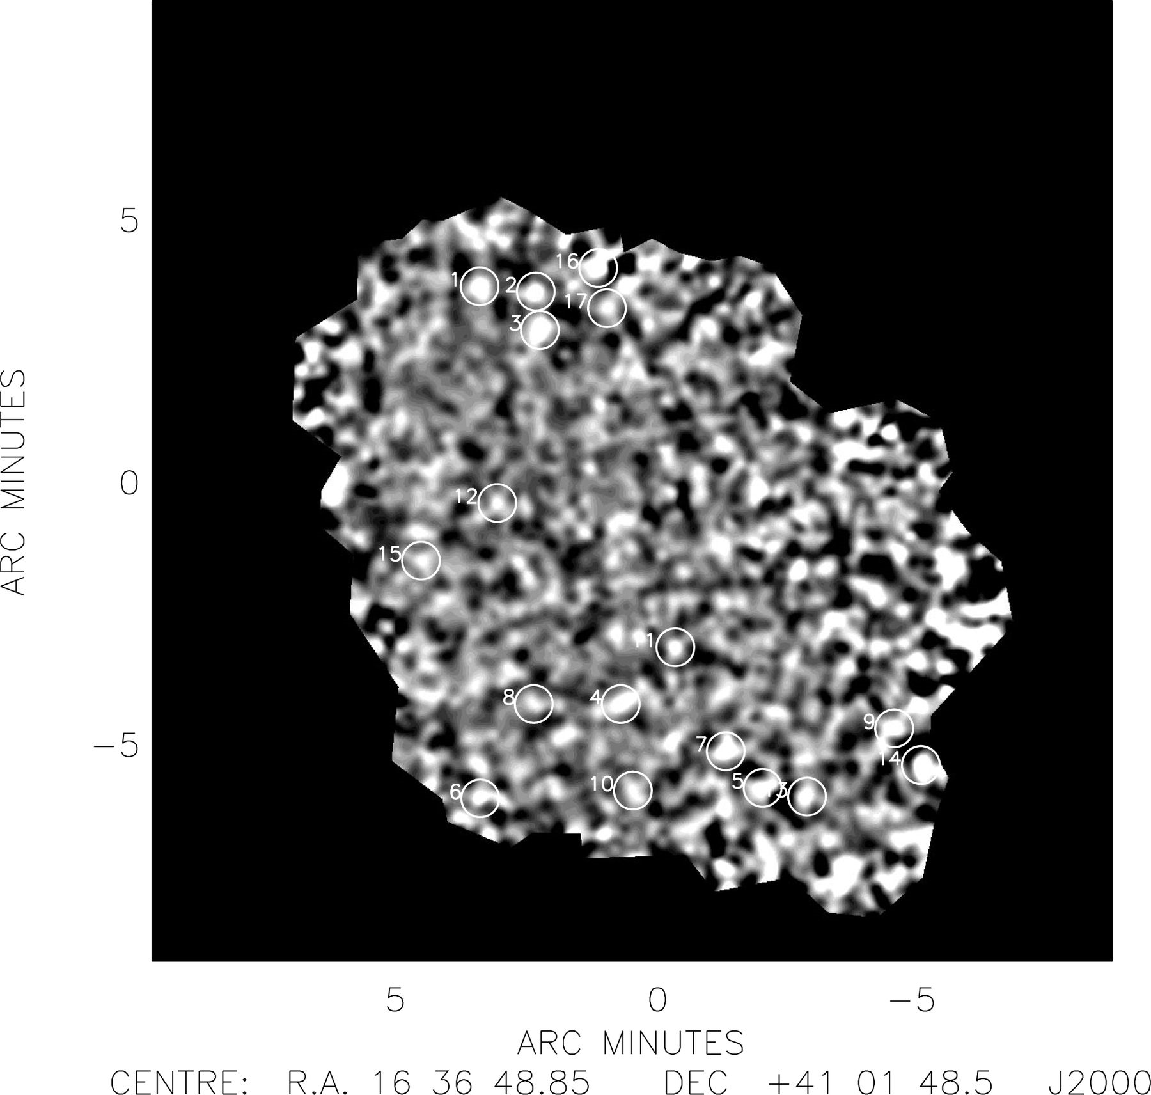
Figure 9. The 850-μm image of the ELAIS N2 field, smoothed with a beam-size Gaussian (14.5-arcsec FWHM). The numbered ...
Notes:
Figure 9. The 850-μm image of the ELAIS N2 field, smoothed with a beam-size Gaussian (14.5-arcsec FWHM). The numbered circles highlight those sources found at a significance of <3.50, the labels corresponding to the numbers in Table 5.
Unless provided in the caption above, the following copyright applies to the content of this slide: © 2002 RAS

Slide 16
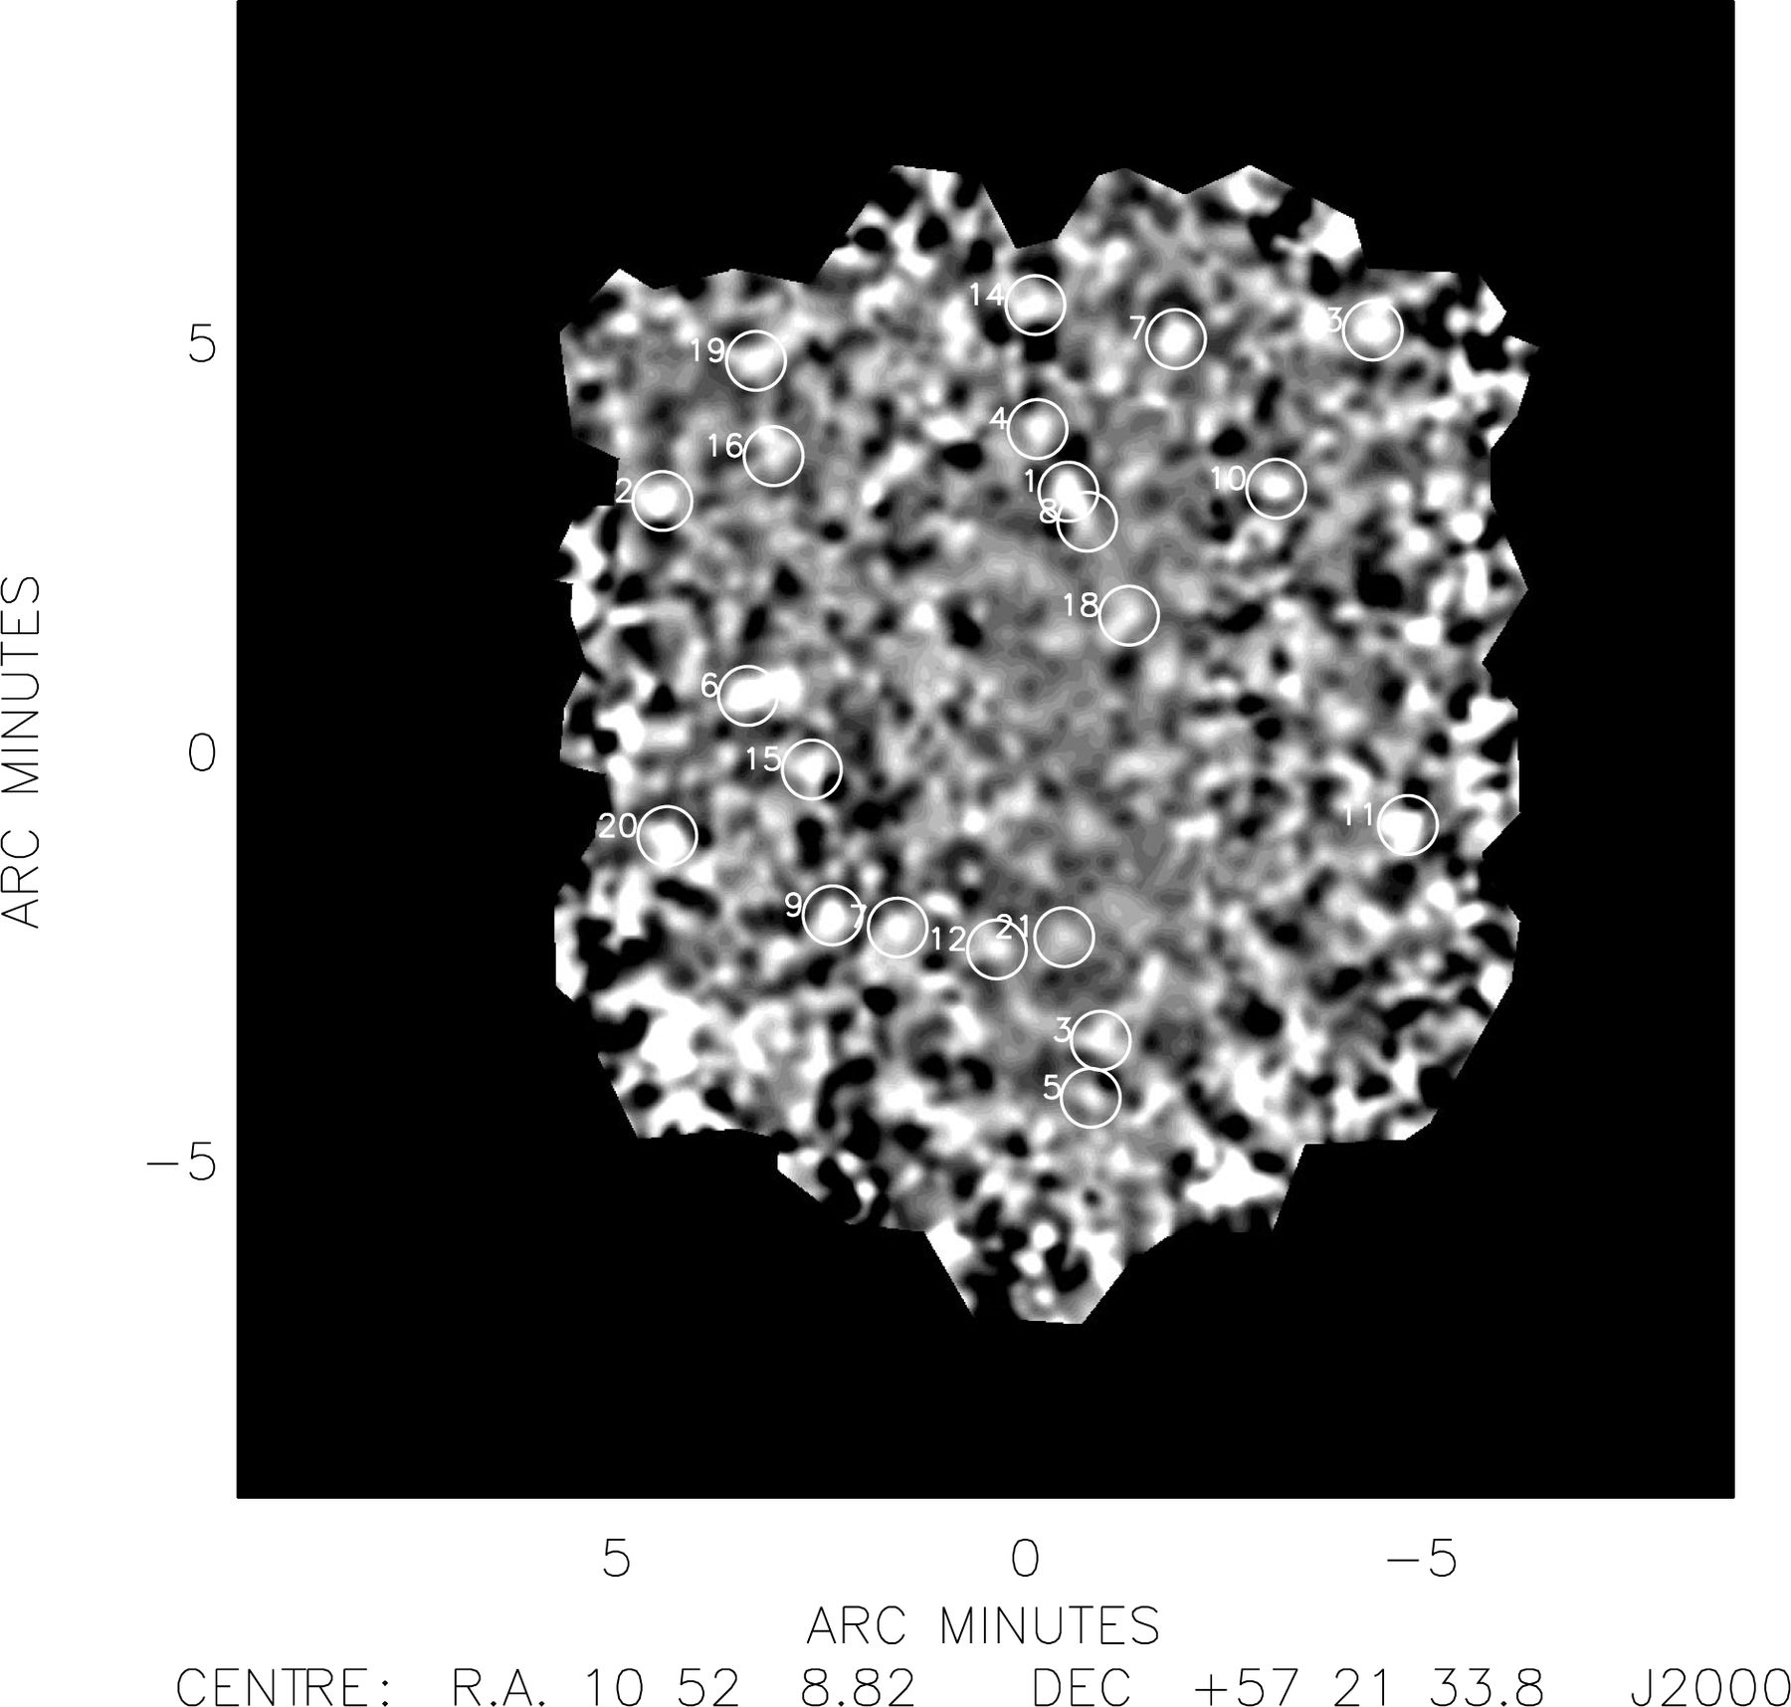
Figure 10. The 850-μm image of the Lockman Hole East field, smoothed with a beam-size Gaussian (14.5-arcsec FWHM). The ...
Notes:
Figure 10. The 850-μm image of the Lockman Hole East field, smoothed with a beam-size Gaussian (14.5-arcsec FWHM). The numbered circles highlight those sources found at a significance of <3.50, the labels corresponding to the numbers in Table 6.
Unless provided in the caption above, the following copyright applies to the content of this slide: © 2002 RAS

Slide 17
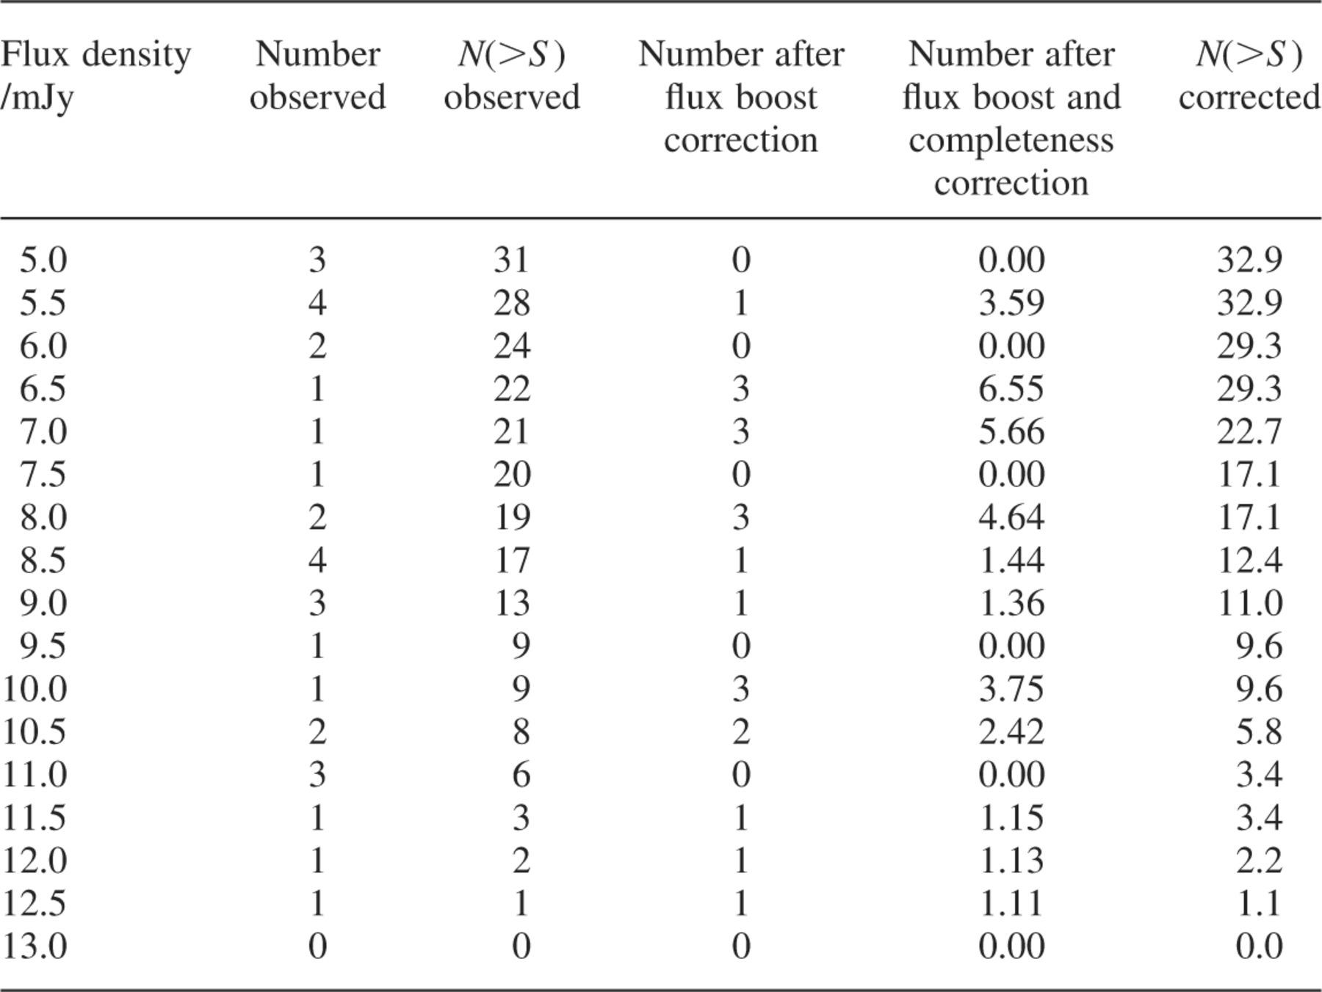
Table 7. A breakdown of the raw and corrected source counts at each 0.5-mJy interval bin for the sources with S/N > ...
Notes:
Table 7. A breakdown of the raw and corrected source counts at each 0.5-mJy interval bin for the sources with S/N > 3:50 from both survey maps, excluding those uncovered in the non-uniform noise regions. Column 1 gives the flux density, and columns 2 and 3 the raw number counts in the 0.5-mJy wide bin and cumulative to that flux-density level. Column 4 gives the number in each bin once flux-density boosting has been accounted for using the fitted curve in Fig 4(a), and similarly column 5 gives the number in each bin once completeness has also been taken into account using the fitted curve in Fig 2(a). Column 6 gives the cumulative corrected counts down to each fluxdensitylevel.
Unless provided in the caption above, the following copyright applies to the content of this slide: © 2002 RAS

Slide 18
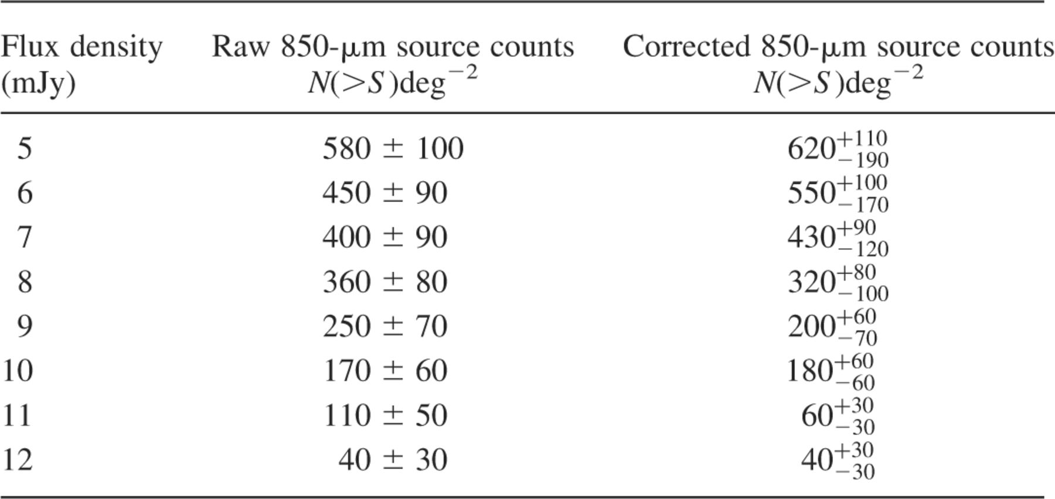
Table 8. The 850-μm source counts per square degree based on sources with S/N<3.50 in both survey maps, and excluding ...
Notes:
Table 8. The 850-μm source counts per square degree based on sources with S/N<3.50 in both survey maps, and excluding those detected in the non-uniform noise regions. Column 1 gives the flux density and column 2 the cumulative raw counts per square degree with the Poisson error. Column 3 gives the cumulative corrected counts per square degree, the upper error corresponding to the Poisson error, and the lower error accounting for both the Poisson error and the presence of spurious sources based on the simulation data.
Unless provided in the caption above, the following copyright applies to the content of this slide: © 2002 RAS

Slide 19
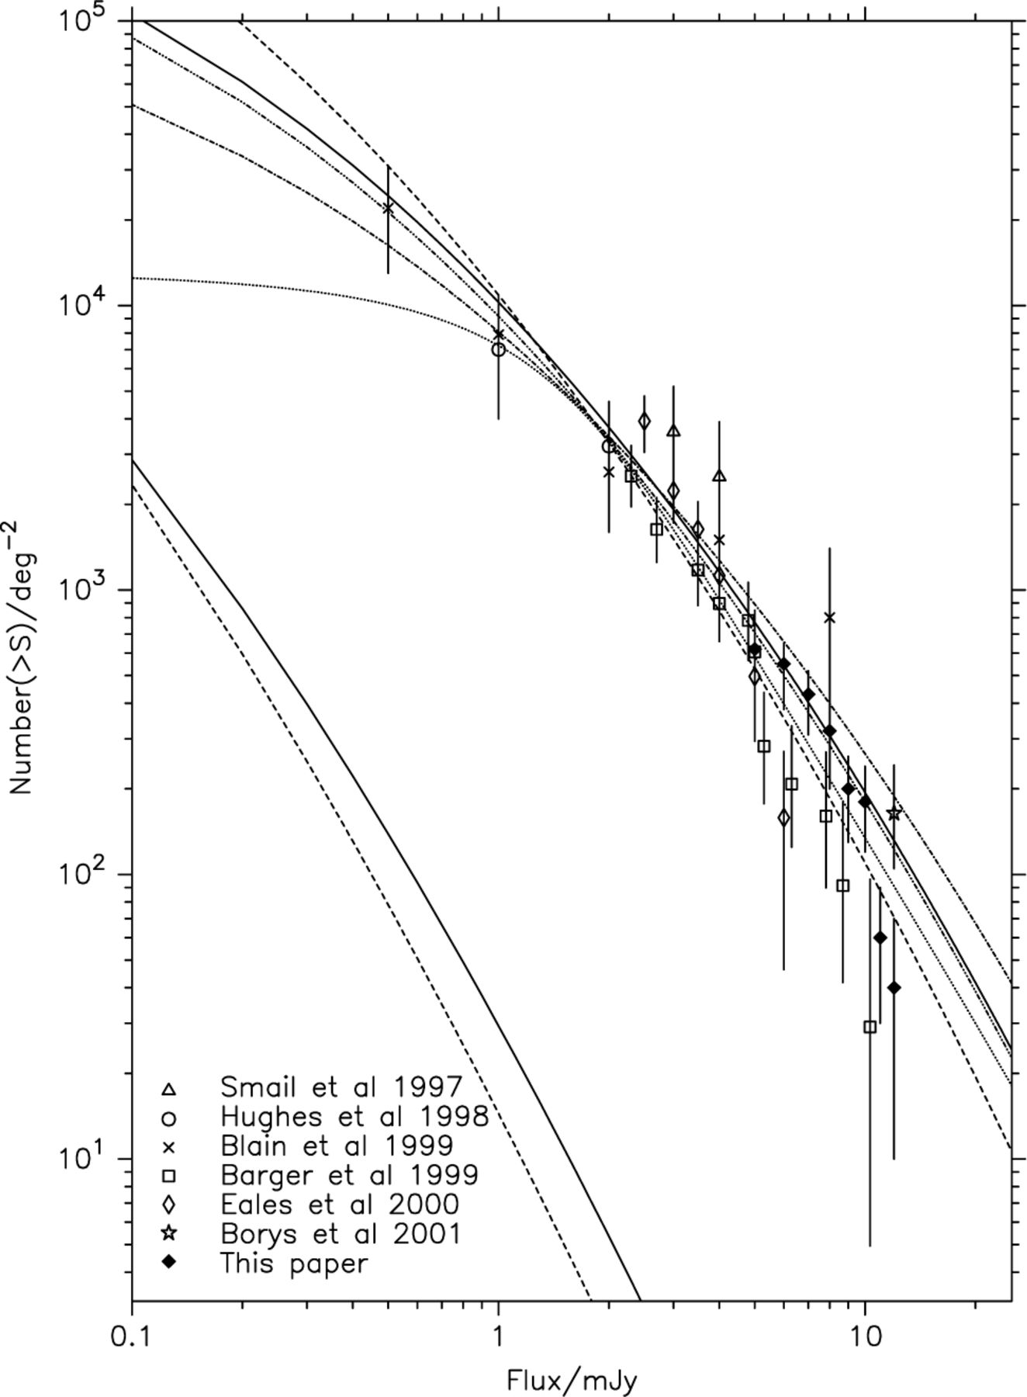
Figure 11. Cumulative 850-μm source counts. The solid diamonds show the new results from the ‘SCUBA 8-mJy Survey’ ...
Notes:
Figure 11. Cumulative 850-μm source counts. The solid diamonds show the new results from the ‘SCUBA 8-mJy Survey’ derived in this paper. The upper solid and dashed curves are predicted number counts, based on the 60-μm luminosity function of Jameson 2000; Smail et al. 2001, assuming a dust temperature of 40 K, a dust emissivity index of β=1.2, and pure luminosity evolution of the form L(z)=L(0)(1+z)3 out to z=2 (beyond which the luminosity function is simply frozen), for cosmologies (ΩM=1.0,ΩΛ=0.0) and (ΩM=0.3,ΩΛ=0.7) respectively. The lower solid and dashed curves show the number counts predicted by the same models if no luminosity evolution is included. The dotted line shows the counts model assumed when creating simulated images. The dot-dash and dot-dot dash assume a more complicated, but arguably more realistic luminosity evolution of the form L(z)=L(0)(1+z)3/2sech2[b ln(1+z)-c]cosh2c, for cosmologies (ΩM=1.0,ΩΛ=0.0) and (ΩM=0.3,ΩΛ=0.7), respectively, and assuming a dust temperature of 37 K and dust emissivity index of β=1.2 (Smail et al. 2001).
Unless provided in the caption above, the following copyright applies to the content of this slide: © 2002 RAS

Slide 20
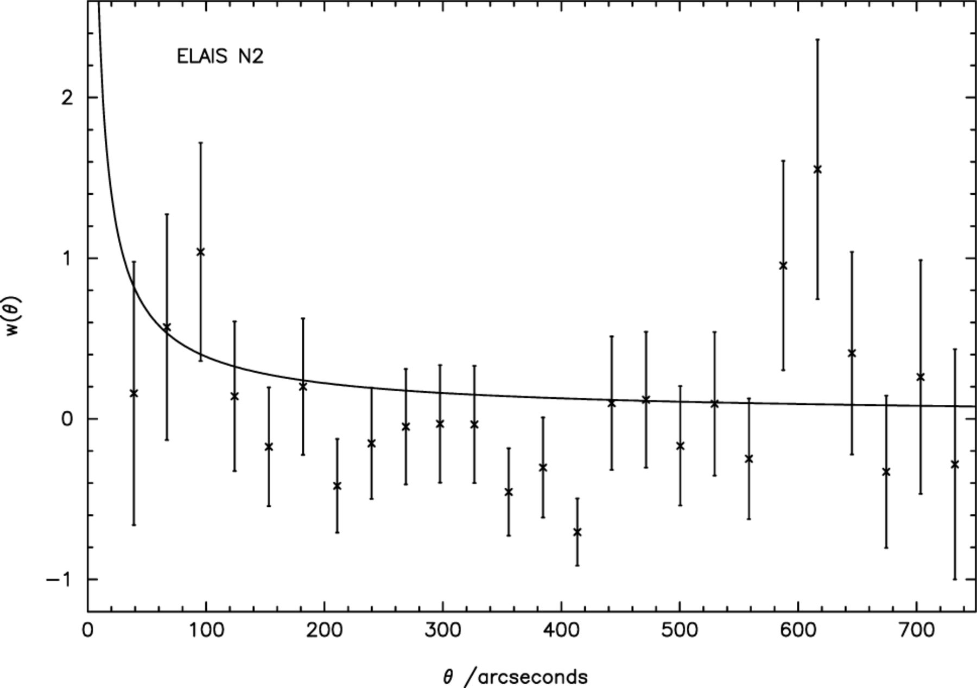
Figure 12. Two-point angular correlation function for the ELAIS N2 survey field. 1+w(θ)=2m〈DD〉/[(n-1)〈DR〉] where there ...
Notes:
Figure 12. Two-point angular correlation function for the ELAIS N2 survey field. 1+w(θ)=2m〈DD〉/[(n-1)〈DR〉] where there are n and m real and fake <3.50σ sources, respectively, and DD and DR are the number of distinct data pairs and cross data random pairs within 29-arcsec wide bins as a function of angular separation θ. The power-law line indicates the correlation function found by Daddi et al. (2000) for extremely red objects (EROs) with R-K18.5 as discussed in Sections 9.3 and 9.4.
Unless provided in the caption above, the following copyright applies to the content of this slide: © 2002 RAS

Slide 21
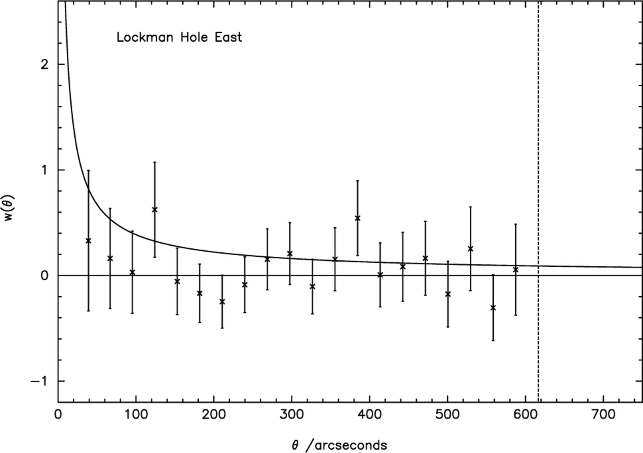
Figure 13. Two-point angular correlation function for the Lockman Hole East survey field. 1+w(θ)=2m〈DD〉/[(n-1)〈DR〉] ...
Notes:
Figure 13. Two-point angular correlation function for the Lockman Hole East survey field. 1+w(θ)=2m〈DD〉/[(n-1)〈DR〉] where there are n and m real and fake <3.50σ sources, respectively, and DD and DR are the number of distinct data pairs and cross data random pairs within 29-arcsec wide bins as a function of angular separation θ. The power-law line indicates the correlation function found by Daddi et al. (2000) for EROs with R-K18.5 as discussed in Sections 9.3 and 9.4. Note that the vertical dashed line demonstrates the cut-off at which there are no more source pairings in the real data.
Unless provided in the caption above, the following copyright applies to the content of this slide: © 2002 RAS

Slide 22
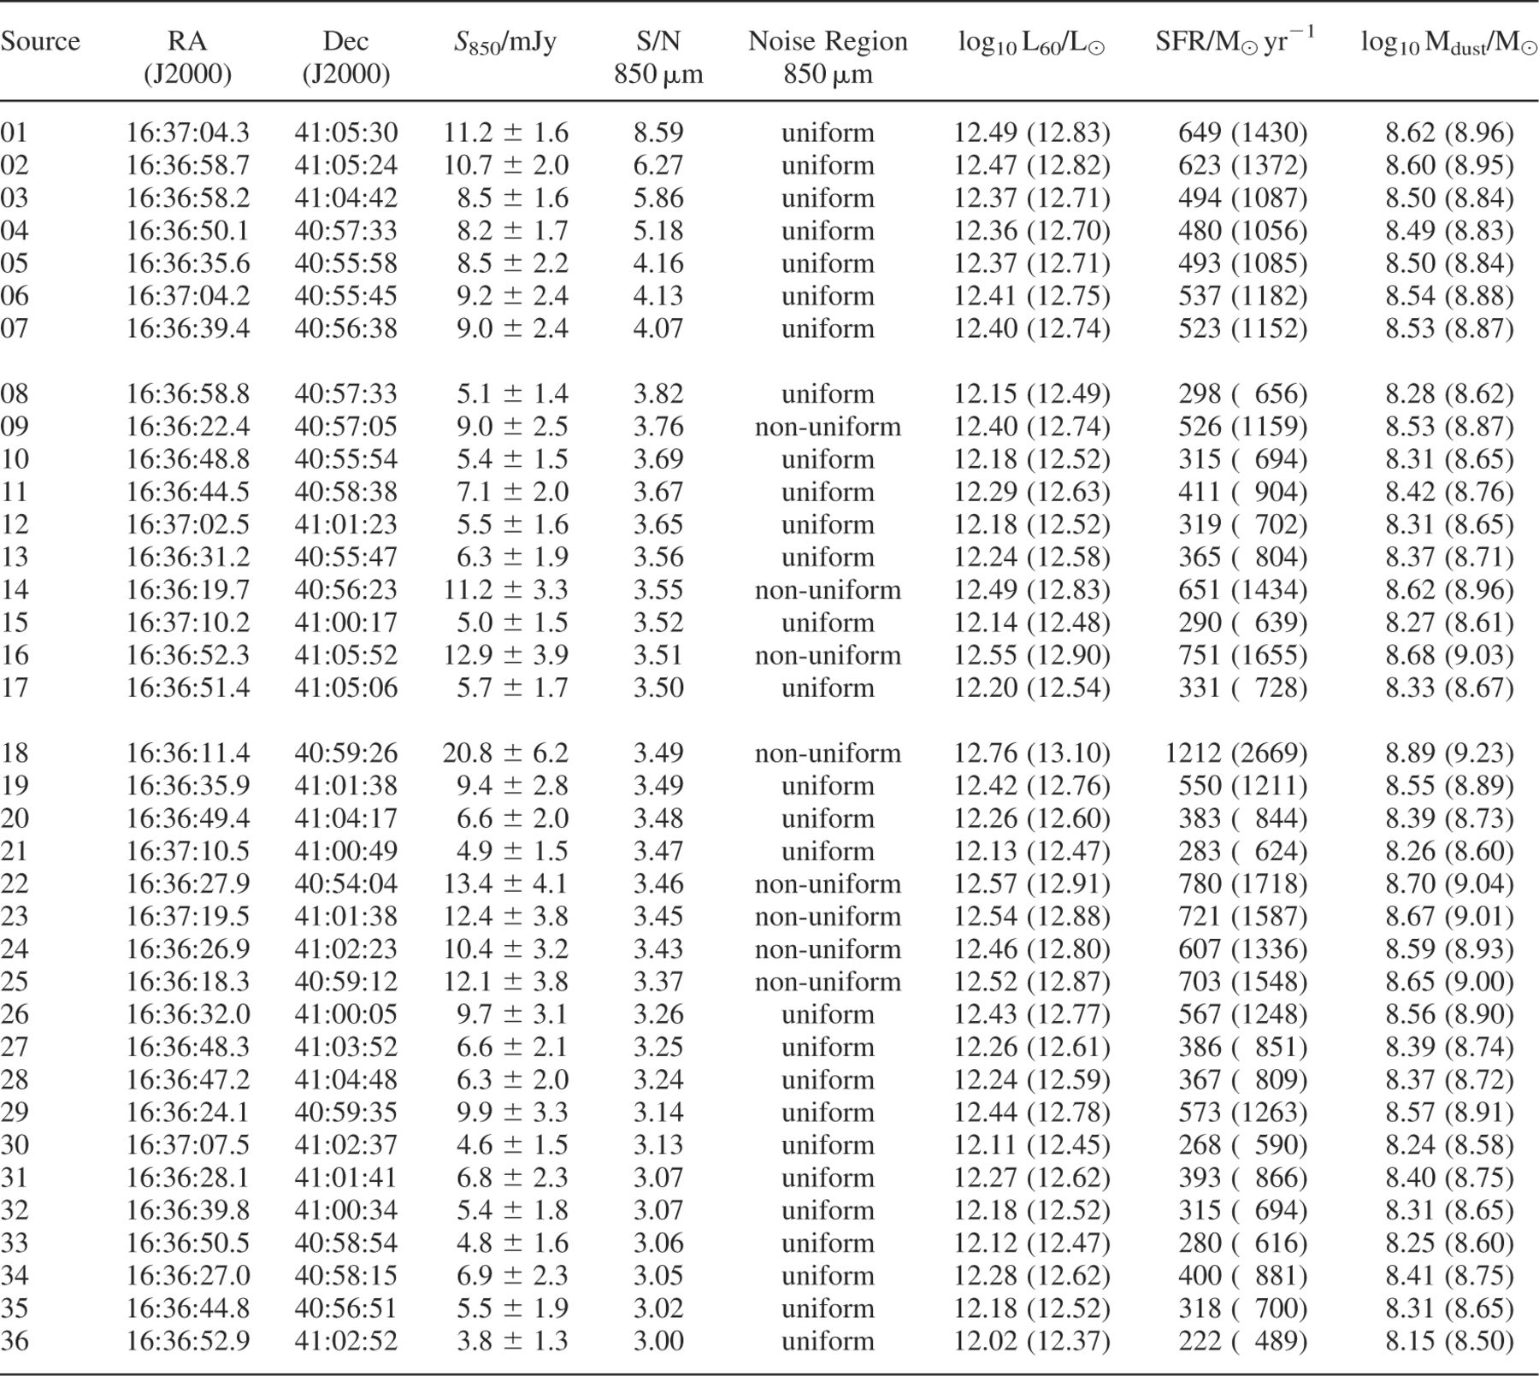
Table 9. Inferred FIR/60-μm luminosities, star-formation rates and dust masses for the sources in ELAIS N2. The ...
Notes:
Table 9. Inferred FIR/60-μm luminosities, star-formation rates and dust masses for the sources in ELAIS N2. The unbracketed numbers in columns 7, 8 and 9 assume an Einstein-de Sitter cosmology, whereas the numbers enclosed in brackets assume ΩM = 0.3 and ΩΛ = 0.7. A dust temperature of 40 K, and emissivity index β = 1.2 were assumed throughout, as was H0 = 67 km s−1 Mpc−1.
Unless provided in the caption above, the following copyright applies to the content of this slide: © 2002 RAS

Slide 23
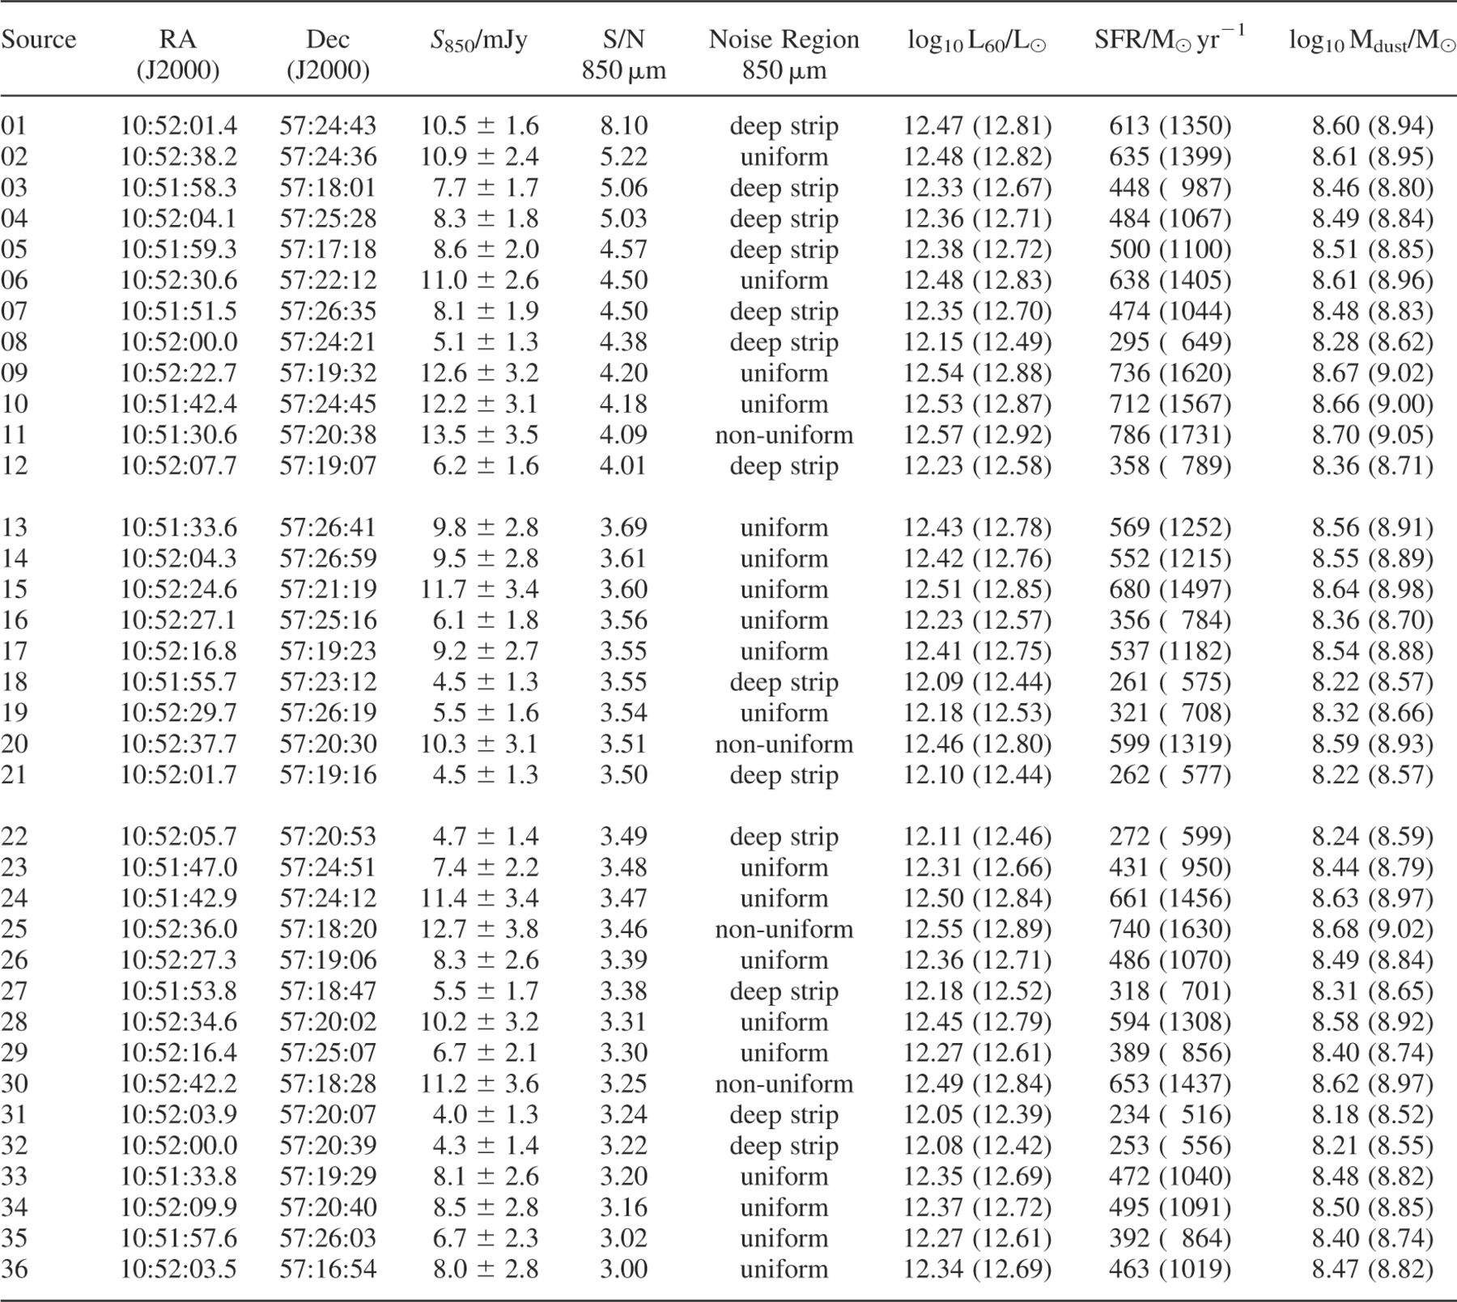
Table 10. Inferred FIR/60-μm luminosities, star-formation rates and dust masses for the sources in the Lockman Hole ...
Notes:
Table 10. Inferred FIR/60-μm luminosities, star-formation rates and dust masses for the sources in the Lockman Hole East. The unbracketed numbers in columns 7, 8 and 9 assume an Einstein-de Sitter cosmology, whereas the numbers enclosed in brackets assume ΩM = 0.3 and ΩΛ = 0.7. A dust temperature of 40 K, and emissivity index β = 1.2 were assumed throughout, as was H0 = 67 km s−1 Mpc−1.
Unless provided in the caption above, the following copyright applies to the content of this slide: © 2002 RAS

Slide 24
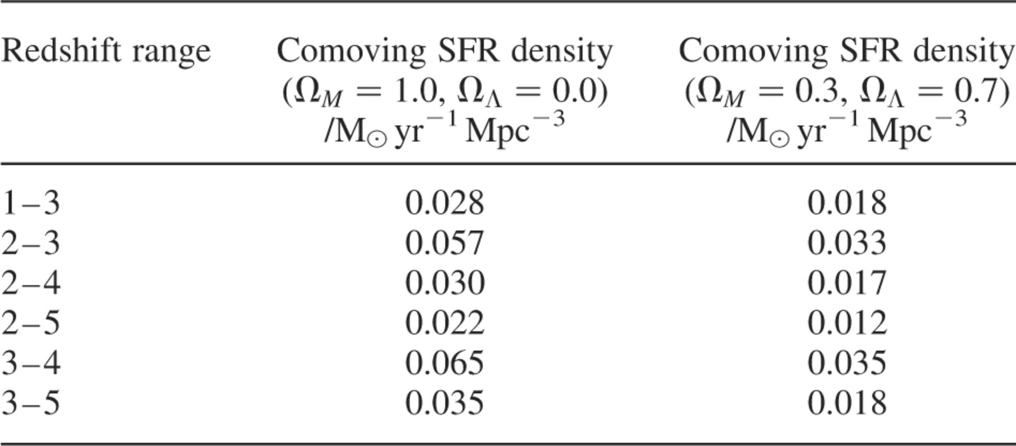
Table 11. The comoving star formation rate density of sources brighter than 8 mJy, detected with S/N > 3.50, using the ...
Notes:
Table 11. The comoving star formation rate density of sources brighter than 8 mJy, detected with S/N > 3.50, using the uniform noise regions of the two survey areas and assuming that all of these sources lie within the redshift range given in column 1. Column 2 assumes an Einstein-de Sitter cosmology, and column 3 assumes ΩM = 0.3, ΩΛ = 0.7. H0 = 67km s−1 Mpc−1 was adopted for both cosmologies.
Unless provided in the caption above, the following copyright applies to the content of this slide: © 2002 RAS

Slide 25
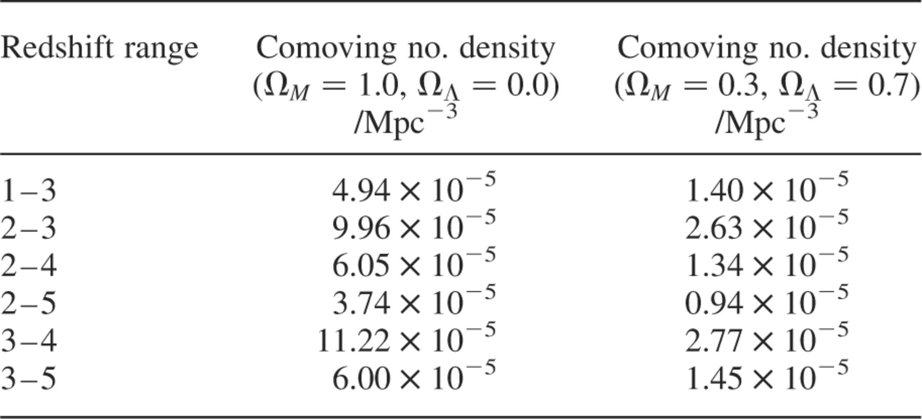
Table 12. The comoving number density of sources brighter than 8 mJy, detected with S/N > 3.50, using the uniform noise ...
Notes:
Table 12. The comoving number density of sources brighter than 8 mJy, detected with S/N > 3.50, using the uniform noise regions of the two survey areas and assuming that all of these sources lie within the redshift range given in column 1. Column 2 assumes an Einstein-de Sitter cosmology, and column 3 assumes ΩM = 0.3, ΩΛ = 0.7. H0 = 67 km s−1 Mpc−1 was adopted for both cosmologies.
Unless provided in the caption above, the following copyright applies to the content of this slide: © 2002 RAS

