Slide 1
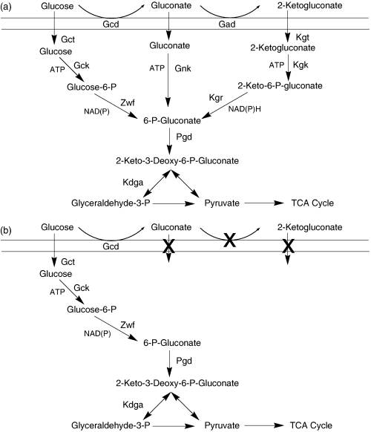
1 Metabolic pathways involved in the utilization of glucose by (a) pseudomonads and (b) Pseudomonas putida ...
Notes:
1 Metabolic pathways involved in the utilization of glucose by (a) pseudomonads and (b) Pseudomonas putida CSV86. The enzymes involved are: Gcd, Gad: glucose and gluconate oxidase; Gct, Kgt: glucose- and 2-ketogluconate-transporter; Gck, Gnk, Kgk: glucose-, gluconate- and 2-ketogluconate-kinase; Zwf: glucose 6-phosphate dehydrogenase; Kgr: 2-keto 6-phospho gluconate reductase; Pgd: 6-phosphogluconate dehydratase; Kdga: 2-Keto-3-deoxy-6-phospho gluconate aldolase Cross indicates the inability of strain to utilize gluconate and 2-ketogluconate as carbon source.
Unless provided in the caption above, the following copyright applies to the content of this slide: © 2006 Federation of European Microbiological Societies

Slide 2
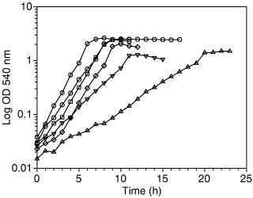
2 Growth profile of Pseudomonas putida CSV86 on naphthalene (○), salicylate (), benzyl alcohol (□), benzoate ...
Notes:
2 Growth profile of Pseudomonas putida CSV86 on naphthalene (○), salicylate (), benzyl alcohol (□), benzoate (⋄), glucose (▵) and succinate ().
Unless provided in the caption above, the following copyright applies to the content of this slide: © 2006 Federation of European Microbiological Societies

Slide 3
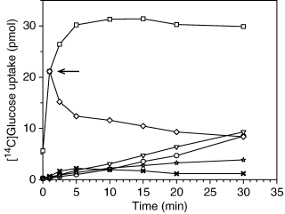
3 [¹⁴C]Glucose uptake by Pseudomonas putida CSV86 cells grown on naphthalene (○), succinate (▿) and ...
Notes:
3 [14C]Glucose uptake by Pseudomonas putida CSV86 cells grown on naphthalene (○), succinate (▿) and glucose (□). Inhibition of [14C]glucose uptake was observed when cells were exposed to sodium azide (25 mM) after one min (arrow,◊) or pretreated for 10 min with sodium azide (25 mM,) or formaldehyde (25 mM, ★).
Unless provided in the caption above, the following copyright applies to the content of this slide: © 2006 Federation of European Microbiological Societies

