Slide 1
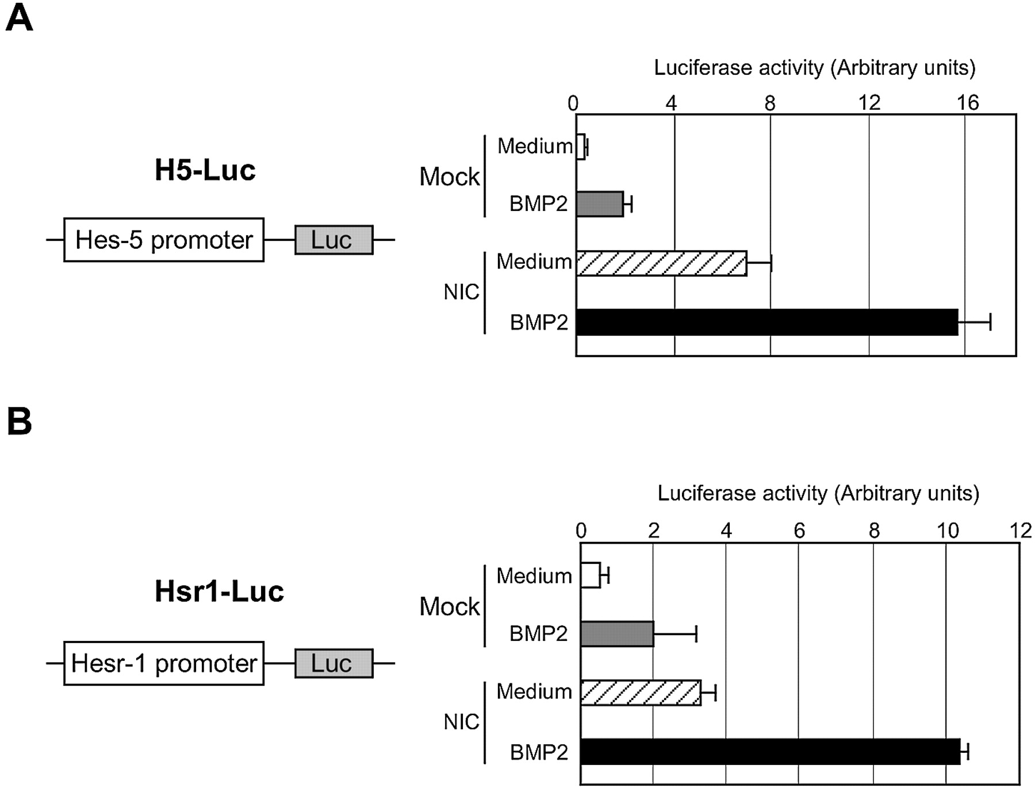
Figure 1. Activation of Hes‐5 and Hesr‐1 gene promoters by BMP2 and Notch signalings. Neuroepithelial cells ...
Notes:
Figure 1. Activation of Hes‐5 and Hesr‐1 gene promoters by BMP2 and Notch signalings. Neuroepithelial cells prepared from E14.5 mouse telencephalons were transfected with H5‐Luc (A) or Hsr1‐Luc (B) with or without NIC‐pEF‐BOS. On the following day, the cells were incubated with medium alone or BMP2 (40 ng/ml) for 8 h. The cells were then lysed and the luciferase activities were determined.
Unless provided in the caption above, the following copyright applies to the content of this slide:

Slide 2
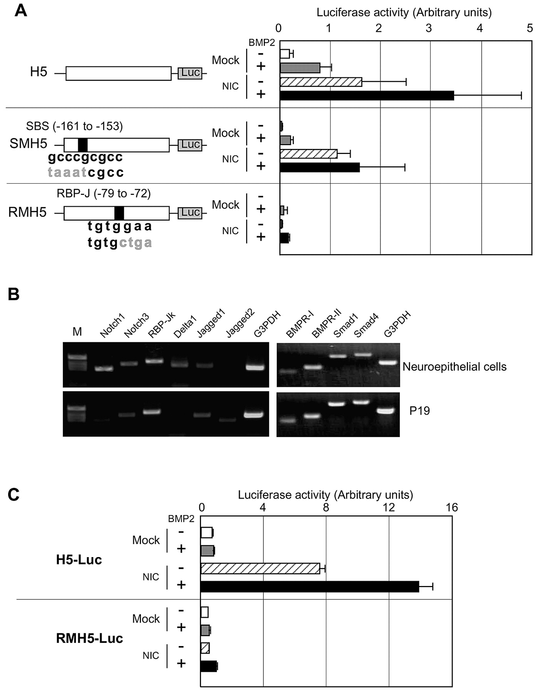
Figure 2. Requirement for a SBS and an RBP‐Jκ binding site for the synergistic gene induction by BMP2 and ...
Notes:
Figure 2. Requirement for a SBS and an RBP‐Jκ binding site for the synergistic gene induction by BMP2 and Notch. (A) Requirement for a SBS and an RBP‐Jκ binding site. Neuroepithelial cells were transfected with H5‐Luc (top), SMH5‐Luc (middle) or RMH5‐Luc (bottom) with or without the NIC expression vector. On the next day, they were stimulated by medium or BMP2 (40 ng/ml) for 8 h and the luciferase activities were determined. (B) RT–PCR for Notch and Notch ligands in neuroepithelial cells and P19 cells. cDNA was synthesized from 5 µg of total RNA from neuroepithelial cells or P19 cells. PCR was performed using the cDNAs for the indicated genes. (C) P19 cells were transfected with H5‐Luc (top) or RMH5‐Luc (bottom) with or without the NIC expression vector, and then stimulated with BMP2 (40 ng/ml).
Unless provided in the caption above, the following copyright applies to the content of this slide:

Slide 3
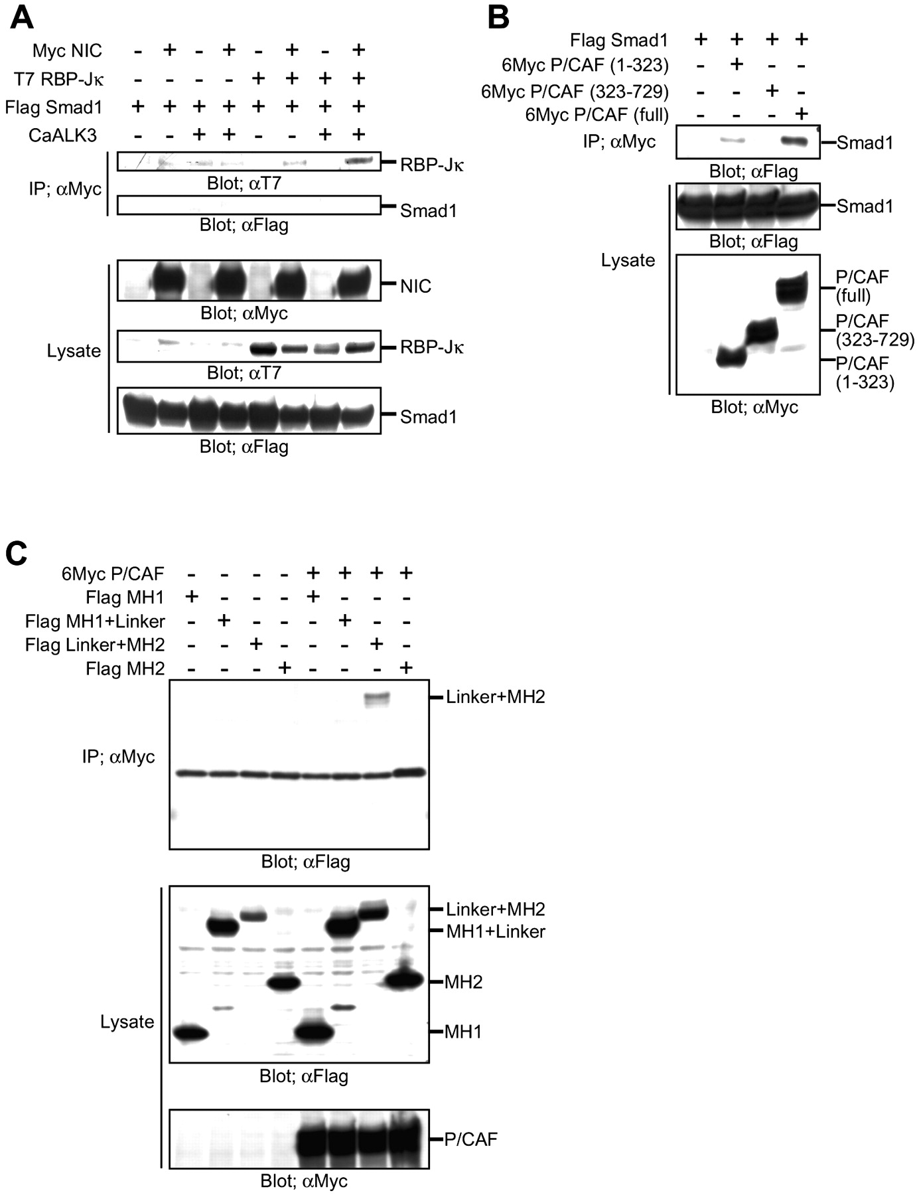
Figure 3. Molecular interactions between Smad1, NIC and P/CAF. (A–C) Cos7 cells were transfected with ...
Notes:
Figure 3. Molecular interactions between Smad1, NIC and P/CAF. (A–C) Cos7 cells were transfected with expression vectors for the indicated genes. On the next day, the cells were lysed and immunoprecipitated with an anti‐Myc antibody. The precipitates and lysates were subjected to SDS–PAGE and blotted with the indicated antibodies.
Unless provided in the caption above, the following copyright applies to the content of this slide:

Slide 4
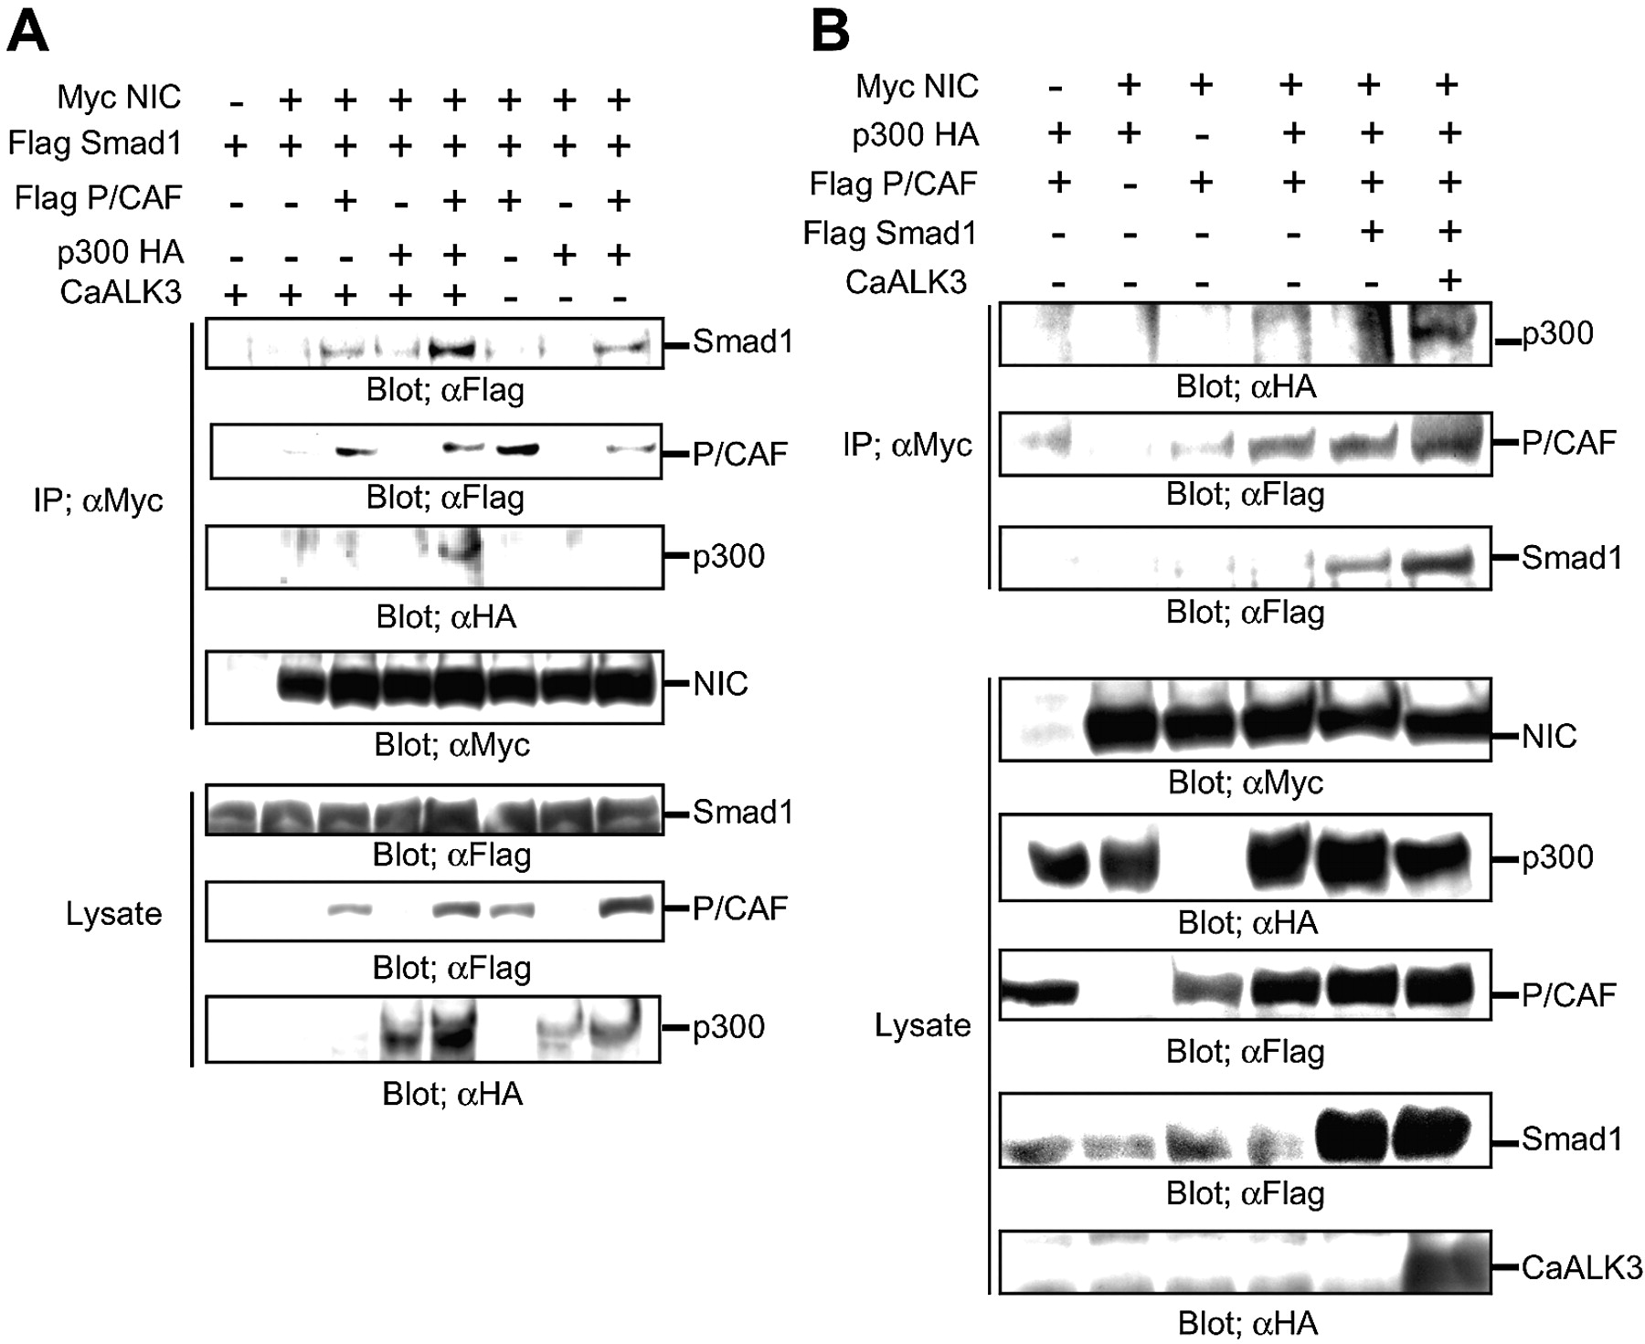
Figure 4. Molecular interactions between NIC and Smad1 in the presence of p300 and P/CAF. (A and B) Cos7 ...
Notes:
Figure 4. Molecular interactions between NIC and Smad1 in the presence of p300 and P/CAF. (A and B) Cos7 cells were transfected with expression vectors for the indicated genes. Western blotting assay was performed as described in Figure 3.
Unless provided in the caption above, the following copyright applies to the content of this slide:

Slide 5
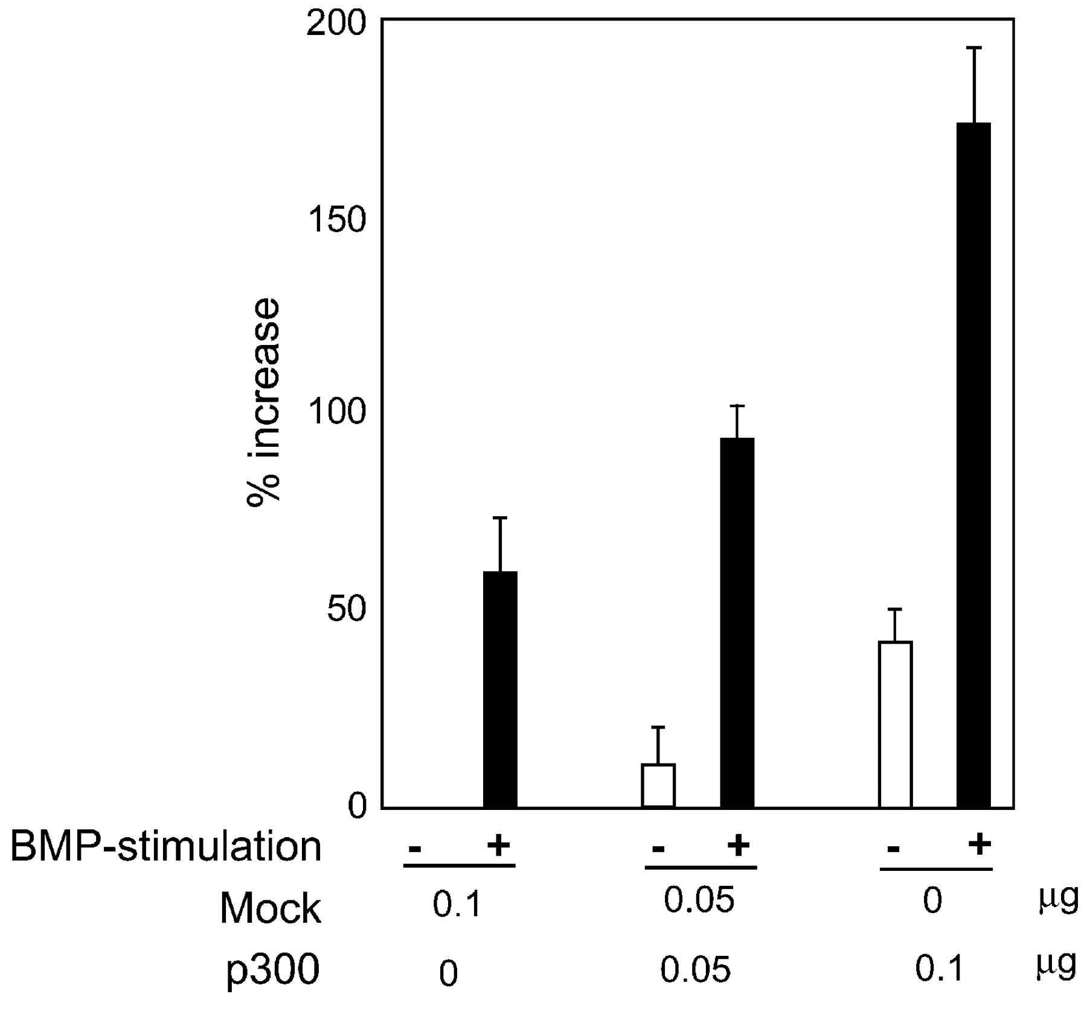
Figure 5. Effect of additional expression of p300 on the cooperative transactivation by Notch and BMP2. P19 ...
Notes:
Figure 5. Effect of additional expression of p300 on the cooperative transactivation by Notch and BMP2. P19 cells were transfected with H5‐Luc and NIC with Mock or p300 expression vector. On the following day, the cells were stimulated with BMP2 (40 ng/ml) for 8 h and the luciferase activities were determined. Data are described as the percentage increase in luciferase activity compared with that obtained by NIC stimulation alone. The arbitrary units of luciferase activity for non‐ or NIC stimulation were 0.24 and 8.87, respectively.
Unless provided in the caption above, the following copyright applies to the content of this slide:

