Slide 1
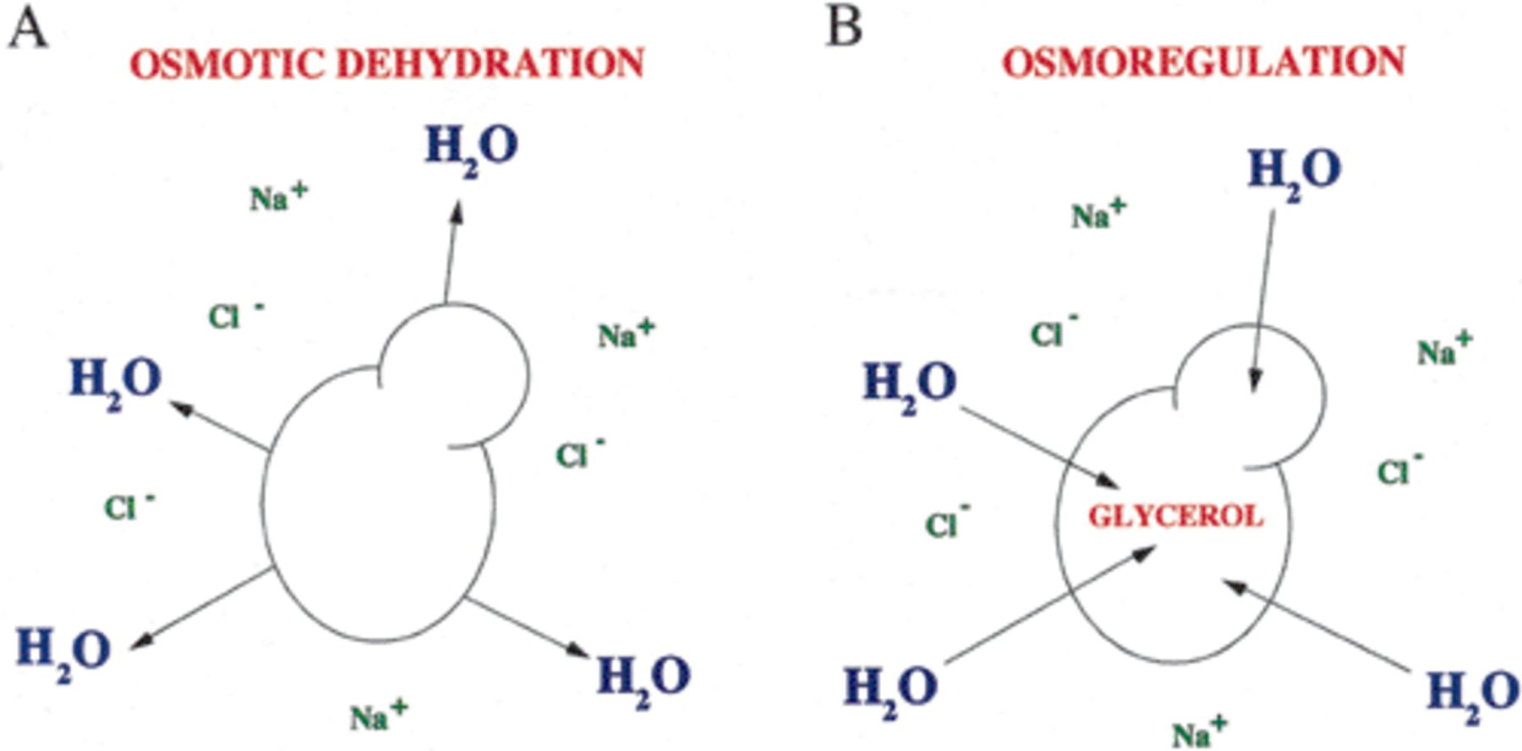
1 Key features of the cellular response in yeast to saline conditions. A: The initial response of the cell is ...
Notes:
1 Key features of the cellular response in yeast to saline conditions. A: The initial response of the cell is efflux of water, which leads to cell shrinkage and growth arrest. B: The main osmoregulatory strategy of the cell is (i) exclusion of the salt via ion pumps, and (ii) regain lost water, and thus turgor and/or volume, by increased production and accumulation of glycerol.
Unless provided in the caption above, the following copyright applies to the content of this slide: © 2000 Federation of European Microbiological Societies

Slide 2
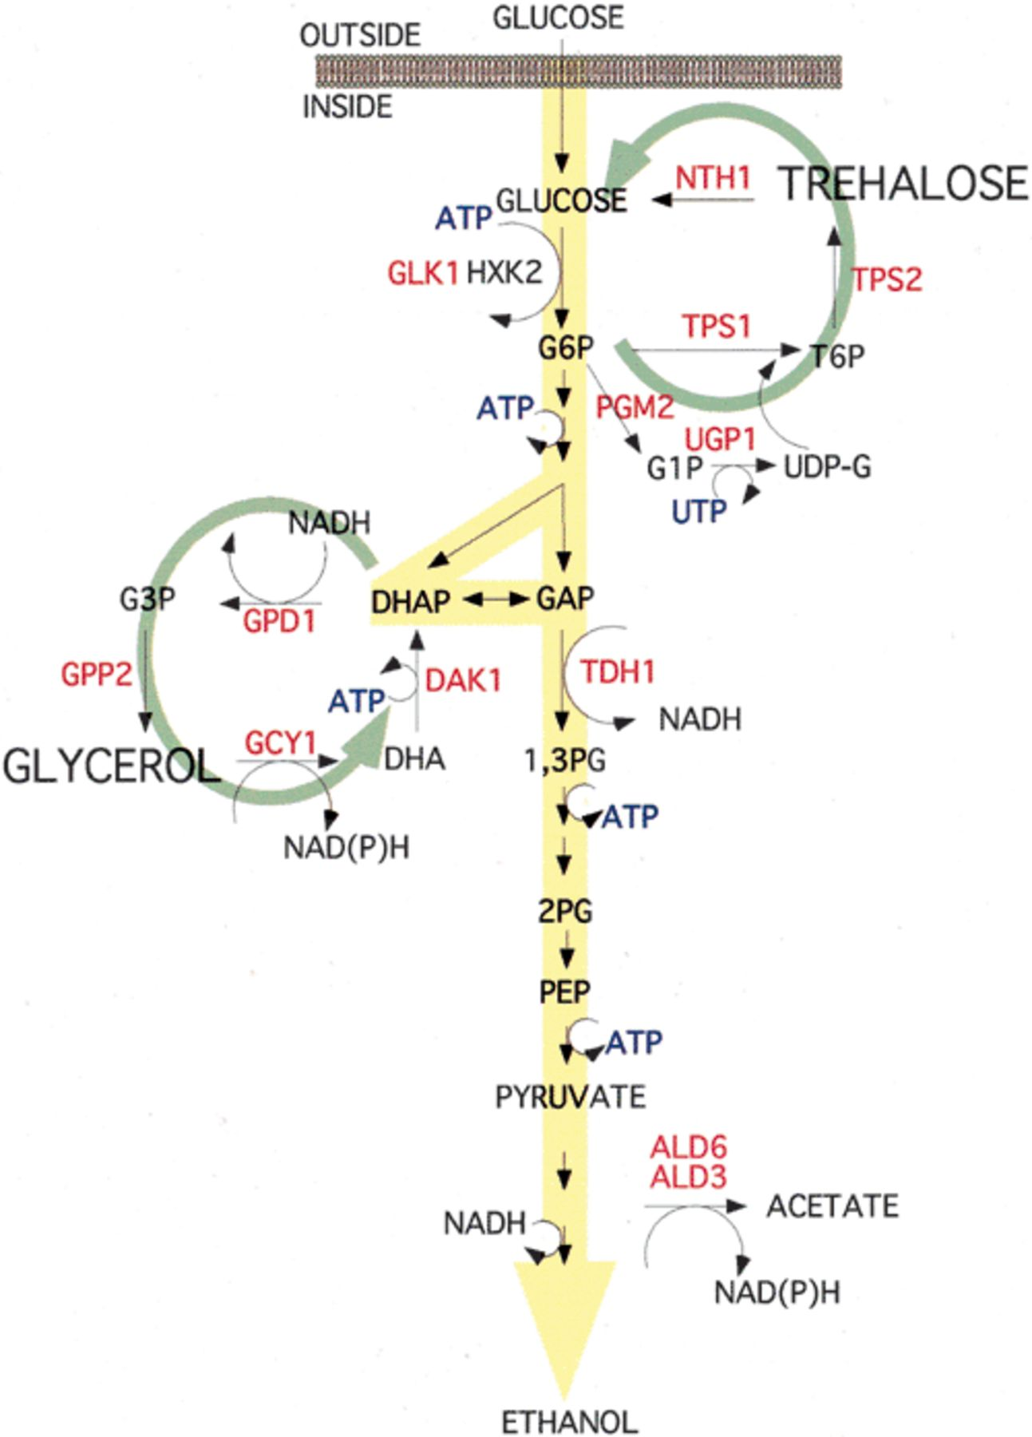
2 The central metabolism of yeast depicting a model for stress-imposed activation of ATP futile cycles by ...
Notes:
2 The central metabolism of yeast depicting a model for stress-imposed activation of ATP futile cycles by trehalose and glycerol turnover (green circles). Salt-induced changes in gene expression during adaptation to salt are indicated in red and placed in their metabolic context. See text for further information.
Unless provided in the caption above, the following copyright applies to the content of this slide: © 2000 Federation of European Microbiological Societies

