Slide 1
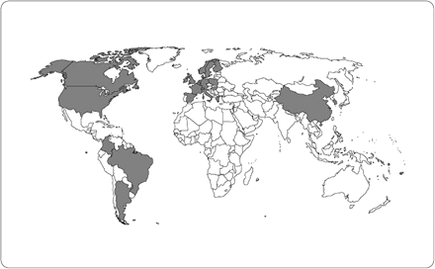
Figure 1. International dissemination of Klebsiella pneumoniae carbapenemase (KPC)–producing Enterobacteriaceae. This ...
Notes:
Figure 1. International dissemination of Klebsiella pneumoniae carbapenemase (KPC)–producing Enterobacteriaceae. This map indicates countries where KPC-producing Enterobacteriaceae have been described in published reports available as of 11 February, 2011. Because of lack of systematic surveillance for these organisms, countries not highlighted in this figure might also have unreported KPC-producing Enterobacteriaceae.
Unless provided in the caption above, the following copyright applies to the content of this slide: Published by Oxford University Press on behalf of the Infectious Diseases Society of America 2011.

Slide 2
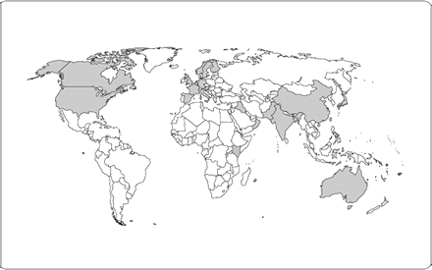
Figure 2. International dissemination of New Delhi metallo-β-lactamase (NDM)–producing Enterobacteriaceae. This map ...
Notes:
Figure 2. International dissemination of New Delhi metallo-β-lactamase (NDM)–producing Enterobacteriaceae. This map indicates countries where NDM-producing Enterobacteriaceae have been described in published reports available as of 11 February, 2011. Because of lack of systematic surveillance for these organisms, countries not highlighted in this figure might also have unreported NDM-producing Enterobacteriaceae.
Unless provided in the caption above, the following copyright applies to the content of this slide: Published by Oxford University Press on behalf of the Infectious Diseases Society of America 2011.

