Slide 1
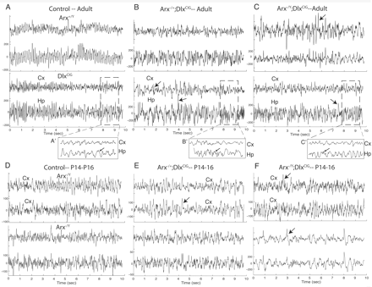
Figure 1 Background EEG findings of Arx^{−/y};Dlx5/6^{CIG}, Arx^{−/+};Dlx5/6^{CIG} and ...
Notes:
Figure 1 Background EEG findings of Arx−/y;Dlx5/6CIG, Arx−/+;Dlx5/6CIG and control genotypes in both adult and immature mice. For all tracings a cortical electrode (Cx; upper tracing) and Hp electrode (Hp; lower tracing) are presented. (A) Representative background EEG of two adult control genotypes Arxfl/Y (upper panel) and Dlx5/6CIG (lower panel) are shown. Typical 5–7 Hz rhythmic activity observed during exploratory behaviors in wakefulness is observed. Expanded time scale of dashed box in the lower tracings is shown in A′. Arrow points to 5–7 Hz rhythm. Note lack of superimposed faster activity. (B) Adult female heterozygotes, Arx−/+;Dlx5/6CIG, background activity is shown from two animals. Intermittent spike and sharp activity is present (arrows in lower traces). Inset (B′) shows faster time scale and increase in higher frequency activity. (C) Examples from two adult CKO Arx−/y;Dlx5/6CIG animals are shown. Frequent spike and sharps are present and is nearly continuous in the upper tracing (arrows). Notice faster frequency and lack of rhythmicity of the resting background (see inset in C′). (D–F) Two representative background traces from controls (D), heterozygous females (E) and CKO (F) P14–16 immature animals are presented. The tracings from each of the animals are very similar in appearance. Intermittent higher voltage spikes were present in the Arx−/y;Dlx5/6CIG Dlx5/6CIG animals (F, lower tracing).
Unless provided in the caption above, the following copyright applies to the content of this slide: © The Author (2009). Published by Oxford University Press on behalf of the Guarantors of Brain. All rights reserved. For Permissions, please email: journals.permissions@oxfordjournals.org

Slide 2
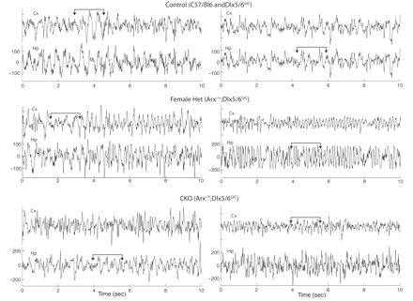
Figure 2 EEG activity during sleep in Arx^{−/y};Dlx5/6^{CIG}, Arx^{−/+};Dlx5/6^{CIG} ...
Notes:
Figure 2 EEG activity during sleep in Arx−/y;Dlx5/6CIG, Arx−/+;Dlx5/6CIG and control genotypes in adult mice. For all tracings a cortical electrode (Cx, upper tracing) and Hp electrode (Hp, lower tracing) are presented. (Upper Panel) representative sleep EEG of two adult control genotypes C57/Bl6 (left) and Dlx5/6CIG (right) are shown. Typical 1–3.5 Hz polymorphic delta activity observed during quiet sleep is shown (brackets with arrows). (Middle Panel) adult female Arx−/+;Dlx5/6CIG heterozygous mice sleep activity shown from two animals. Typical 1–3.5 Hz polymorphic delta activity observed during quiet sleep is shown, but with interruption on the right by faster 10–12 Hz activity. (Lower Panel) examples of sleep from two adult Arx−/y;Dlx5/6CIG animals EEG are shown. Notice faster frequencies, excessive sharps and paucity of the typical 1–3.5 Hz delta activity of normal sleep.
Unless provided in the caption above, the following copyright applies to the content of this slide: © The Author (2009). Published by Oxford University Press on behalf of the Guarantors of Brain. All rights reserved. For Permissions, please email: journals.permissions@oxfordjournals.org

Slide 3
Figure 3 Fast Fourier Transformations from a random 30-min segment of each genotype show difference in background ...
Notes:
Figure 3 Fast Fourier Transformations from a random 30-min segment of each genotype show difference in background activity. Representative spectrums from Control (left- Arx−/Y), Arx−/+;Dlx5/6CIG-middle, and Arx−/y;Dlx5/6CIG-left are presented. x-axis = frequency; y-axis = normalized power. In control spectrum, the typical EEG frequency bandwidths are depicted in the left axis by colour. A shift from peak power in delta and theta bands in the controls to peak power in the higher frequency bands in the Arx−/y;Dlx5/6CIG-CKO is demonstrated by the arrows in each graph. The dotted line represents where two-third of total power falls and shifts from 17 Hz in Arxfl/+ controls to 24 Hz in the CKO.
Unless provided in the caption above, the following copyright applies to the content of this slide: © The Author (2009). Published by Oxford University Press on behalf of the Guarantors of Brain. All rights reserved. For Permissions, please email: journals.permissions@oxfordjournals.org

Slide 4
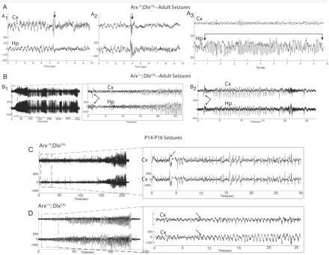
Figure 4 Examples of the electrographic changes during seizures in the Arx^{−/+};Dlx5/6^{CIG} females ...
Notes:
Figure 4 Examples of the electrographic changes during seizures in the Arx−/+;Dlx5/6CIG females and Arx−/y;Dlx5/6CIG CKO males in adults and immature animals. (A) The two seizure types in the adult Arx−/y;Dlx5/6CIG CKO males are presented. All CKO (n = 3) had these seizure types. A1 and A2 are examples of seizures where the animal jerks forward after the higher voltage spike and slow wave activity (arrows), which is frequently followed by a flattening of the recording (electro-decrement). A3 shows repetitive spiking that builds in frequency that occurs when the animals freeze during normal waking activity. (B) The two seizure types in the adult Arx−/+;Dlx5/6CIG heterozygous females are presented. Fifty-three per cent of females had seizures represented by these tracings. B1 depicts a convulsive-stage 5 seizure, which begins (see dashed boxed area with faster time scale showing onset) with a high amplitude spike and slow wave followed by repetitive spike and slow waves that build in frequency and amplitude. A freezing, arrest of activity, type seizure's EEG change is presented in B2. (C and D) Seizures in the immature Arx−/y;Dlx5/6CIG CKO males (C) and Arx−/+;Dlx5/6CIG females are presented. At this age, the seizures in the two groups were identical with both groups having convulsive type seizures. EEG shows onsets in dashed boxes. Onsets of spike and slow waves are illustrated (arrows).
Unless provided in the caption above, the following copyright applies to the content of this slide: © The Author (2009). Published by Oxford University Press on behalf of the Guarantors of Brain. All rights reserved. For Permissions, please email: journals.permissions@oxfordjournals.org

Slide 5
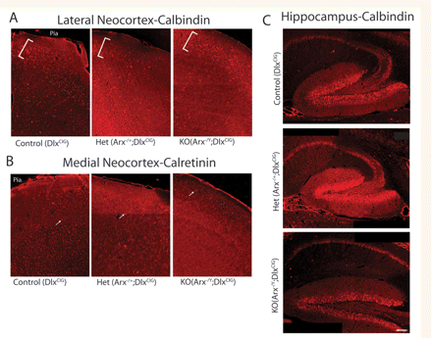
Figure 5 Representative Calbindin and Calretinin immunohistochemistry in the neocortex and hippocampus of control, ...
Notes:
Figure 5 Representative Calbindin and Calretinin immunohistochemistry in the neocortex and hippocampus of control, Arx−/+;Dlx5/6CIG and Arx−/y;Dlx5/6CIG animals. (A) Calbindin staining for control (Dlx5/6CIG)-left, Arx−/+;Dlx5/6CIG-middle and Arx−/y;Dlx5/6CIG-right from the lateral neocortex frontal region is presented at 10× magnification. Layers two and three where the majority of calbindin interneurons are present and highlighted by the bracket. Calbindin interneurons are clearly reduced in the Arx−/+;Dlx5/6CIG compared with controls. A smaller reduction of Calbindin interneurons is present in the Arx−/y;Dlx5/6CIG mice. (B) Calretinin staining from medial neocortex for control (Dlx5/6CIG)-left, Arx−/+;Dlx5/6CIG -middle and Arx−/y;Dlx5/6CIG-right are presented at 10× magnification. A more subtle change in calretinin interneurons is present (arrows highlight labelled cells). (C) Calbindin staining in the hippocampus for control (Dlx5/6CIG)-upper, Arx−/+;Dlx5/6CIG-middle and Arx−/y;Dlx5/6CIG-lower panels are presented. Pia–pial surface of brain. Scale bar = 100 μ in Hp images.
Unless provided in the caption above, the following copyright applies to the content of this slide: © The Author (2009). Published by Oxford University Press on behalf of the Guarantors of Brain. All rights reserved. For Permissions, please email: journals.permissions@oxfordjournals.org

Slide 6
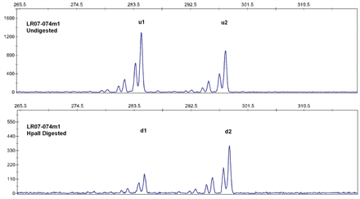
Figure 6 X inactivation assay at human androgen receptor done by genotyping the CAG repeat after digestion by the ...
Notes:
Figure 6 X inactivation assay at human androgen receptor done by genotyping the CAG repeat after digestion by the HpaII methylation-sensitive enzyme. In the figure, the x-axis shows the size of the alleles and the y-axis shows the peak areas. u1 and u2 are the smaller and the larger alleles respectively from undigested sample, as seen in the top panel and d1 and d2 are the corresponding alleles from digested sample, the bottom panel. In this case, the smaller allele is active (unmethylated digested) and the larger allele is inactive (methylated undigested). The X inactivation ratios after calculating the peak areas are 21:79 listing the smaller allele first.
Unless provided in the caption above, the following copyright applies to the content of this slide: © The Author (2009). Published by Oxford University Press on behalf of the Guarantors of Brain. All rights reserved. For Permissions, please email: journals.permissions@oxfordjournals.org

