Slide 1
Notes:
Unless provided in the caption above, the following copyright applies to the content of this slide: © Oxford University Press

Slide 2
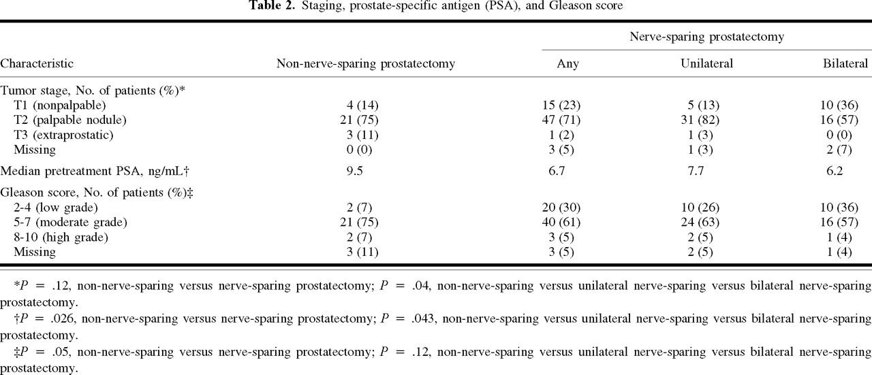
Notes:
Unless provided in the caption above, the following copyright applies to the content of this slide: © Oxford University Press

Slide 3
Notes:
Unless provided in the caption above, the following copyright applies to the content of this slide: © Oxford University Press

Slide 4
Notes:
Unless provided in the caption above, the following copyright applies to the content of this slide: © Oxford University Press

Slide 5
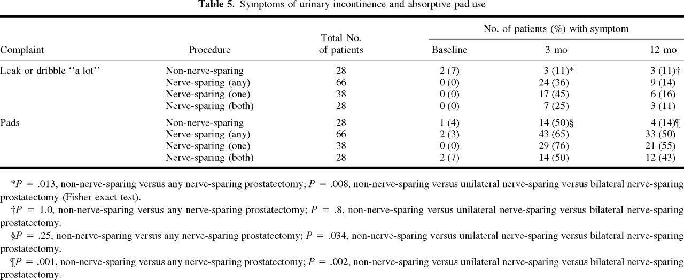
Notes:
Unless provided in the caption above, the following copyright applies to the content of this slide: © Oxford University Press

