Slide 1
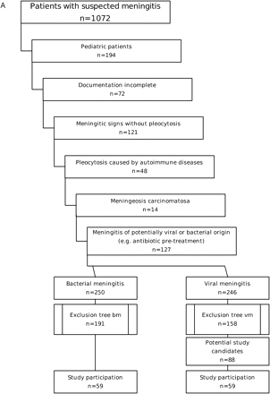
Fig. 1 (A) Study inclusion/exclusion diagram. (B) Exclusion diagram for the BM group. (C) Exclusion diagram for the ...
Notes:
Fig. 1 (A) Study inclusion/exclusion diagram. (B) Exclusion diagram for the BM group. (C) Exclusion diagram for the VM group.
Unless provided in the caption above, the following copyright applies to the content of this slide: © The Author (2005). Published by Oxford University Press on behalf of the Guarantors of Brain. All rights reserved. For Permissions, please email: journals.permissions@oupjournals.org

Slide 2
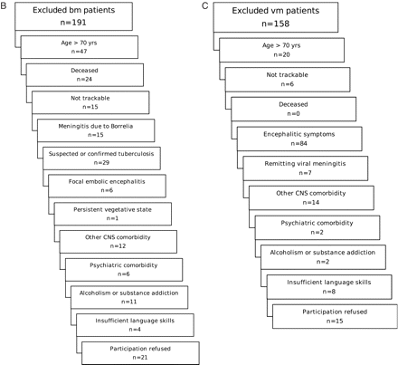
Fig. 1 (A) Study inclusion/exclusion diagram. (B) Exclusion diagram for the BM group. (C) Exclusion diagram for the ...
Notes:
Fig. 1 (A) Study inclusion/exclusion diagram. (B) Exclusion diagram for the BM group. (C) Exclusion diagram for the VM group.
Unless provided in the caption above, the following copyright applies to the content of this slide: © The Author (2005). Published by Oxford University Press on behalf of the Guarantors of Brain. All rights reserved. For Permissions, please email: journals.permissions@oupjournals.org

Slide 3
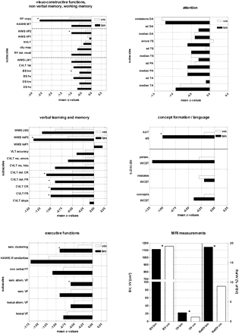
Fig. 2 Overview of substantially different neuropsychological and MRI results for patients after BM and VM. Mean ...
Notes:
Fig. 2 Overview of substantially different neuropsychological and MRI results for patients after BM and VM. Mean Z-values are given. Filled bars denominate results of patients after BM, open bars those after VM. Statistically significant differences are marked with*; please refer to Appendix for the explanations of the respective subdomains, and to Table 3 for exact means, standard deviations and respective P-values.
Unless provided in the caption above, the following copyright applies to the content of this slide: © The Author (2005). Published by Oxford University Press on behalf of the Guarantors of Brain. All rights reserved. For Permissions, please email: journals.permissions@oupjournals.org

