Slide 1
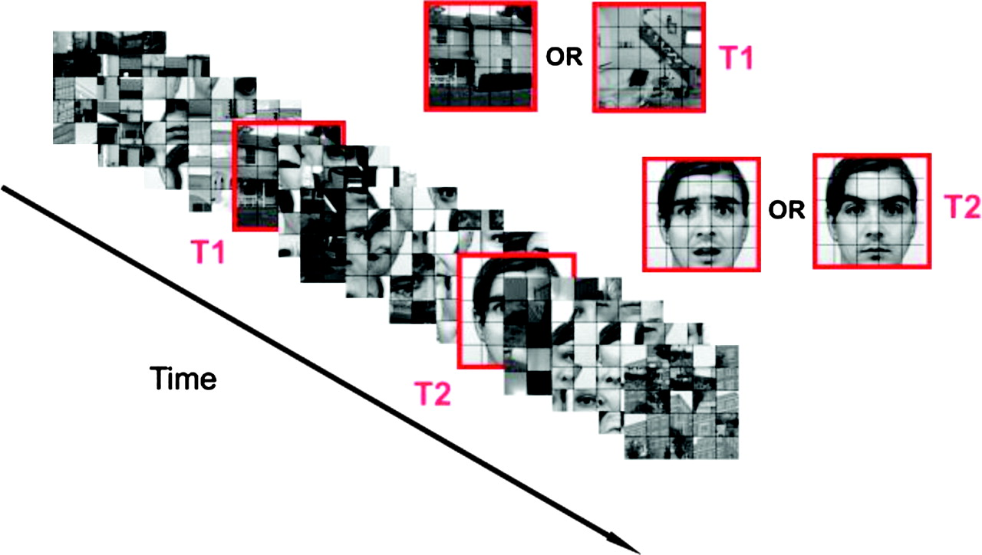
Figure 1. Task. Subjects were asked to search for 2 targets (T1 and T2) embedded in between 13 distractors items at ...
Notes:
Figure 1. Task. Subjects were asked to search for 2 targets (T1 and T2) embedded in between 13 distractors items at fixation for 70 ms each with no interstimulus interval. The first stimulus (T1) was a scene (either indoor or outdoor) and the second target (T2) was a face (either neutral or fearful). The distractors were scrambled images of the scene and face together. The 2 targets were always separated by 5 distractors (350 ms). At the end of the rapid visual stimuli presentation (RVSP) subjects were asked to report by a key press whether no scene, an outdoor scene or an indoor scene was presented (T1 response 4 s). Subsequently, they were asked to identify the identity of the face T2 by key press in a forced choice between 3 faces: one of these was the one presented in the trial (T2 response 4 s). Note that the red frame is shown here only for the purpose of display and was not part of the original stimuli.
Unless provided in the caption above, the following copyright applies to the content of this slide: © 2008 The AuthorsThis is an Open Access article distributed under the terms of the Creative Commons Attribution Non-Commercial License (http://creativecommons.org/licenses/by-nc/2.0/uk/) which permits unrestricted non-commercial use, distribution, and reproduction in any medium, provided the original work is properly cited.

Slide 2
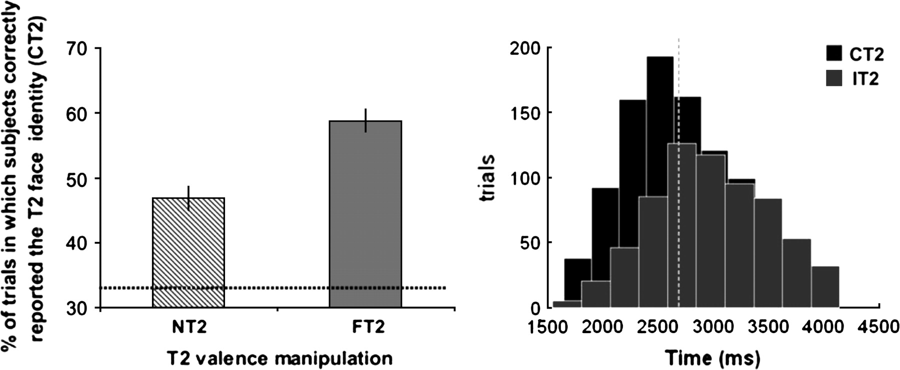
Figure 2. Behavioral results. (a) Behavioral results (main). The graph shows the × percentage (%) increase of trials in ...
Notes:
Figure 2. Behavioral results. (a) Behavioral results (main). The graph shows the × percentage (%) increase of trials in which the subject correctly reported the T2 face identity (Correct-T2) for a T2 fearful face condition (Fearful-T2 58.8%; SE 1.85) respect to a T2 neutral face condition (Neutral-T2 46.8%; SE 1.95) (Fearful-T2 vs. Neutral-T2 [t(14) = 5.2, P < 0.001 2-tailed paired t-test]). In both the T2 detection was significantly above chance level of 33% (forced choice between tree faces) represented in the graph with a dashed line (neutral-T2: t(14) = 7.05, P < 0.001, Fearful-T2: t(14) = 13.9, P < 0.001 2 tailed 1-sample t-test). (b) Behavioral results (RT). The histograms represent the RT distributions for number of trials. In black is shown the condition in which the T2 face was correctly reported (Correct-T2) and in brown the condition in which the T2 face was incorrectly reported (Incorrect-T2). The 2 distributions partially overlap with the RT mean value significantly shorter in the Correct-T2 versus the Incorrect-T2 (F1,14 = 22.6, P < 0.001). The dashed line represent the median split for the Correct-T2 condition (see experimental procedure).
Unless provided in the caption above, the following copyright applies to the content of this slide: © 2008 The AuthorsThis is an Open Access article distributed under the terms of the Creative Commons Attribution Non-Commercial License (http://creativecommons.org/licenses/by-nc/2.0/uk/) which permits unrestricted non-commercial use, distribution, and reproduction in any medium, provided the original work is properly cited.

Slide 3
Figure 3. FFA. (a) Coronal section of SPMs showing both FFA contrasting activity during the entire task against the ...
Notes:
Figure 3. FFA. (a) Coronal section of SPMs showing both FFA contrasting activity during the entire task against the baseline (R-FFA ([x = 30, y = −48, z = −24] Z = 5.88, 25-voxels L-FFA ([x = −38, y = −50, z = −22] Z = 5.28, 97-voxels P < 0.05 whole-brain corrected for multiple comparison FWE). Both clusters were used to identify respective ROIs used in a ROIs analysis that revealed a significant increased activation in the Correct-T2 versus Incorrect-T2 (R-FFA Z = 3.27 P < 0.05, L-FFA Z = 5.32, P < 0.05). L-FFA showed a nonsignificant trend for Fearful-T2 versus Neutral-T2 (Z = 2.01, P = 0.11) with a significant simple effect in the Incorrect-T2 condition Fearful-T2_Incorrect-T2 versus Neutral-T2_Incorrect-T2 (Z = 2.56, P < 0.05). (b) Plot of signal percentage changes for the L-FFA cluster.
Unless provided in the caption above, the following copyright applies to the content of this slide: © 2008 The AuthorsThis is an Open Access article distributed under the terms of the Creative Commons Attribution Non-Commercial License (http://creativecommons.org/licenses/by-nc/2.0/uk/) which permits unrestricted non-commercial use, distribution, and reproduction in any medium, provided the original work is properly cited.

Slide 4
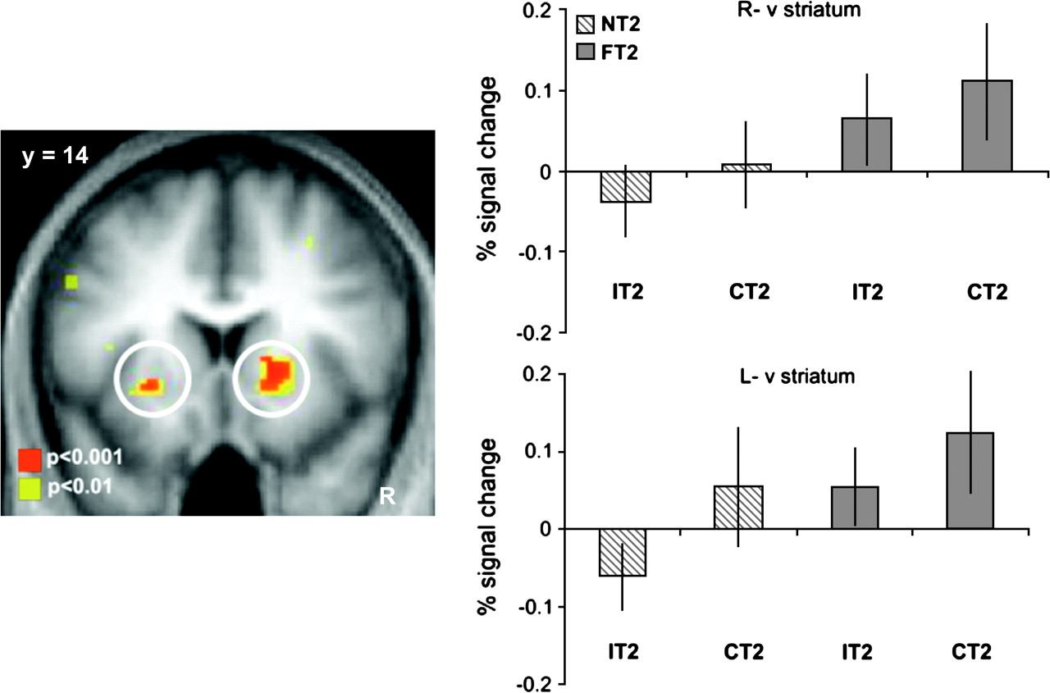
Figure 4. Striatum. (a) SPM showing response in both ventral striatum nuclei for the Fearful-T2 versus Neutral-T2 ...
Notes:
Figure 4. Striatum. (a) SPM showing response in both ventral striatum nuclei for the Fearful-T2 versus Neutral-T2 statistical contrast R-striatum ([x = 20, y = 16, z = 0] Z = 4.08, 68-voxels, P < 0.001 uncorrected), L-striatum ([x = −26, y = 14, z = −4) Z = 3.63, 8-voxels, P < 0.001 uncorrected and P < 0.05 SVC). (b) Plot of signal percentage changes for the both ventral striatum nuclei clusters.
Unless provided in the caption above, the following copyright applies to the content of this slide: © 2008 The AuthorsThis is an Open Access article distributed under the terms of the Creative Commons Attribution Non-Commercial License (http://creativecommons.org/licenses/by-nc/2.0/uk/) which permits unrestricted non-commercial use, distribution, and reproduction in any medium, provided the original work is properly cited.

Slide 5
Figure 5. rACC. (a) Plot of signal percentage changes for the rACC cluster. (b) Sagittal SPM image during the ...
Notes:
Figure 5. rACC. (a) Plot of signal percentage changes for the rACC cluster. (b) Sagittal SPM image during the interaction contrast ([Fearful-T2_Correct-T2 − Fearful-T2_Incorrect-T2] > [Neutral-T2_Correct-T2 − Neutral-T2_Incorrect-T2]) showing the activity of the rACC ([x = 14, y = 40, z = 22] Z = 3.59, 25-voxels P < 0.001 uncorrected and P < 0.05 SVC) is modulated by the T2 identification (Correct-T2 vs. Incorrect-T2) selectively in the when the T2 stimulus was a fearful face (Fearful-T2). rACC is significantly more active simple effect (Fearful-T2_Correct-T2 vs. Fearful-T2_Incorrect-T2) ([x = 10, y = 38, z = 18] Z = 4.25, 32-voxels P < 0.001 uncorrected and P < 0.05 SVC).
Unless provided in the caption above, the following copyright applies to the content of this slide: © 2008 The AuthorsThis is an Open Access article distributed under the terms of the Creative Commons Attribution Non-Commercial License (http://creativecommons.org/licenses/by-nc/2.0/uk/) which permits unrestricted non-commercial use, distribution, and reproduction in any medium, provided the original work is properly cited.

