Slide 1
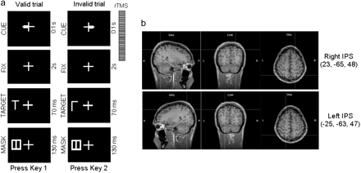
Figure 1. Task and rTMS localization. (a) Sequence of events during a trial. (b) MRI-constructed stereotaxic template ...
Notes:
Figure 1. Task and rTMS localization. (a) Sequence of events during a trial. (b) MRI-constructed stereotaxic template showing the sagittal (a), coronal (b), and axial (c) projections of the 2 rTMS sites on the right and left hemisphere.
Unless provided in the caption above, the following copyright applies to the content of this slide: © The Author 2011. Published by Oxford University Press. All rights reserved. For permissions, please e-mail: journals.permissions@oup.com

Slide 2
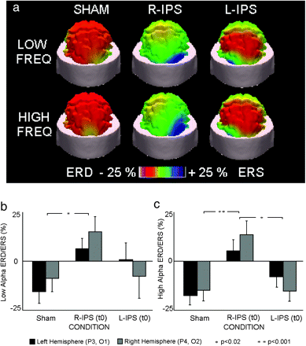
Figure 2. Topography of alpha power as function of rTMS conditions. (a) Topographic maps (rear view) of anticipatory ...
Notes:
Figure 2. Topography of alpha power as function of rTMS conditions. (a) Topographic maps (rear view) of anticipatory low and high alpha ERD/ERS during the cue period (+1000 to 2000 ms after the onset of the cue). (b) Group means (±SE) of the low alpha ERD/ERS divided by hemisphere (left or right). (c) Group means (±SE) of the high alpha ERD/ERS divided by hemisphere (left or right). Duncan post hoc tests: 1 (P < 0.02) or 2 asterisks (P < 0.001).
Unless provided in the caption above, the following copyright applies to the content of this slide: © The Author 2011. Published by Oxford University Press. All rights reserved. For permissions, please e-mail: journals.permissions@oup.com

Slide 3
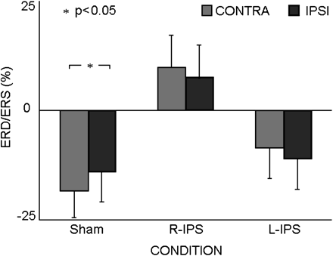
Figure 3. Contralateral spatial selectivity of alpha power by rTMS condition. Group means (±SE) of the high alpha ...
Notes:
Figure 3. Contralateral spatial selectivity of alpha power by rTMS condition. Group means (±SE) of the high alpha ERD/ERS for the 3 Conditions (Sham, R-IPS (t0), L-IPS (t0)) divided by Hemisphere (contra or ipsi to cue stimulus).
Unless provided in the caption above, the following copyright applies to the content of this slide: © The Author 2011. Published by Oxford University Press. All rights reserved. For permissions, please e-mail: journals.permissions@oup.com

Slide 4
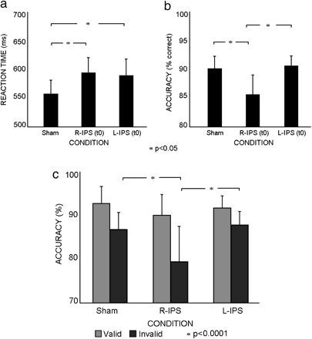
Figure 4. Behavioral effects of rTMS at different cortical sites. (a) Group means (±SE) of the RT (ms). (b) Group means ...
Notes:
Figure 4. Behavioral effects of rTMS at different cortical sites. (a) Group means (±SE) of the RT (ms). (b) Group means (±SE) of the accuracy (%). Duncan post hoc tests: 1 (P < 0.05) asterisk. (c) The accuracy of visual discrimination was significantly more impaired on invalid trials after rTMS in R-IPS (t0) than Sham and L-IPS (t0). Duncan post hoc tests: 1 asterisk (P < 0.0001).
Unless provided in the caption above, the following copyright applies to the content of this slide: © The Author 2011. Published by Oxford University Press. All rights reserved. For permissions, please e-mail: journals.permissions@oup.com

Slide 5
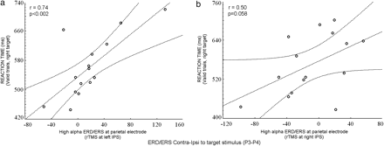
Figure 5. Across-subject correlation between alpha ERD/ERS and RTs. (a) Scatter plot showing the (positive) linear ...
Notes:
Figure 5. Across-subject correlation between alpha ERD/ERS and RTs. (a) Scatter plot showing the (positive) linear correlation between anticipatory high alpha ERD/ERS at parietal electrode (i.e., P3–P4) and RT to valid target presented in the right hemifield, for left “IPS” condition. (b) Scatter plot showing the (positive) linear correlation between anticipatory high alpha ERD/ERS at parietal electrode (i.e., P3–P4) and RT to valid target presented in the right hemifield, for right “IPS” condition.
Unless provided in the caption above, the following copyright applies to the content of this slide: © The Author 2011. Published by Oxford University Press. All rights reserved. For permissions, please e-mail: journals.permissions@oup.com

