Slide 1
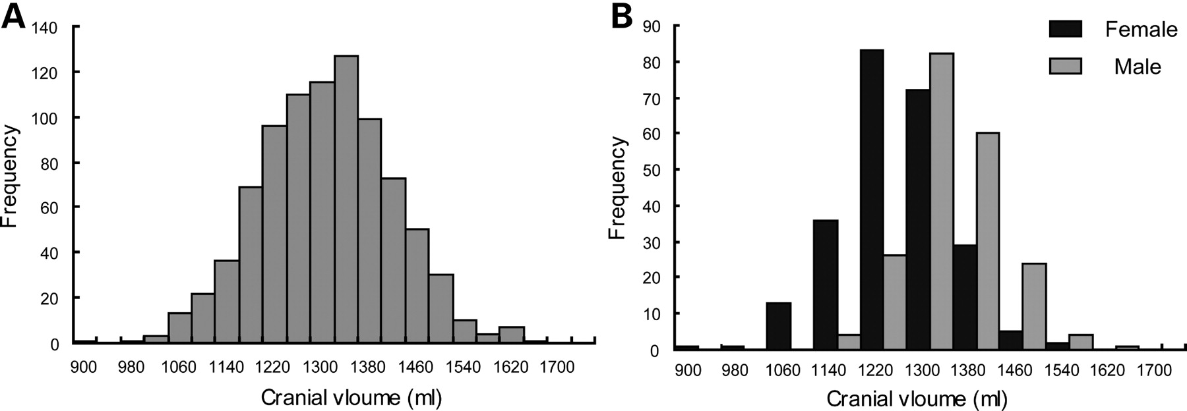
Figure 2. Distribution of the cranial volumes. (A) The overall distribution of the cranial volumes. (B) The sex ...
Notes:
Figure 2. Distribution of the cranial volumes. (A) The overall distribution of the cranial volumes. (B) The sex distribution of the cranial volumes.
Unless provided in the caption above, the following copyright applies to the content of this slide: © The Author 2008. Published by Oxford University Press. All rights reserved. For Permissions, please email: journals.permissions@oxfordjournals.org

Slide 2
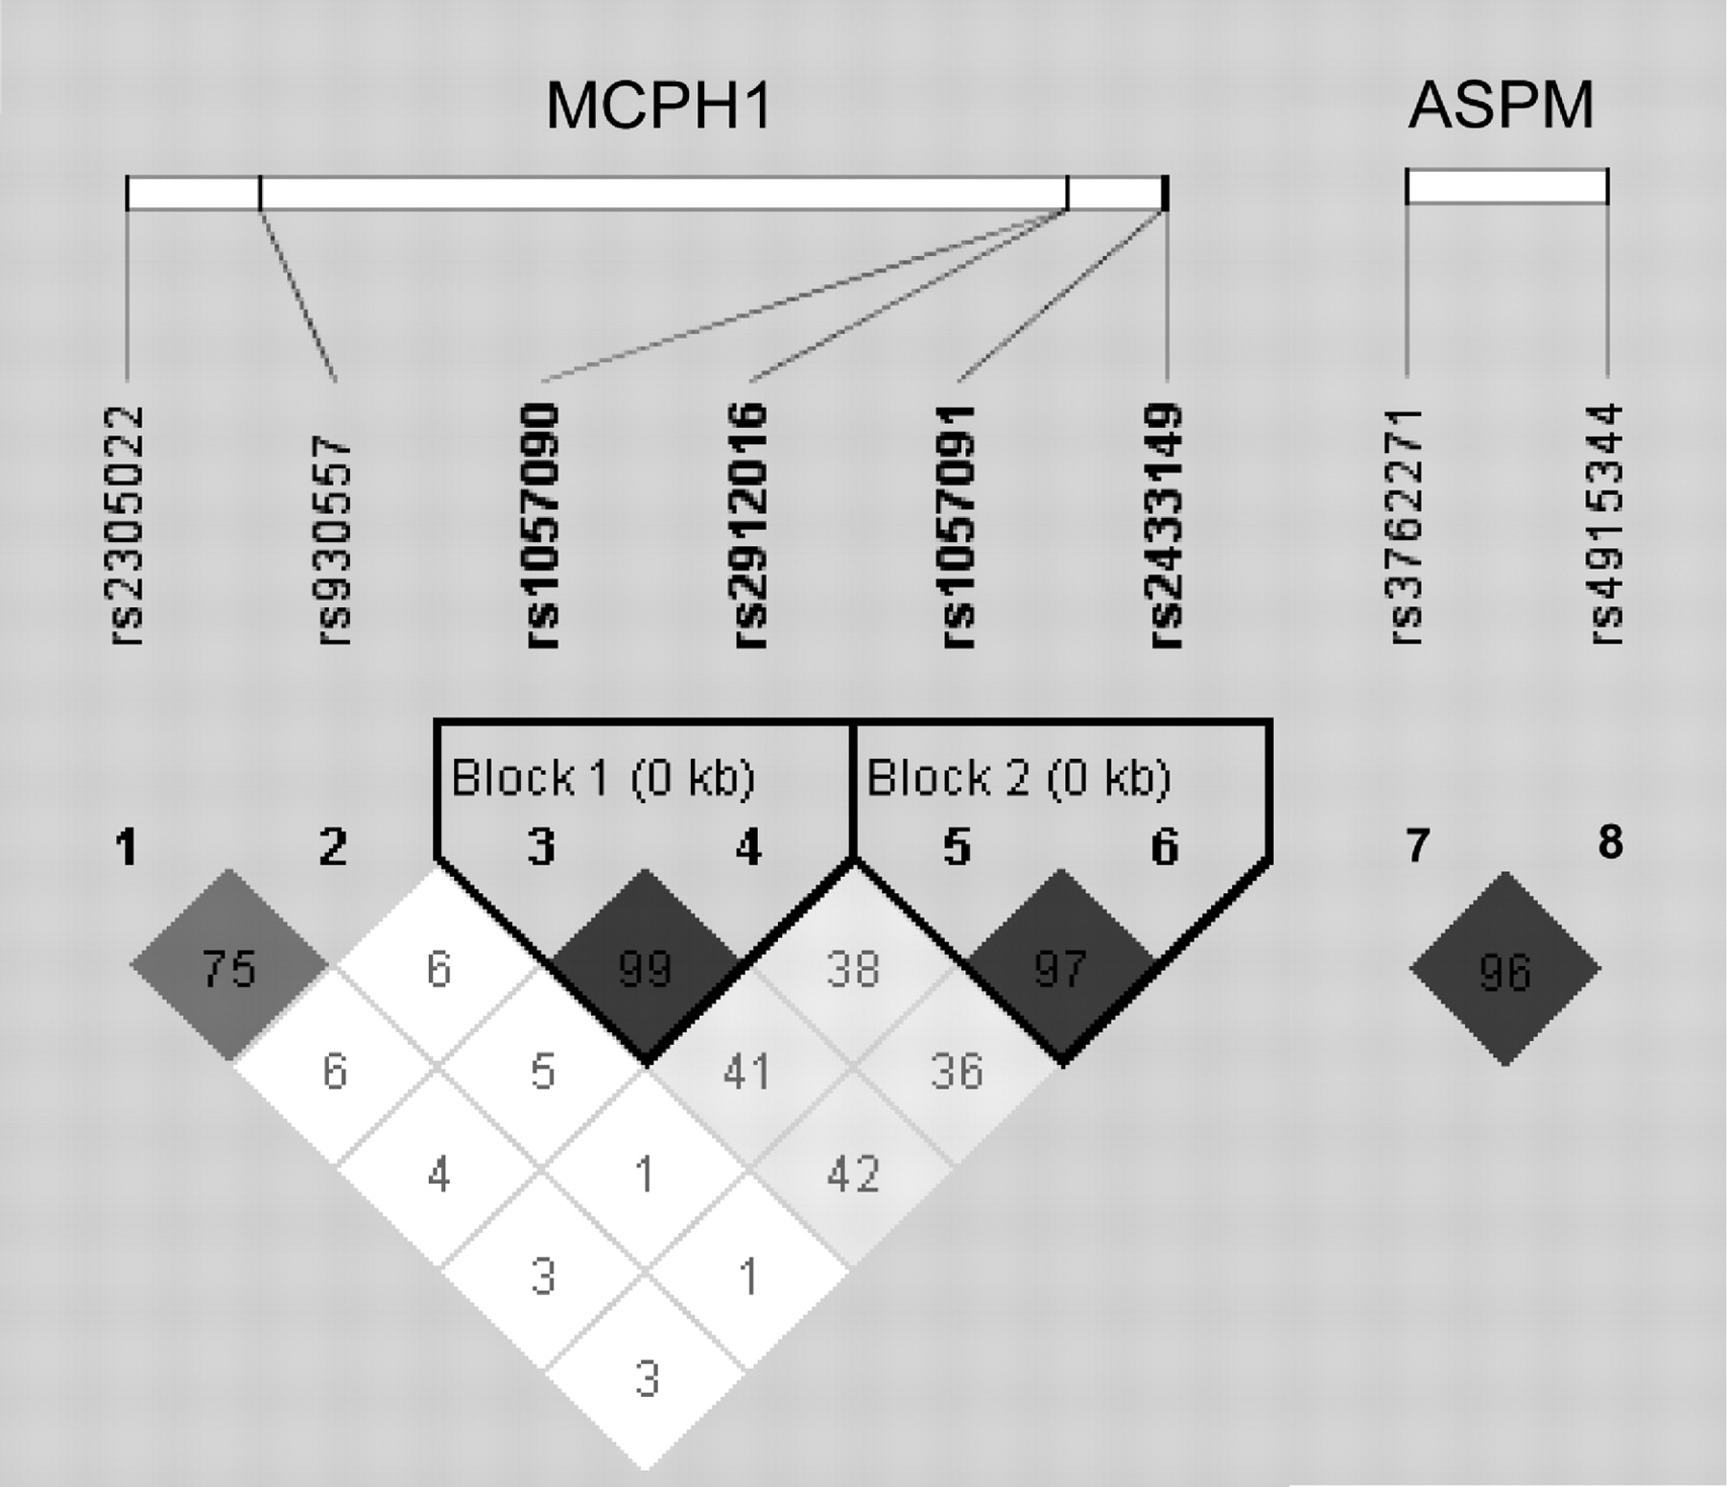
Figure 1. Linkage disequilibrium (LD) plots of the single nucleotide polymorphisms (SNPs) used in this study. We ...
Notes:
Figure 1. Linkage disequilibrium (LD) plots of the single nucleotide polymorphisms (SNPs) used in this study. We constructed the plots with the program Haploview (29), the triangles are the LD values calculated using the D′ measurement. The haplotype blocks were defined using an algorithm which creates the 95% confidence boundaries on D’ to define SNP pairs in strong LD.
Unless provided in the caption above, the following copyright applies to the content of this slide: © The Author 2008. Published by Oxford University Press. All rights reserved. For Permissions, please email: journals.permissions@oxfordjournals.org

Slide 3
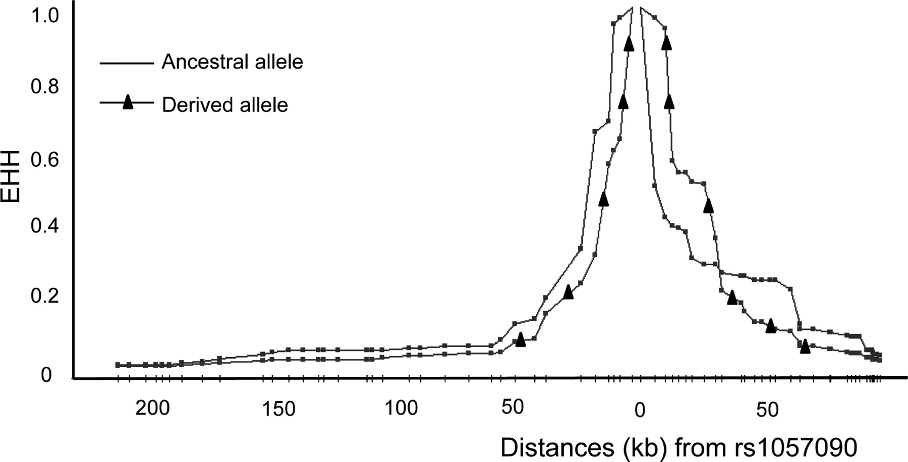
Figure 3. EHH (extended haplotype homozygosity) decay plot around rs1057090 in HapMap ASN (Chinese + Japanese) ...
Notes:
Figure 3. EHH (extended haplotype homozygosity) decay plot around rs1057090 in HapMap ASN (Chinese + Japanese) population. The figure was created by using Haplotter (38). The line with triangles represents the derived C allele, while the line without triangles represents the ancestral T allele. Each dot on the line represents a single nucleotide polymorphism(SNP). The distances (kb) from the rs1057090 is displayed in the x-axis, and the EHH values are shown in the y-axis. The EHH of the derived allele decays as rapidly as that of the ancestral allele, showing no recent selection signal.
Unless provided in the caption above, the following copyright applies to the content of this slide: © The Author 2008. Published by Oxford University Press. All rights reserved. For Permissions, please email: journals.permissions@oxfordjournals.org

