Slide 1
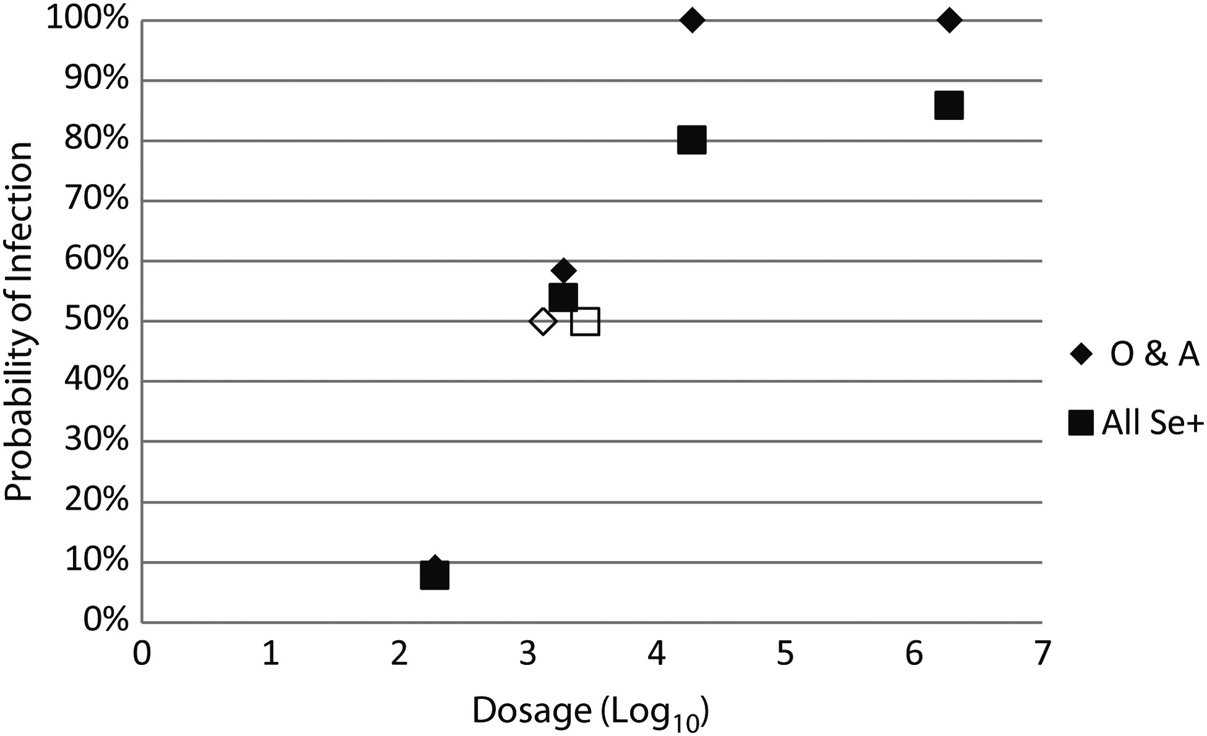
Figure 1. Probability of infection based upon inoculum dosage. The infection frequency observed for secretor-positive ...
Notes:
Figure 1. Probability of infection based upon inoculum dosage. The infection frequency observed for secretor-positive (Se+) persons who were blood group O or A or any blood group (All Se+) is shown for each dosage group expressed as log10 genomic equivalents, where 1 reverse transcription polymerase chain reaction unit is approximately 400 genomic equivalents. The open boxes represent the calculated 50% human infectious dose estimates, and the closed boxes represent observed infection frequencies.
Unless provided in the caption above, the following copyright applies to the content of this slide: © The Author 2013. Published by Oxford University Press on behalf of the Infectious Diseases Society of America. All rights reserved. For Permissions, please e-mail: journals.permissions@oup.com.

