Slide 1
Fig. 1. Example of the chromatogram analyzed by the EMP software. (A) The original chromatogram and (B) the ...
Notes:
Fig. 1. Example of the chromatogram analyzed by the EMP software. (A) The original chromatogram and (B) the chromatogram after the analysis.
Unless provided in the caption above, the following copyright applies to the content of this slide: © The Author 2009. Published by Oxford University Press. All rights reserved. For Permissions, please email: journals.permissions@oxfordjournals.org

Slide 2
Fig. 2. The three components of the chromatogram (signal, random and systemic noise) and their projection onto the ...
Notes:
Fig. 2. The three components of the chromatogram (signal, random and systemic noise) and their projection onto the (t, y) plane. In (A), blue dots represent the sum of all y(t, m) at each t. Green open circles represent the sum of all signals, here sum of all y(t, m) with p(t, m) > 0.01. Red triangles represent the sum of random noise, here sum of all y(t, m) with pr(t, m) ≤ 0.01. Black stars represent the sum of systemic noise, here y(t, m) with pq(t, m) ≤ 0.01. (B) The sum of all the y(t, m) which, after the spike elimination, are still assigned to a peak.
Unless provided in the caption above, the following copyright applies to the content of this slide: © The Author 2009. Published by Oxford University Press. All rights reserved. For Permissions, please email: journals.permissions@oxfordjournals.org

Slide 3
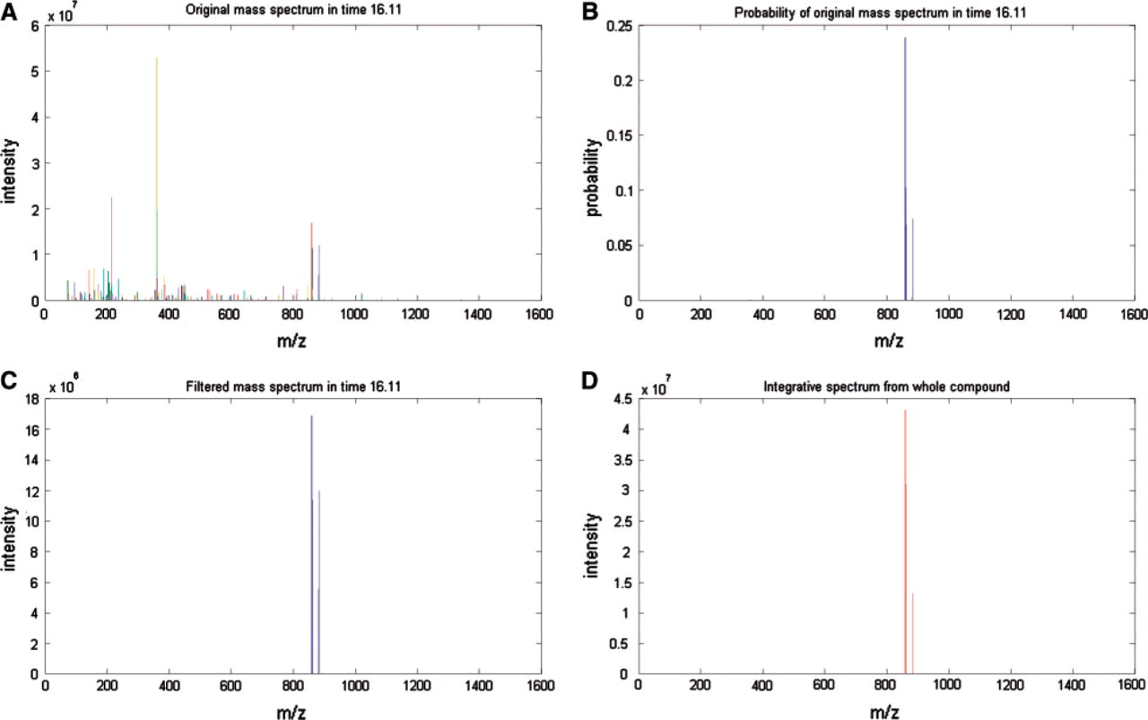
Fig. 3. Results for the time t = 16.11. (A) Raw spectrometer output. (B) Probability of the signal to be a peak p(t, ...
Notes:
Fig. 3. Results for the time t = 16.11. (A) Raw spectrometer output. (B) Probability of the signal to be a peak p(t, m). (C) The sum of y(t, m) in m positions of most probable signals. (D) Integral spectrum showing the area under the peaks.
Unless provided in the caption above, the following copyright applies to the content of this slide: © The Author 2009. Published by Oxford University Press. All rights reserved. For Permissions, please email: journals.permissions@oxfordjournals.org

Slide 4
Fig. 4. Example of the output table produced by the EMP software. It shows one compound and its five peaks with their ...
Notes:
Fig. 4. Example of the output table produced by the EMP software. It shows one compound and its five peaks with their masses (Mass), probabilities (CF), the relative content of the compound in sample, the relative content of the peaks in this compound and the statistical parameters of the peaks.
Unless provided in the caption above, the following copyright applies to the content of this slide: © The Author 2009. Published by Oxford University Press. All rights reserved. For Permissions, please email: journals.permissions@oxfordjournals.org

