Slide 1
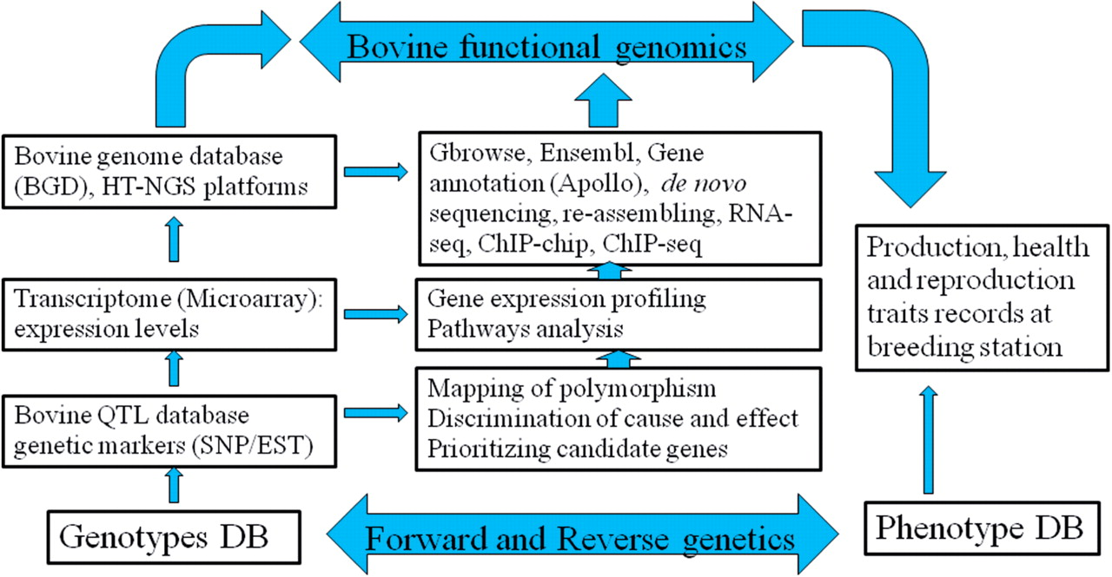
Figure 1: Central dogma of forward and reverse genetics in bovine functional genomics.
Notes:
Figure 1: Central dogma of forward and reverse genetics in bovine functional genomics.
Unless provided in the caption above, the following copyright applies to the content of this slide: © The Author 2011. Published by Oxford University Press. All rights reserved. For permissions, please email: journals.permissions@oup.com

