Slide 1
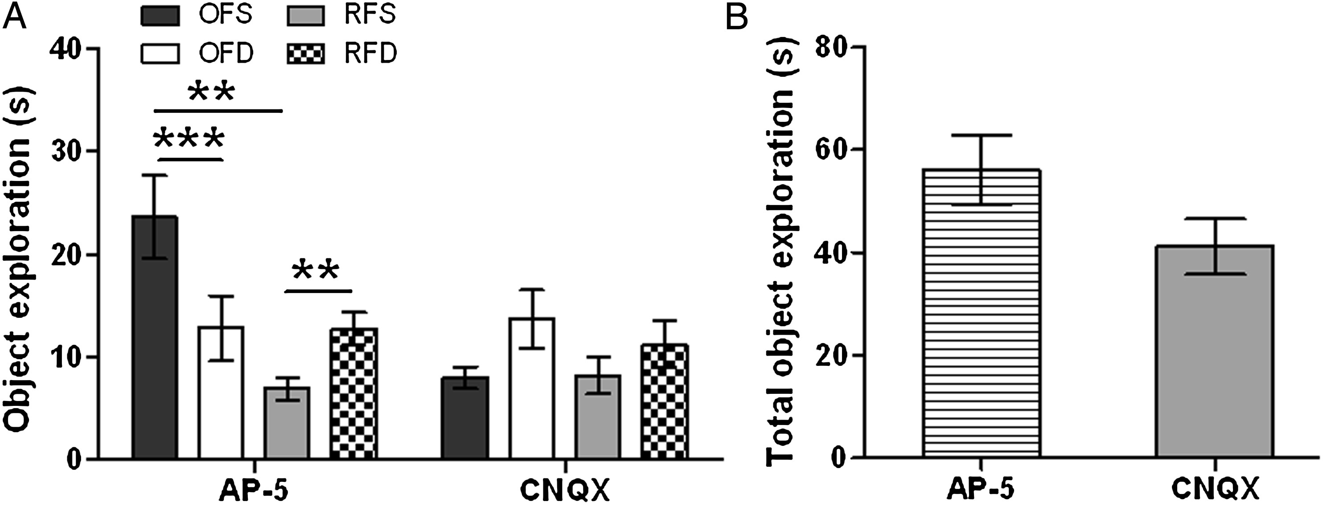
Figure 3. Experiment 2: Effect of AP-5 or CNQX injection into the mPFC of animals with a contralateral lesion of the ...
Notes:
Figure 3. Experiment 2: Effect of AP-5 or CNQX injection into the mPFC of animals with a contralateral lesion of the CA3 area (disconnection model). (A) The AP-5 injection group explored OFS more than OFD, and RFD more than RFS. This opposite exploration pattern suggests the existence of an interaction between the “where” and “when” components. In contrast, the CNQX-injected rats did not show this exploration pattern. (B) No significant group difference in total time of object exploration in the test trial was found in animals administered the glutamate antagonists into the mPFC. Values are presented as mean ± SEM. *P < 0.05, **P < 0.01, ***P < 0.001 compared with the group.
Unless provided in the caption above, the following copyright applies to the content of this slide: © The Author 2015. Published by Oxford University Press. All rights reserved. For Permissions, please e-mail: journals.permissions@oup.com

Slide 2
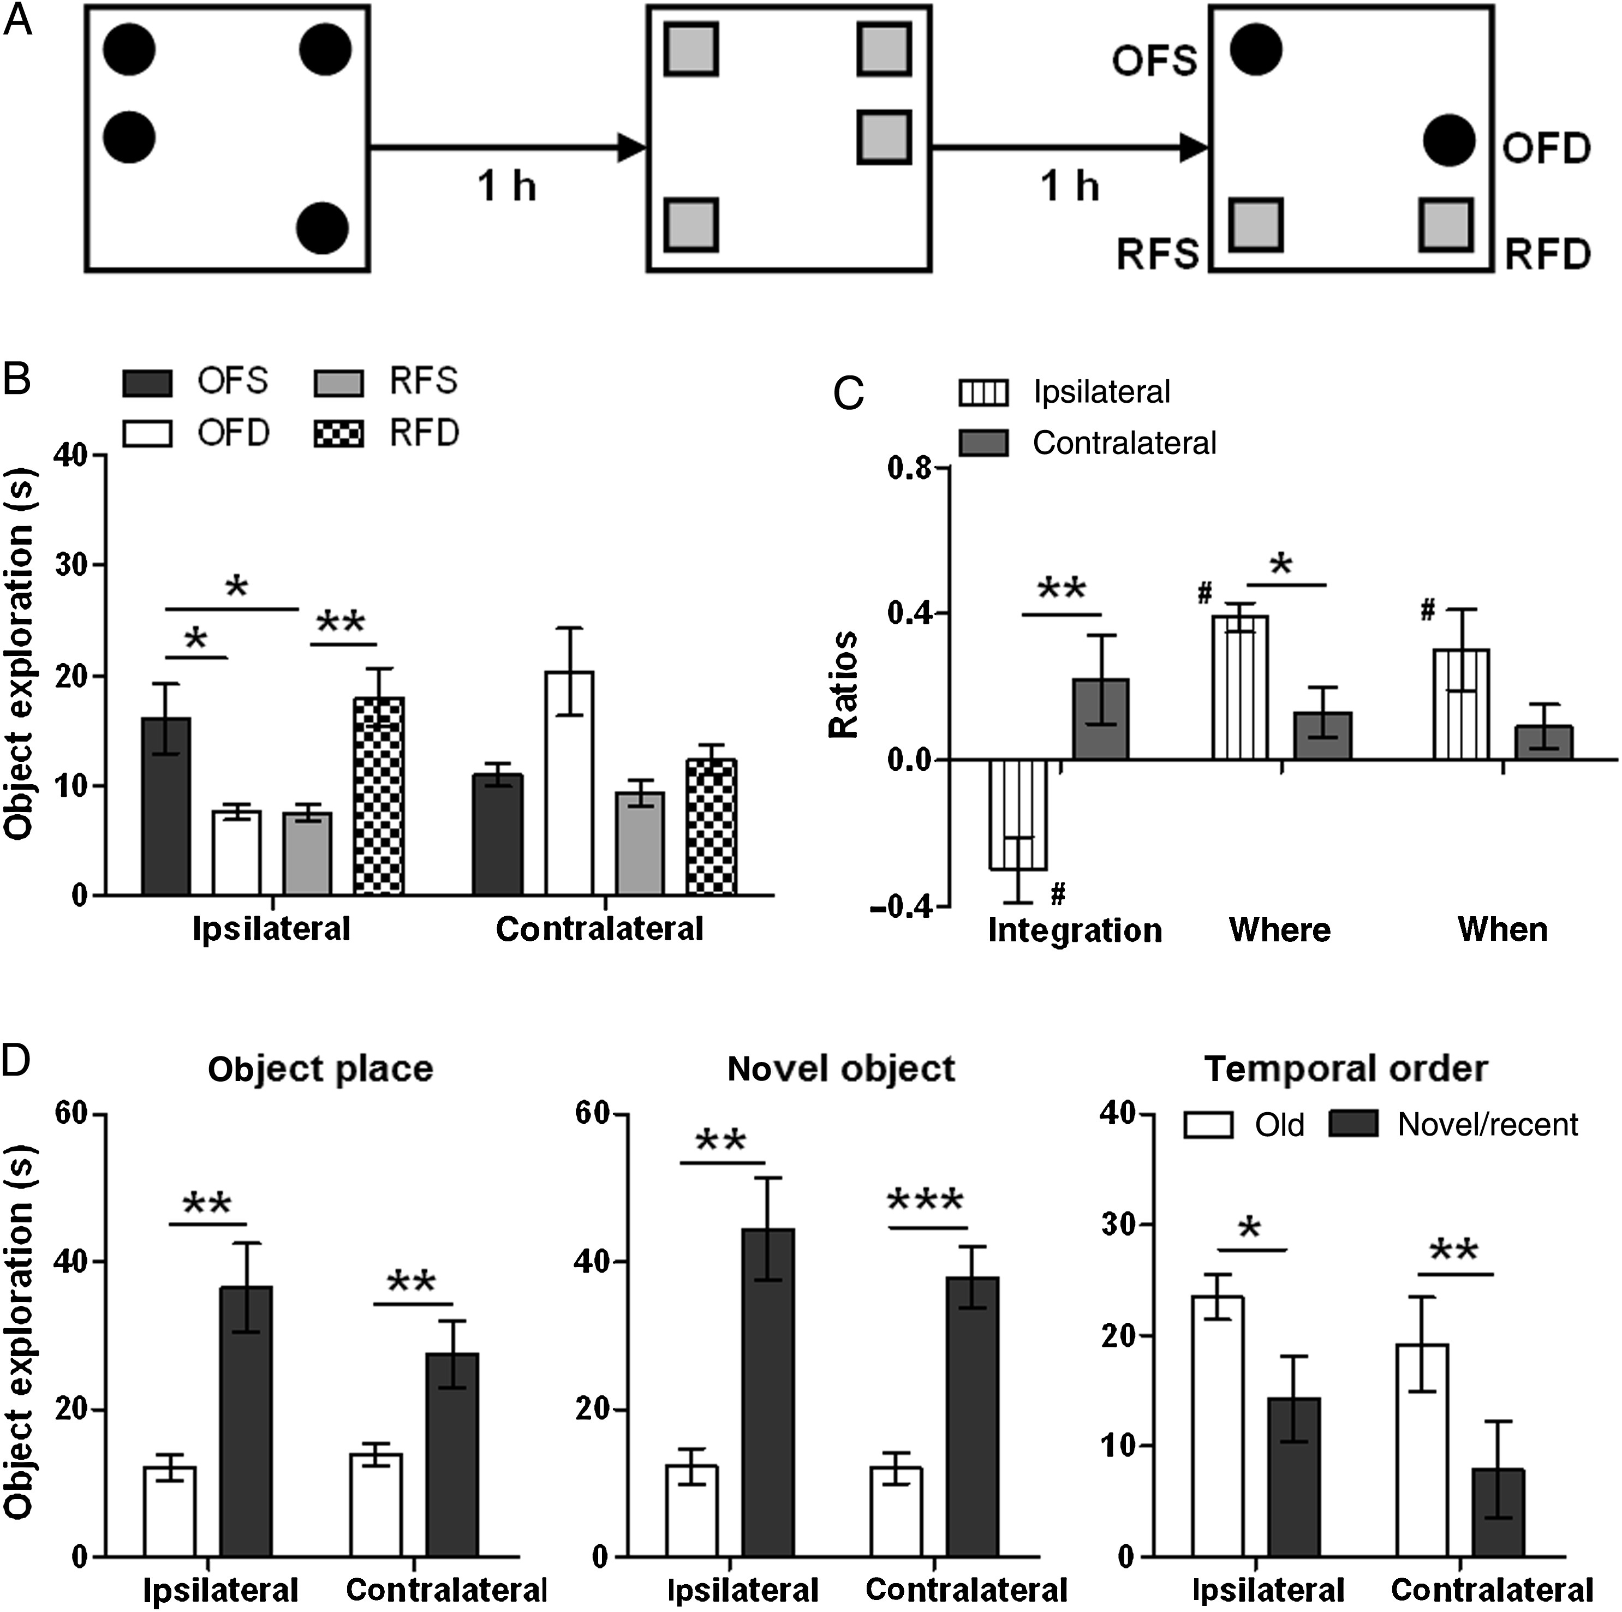
Figure 2. Experiment 1: Effects of ipsilateral and contralateral (disconnection) lesion of mPFC and CA3 region on ...
Notes:
Figure 2. Experiment 1: Effects of ipsilateral and contralateral (disconnection) lesion of mPFC and CA3 region on episodic-like memory and object recognition tests. (A) Episodic-like memory paradigm: Two sets of objects were used (represented as black circles and gray squares, counterbalanced for sample trials 1 and 2). In the test trial, rats explore the displaced circle less, but the displaced square more, than the respective stationary objects. OFS, old-familiar stationary object; OFD, old-familiar displaced object; RFS, recent-familiar stationary object; RFD, recent-familiar displaced object. Locations for placing objects are semirandomly selected based on the test design (see Materials and Methods). (B) The mPFC + CA3 ipsilateral lesion rats exhibited this pattern (which reflects episodic memory), while the mPFC + CA3 contralateral lesion rats did not. (C) The mPFC + CA3 ipsilateral lesion rats had lower “integration” and higher “where” ratios than the contralateral lesion group. (D) Both groups showed intact memories for place of object (where), object identity (what), and temporal order (when). Values are presented as mean ± SEM. *P < 0.05, **P < 0.01, ***P < 0.001 compared with the group; #P < 0.05 compared with zero value.
Unless provided in the caption above, the following copyright applies to the content of this slide: © The Author 2015. Published by Oxford University Press. All rights reserved. For Permissions, please e-mail: journals.permissions@oup.com

Slide 3
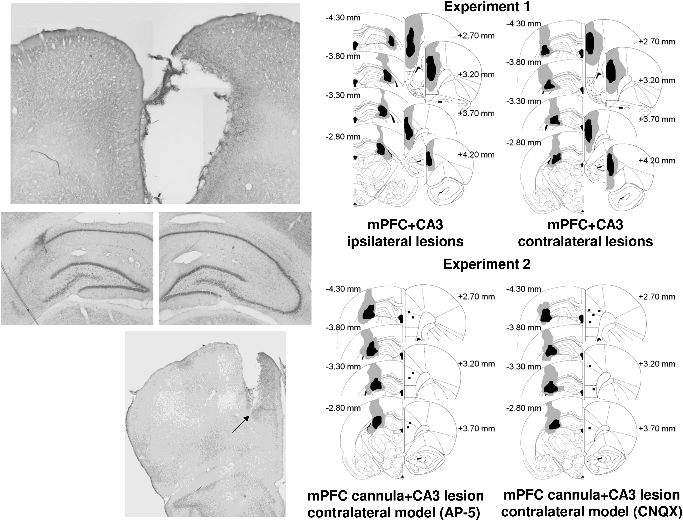
Figure 1. Left: Representative photomicrographs of lesions in the medial prefrontal cortex (top), CA3 region (middle), ...
Notes:
Figure 1. Left: Representative photomicrographs of lesions in the medial prefrontal cortex (top), CA3 region (middle), and injection cannula tract (bottom). The middle part contains an intact side (right) and a lesion side (left) of the dorsal hippocampus CA3 region from the same section. The arrow in the bottom photo indicates the tip of an implanted cannula. Right: Schematic diagram of extent of lesions and sites of injection. The maximal and minimal extent of the lesions is depicted in black and gray, respectively. Both the right and left lesions are presented in one hemisphere. Numbers indicate approximate distance (mm) relative to bregma. Black squares in experiment 2 represent the centers of the tips of the implanted cannulae.
Unless provided in the caption above, the following copyright applies to the content of this slide: © The Author 2015. Published by Oxford University Press. All rights reserved. For Permissions, please e-mail: journals.permissions@oup.com

