Slide 1
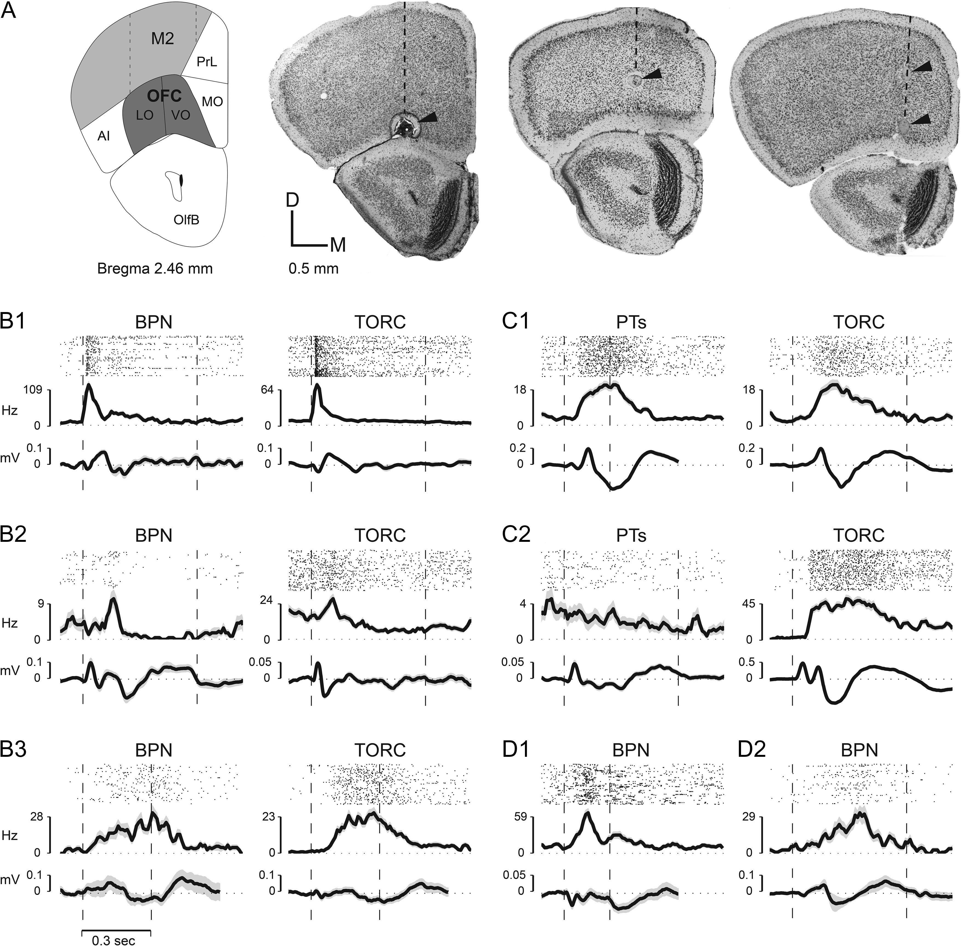
Figure 1. Single-units in OFC respond to sound. (A) Recording sites in OFC in LO and VO OFC. Top-left panel—coronal ...
Notes:
Figure 1. Single-units in OFC respond to sound. (A) Recording sites in OFC in LO and VO OFC. Top-left panel—coronal brain section (modified from Paxinos and Franklin 2013) from 2.46 mm anterior to bregma showing the position of LO/VO, lying ventral to M2 in this section (and below FrA in more anterior sections [not shown]). The adjacent 3 panels (in Fig. 1A) are coronal frontal cortex slices that illustrate the location of small electrolytic lesions placed near sites in LO/VO in 3 different mice where auditory responses were recorded. The dashed line in each brain section indicates the location of one electrode penetration, and the arrows point to the lesions made along that penetration. Each coronal section was cut at 50 μm thickness and stained with cresyl violet for Nissl bodies. (B) Three examples of single-unit raster plots, PSTHs and site-associated LFP responses in LO/VO to broadband noise stimuli (BPN) and TORCs (B1, B2, B3). The dashed vertical lines indicate stimulus onset and offset times. Note similar responses to both types of noise stimuli. (C) Two examples (C1, C2) of single-unit PSTH and site-associated LFP responses in LO/VO to pure tones (PT) and TORCs in LO/VO neurons. Note the strong excitatory response to broadband stimuli, and lack of response to tones shown in C2. (D) Two examples (D1, D2) of single-unit PSTH and site-associated LFP responses to BPN in M2 neurons. Acoustic stimuli used include tone stimuli (100–500 ms) that ranged over 3–6 octaves with 1/5 octave spacing between tones (in the range 1–64kHz) and were presented in randomized frequency order. BPN (100–500 ms, 2 octaves wide, i.e. 10–40 kHz) and TORCs (300 ms–3 s, 2–64 kHz) were also presented. Overall, we found non-selective OFC responses to sound, and with a few exceptions (C2), individual cells tended to have similar responses to all acoustic stimuli presented irrespective of stimulus type or duration (ranging from 200 ms [C1 PT, D1 BPN] to 1000 ms [C2 TORC]).
Unless provided in the caption above, the following copyright applies to the content of this slide: © The Author 2017. Published by Oxford University Press. All rights reserved. For Permissions, please e-mail: journals.permissions@oup.com

Slide 2
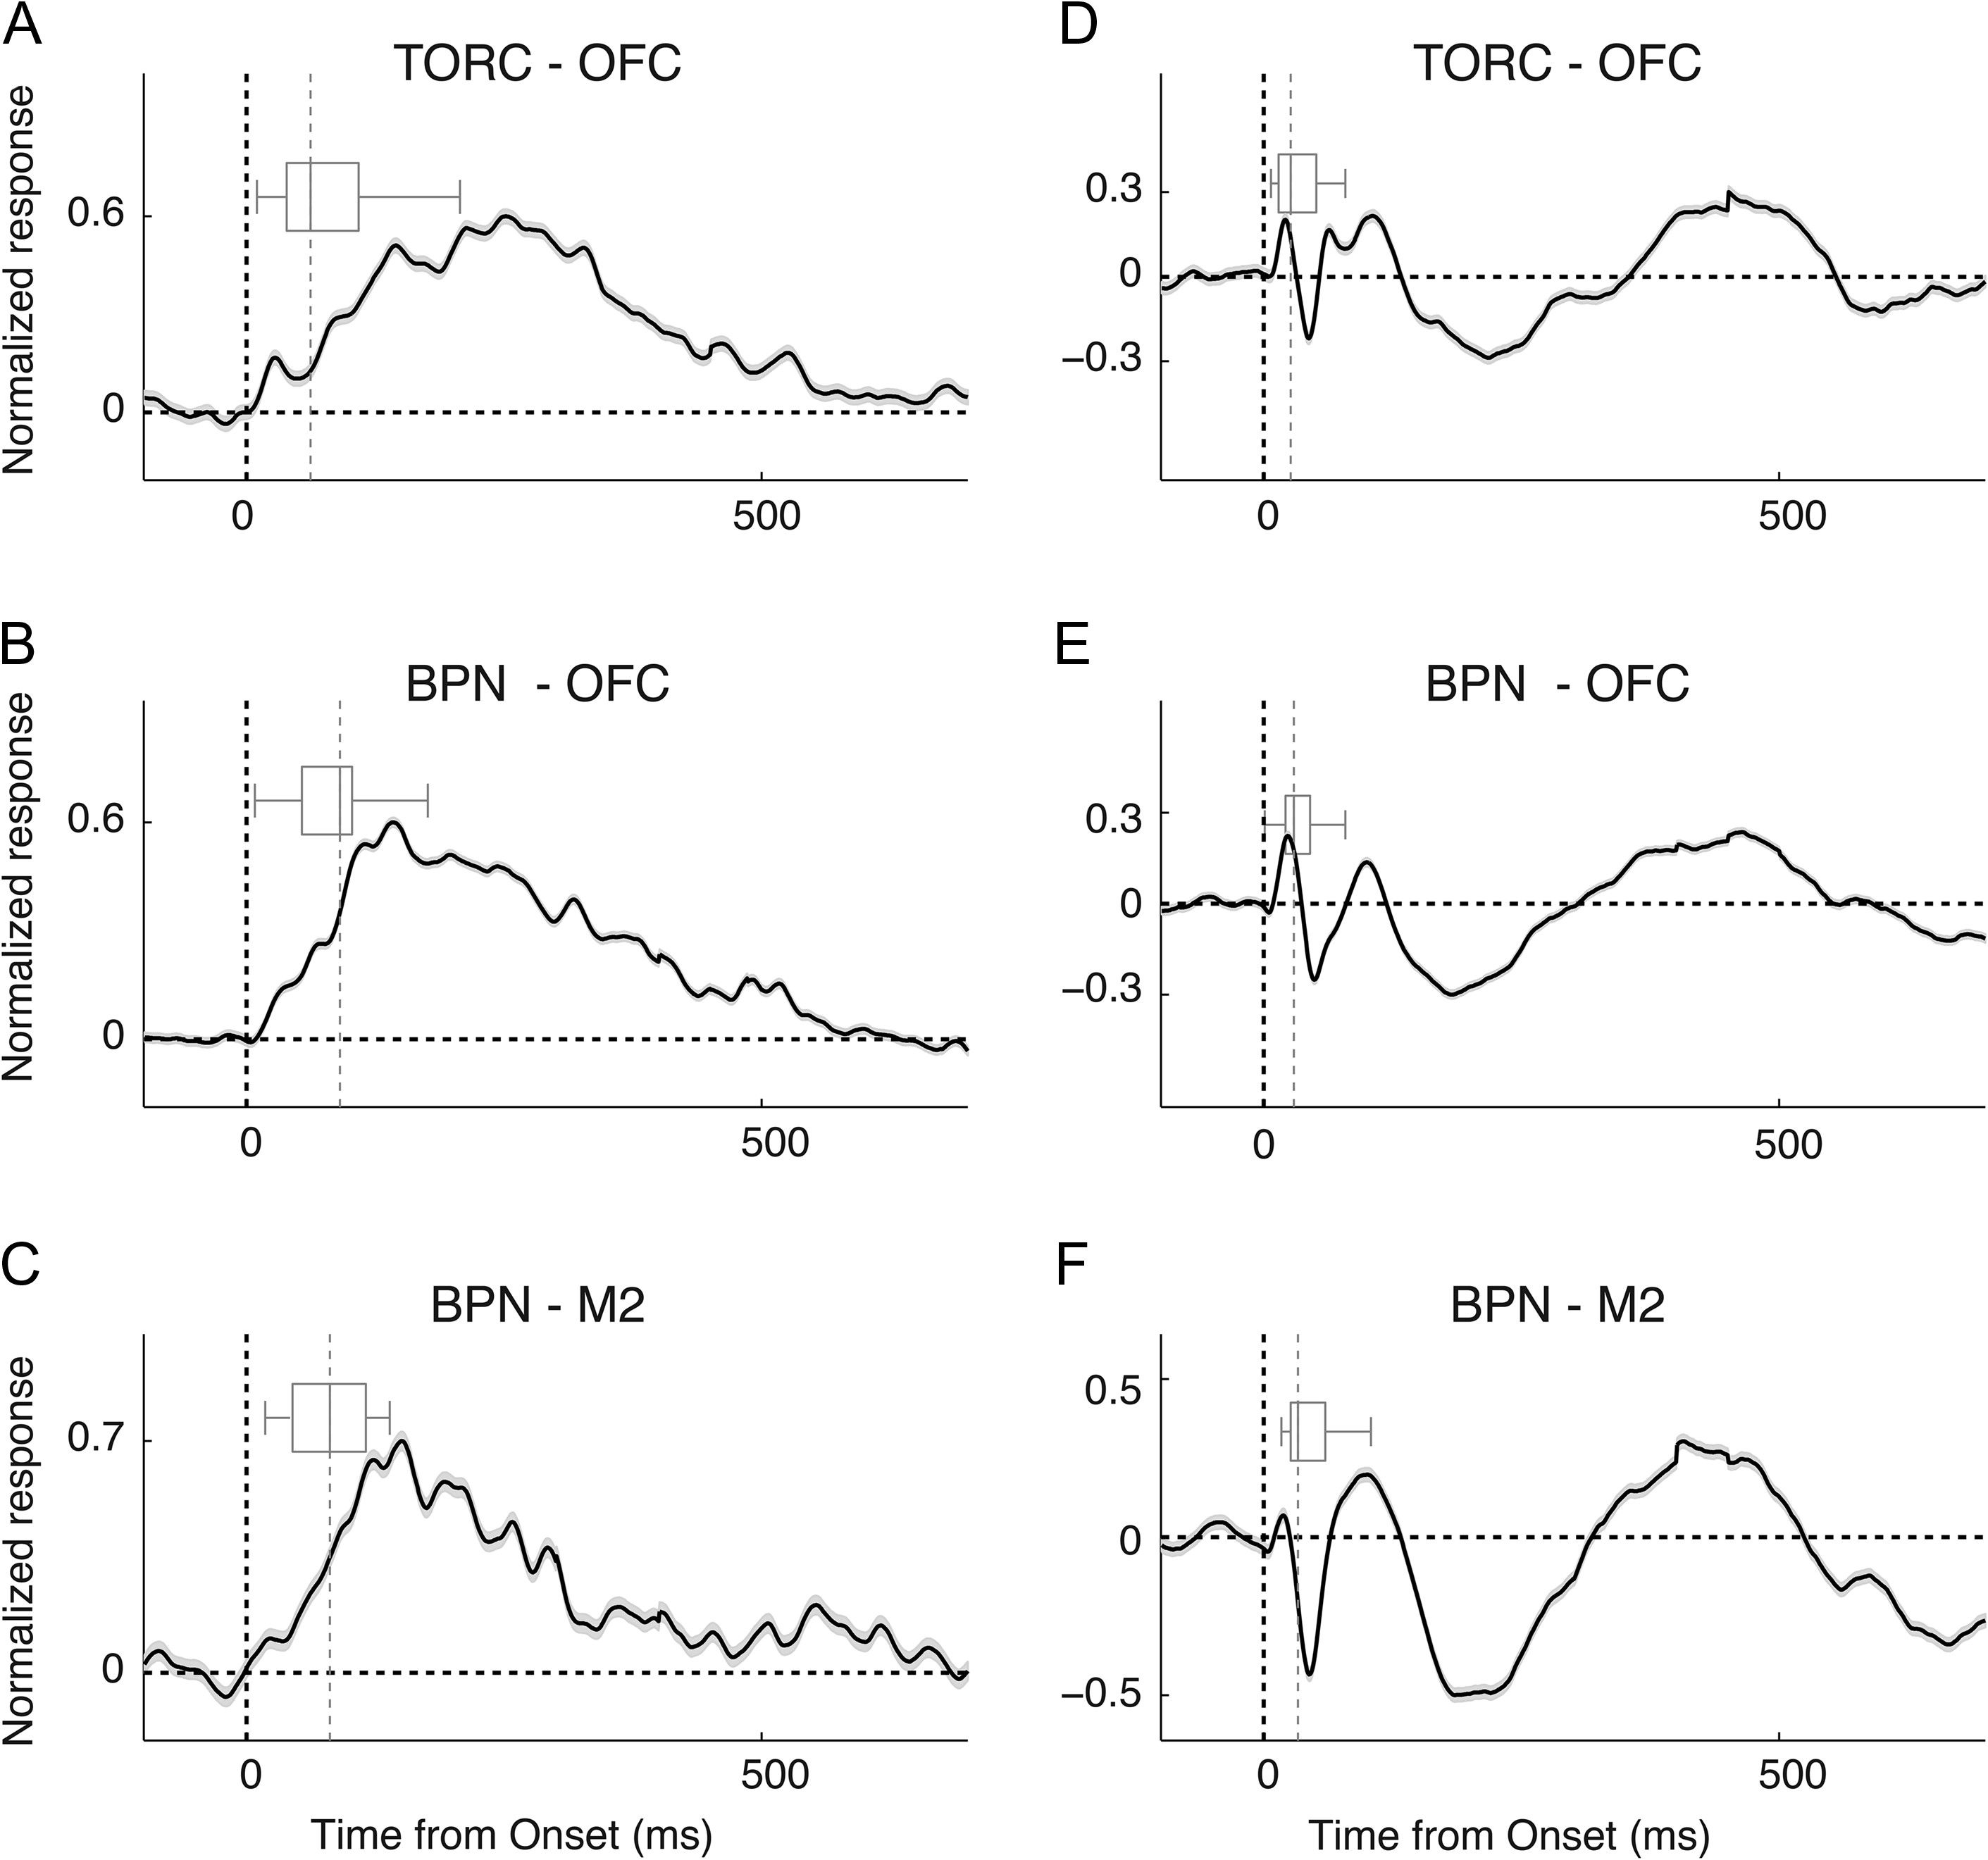
Figure 2 Average population responses to sound stimulation. Population average of single-unit PSTHs (A–C) and LFP ...
Notes:
Figure 2 Average population responses to sound stimulation. Population average of single-unit PSTHs (A–C) and LFP (D–F) responses. (A,D) Averaged single-unit/LFP responses to TORCs in LO/VO neurons; (B,E) averaged single-unit/LFP responses to BPN in LO/VO neurons; (C,F) averaged single-unit/LFP responses to BPN in M2/FrA neurons. The boxplot in each panel indicates the distribution of response latency. The dashed vertical lines indicate stimulus onset (black) and median latencies (gray).
Unless provided in the caption above, the following copyright applies to the content of this slide: © The Author 2017. Published by Oxford University Press. All rights reserved. For Permissions, please e-mail: journals.permissions@oup.com

Slide 3
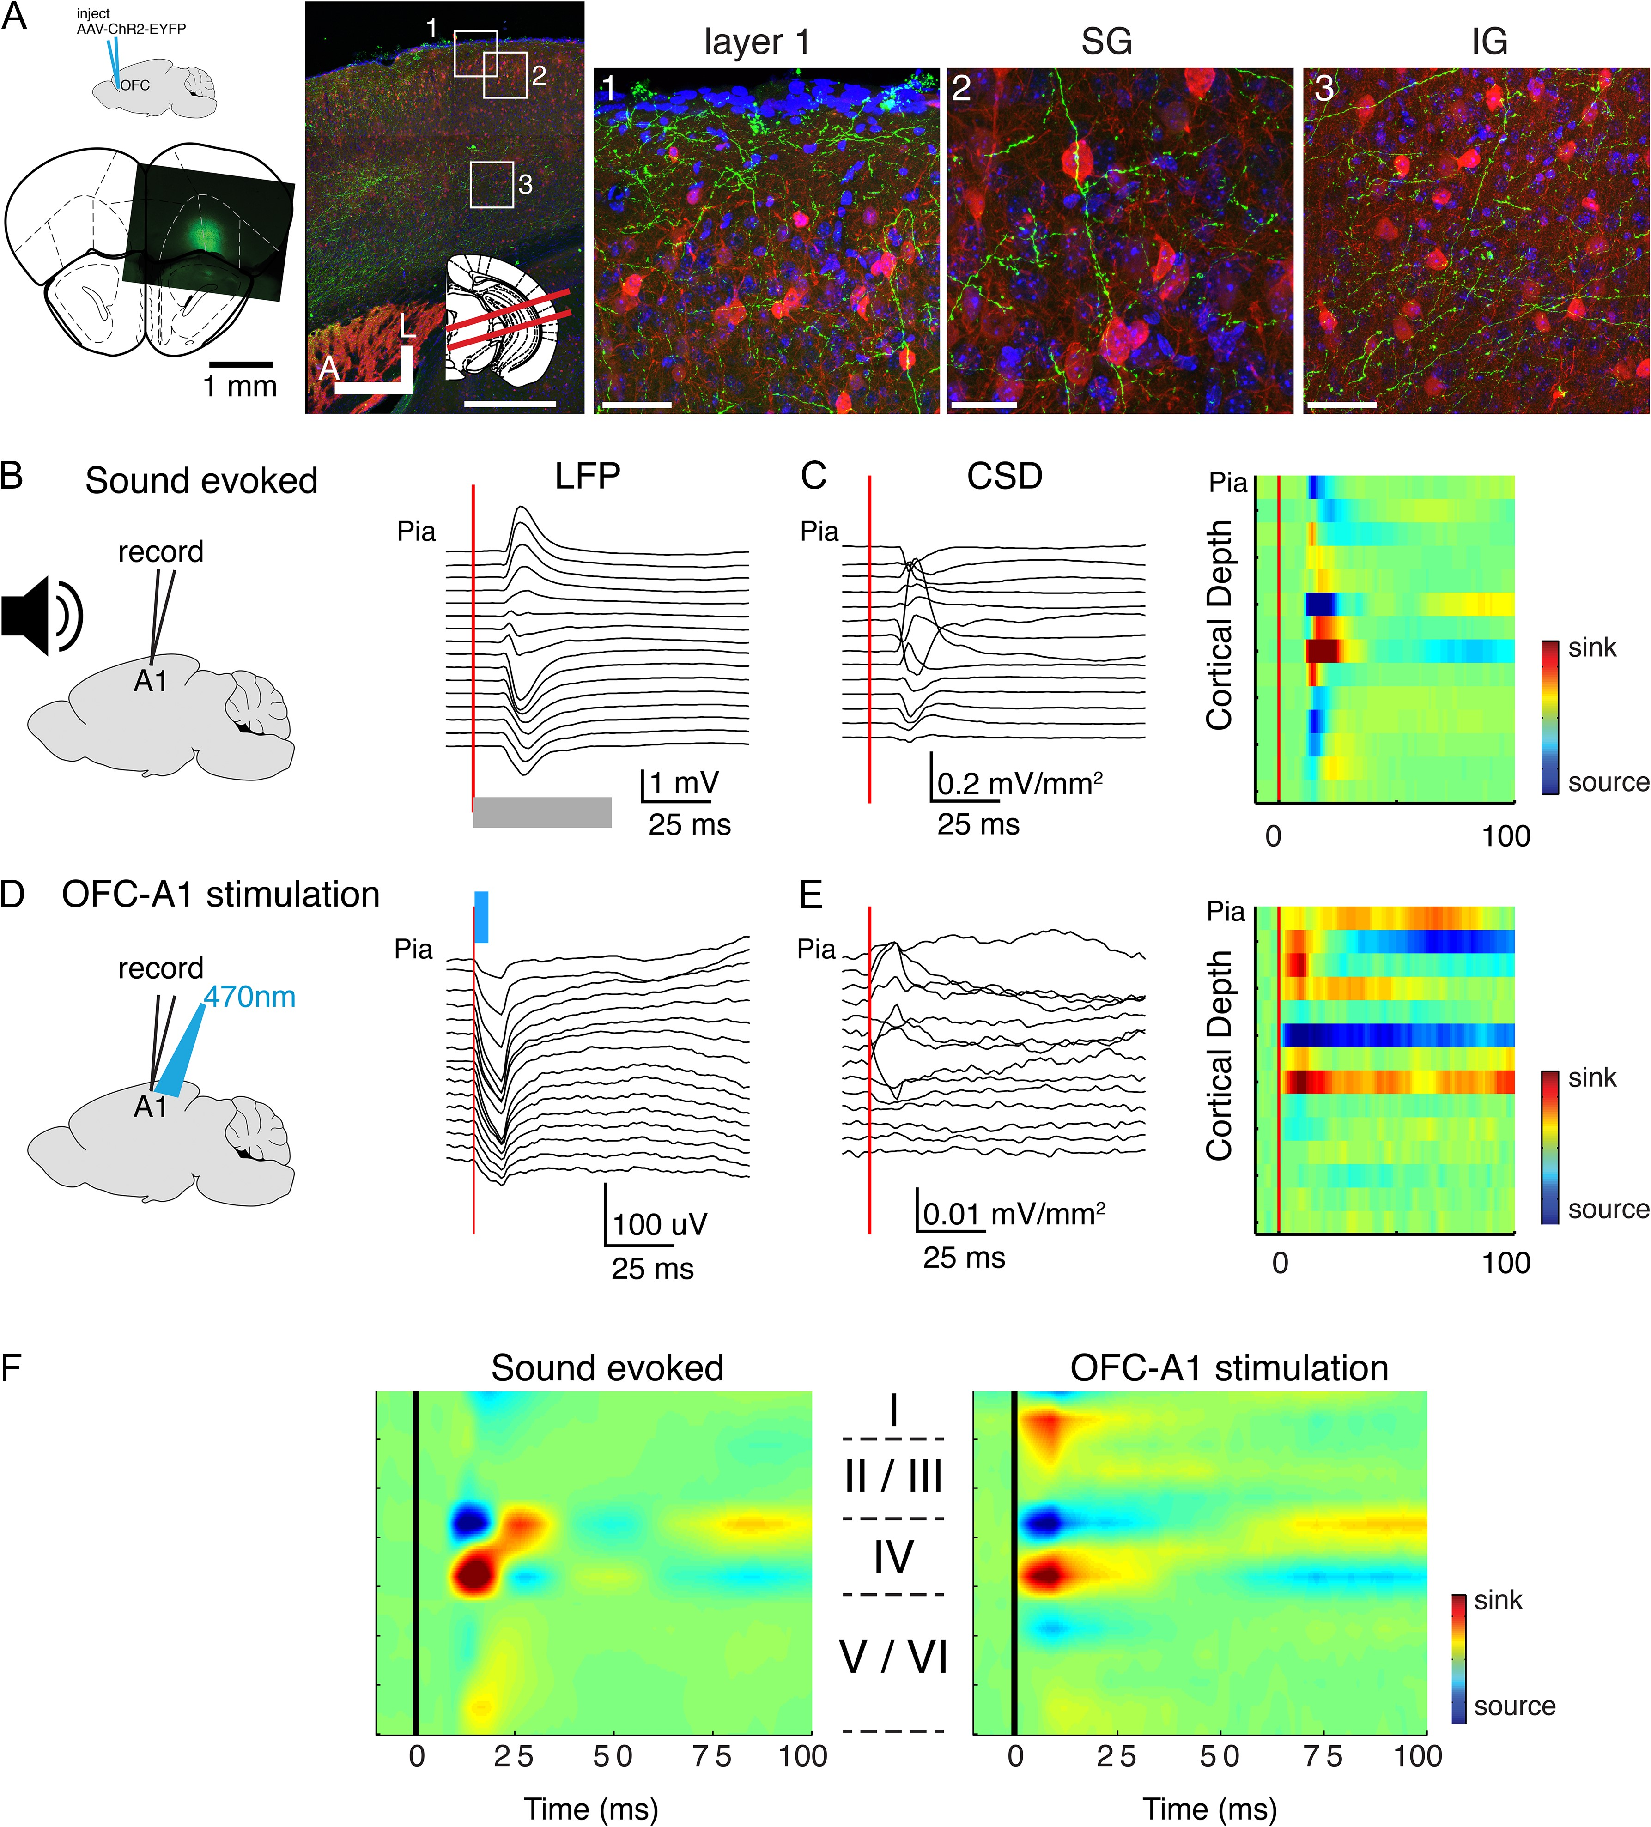
Figure 3. Optogenetic stimulation of OFC axons in vivo elicits activity in A1. (A) OFC axons are present in A1. Left: ...
Notes:
Figure 3. Optogenetic stimulation of OFC axons in vivo elicits activity in A1. (A) OFC axons are present in A1. Left: top: schematic shows that AAV-ChR2-EGFP was injected into OFC. Bottom: image indicating location of a representative injection site. Image on right shows brain slice through A1 visualizing OFC fibers in A1 (green). Inset: red lines indicate slice angle (15° from horizontal). Squares indicate regions of interest shown in 1–3. Green: labeled OFC axons in Layer 1 and upper L2/3. Blue: DAPI; red: Gad. Scale bar: 500 μm. (1) High magnification view of pial surface of A1. Scale bar: 50 μm. (2) High magnification view of L2/3 in A1. Scale bar: 25μm. (3) High magnification view of L5/6 in A1. Scale bar: 50 μm. (B) Example sound-evoked LFPs (ERPs) recorded from linear 16 channel array. Gray bar denotes sound onset and duration. (C) Sound-evoked CSD (left) and pseudocolor representation (right) derived from voltage traces in (B). (D) Example light-evoked ERPs recorded from same location as in (A). Light (470 nm) was targeted to the A1 recording location activating OFC terminals. Blue bar denotes light onset and duration. (E) Light-evoked CSD profile (left) and pseudocolor representation (right) derived from voltage traces in (D). (F) Population averages of auditory evoked (left) and optogenetically evoked (right) CSD profiles.
Unless provided in the caption above, the following copyright applies to the content of this slide: © The Author 2017. Published by Oxford University Press. All rights reserved. For Permissions, please e-mail: journals.permissions@oup.com

Slide 4
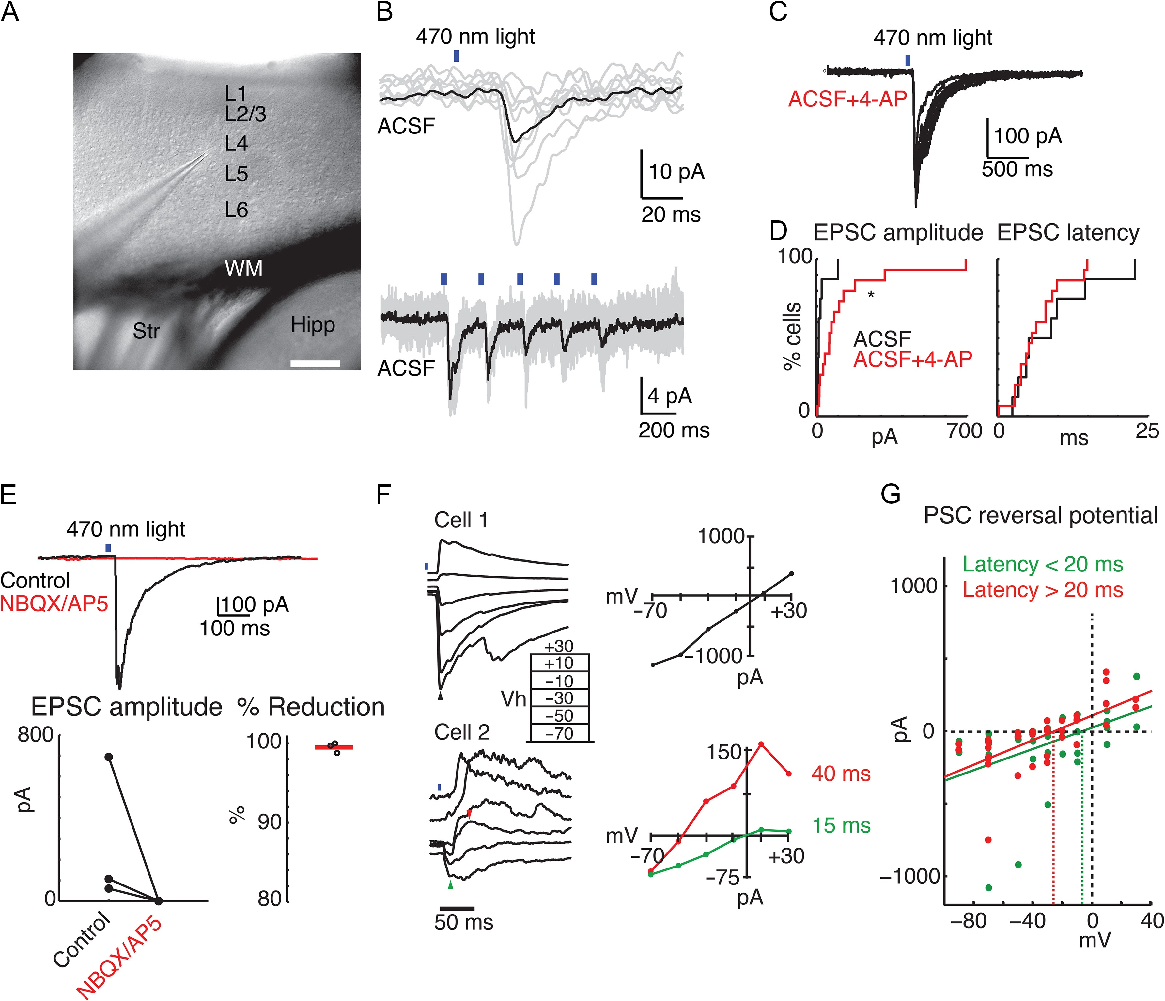
Figure 4. Optogenetic stimulation of OFC axons in vitro elicits EPSCs in A1 neurons. (A) Low-power infrared image of an ...
Notes:
Figure 4. Optogenetic stimulation of OFC axons in vitro elicits EPSCs in A1 neurons. (A) Low-power infrared image of an A1 TC slice. A neuron is being patched in L4. Scale bar 250 μm. (B) Upper trace, example of ChR2-evoked postsynaptic current (PSC) in the cell recorded from in A. Black trace is the mean of successive stimulation trials (gray traces). Lower trace, different cells, 5 Hz light stimulation elicited synchronous train of PSCs. Recordings done in normal ACSF, at a holding potential of −70 mV. (C) Recording performed in the presence of 4-AP. (D) Cumulative distribution functions of PSC amplitude (left) and onset latency (right) recorded from cells patched blindly in 500–600 μm A1 TC slices. Cells patched in normal ACSF are in black (N = 8) and cells patched in ACSF + 10–20 μM 4-AP are in red (N = 15). 4-AP significantly increased amplitudes (P = 0.023) but did not change latency of PSCs (P = 0.899). (E) Averaged response in a single cell before (black trace) and after (red trace) application of iGluR antagonists NBQX and AP5. The response was completely blocked by the iGluR antagonists. Below the averaged trace, summary plots show the amplitude of EPSCs before and after adding iGluR antagonists (left), and the percent reduction by iGluR antagonists (right) for n = 3 cells. 4-AP is present. (F) Reversal potentials obtained from blindly patched A1 cells (likely pyramidal). Top recording, single PSC with a reversal potential near 0 mV indicates monosynaptic glutamatergic transmission. Bottom recording, possible disynaptic response, having a fast component reversing near 0 mV (green triangle in the trace, green line in the IV plot) and a slower component (red triangle in the trace, red line in the IV plot) reversing near −50 mV (ca. ECl). Both recordings performed in the presence of 4-AP. (G) Summary of reversal potentials of early (0–20 ms) and late (20–100 ms) components of PSCs from n = 7 cells. Green and red dots indicate individual current amplitudes measured during the early and late time periods, respectively. Green and red diagonal lines are best linear fit for all individual early and late responses, respectively. Green and red dashed vertical lines indicate zero current intercept and thus the reversal potential of the component. Note that the reversal potential of the late component is more negative than that of the short-latency component.
Unless provided in the caption above, the following copyright applies to the content of this slide: © The Author 2017. Published by Oxford University Press. All rights reserved. For Permissions, please e-mail: journals.permissions@oup.com

Slide 5
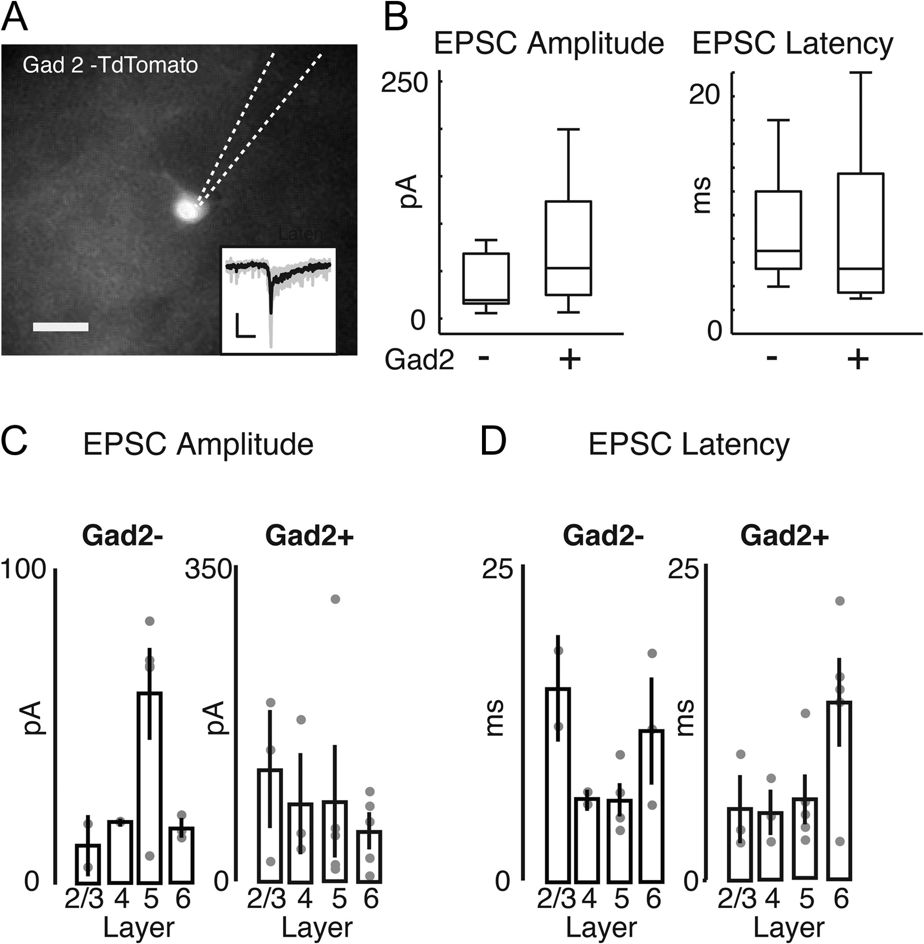
Figure 5. Short-latency EPCSs are evoked in both interneurons and pyramidal cells following optogenetic stimulation of ...
Notes:
Figure 5. Short-latency EPCSs are evoked in both interneurons and pyramidal cells following optogenetic stimulation of OFC axons. (A) Fluorescence image of a Td-Tomato expressing cell in a TC slice from Gad2-Td-tomato mouse, injected with AAV-ChR2 in the left OFC. Dotted lines show the outline of the recording pipette. Scale bar 10 μm. Inset trace shows that a light-evoked EPSC is from the same cell. Thus, light stimulation of OFC axons evokes EPSCs in interneurons in A1. (B) Boxplots of EPSC peak amplitude (left) and onset latency (right) of cells recorded in Gad-Td-Tomato mice that were Td-tomato+ (presumed interneurons) or Td-tomato negative with pyramidal morphology (presumed pyramidal cells). There are no significant differences between pyramidal cells and interneurons for either PSCs peak amplitude or latency (P > 0.05, rank-sum test; P = 0.054 for EPSC amplitude comparison). (C) Amplitude of EPSCs in Gad+ and Gad− neurons separated by recording lamina. Dots indicate values for individual cells, bars show mean ± SEM. (D) Onset Latency of EPSCs in Gad+ and Gad− neurons separated by recording lamina. Dots indicate values for individual cells, bars show mean ± SEM.
Unless provided in the caption above, the following copyright applies to the content of this slide: © The Author 2017. Published by Oxford University Press. All rights reserved. For Permissions, please e-mail: journals.permissions@oup.com

Slide 6
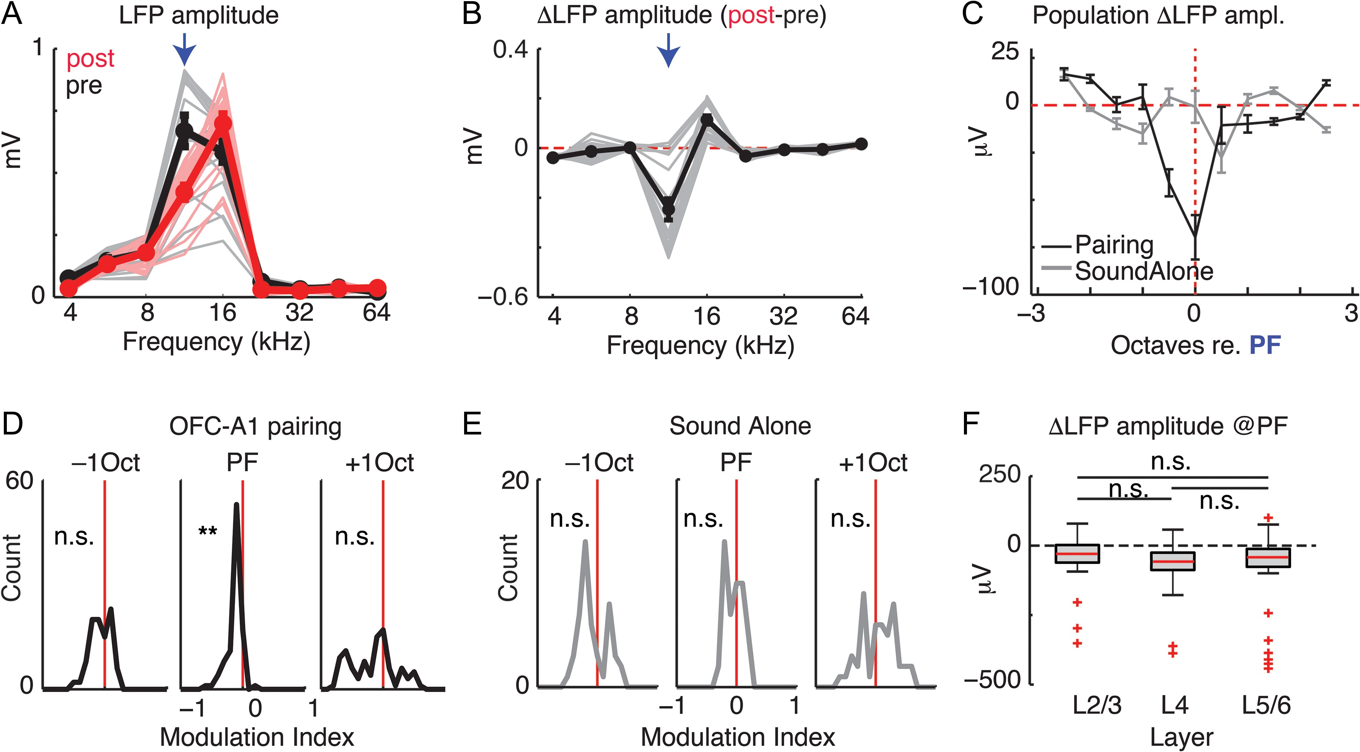
Figure 6. Pairing optogenetic stimulation of OFC axons in vivo with sounds changes sound-evoked responses in A1. (A) ...
Notes:
Figure 6. Pairing optogenetic stimulation of OFC axons in vivo with sounds changes sound-evoked responses in A1. (A) Sound-evoked LFP amplitude (peak-to-peak) as a function of sound frequency before (black) and after (red) pairing selective optogenetic stimulation of OFC axons with 12 kHz (arrow). Thin lines indicate responses averaged across repeats recorded on each channels before (gray, pre) and after (red, post) OFC-sound pairing episode. Thick lines are the mean responses across all channels. Error bars: SEM. (B) Difference (post–pre) in response amplitude to sounds after OFC optical pairing episode. Thin gray lines are the changes on each channel; thick black line: average across all channels. Error bars: SEM. Arrow indicates PF of 12 kHz. (C) Average changes in response amplitude (post–pre) for pairing experiments (black, filled circles) and sound alone experiments (gray, open circles) for the population (n = 6 animals; 96 recording channels). The frequency axis was normalized to the PF in every experiment. (D) Modulation indices for changes in response amplitude across responsive channels at the PF and ±1 octave away. **P < 10−7; n.s., not significant P > 0.1. (E) Modulation indices for changes in response amplitude across responsive channels for sound alone control; n.s., not significant P > 0.1. (F) Changes in response amplitude at the PF grouped by laminar position. LFP amplitudes at the PF are reduced in each lamina (P 0.1.
Unless provided in the caption above, the following copyright applies to the content of this slide: © The Author 2017. Published by Oxford University Press. All rights reserved. For Permissions, please e-mail: journals.permissions@oup.com

