Slide 1
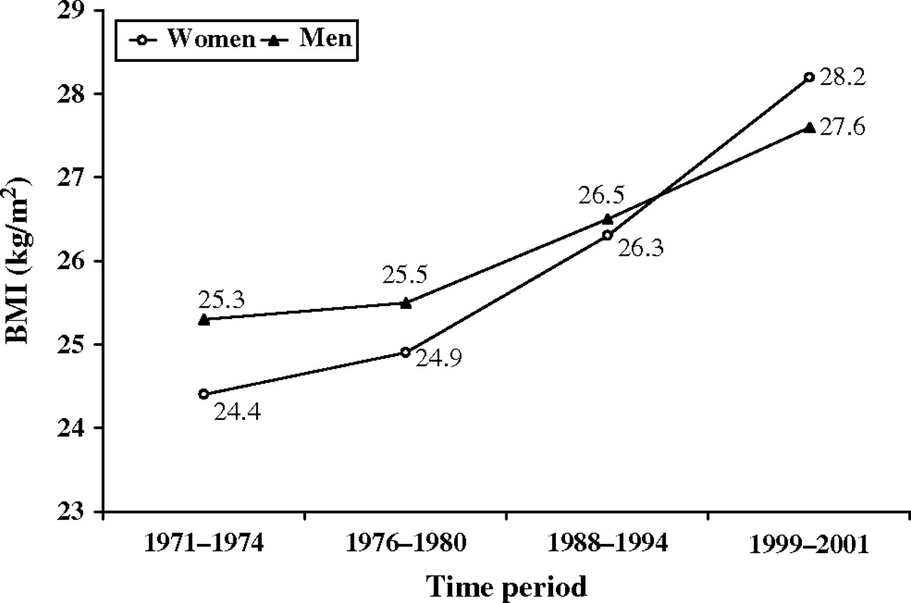
FIGURE 1. Trends in body mass index (BMI) means among US men and women, National Health and Nutrition Examination ...
Notes:
FIGURE 1. Trends in body mass index (BMI) means among US men and women, National Health and Nutrition Examination Survey, 1971–2001. (Source: 40).
Unless provided in the caption above, the following copyright applies to the content of this slide: Epidemiologic Reviews Copyright © 2007 by the Johns Hopkins Bloomberg School of Public Health All rights reserved; printed in U.S.A.

Slide 2
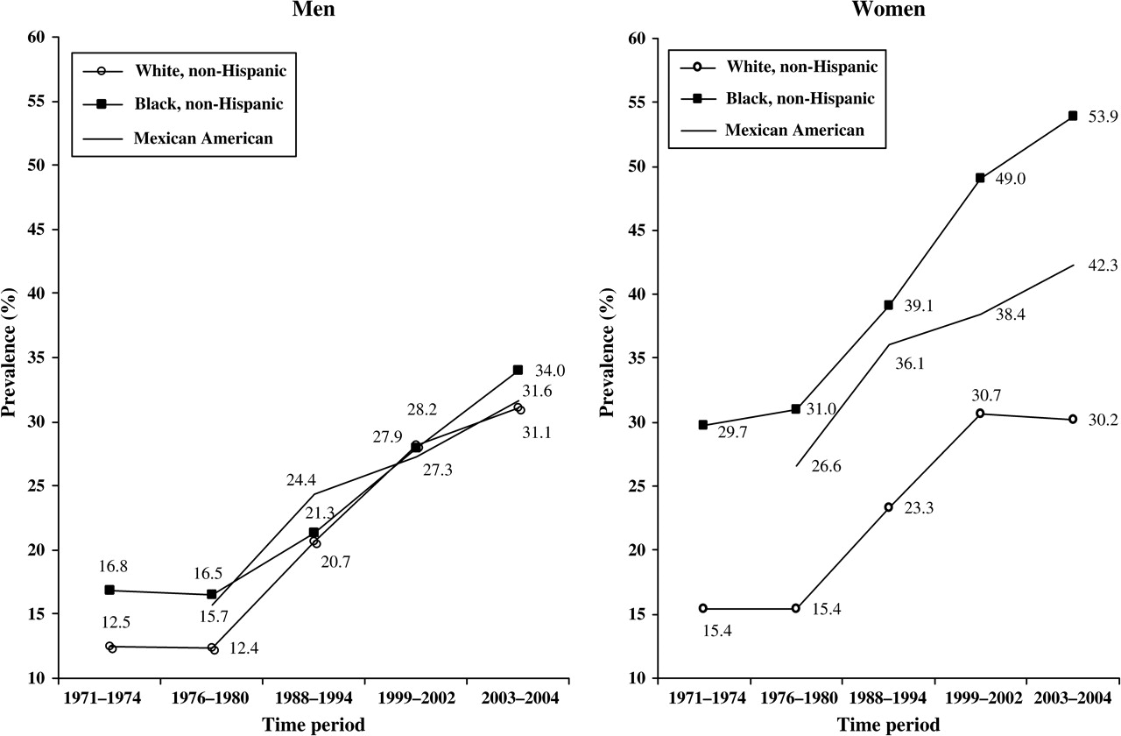
FIGURE 2. Trends in the prevalence of obesity (body mass index ≥30 kg/m ² ) in US adults, by gender and ...
Notes:
FIGURE 2. Trends in the prevalence of obesity (body mass index ≥30 kg/m 2 ) in US adults, by gender and ethnicity, National Health and Nutrition Examination Survey, 1971–2004. (Sources: 2, 54).
Unless provided in the caption above, the following copyright applies to the content of this slide: Epidemiologic Reviews Copyright © 2007 by the Johns Hopkins Bloomberg School of Public Health All rights reserved; printed in U.S.A.

Slide 3
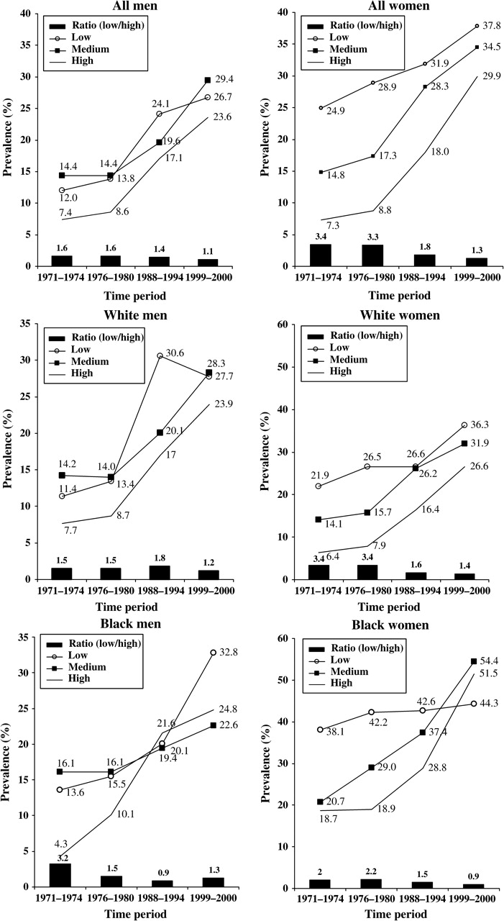
FIGURE 3. Trends in the socioeconomic status (SES) disparities of obesity in US adults during the National Health and ...
Notes:
FIGURE 3. Trends in the socioeconomic status (SES) disparities of obesity in US adults during the National Health and Nutrition Examination Survey, 1971–2000, by gender and ethnicity: prevalence of obesity (body mass index ≥30 kg/m 2 ) and low to high-SES ratio (i.e., prevalence in low-SES group/prevalence in high-SES group). (Source: 40).
Unless provided in the caption above, the following copyright applies to the content of this slide: Epidemiologic Reviews Copyright © 2007 by the Johns Hopkins Bloomberg School of Public Health All rights reserved; printed in U.S.A.

Slide 4
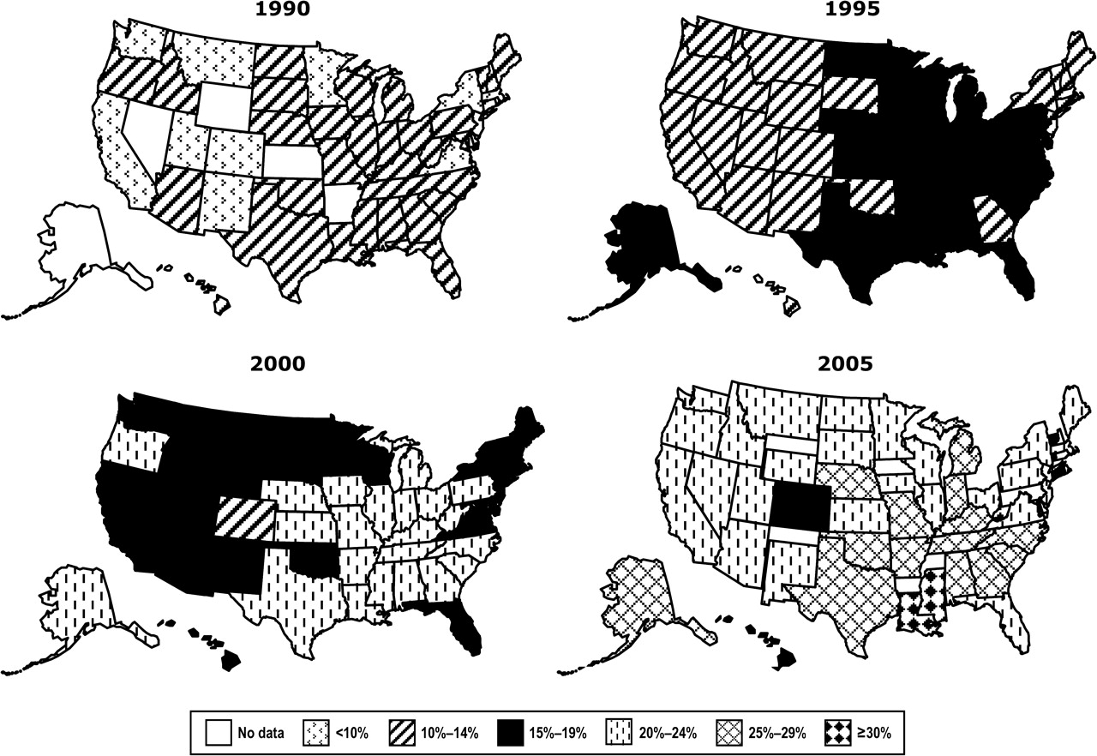
FIGURE 4. Trends in regional differences in the prevalence of obesity (body mass index ≥30 kg/m ² ) in US ...
Notes:
FIGURE 4. Trends in regional differences in the prevalence of obesity (body mass index ≥30 kg/m 2 ) in US adults, Behavioral Risk Factor Surveillance System data, 1990–2005. Self-reported body mass index data were used. (Source: 27).
Unless provided in the caption above, the following copyright applies to the content of this slide: Epidemiologic Reviews Copyright © 2007 by the Johns Hopkins Bloomberg School of Public Health All rights reserved; printed in U.S.A.

Slide 5
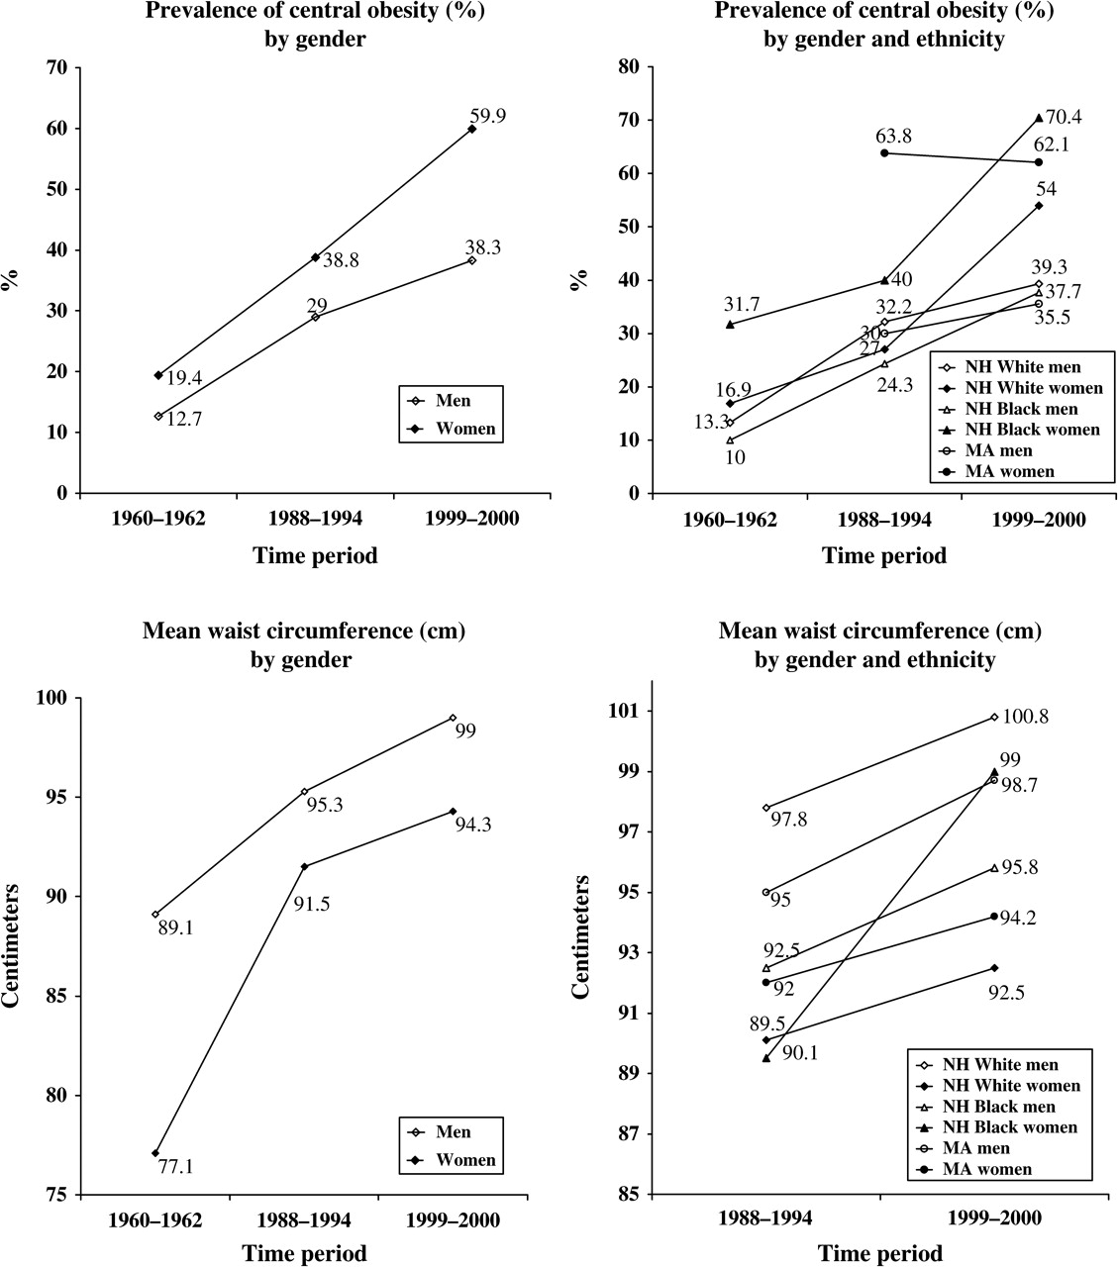
FIGURE 5. Trends as well as gender and ethnicity differences in the age-adjusted prevalence of central obesity (also ...
Notes:
FIGURE 5. Trends as well as gender and ethnicity differences in the age-adjusted prevalence of central obesity (also known as abdominal obesity, defined as waist circumference >40 inches (102 cm) in men and >35 inches (88 cm) in women) and mean waist circumference among US adults (aged ≥20 years), National Health and Nutrition Examination Survey, 1960–2000. Data on mean waist circumference by gender and ethnicity are not available for 1960–1962. NH, non-Hispanic; MA, Mexican American. (Sources: 52, 53).
Unless provided in the caption above, the following copyright applies to the content of this slide: Epidemiologic Reviews Copyright © 2007 by the Johns Hopkins Bloomberg School of Public Health All rights reserved; printed in U.S.A.

Slide 6
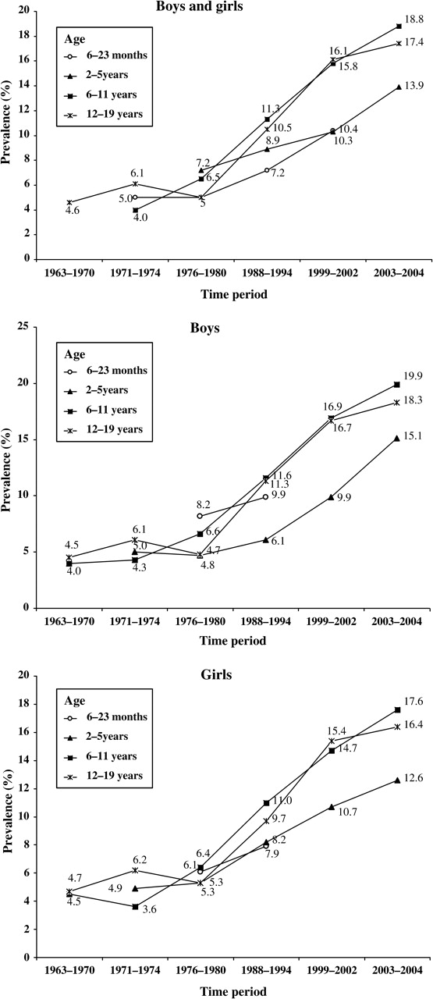
FIGURE 6. Trends in the prevalence of overweight (body mass index ≥95th percentile) in US children and adolescents, by ...
Notes:
FIGURE 6. Trends in the prevalence of overweight (body mass index ≥95th percentile) in US children and adolescents, by gender, National Health and Nutrition Examination Survey, 1963–2004. (Sources: 2, 54).
Unless provided in the caption above, the following copyright applies to the content of this slide: Epidemiologic Reviews Copyright © 2007 by the Johns Hopkins Bloomberg School of Public Health All rights reserved; printed in U.S.A.

Slide 7
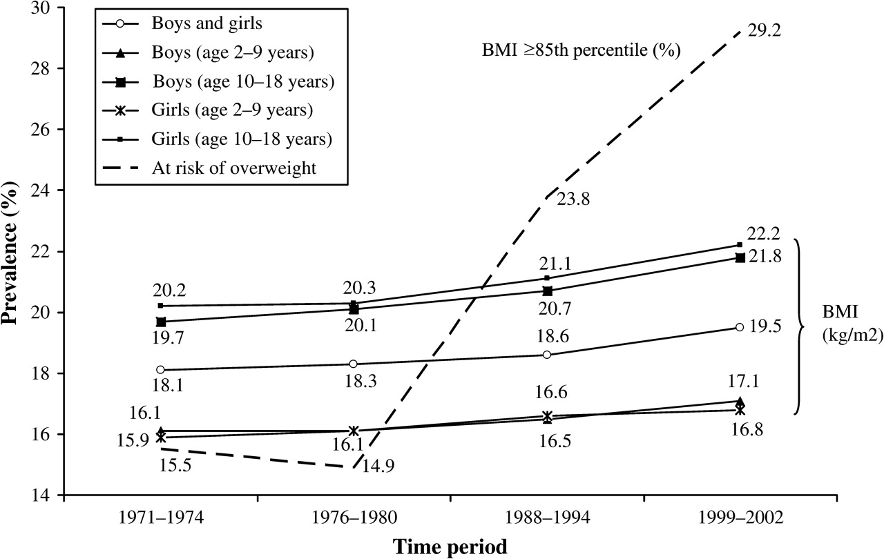
FIGURE 7. Trends in body mass index (BMI) means (cm) and combined prevalence (%) of at risk of overweight and ...
Notes:
FIGURE 7. Trends in body mass index (BMI) means (cm) and combined prevalence (%) of at risk of overweight and overweight (BMI ≥85th percentile) in US children and adolescents, National Health and Nutrition Examination Survey, 1971–2002. (Source: 3).
Unless provided in the caption above, the following copyright applies to the content of this slide: Epidemiologic Reviews Copyright © 2007 by the Johns Hopkins Bloomberg School of Public Health All rights reserved; printed in U.S.A.

Slide 8
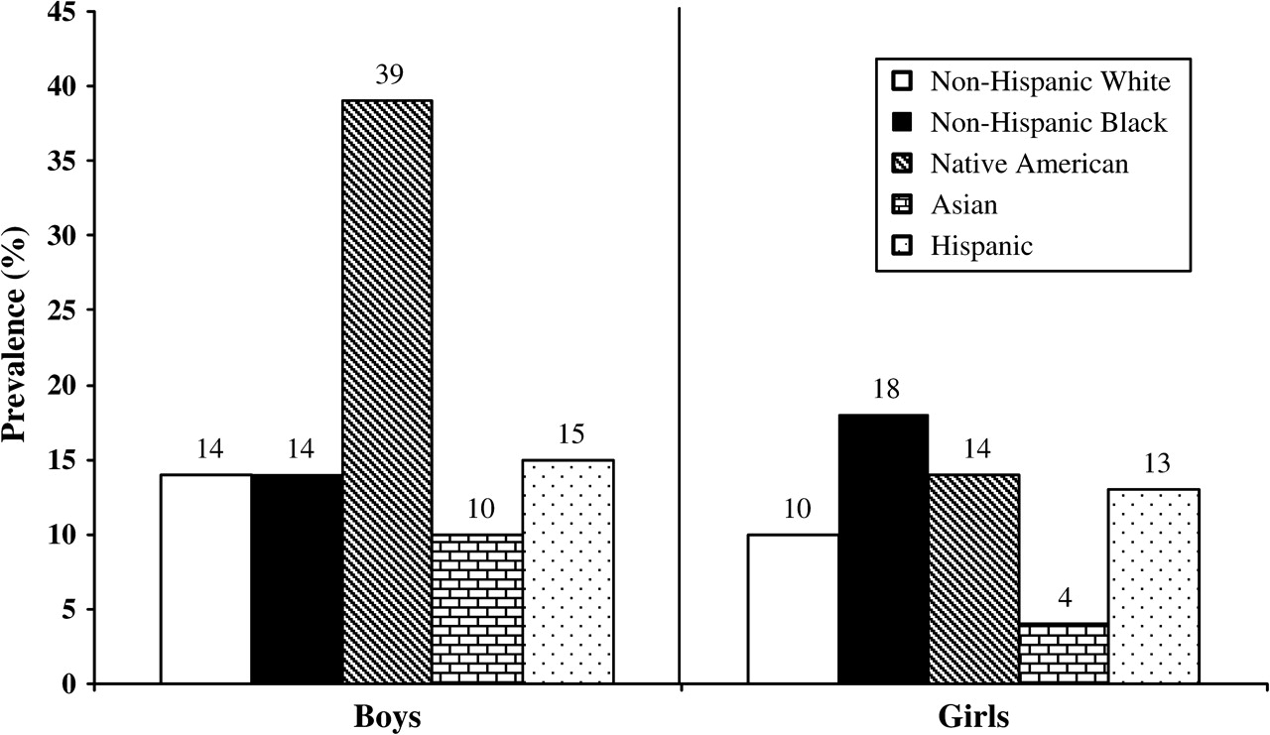
FIGURE 8. Prevalence of obesity (body mass index ≥30 kg/m ² ) among US adolescents, by ethnicity, National ...
Notes:
FIGURE 8. Prevalence of obesity (body mass index ≥30 kg/m 2 ) among US adolescents, by ethnicity, National Longitudinal Survey of Adolescent Health, 1994–1996 data. Data on self-reported weight and height were collected for 14,738 (waves I and II) adolescents aged 12–19 years. (Source: 29).
Unless provided in the caption above, the following copyright applies to the content of this slide: Epidemiologic Reviews Copyright © 2007 by the Johns Hopkins Bloomberg School of Public Health All rights reserved; printed in U.S.A.

Slide 9
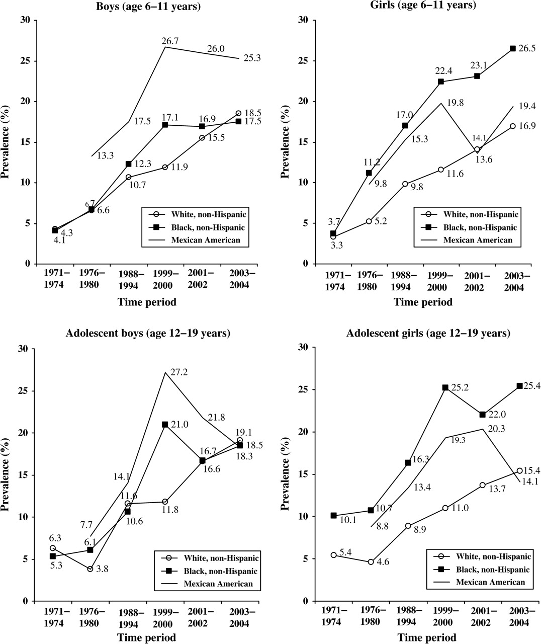
FIGURE 9. Trends in the prevalence of overweight (body mass index ≥95th percentile) in US children and adolescents, by ...
Notes:
FIGURE 9. Trends in the prevalence of overweight (body mass index ≥95th percentile) in US children and adolescents, by gender, age, and ethnicity, National Health and Nutrition Examination Survey, 1971–2004. The dramatic decline in prevalence between 2001 and 2004 among Mexican-American adolescents may be due to sampling problems. (Sources: 2, 54).
Unless provided in the caption above, the following copyright applies to the content of this slide: Epidemiologic Reviews Copyright © 2007 by the Johns Hopkins Bloomberg School of Public Health All rights reserved; printed in U.S.A.

Slide 10
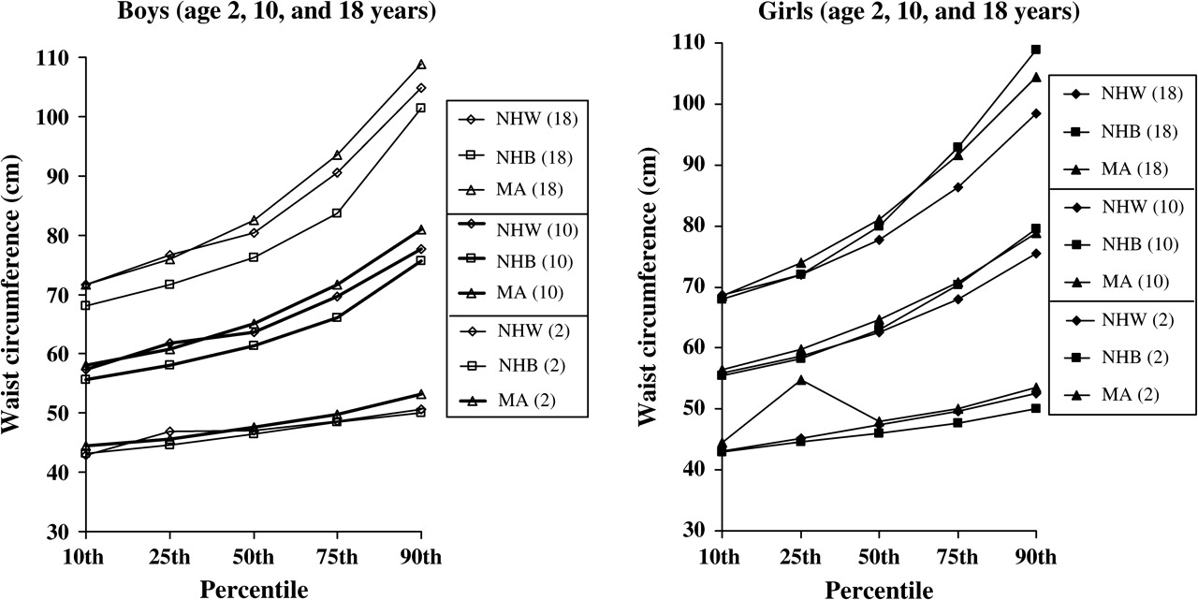
FIGURE 10. Ethnic differences in waist circumference (cm) and gender, age-, and ethnicity-specific percentiles among US ...
Notes:
FIGURE 10. Ethnic differences in waist circumference (cm) and gender, age-, and ethnicity-specific percentiles among US children and adolescents, National Health and Nutrition Examination Survey III, 1988–1994. In the two keys, ages are given in parentheses. NHW, non-Hispanic White; NHB, non-Hispanic Black; MA, Mexican American. (Source: 61).
Unless provided in the caption above, the following copyright applies to the content of this slide: Epidemiologic Reviews Copyright © 2007 by the Johns Hopkins Bloomberg School of Public Health All rights reserved; printed in U.S.A.

