Slide 1
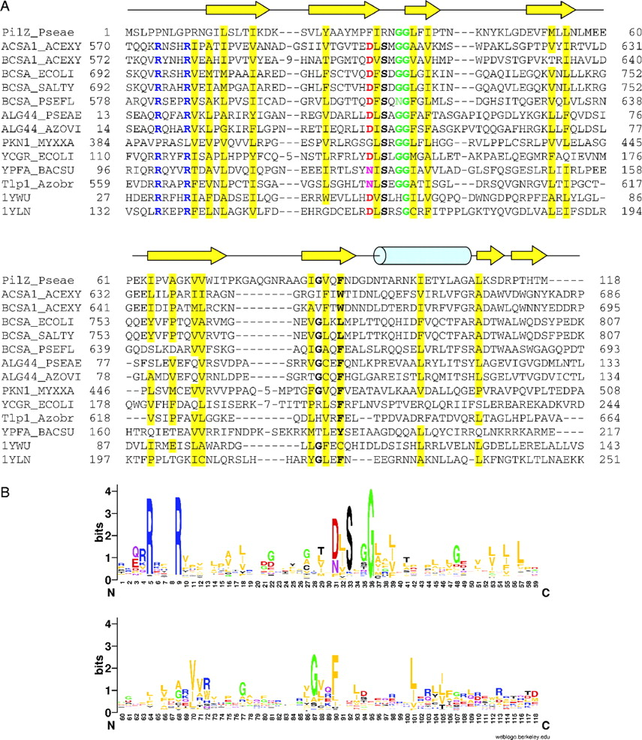
Fig. 1 Multiple alignment of the PilZ domain. (A) Experimentally studied proteins. Conserved hydrophobic residues ...
Notes:
Fig. 1 Multiple alignment of the PilZ domain. (A) Experimentally studied proteins. Conserved hydrophobic residues are shaded, other conserved residues are shown in bold. Proteins are listed by their gene names, UniProt entry names, or PDB codes. GenBank/EMBL protein accession numbers for PilZ_Pseae and Tlp1_Azobr are AAA93519 and AAT76671, respectively. Secondary structure assignments are from the VCA0042 structure (PDB: 1YLN); arrows indicate β-strands, the cylinder indicates an α-helix. (B) Sequence logo of 472 non-redundant sequences of the PilZ domain, generated by the WebLogo tool (, Crooks et al., 2004) from a master–slave alignment, produced by PSI-BLAST using PilZ-Pseae as the query. Residue numbering is as in PilZ_Pseae.
Unless provided in the caption above, the following copyright applies to the content of this slide: Published by Oxford University Press 2005The online version of this article has been published under an open access model. Users are entitled to use, reproduce, disseminate, or display the open access version of this article for non-commercial purposes provided that: the orginial authorship is properly and fully attributed; the Journal and Oxford University Press are attributed as the original place of publication with the correct citation details given; if an article is subsequently reproduced or disseminated not in its entirety but only in part or as a derivative work this must be clearly indicated. For commercial re-use, please contact journals.permissions@oxfordjournals.org

Slide 2
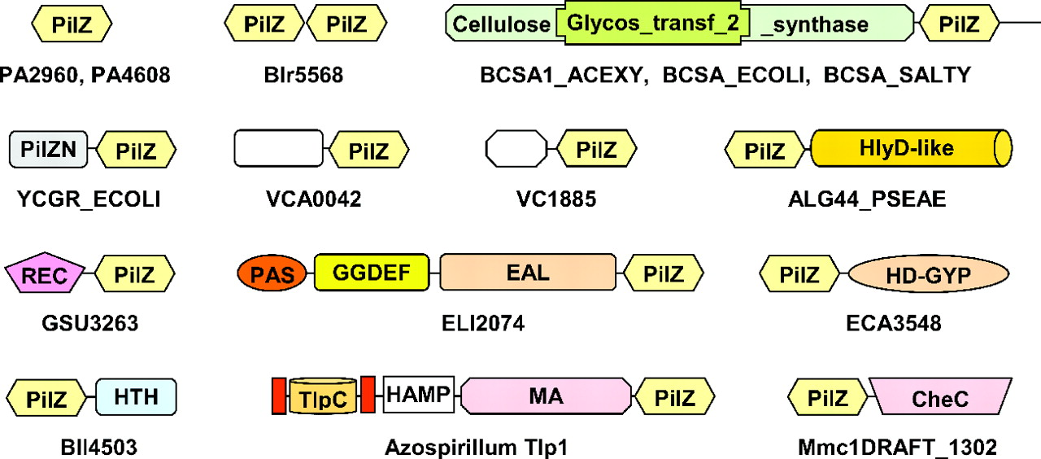
Fig. 2 Domain architectures of selected PilZ-containing proteins. The first two rows show the most common domain ...
Notes:
Fig. 2 Domain architectures of selected PilZ-containing proteins. The first two rows show the most common domain structures, the last two rows show rare domain combinations that indicate involvement of PilZ in signaling. Proteins are listed by UniProt entry names or their gene names. Source organisms and GenBank/EMBL protein accession numbers are as follows: PA2960 and PA4608, Pseudomonas aeruginosa AAG06348 and AAG07996, respectively; Blr5568 and Bll4503, Bradyrhizobium japonicum BAC50833 and BAC49768; VCA0042 and VC1885, Vibrio cholerae AAF95956 and AAF95033; GSU3263, Geobacter sulfurreducens AAR36654; ELI2074, Erythrobacter litoralis EAL74814; ECA3548, Erwinia carotovora CAG76446; Mmc1draft_1302, Magnetococcus sp. MC-1 EAN28119. Domain designations are as follows: Cellulose synthase, Pfam domain PF03552; Glycos_transf_2, PF00535; PilZN and PilZNR, new domains that will be described elsewhere; HlyD-like, a divergent variant of the PF00529 domain; REC, PF00072; PAS, PF0989; GGDEF, PF00990; EAL, PF00563; HD-GYP, COG2206, a variant of PF01966 (Galperin et al., 1999); HTH_3, PF01381; TlpC, a periplasmic signaling domain (Greer-Phillips et al., 2004); HAMP, PF00672; MCPsignal, PF00015; CheC, COG1776, a protein phosphatase domain (Park et al., 2004).
Unless provided in the caption above, the following copyright applies to the content of this slide: Published by Oxford University Press 2005The online version of this article has been published under an open access model. Users are entitled to use, reproduce, disseminate, or display the open access version of this article for non-commercial purposes provided that: the orginial authorship is properly and fully attributed; the Journal and Oxford University Press are attributed as the original place of publication with the correct citation details given; if an article is subsequently reproduced or disseminated not in its entirety but only in part or as a derivative work this must be clearly indicated. For commercial re-use, please contact journals.permissions@oxfordjournals.org

