Slide 1
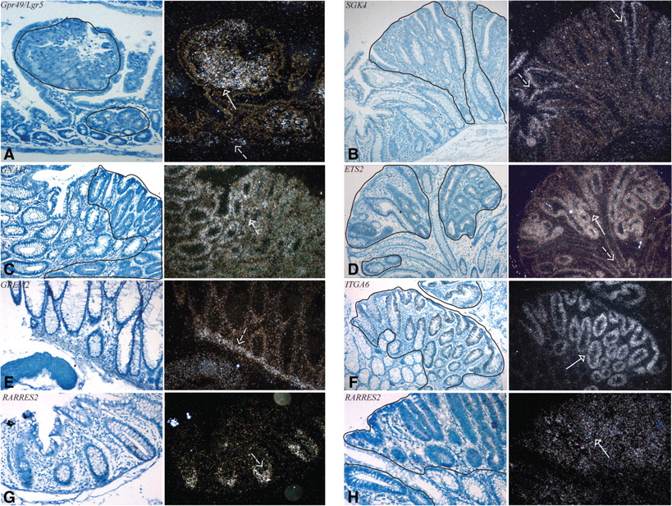
Figure 1. In situ hybridization analysis of selected genes showing differential expression in APC-mutant adenomas and ...
Notes:
Figure 1. In situ hybridization analysis of selected genes showing differential expression in APC-mutant adenomas and normal tissue. Representative images (human adenomas unless otherwise stated) of ISH (×20 magnification) for Gpr49/Lgr5 (mouse adenoma shown, A), SGK1 (B), GNA11 (C), ETS2 (D), GREM2 (normal tissue only, E), ITGA6 (F) and RARRES2 (normal tissue, G and adenoma, H). Left panels of each pair are Giemsa-stained sections. Right panels are dark-field images highlighting autoradiographic silver. Solid lines on Giemsa-stained images delineate tumour tissue. White solid arrows on dark field images illustrate gene expression in tumour tissue. Dashed arrows indicate gene expression in normal tissue.
Unless provided in the caption above, the following copyright applies to the content of this slide: © 2008 The Author(s)This is an Open Access article distributed under the terms of the Creative Commons Attribution Non-Commercial License (http://creativecommons.org/licenses/by-nc/2.0/uk/) which permits unrestricted non-commercial use, distribution, and reproduction in any medium, provided the original work is properly cited.

