Slide 1
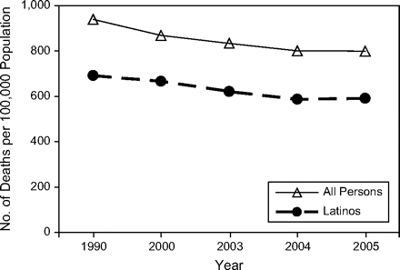
Figure 1. Age-adjusted rates of death from all causes for all persons and for Latinos, United States, selected years ...
Notes:
Figure 1. Age-adjusted rates of death from all causes for all persons and for Latinos, United States, selected years between 1990 and 2005. Data were obtained from the National Center for Health Statistics (20).
Unless provided in the caption above, the following copyright applies to the content of this slide: Epidemiologic Reviews © The Author 2009. Published by the Johns Hopkins Bloomberg School of Public Health. All rights reserved. For permissions, please e-mail: journals.permissions@oxfordjournals.org.

Slide 2
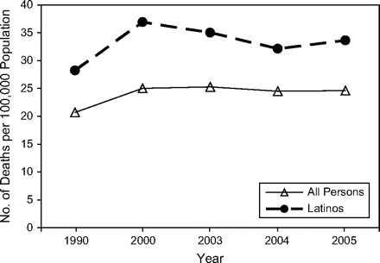
Figure 2. Age-adjusted rates of death from diabetes mellitus for all persons and for Latinos, United States, selected ...
Notes:
Figure 2. Age-adjusted rates of death from diabetes mellitus for all persons and for Latinos, United States, selected years between 1990 and 2005. Data were obtained from the National Center for Health Statistics (20).
Unless provided in the caption above, the following copyright applies to the content of this slide: Epidemiologic Reviews © The Author 2009. Published by the Johns Hopkins Bloomberg School of Public Health. All rights reserved. For permissions, please e-mail: journals.permissions@oxfordjournals.org.

Slide 3
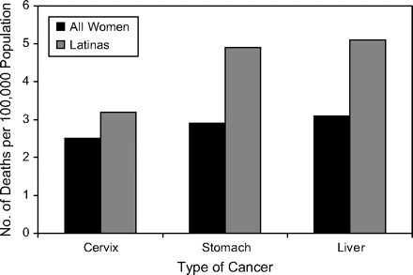
Figure 3. Age-adjusted rates of death from selected cancers for all women and for Latinas, United States, 2001–2005. ...
Notes:
Figure 3. Age-adjusted rates of death from selected cancers for all women and for Latinas, United States, 2001–2005. Data were obtained from the US Cancer Statistics Working Group (59).
Unless provided in the caption above, the following copyright applies to the content of this slide: Epidemiologic Reviews © The Author 2009. Published by the Johns Hopkins Bloomberg School of Public Health. All rights reserved. For permissions, please e-mail: journals.permissions@oxfordjournals.org.

Slide 4
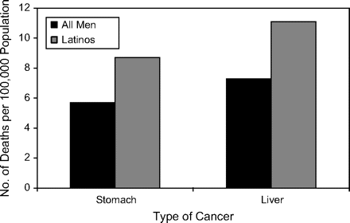
Figure 4. Age-adjusted rates of death from selected cancers for all men and for male Latinos, United States, 2001–2005. ...
Notes:
Figure 4. Age-adjusted rates of death from selected cancers for all men and for male Latinos, United States, 2001–2005. Data were obtained from the US Cancer Statistics Working Group (59).
Unless provided in the caption above, the following copyright applies to the content of this slide: Epidemiologic Reviews © The Author 2009. Published by the Johns Hopkins Bloomberg School of Public Health. All rights reserved. For permissions, please e-mail: journals.permissions@oxfordjournals.org.

Slide 5
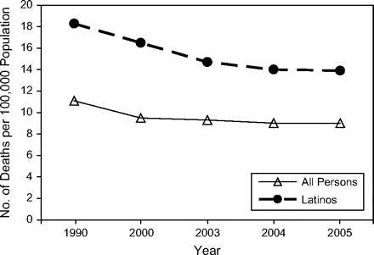
Figure 5. Age-adjusted rates of death from chronic liver disease for all persons and for Latinos, United States, ...
Notes:
Figure 5. Age-adjusted rates of death from chronic liver disease for all persons and for Latinos, United States, selected years between 1990 and 2005. Data were obtained from the National Center for Health Statistics (20).
Unless provided in the caption above, the following copyright applies to the content of this slide: Epidemiologic Reviews © The Author 2009. Published by the Johns Hopkins Bloomberg School of Public Health. All rights reserved. For permissions, please e-mail: journals.permissions@oxfordjournals.org.

Slide 6
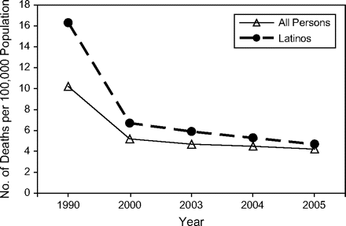
Figure 6. Age-adjusted rates of death from human immunodeficiency virus disease, for all persons and for Latinos, ...
Notes:
Figure 6. Age-adjusted rates of death from human immunodeficiency virus disease, for all persons and for Latinos, United States, selected years between 1990 and 2005. Data were obtained from the National Center for Health Statistics (20).
Unless provided in the caption above, the following copyright applies to the content of this slide: Epidemiologic Reviews © The Author 2009. Published by the Johns Hopkins Bloomberg School of Public Health. All rights reserved. For permissions, please e-mail: journals.permissions@oxfordjournals.org.

Slide 7
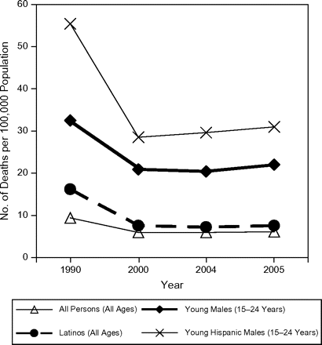
Figure 7. Age-adjusted rates of death from homicide for all persons and for Latinos, by age group, United States, ...
Notes:
Figure 7. Age-adjusted rates of death from homicide for all persons and for Latinos, by age group, United States, selected years between 1990 and 2005. Data were obtained from the National Center for Health Statistics (20).
Unless provided in the caption above, the following copyright applies to the content of this slide: Epidemiologic Reviews © The Author 2009. Published by the Johns Hopkins Bloomberg School of Public Health. All rights reserved. For permissions, please e-mail: journals.permissions@oxfordjournals.org.

