Slide 1
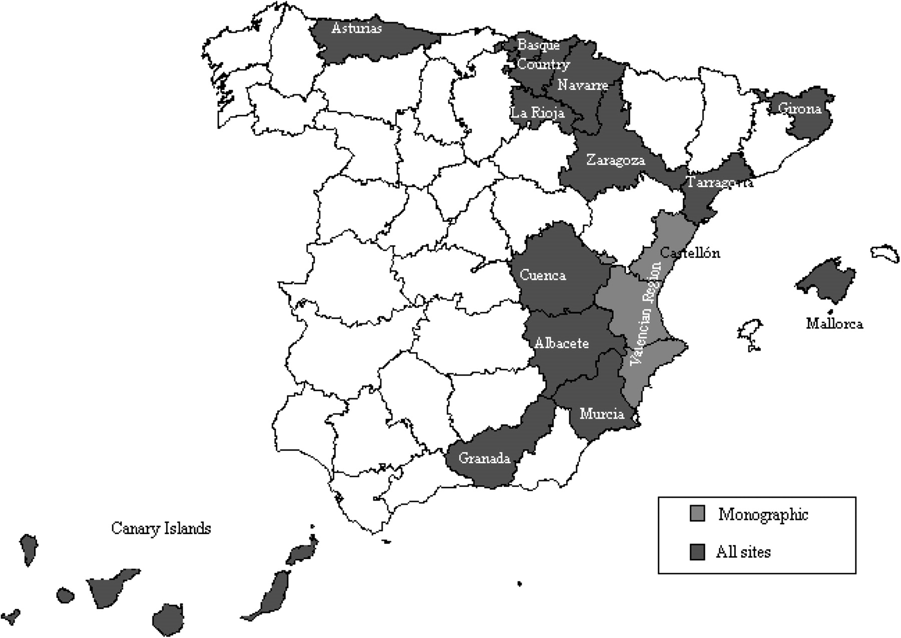
Figure 1. Population-based cancer registries in Spain 2009.
Notes:
Figure 1. Population-based cancer registries in Spain 2009.
Unless provided in the caption above, the following copyright applies to the content of this slide: © The Author 2010. Published by Oxford University Press on behalf of the European Society for Medical Oncology. All rights reserved. For permissions, please email: journals.permissions@oxfordjournals.org

Slide 2
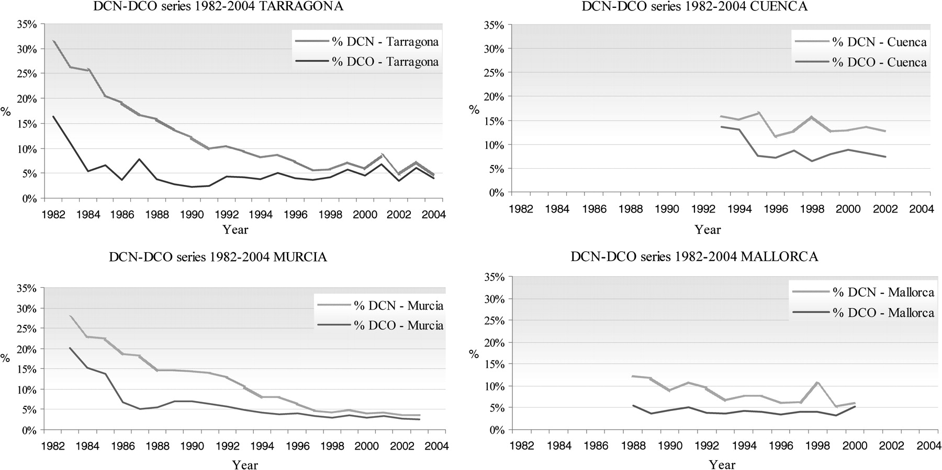
Figure 2. Death Certificate Notification (DCN) and Death Certificate Only (DCO) cases as a percentage of total ...
Notes:
Figure 2. Death Certificate Notification (DCN) and Death Certificate Only (DCO) cases as a percentage of total registrations for all sites, except non-melanoma skin cancer: Tarragona, Murcia, Mallorca and Cuenca registries, 1982–2004.
Unless provided in the caption above, the following copyright applies to the content of this slide: © The Author 2010. Published by Oxford University Press on behalf of the European Society for Medical Oncology. All rights reserved. For permissions, please email: journals.permissions@oxfordjournals.org

Slide 3
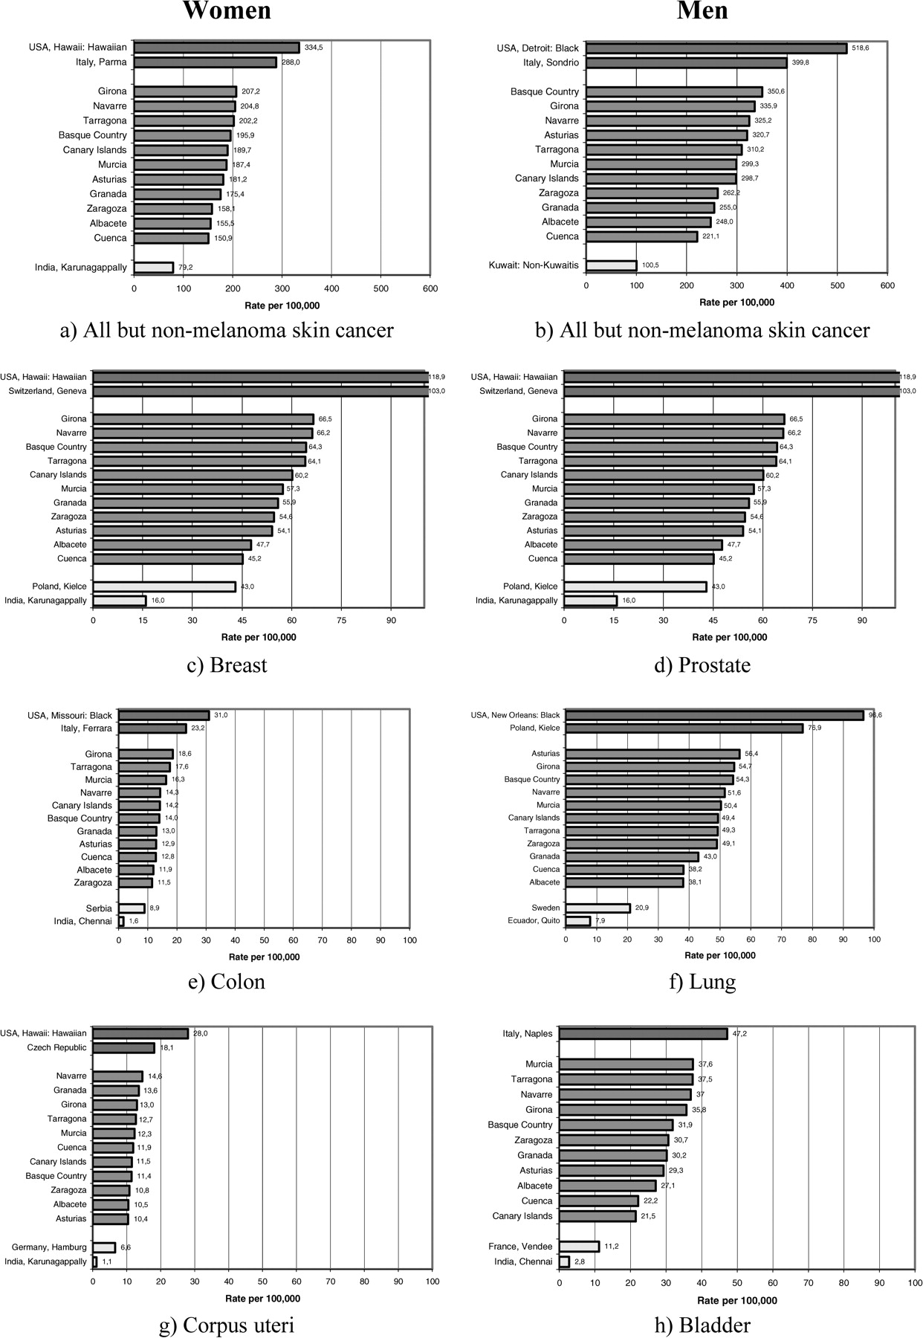
Figure 3. Age-standardised (world) incidence rates for all cancers, except non-melanoma skin cancer, and for the three ...
Notes:
Figure 3. Age-standardised (world) incidence rates for all cancers, except non-melanoma skin cancer, and for the three leading sites for men and women: Spanish regions covered by population-based cancer registries, 1998–2002. Data published in Cancer Incidence in Five Continents, Vol IX (reference 23).
Unless provided in the caption above, the following copyright applies to the content of this slide: © The Author 2010. Published by Oxford University Press on behalf of the European Society for Medical Oncology. All rights reserved. For permissions, please email: journals.permissions@oxfordjournals.org

