Slide 1
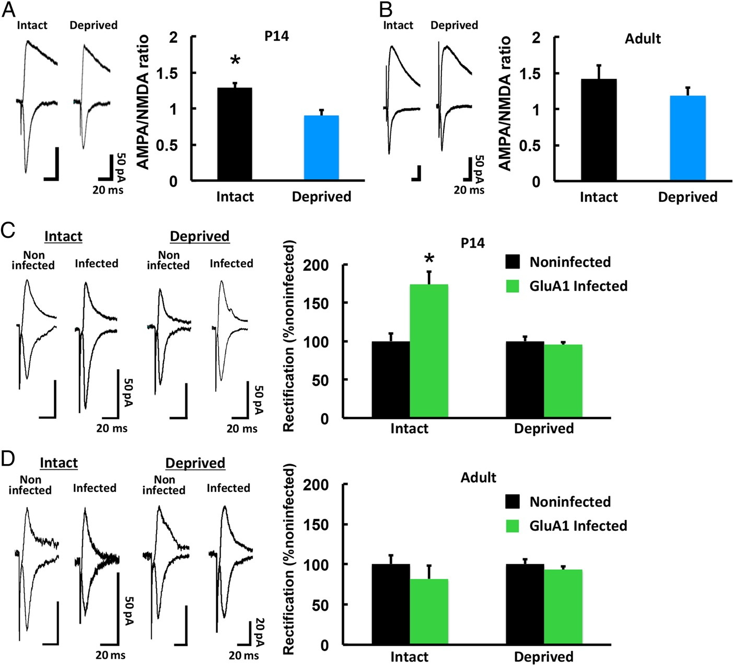
Figure 1. Experience-driven synaptic AMPAR delivery is limited in the adult barrel cortex. (A) (Left) Synaptic ...
Notes:
Figure 1. Experience-driven synaptic AMPAR delivery is limited in the adult barrel cortex. (A) (Left) Synaptic responses at layer 4–2/3 synapses in the barrel cortex of developing (P14) WT mice with (Intact) and without (Deprived) whiskers. Scale bars: 50 pA, 20 ms. (Right) Mean ratio of AMPAR-mediated currents to NMDA receptor-mediated currents (A/N ratio). Intact: n = 5 (11 cells from 5 animals); Deprived: n = 5 (10 cells from 5 animals). *P < 0.05. (B) Synaptic responses at layer 4–2/3 synapses in the barrel cortex of adult (3-month-old) WT mice with (Intact) and without (Deprived) whiskers. Scale bars: 50 pA, 20 ms. (Right) Mean A/N ratio. Intact: n = 6 (17 cells from 6 animals); Deprived: n = 5 (13 cells from 5 animals). (C) (Left) Synaptic responses from neurons infected with Herpes simplex virus expressing GFP-GluA1 and from noninfected neurons (held at −60 mV and +40 mV, as indicated) at layer 4–2/3 synapses in the barrel cortex of P14 WT mice with (Intact) and without (Deprived) whiskers. The AMPAR-mediated responses were isolated by the application of 0.1 mM APV. Scale bars: 50 pA, 20 ms. (Right) Average rectification indices (RI; response at −60 mV/response at +40 mV) of neurons expressing GFP-GluA1 (green), normalized to the RI value of nearby noninfected cells (black). Intact: n = 5 (10 infected cells and 10 noninfected cells from 5 animals); Deprived: n = 5 (10 infected cells and 10 noninfected cells from 5 animals). *P < 0.05. (D) (Left) Synaptic responses from neurons infected with Herpes simplex virus expressing GFP-GluA1 and from noninfected neurons at layer 4-2/3 synapses in the barrel cortex of adult WT mice with (Intact) and without (Deprived) whiskers. Scale bars: 20 pA, 20 ms. (Right) Average RI of neurons expressing GFP-GluA1 (green), normalized to the RI value of nearby noninfected cells (black). Intact: n = 6 (6 infected cells and 6 noninfected cells from 6 animals); Deprived: n = 4 (8 infected cells and 8 noninfected cells from 4 animals). Data were analyzed by Student's t-test. Data are presented as mean ± SEM.
Unless provided in the caption above, the following copyright applies to the content of this slide: © The Author 2015. Published by Oxford University PressThis is an Open Access article distributed under the terms of the Creative Commons Attribution Non-Commercial License (http://creativecommons.org/licenses/by-nc/4.0/), which permits non-commercial re-use, distribution, and reproduction in any medium, provided the original work is properly cited. For commercial re-use, please contact journals.permissions@oup.com

Slide 2
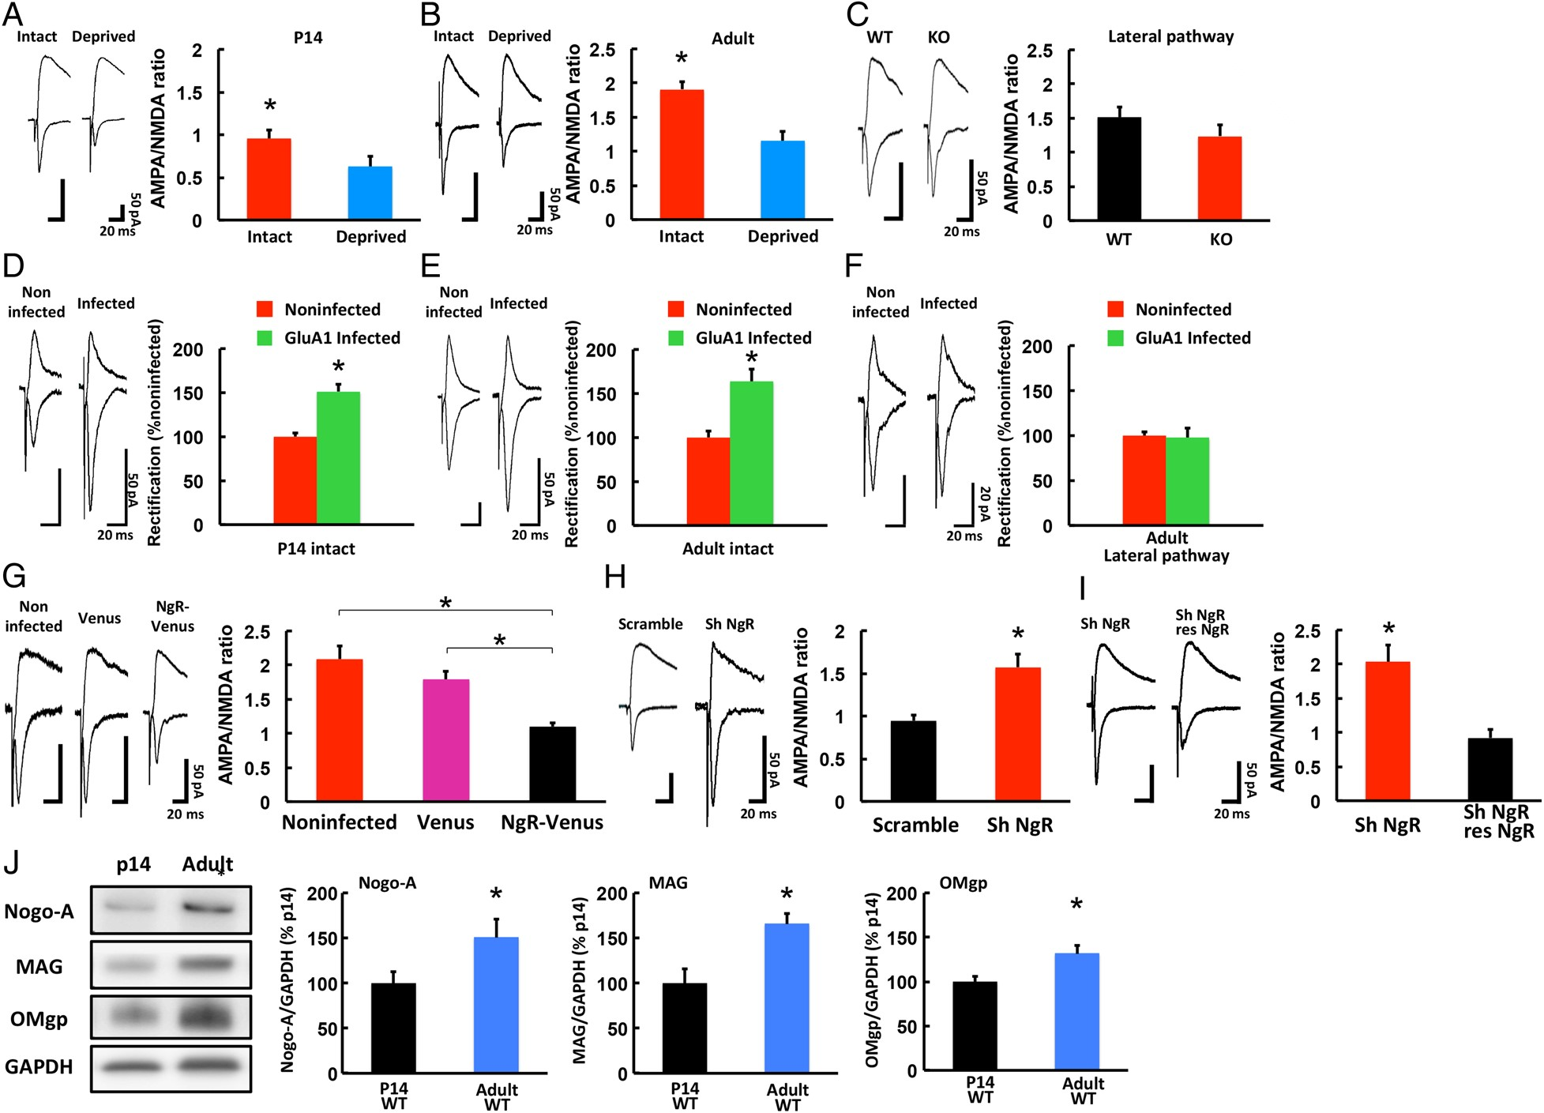
Figure 2. Experience-driven synaptic AMPAR delivery is restored in the adult barrel cortex of NgR1-deficient mice. (A) ...
Notes:
Figure 2. Experience-driven synaptic AMPAR delivery is restored in the adult barrel cortex of NgR1-deficient mice. (A) (Left) Synaptic responses at layer 4–2/3 synapses in the barrel cortex of developing (P14) NgR1-deficient mice with (Intact) and without (Deprived) whiskers. Scale bars: 50 pA, 20 ms. (Right) Mean A/N ratio. Intact: n = 5 (17 cells from 5 animals); Deprived: n = 5 (16 cells from 5 animals). *P < 0.05. (B) (Left) Synaptic responses at layer 4–2/3 synapses in the barrel cortex of adult (3-month-old) NgR1-deficient mice with (Intact) and without (Deprived) whiskers. Scale bars: 50 pA, 20 ms. (Right) Mean A/N ratio. Intact: n = 5 (14 cells from 5 animals); Deprived: n = 5 (12 cells from 5 animals). *P < 0.05. (C) (Left) Synaptic responses from layer 2/3 to layer 2/3 (lateral pathway) synapses in the barrel cortex of adult NgR1-deficient (KO) and WT mice. Scale bars: 50 pA, 20 ms. (Right) Mean A/N ratio. WT: n = 6 (15 cells from 6 animals); KO: n = 5 (11 cells from 5 animals). (D) (Left) Synaptic responses from neurons infected with Herpes simplex virus expressing GFP-GluA1 and from noninfected neurons (held at −60 mV and +40 mV, as indicated) at layer 4–2/3 synapses in the barrel cortex of P14 NgR1-deficient mice with intact whiskers (P14 intact). The AMPAR-mediated responses were isolated by 0.1 mM APV. Scale bars: 50 pA, 20 ms. (Right) Average rectification indices (RI; response at −60 mV/response at +40 mV) of neurons expressing GFP-GluA1 (green), normalized to the RI value of nearby noninfected cells (red). P14 Intact: n = 5 (11 infected cells and 11 noninfected cells from 5 animals). *P < 0.05. (E) (Left) Synaptic responses from neurons infected with Herpes simplex virus expressing GFP-GluA1 and from noninfected neurons at layer 4–2/3 synapses in the barrel cortex of adult NgR1-deficient mice with intact whiskers (Adult intact). Scale bars: 50 pA, 20 ms. (Right) Average RI of neurons expressing GFP-GluA1 (green), normalized to the RI value of nearby noninfected cells (red). Adult intact: n = 5 (10 infected cells and 10 noninfected cells from 5 animals). *P < 0.05. (F) (Left) Synaptic responses from layer 2/3 to layer 2/3 (lateral pathway) synapses infected with Herpes simplex virus expressing GFP-GluA1 and noninfected neurons in the barrel cortex of adult NgR1-deficient mice. Scale bars: 20 pA, 20 ms. (Right) Average RI of neurons expressing GFP-GluA1 (green), normalized to the RI value of nearby noninfected cells (red). Adult Lateral pathway: n = 4 (9 infected cells and 9 noninfected cells from 4 animals). (G) (Left) Synaptic responses from noninfected, Venus-expressing (Venus), and NgR1 IRES Venus expressing (NgR-Venus) neurons at layer 4–2/3 synapses in the barrel cortex of adult NgR1-deficient mice. Scale bars: 50 pA, 20 ms. (Right) Mean A/N ratio. Noninfected: n = 4 (12 cells from 4 animals), Venus: n = 5 (13 cells from 5 animals), NgR-Venus: n = 4 (8 cells from 4 animals). *P < 0.05 Noninfected versus NgR-Venus and Venus versus NgR-Venus. (H) (Left) Synaptic responses from scrambled control-expressing (Scramble) and shNgR1-expressing (Sh NgR) neurons at layer 4–2/3 synapses of the WT adult barrel cortex. Scale bars: 50 pA, 20 ms. (Right) Mean A/N ratio. Scramble: n = 5 (10 cells from 5 animals); ShNgR1: n = 5 (11 cells from 5 animals). *P < 0.05. (I) (Left) Synaptic responses from shNgR1-expressing (Sh NgR) and shNgR1+shRNA-resistant NgR1 (res-NgR) neurons at layer 4–2/3 synapses of the WT adult barrel cortex. Scale bars: 50 pA, 20 ms. (Right) Mean A/N ratio. ShNgR1: n = 5 (6 cells from 5 animals), ShNgR1+ res-NgR: n = 5 (6 cells from 5 animals). *P < 0.05. (J) Expression level of Nogo-A, MAG, and OMgp in the synaptoneurosome fraction from P14 WT mice (p14 WT) and adult WT mice (Adult WT) mice. The GAPDH level was used as the reference in the quantitative analysis. The expression level of each protein in P14 WT mice was normalized to that in adult WT mice. p14 WT: n = 6; adult WT: n = 6. *P < 0.05. Data were analyzed by Student's t-test (A, B, C, D, E, F, H, I, J) or one-way ANOVA followed by post hoc Bonferroni test (G). Data are presented as mean ± SEM.
Unless provided in the caption above, the following copyright applies to the content of this slide: © The Author 2015. Published by Oxford University PressThis is an Open Access article distributed under the terms of the Creative Commons Attribution Non-Commercial License (http://creativecommons.org/licenses/by-nc/4.0/), which permits non-commercial re-use, distribution, and reproduction in any medium, provided the original work is properly cited. For commercial re-use, please contact journals.permissions@oup.com

Slide 3
Figure 3. LTP induction is facilitated in adult NgR1-deficient mice. Acute brain slices were obtained from 3-month-old ...
Notes:
Figure 3. LTP induction is facilitated in adult NgR1-deficient mice. Acute brain slices were obtained from 3-month-old mice. Synaptic plasticity was induced by pairing 5 Hz stimulation (90 s) with postsynaptic potential at 0 mV in WT or NgR1-deficient (KO) mice. EPSC amplitude was normalized to the average baseline amplitude before pairing. (Right) Mean amplitude between 30 and 40 min after induction, normalized to the baseline amplitude. WT: n = 5 (5 cells from 5 animals); KO: n = 6 (6 cells from 6 animals). *P < 0.05. Data were analyzed by Student's t-test. Data are presented as mean ± SEM.
Unless provided in the caption above, the following copyright applies to the content of this slide: © The Author 2015. Published by Oxford University PressThis is an Open Access article distributed under the terms of the Creative Commons Attribution Non-Commercial License (http://creativecommons.org/licenses/by-nc/4.0/), which permits non-commercial re-use, distribution, and reproduction in any medium, provided the original work is properly cited. For commercial re-use, please contact journals.permissions@oup.com

Slide 4
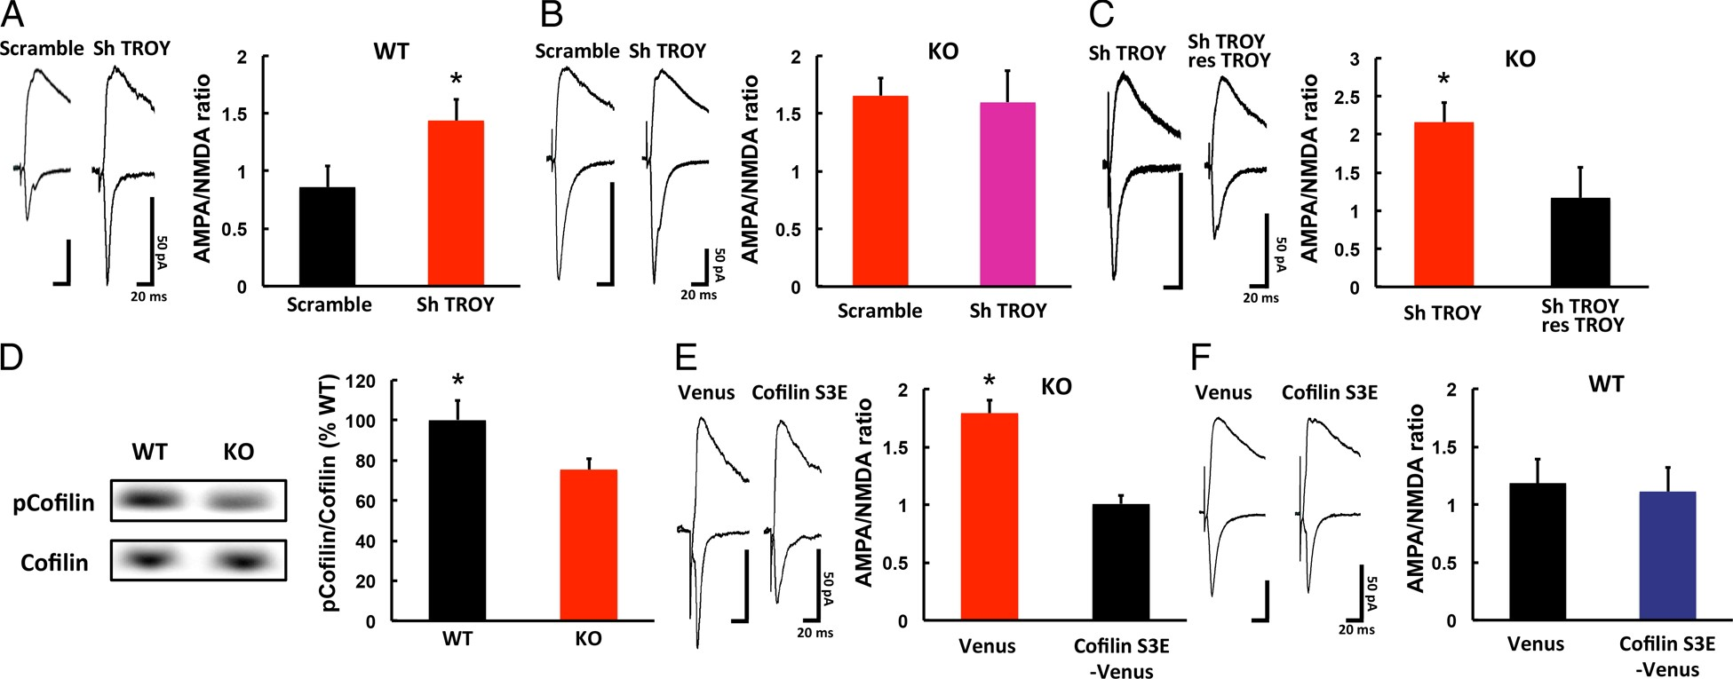
Figure 4. Signaling mechanism underlying the NgR1-mediated restriction of synaptic AMPAR delivery in the adult barrel ...
Notes:
Figure 4. Signaling mechanism underlying the NgR1-mediated restriction of synaptic AMPAR delivery in the adult barrel cortex. (A) (Left) Synaptic responses from shTROY-expressing (Sh TROY) and scrambled control-shRNA-expressing (Scramble) neurons at layer 4–2/3 of WT adult barrel cortex. Scale bars: 50 pA, 20 ms. (Right) Mean A/N ratio. Scramble: n = 5 (10 cells from 5 animals); ShTROY: n = 6 (11 cells from 6 animals). *P < 0.05. (B) (Left) Synaptic responses from shTROY-expressing (Sh TROY) and scrambled control-shRNA-expressing (Scramble) neurons at layer 4–2/3 synapses of NgR1-deficient adult barrel cortex. Scale bars: 50 pA, 20 ms. (Right) Mean A/N ratio. Scramble: n = 5 (10 cells from 5 animals); ShTROY: n = 5 (11 cells from 5 animals). (C) (Left) Synaptic responses from shTROY-expressing (Sh TROY) and shTROY+shRNA-resistant TROY (res-TROY) neurons at layer 4–2/3 synapses of the WT adult barrel cortex. Scale bars: 50 pA, 20 ms. (Right) Mean A/N ratio. ShTROY: n = 5 (6 cells from 5 animals), ShTROY+ res-TROY: n = 5 (6 cells from 5 animals). *P < 0.05. (D) Phosphorylation level of ADF/cofilin in the synaptoneurosome fraction from the adult barrel cortex of WT and NgR1-deficient (KO) mice. The total ADF/cofilin level was used as the reference in the quantitative analysis. The ADF/cofilin phosphorylation level in KO mice was normalized to that of WT. WT: n = 10; KO: n = 11. *P < 0.05. (E) (Left) Synaptic responses from Venus-tagged dominant-negative ADF/cofilin-expressing (Cofilin S3E-venus) and venus-expressing (Venus) neurons at layer 4-2/3 synapses of the NgR1-deficient adult barrel cortex. Scale bars: 50 pA, 20 ms. (Right) Mean A/N ratio. Cofilin S3E: n = 4 (9 cells from 4 animals); Venus: n = 5 (13 cells from 5 animals, same data in Fig. 2G). *P < 0.05. (F) (Left) Synaptic responses from Venus-tagged dominant-negative ADF/cofilin-expressing (Cofilin S3E-venus) and venus-expressing (Venus) neurons at layer 4-2/3 synapses of the WT adult barrel cortex. Scale bars: 50 pA, 20 ms. (Right) Mean A/N ratio. Cofilin S3E: n = 5 (11 cells from 5 animals); Venus: n = 5 (9 cells from 5 animals). Data were analyzed by Student's t-test. Data are presented as mean ± SEM.
Unless provided in the caption above, the following copyright applies to the content of this slide: © The Author 2015. Published by Oxford University PressThis is an Open Access article distributed under the terms of the Creative Commons Attribution Non-Commercial License (http://creativecommons.org/licenses/by-nc/4.0/), which permits non-commercial re-use, distribution, and reproduction in any medium, provided the original work is properly cited. For commercial re-use, please contact journals.permissions@oup.com

Slide 5
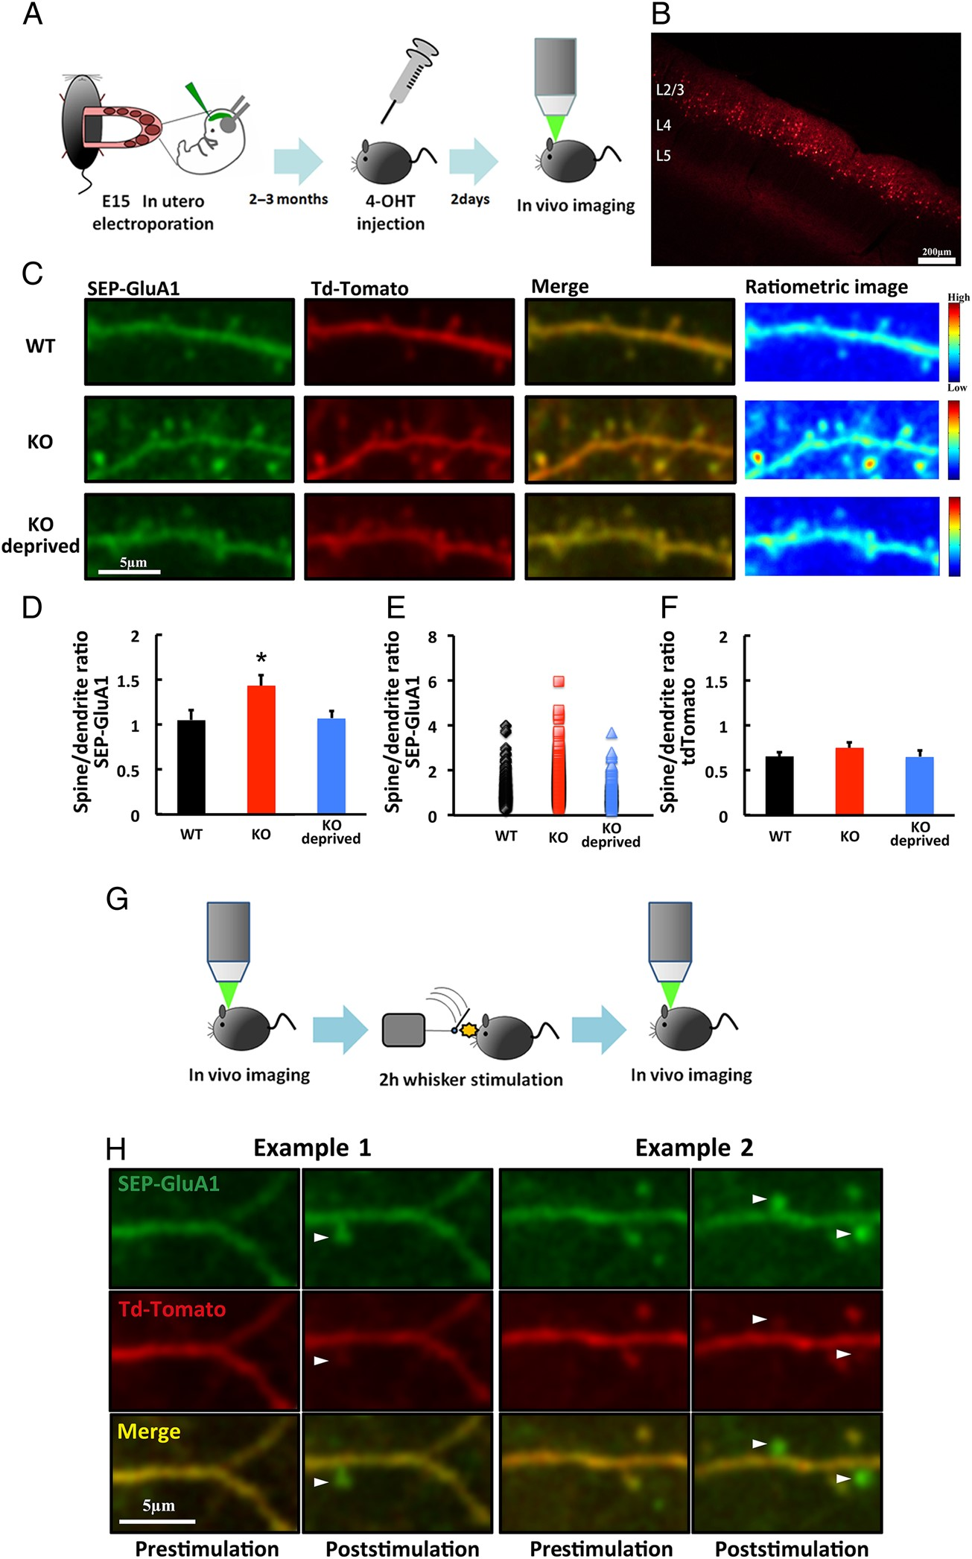
Figure 5. Surface accumulation of AMPAR is increased at spines in layer 2/3 of the adult barrel cortex of ...
Notes:
Figure 5. Surface accumulation of AMPAR is increased at spines in layer 2/3 of the adult barrel cortex of NgR1-deficient mice. (A) Schematic of the SEP-GluA1 and tdTomato expression and in vivo imaging. (B) Example of transfected neurons in layer 2/3 of the barrel cortex. Scale bar: 200 µm. (C) Examples of SEP-GluA1- and tdTomato-expressing neurons or pseudo-color ratiometric heat maps of the SEP-GluA1 intensity in adult WT mice and NgR1-deficient mice with (KO) and without (KO deprived) whiskers. Scale bar: 5 µm. (D) Ratio of fluorescence intensity in spines to dendritic shaft for SEP-GluA1 in adult WT mice and NgR1-deficient mice with (KO) and without (KO deprived) whiskers. WT: n = 7 (376 spines 7 animals); KO: n = 7 (403 spines from 7 animals); KO deprived: n = 5 (309 spines from 5 animals). *P < 0.05 KO versus WT and KO versus KO deprived. (E) Scatter plot of spine-to-dendrite SEP-GluA1 ratios in adult WT mice and NgR1-deficient mice with (KO) and without (KO-deprived) whiskers. (F) Ratio of fluorescence intensity in spines to dendritic shaft for tdTomato in WT mice, and in NgR1-deficient adult mice with (KO) and without (KO deprived) whiskers. WT: n = 7 (376 spines 7 animals); KO: n = 7 (403 spines from 7 animals); KO deprived: n = 5 (309 spines from 5 animals). (G) Schematic of the in vivo imaging of animals with 2 h of whisker stimulation. (H) Examples of the surface accumulation of GluA1 on newly synthesized spines of adult NgR1-deficient mice after 2 h of whisker stimulation (arrowheads). Scale bar: 5 µm. Data in D, F were analyzed by one-way ANOVA followed by post hoc Fisher's Least Significant Difference (LSD). Data are presented as mean ± SEM. Representative images shown in the figures were Gaussian filtered.
Unless provided in the caption above, the following copyright applies to the content of this slide: © The Author 2015. Published by Oxford University PressThis is an Open Access article distributed under the terms of the Creative Commons Attribution Non-Commercial License (http://creativecommons.org/licenses/by-nc/4.0/), which permits non-commercial re-use, distribution, and reproduction in any medium, provided the original work is properly cited. For commercial re-use, please contact journals.permissions@oup.com

