Slide 1
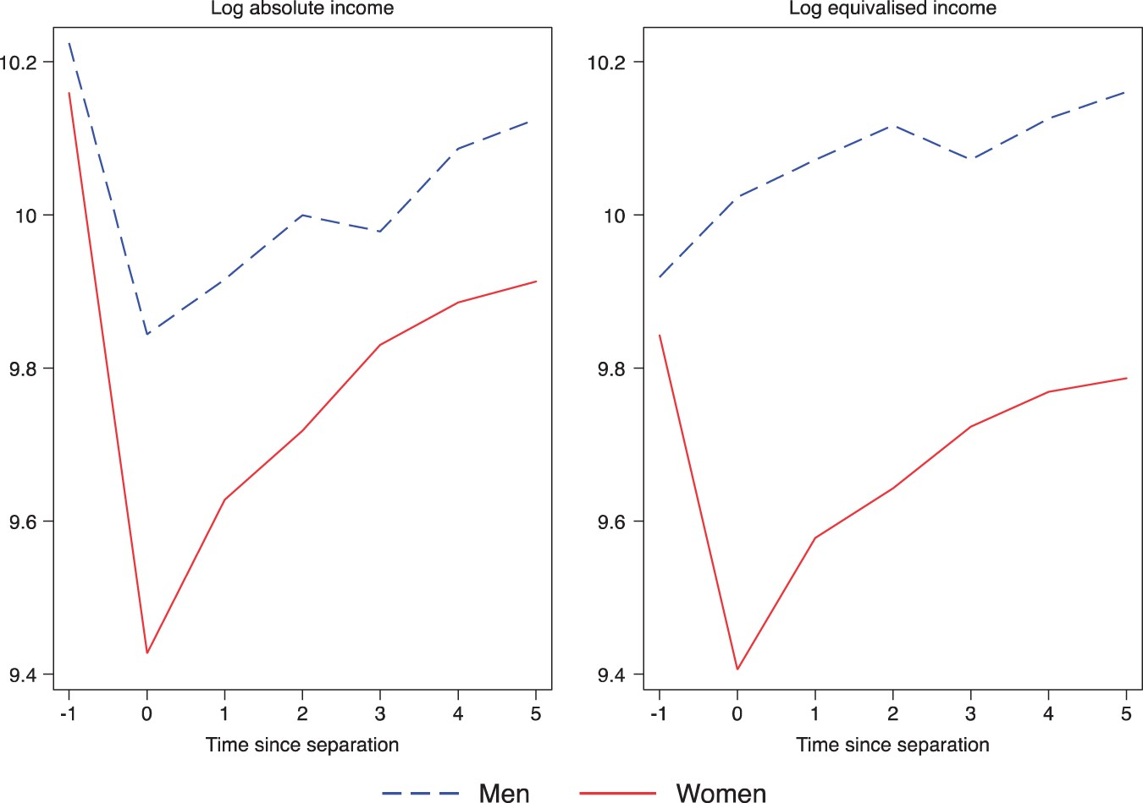
Figure 1. Changes in absolute and equivalized income on divorceThe graphs report the average of log absolute income and ...
Notes:
Figure 1. Changes in absolute and equivalized income on divorceThe graphs report the average of log absolute income and the average of log equivalized income. Natural logarithms are used so that the vertical difference between any two points measures the proportional change in income, rather than the monetary change. A fall of 0.4 is approximately a 40% decline.
Unless provided in the caption above, the following copyright applies to the content of this slide: © The Author 2016. Published by Oxford University Press. All rights reserved. For permissions, please email: journals.permissions@oup.com

Slide 2
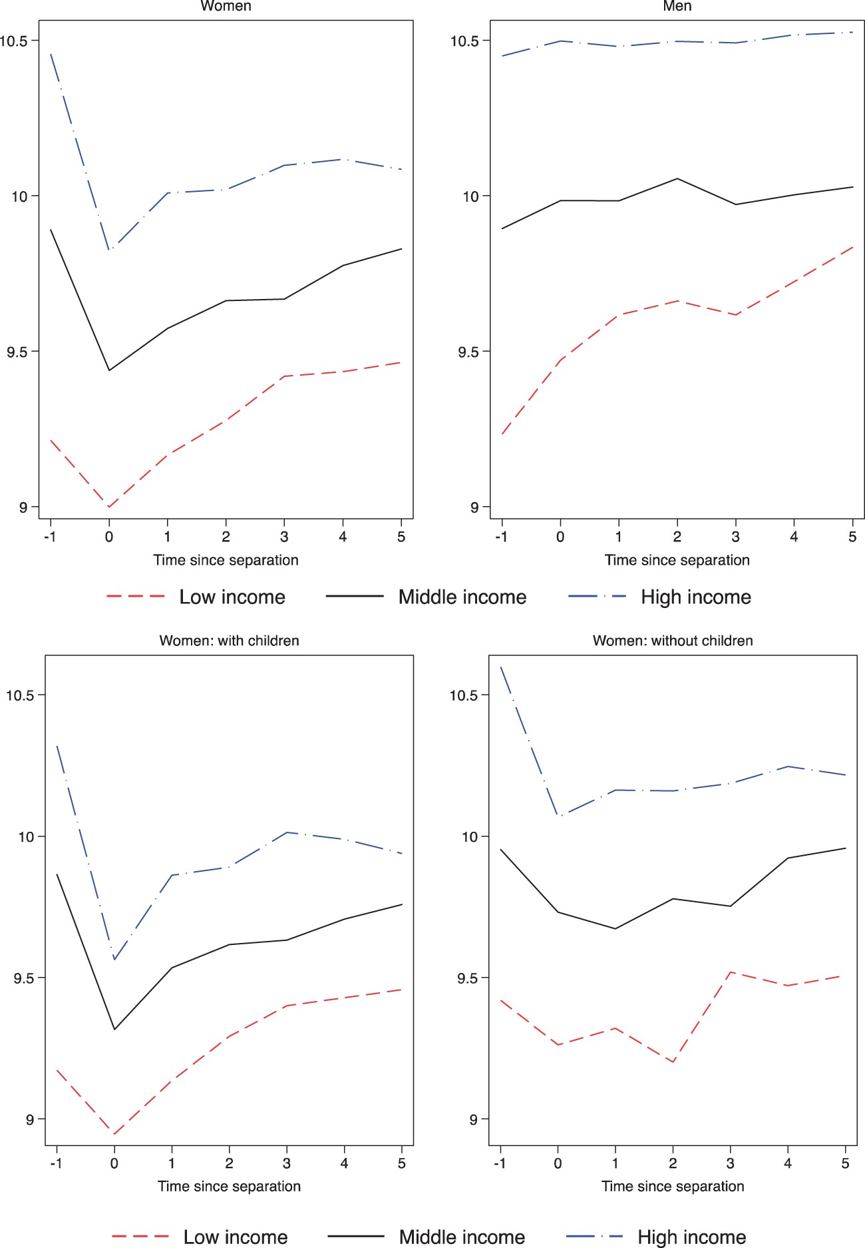
Figure 2. Changes in equivalized income on divorce by income tercileThe graphs report the average of log equivalized ...
Notes:
Figure 2. Changes in equivalized income on divorce by income tercileThe graphs report the average of log equivalized income. Natural logarithms are used so that the vertical difference between any two points measures the proportional change in income, rather than the monetary change. A fall of 0.4 is approximately a 40% decline. The top row reports changes for women on the left-hand graph and for men on the right-hand graph. The bottom row splits the sample of women into those with dependent children at the time of divorce on the left-hand graph and those without dependent children at the time of divorce on the right-hand graph.
Unless provided in the caption above, the following copyright applies to the content of this slide: © The Author 2016. Published by Oxford University Press. All rights reserved. For permissions, please email: journals.permissions@oup.com

Slide 3
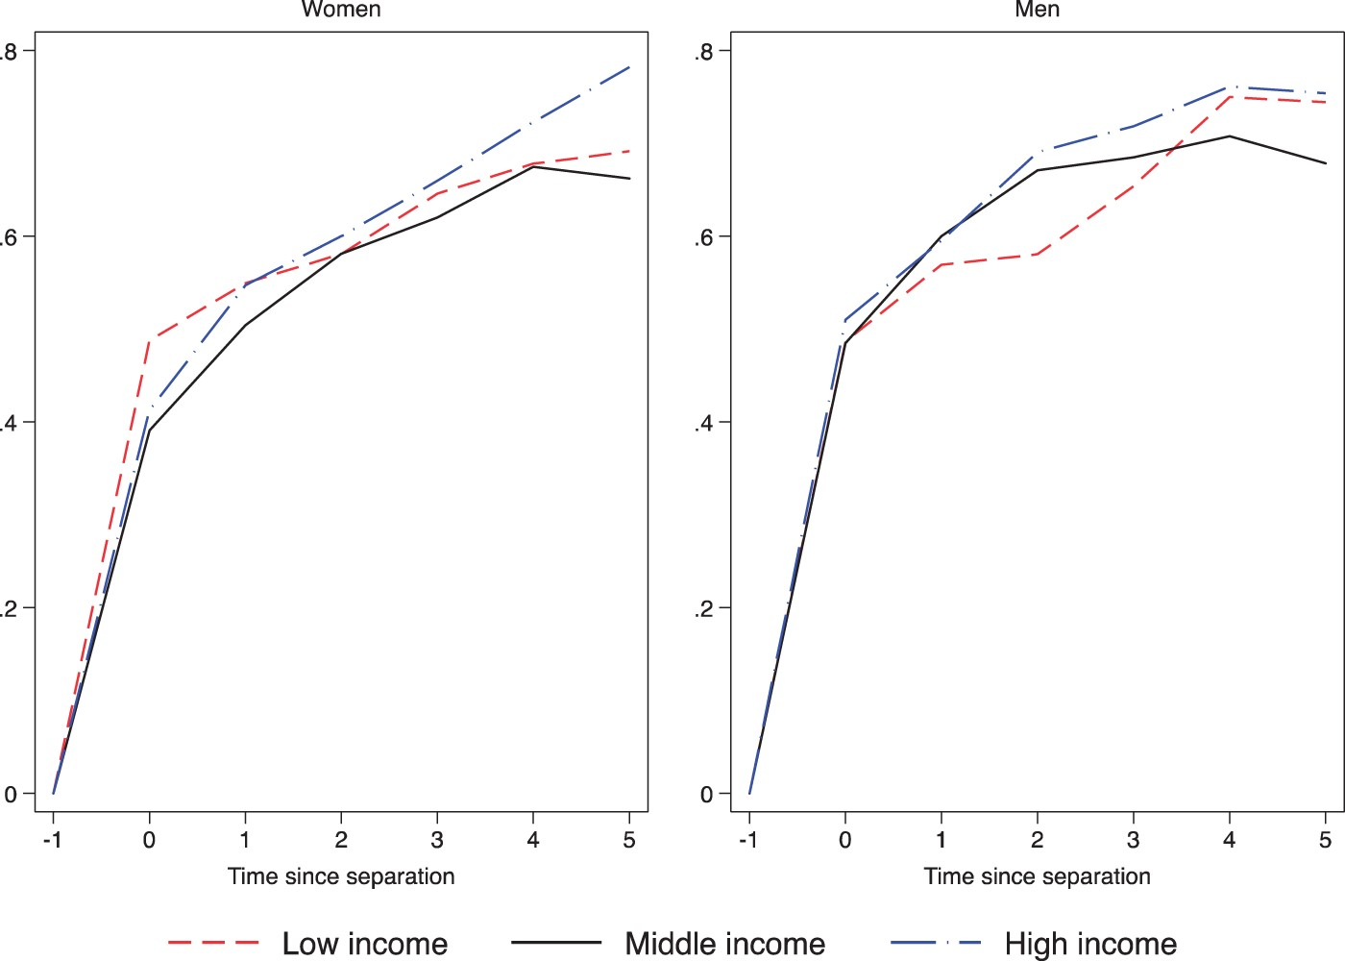
Figure 3. Housing: moved since divorceThe graphs show the proportions of women (on the left-hand side) and of men (on ...
Notes:
Figure 3. Housing: moved since divorceThe graphs show the proportions of women (on the left-hand side) and of men (on the right-hand side) who change their home following separation.
Unless provided in the caption above, the following copyright applies to the content of this slide: © The Author 2016. Published by Oxford University Press. All rights reserved. For permissions, please email: journals.permissions@oup.com

Slide 4
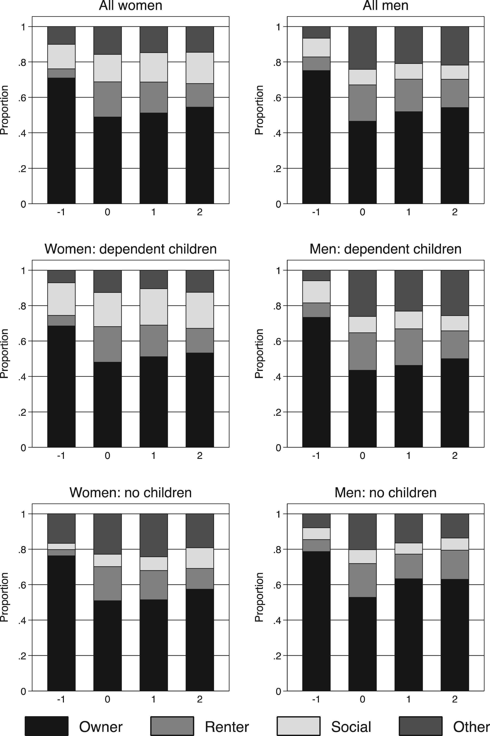
Figure 4. Housing tenure after divorceThe charts show the proportion of the sample with different housing tenure and ...
Notes:
Figure 4. Housing tenure after divorceThe charts show the proportion of the sample with different housing tenure and how this changes through divorce. The top row shows housing tenure for all women (left-hand chart) and all men (right hand chart). The second row shows tenure for those with dependent children and the bottom row those without dependent children.
Unless provided in the caption above, the following copyright applies to the content of this slide: © The Author 2016. Published by Oxford University Press. All rights reserved. For permissions, please email: journals.permissions@oup.com

Slide 5
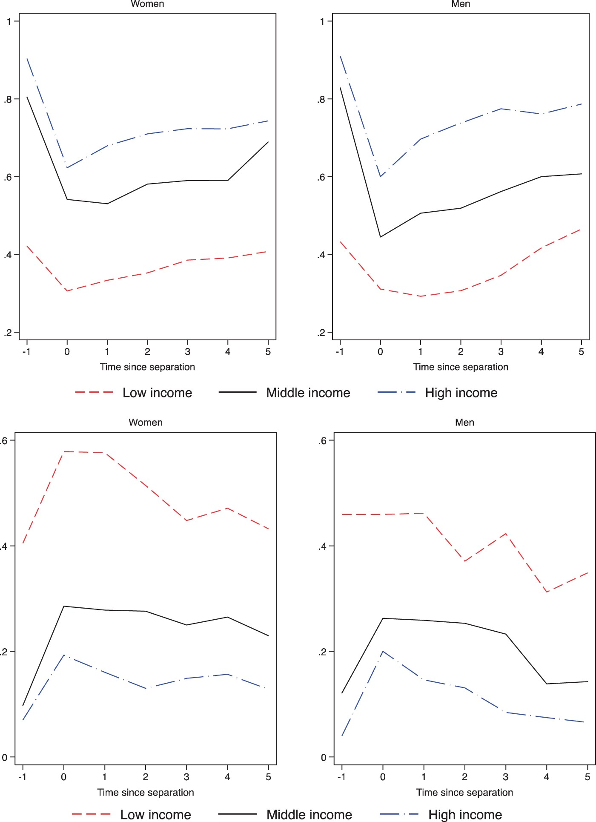
Figure 5. Housing: ownership and rentingThe graphs in the top row show the proportions who own their own home and ...
Notes:
Figure 5. Housing: ownership and rentingThe graphs in the top row show the proportions who own their own home and changes through divorce; the graphs in the bottom row show the proportions who rent their home and the changes through divorce. Proportions for women are on the left-hand side and proportions for men on the right-hand side.
Unless provided in the caption above, the following copyright applies to the content of this slide: © The Author 2016. Published by Oxford University Press. All rights reserved. For permissions, please email: journals.permissions@oup.com

Slide 6
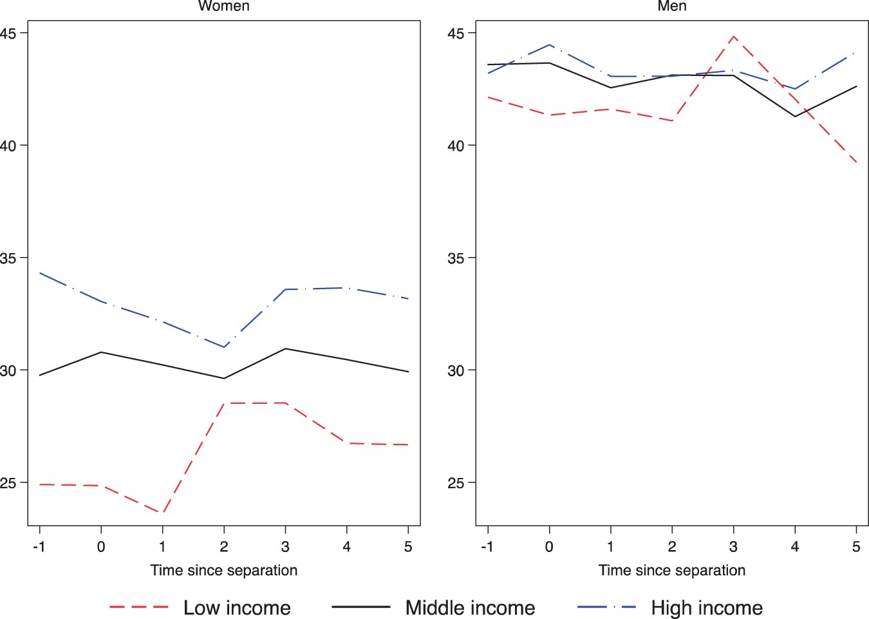
Figure 11. Hours worked (conditional on working)The graphs show average weekly hours worked for women and for men for ...
Notes:
Figure 11. Hours worked (conditional on working)The graphs show average weekly hours worked for women and for men for those who have some level of paid employment.
Unless provided in the caption above, the following copyright applies to the content of this slide: © The Author 2016. Published by Oxford University Press. All rights reserved. For permissions, please email: journals.permissions@oup.com

Slide 7
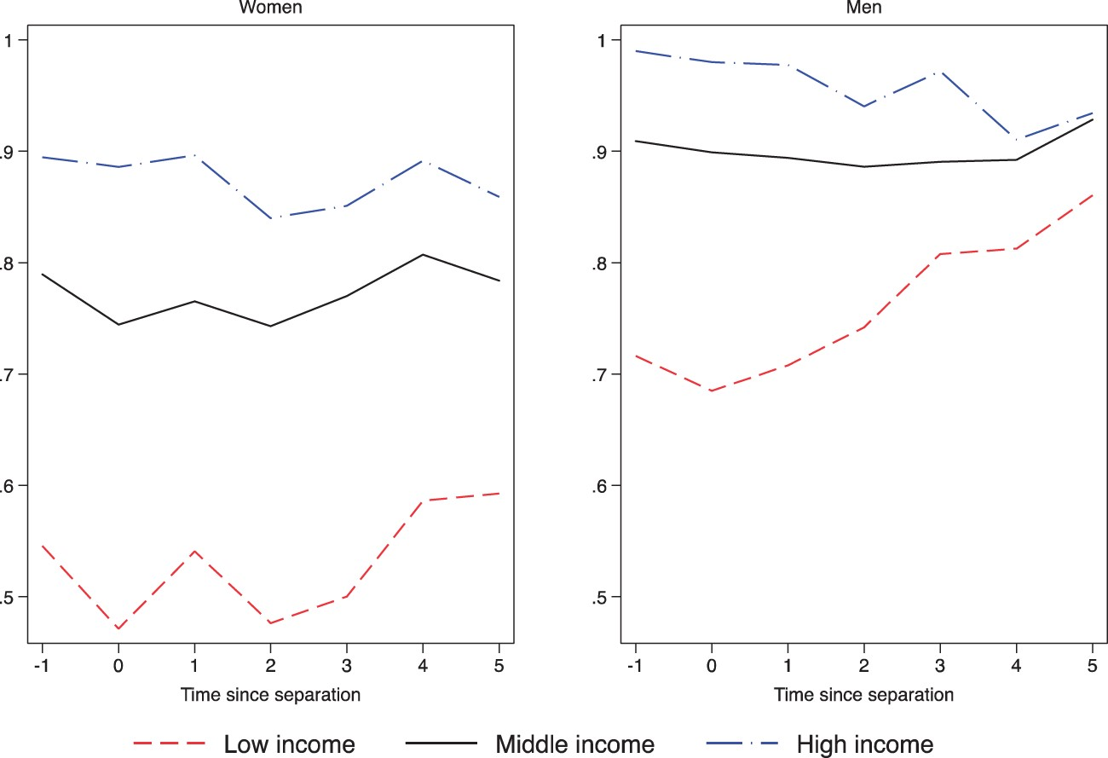
Figure 10. In paid employmentThe graphs show the proportions of women and of men who have some level of paid ...
Notes:
Figure 10. In paid employmentThe graphs show the proportions of women and of men who have some level of paid employment.
Unless provided in the caption above, the following copyright applies to the content of this slide: © The Author 2016. Published by Oxford University Press. All rights reserved. For permissions, please email: journals.permissions@oup.com

Slide 8
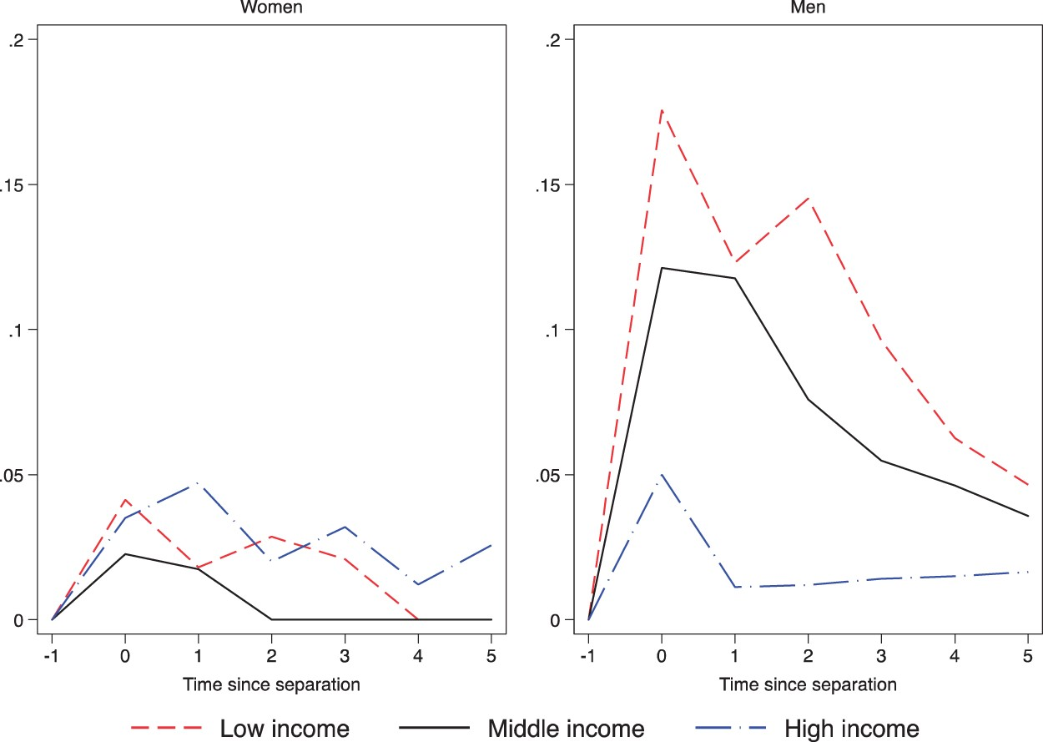
Figure 9. Living arrangements: extended familyThe graphs show the proportions of women and of men who are living with ...
Notes:
Figure 9. Living arrangements: extended familyThe graphs show the proportions of women and of men who are living with their extended family.
Unless provided in the caption above, the following copyright applies to the content of this slide: © The Author 2016. Published by Oxford University Press. All rights reserved. For permissions, please email: journals.permissions@oup.com

Slide 9
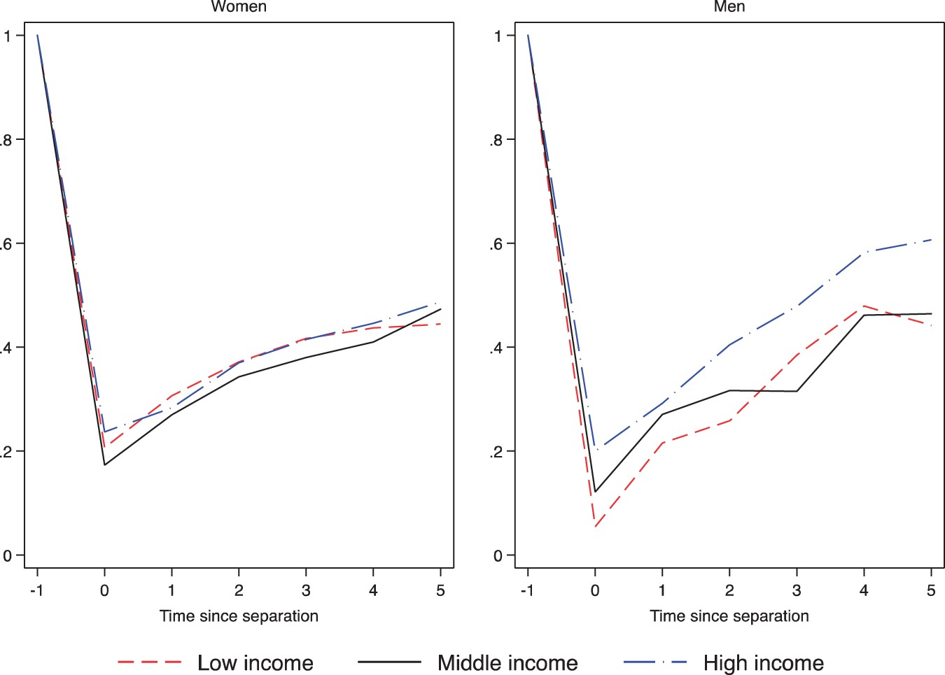
Figure 8. RepartneringThe graphs show the proportions of women and of men who are living as if married.
Notes:
Figure 8. RepartneringThe graphs show the proportions of women and of men who are living as if married.
Unless provided in the caption above, the following copyright applies to the content of this slide: © The Author 2016. Published by Oxford University Press. All rights reserved. For permissions, please email: journals.permissions@oup.com

Slide 10
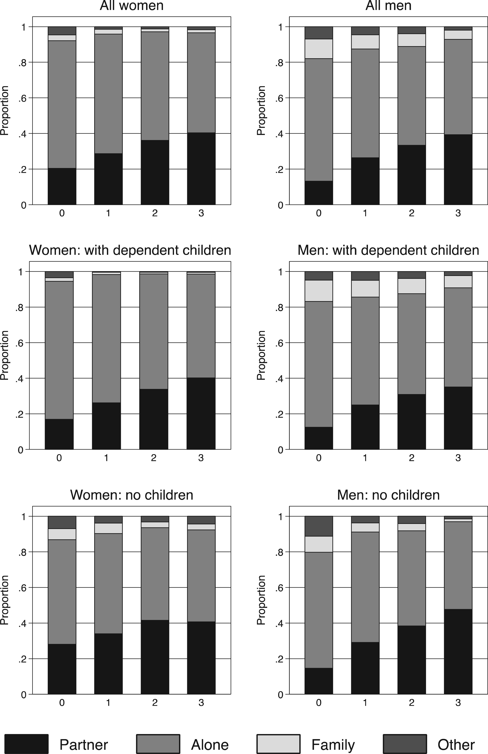
Figure 7. Living arrangements by presence of childrenGraphs show how the living arrangements of our divorcing sample ...
Notes:
Figure 7. Living arrangements by presence of childrenGraphs show how the living arrangements of our divorcing sample changes after divorce, separated out by gender and the presence of dependent children.
Unless provided in the caption above, the following copyright applies to the content of this slide: © The Author 2016. Published by Oxford University Press. All rights reserved. For permissions, please email: journals.permissions@oup.com

Slide 11
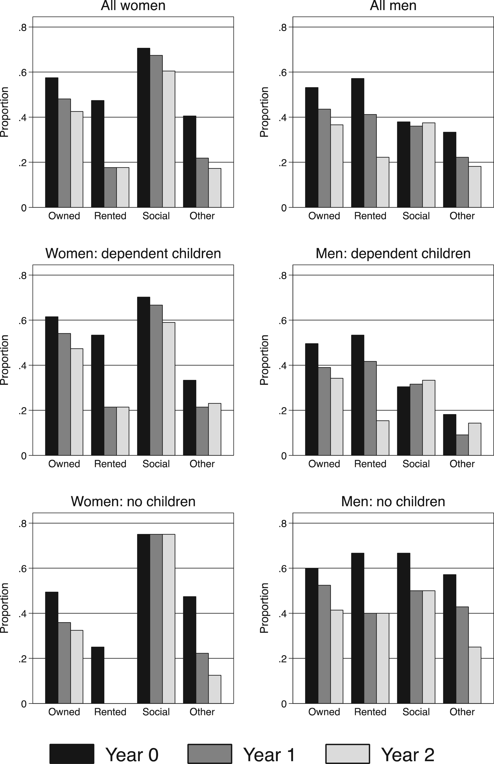
Figure 6. Proportions staying in the same house after divorce, by initial tenureEach panel shows the proportion of the ...
Notes:
Figure 6. Proportions staying in the same house after divorce, by initial tenureEach panel shows the proportion of the relevant group still living in the pre-divorce immediately following divorce, and in year 1 and year 2. Due to sample attrition, in some cases this proportion increases as time since divorce increases, reflecting the attrition of individuals who have already moved out of the marital home.
Unless provided in the caption above, the following copyright applies to the content of this slide: © The Author 2016. Published by Oxford University Press. All rights reserved. For permissions, please email: journals.permissions@oup.com

Slide 12
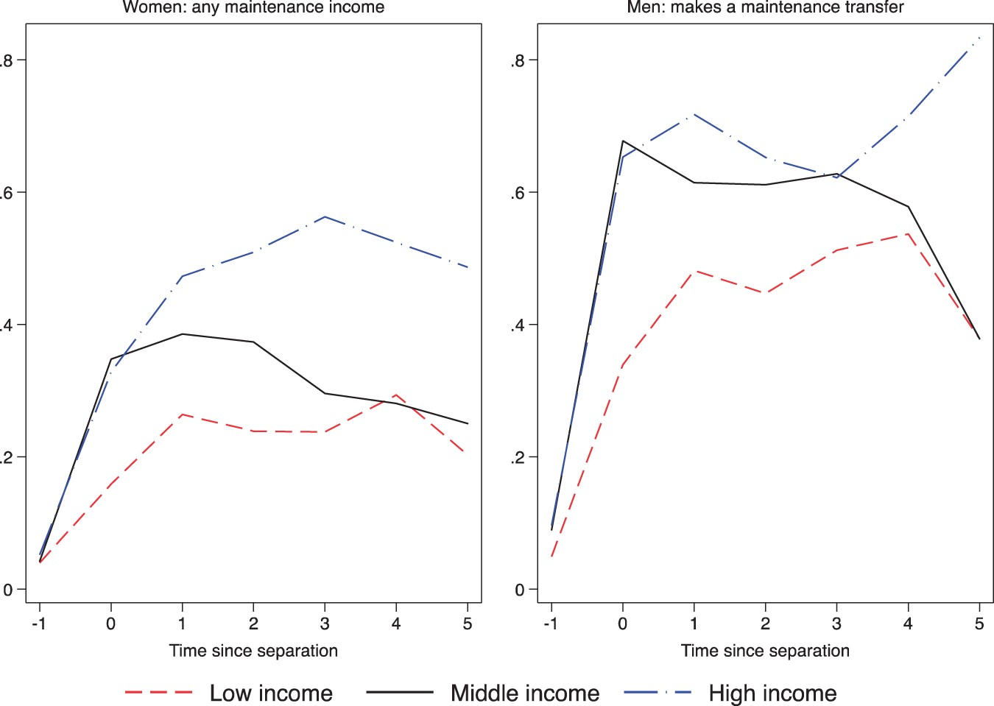
Figure 12. Transfers women receiving a transfer; men making a transferThe left graph shows the proportion of women ...
Notes:
Figure 12. Transfers women receiving a transfer; men making a transferThe left graph shows the proportion of women receiving a transfer within each income group; the right graph shows the proportion of men who make a transfer within each income group.
Unless provided in the caption above, the following copyright applies to the content of this slide: © The Author 2016. Published by Oxford University Press. All rights reserved. For permissions, please email: journals.permissions@oup.com

Slide 13
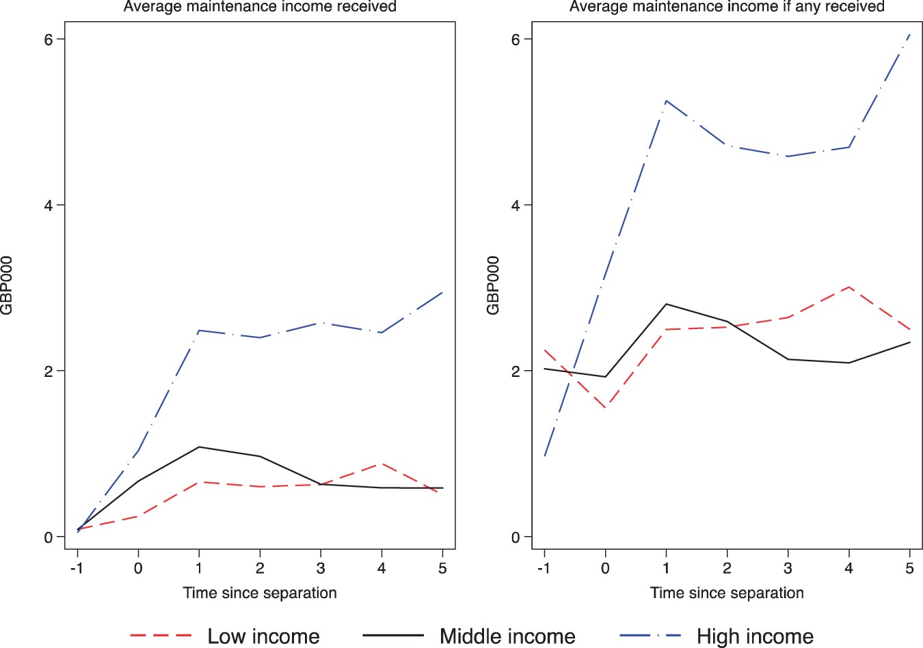
Figure 13. Transfers: average maintenance incomeThe left-hand side shows average amount received across all women, the ...
Notes:
Figure 13. Transfers: average maintenance incomeThe left-hand side shows average amount received across all women, the right-hand side shows the average amount received among those who receive a positive amount.
Unless provided in the caption above, the following copyright applies to the content of this slide: © The Author 2016. Published by Oxford University Press. All rights reserved. For permissions, please email: journals.permissions@oup.com

Slide 14
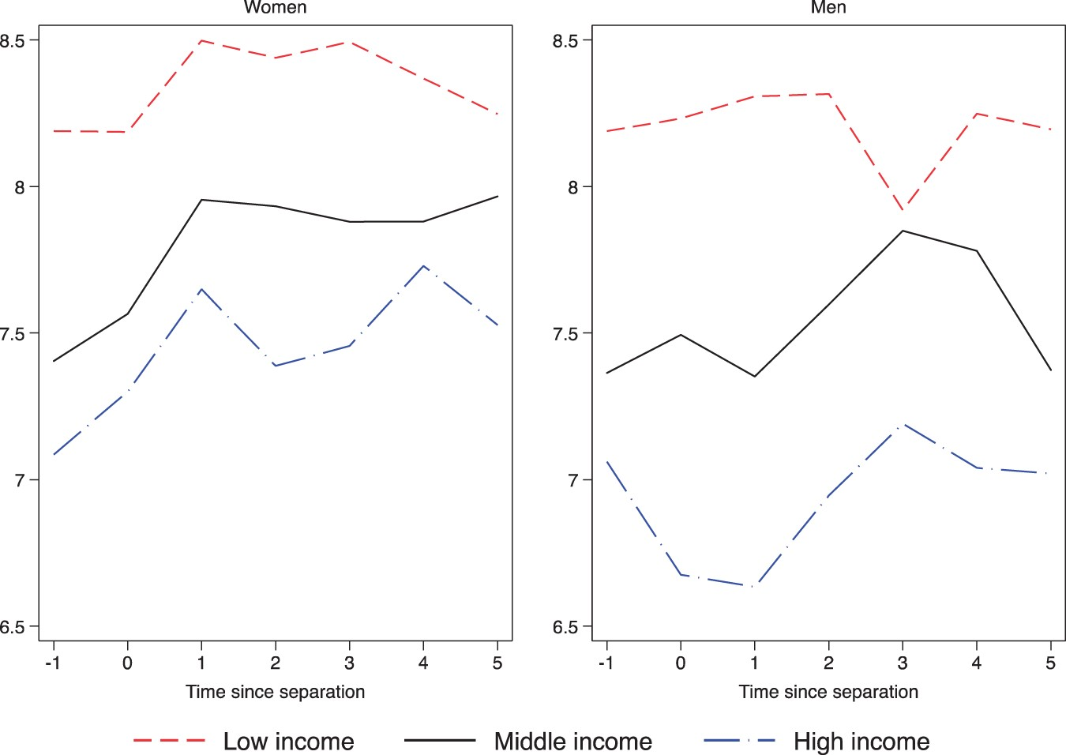
Figure 14. Log household benefit incomeThe graphs report the average of log of benefit income. Natural logarithms are ...
Notes:
Figure 14. Log household benefit incomeThe graphs report the average of log of benefit income. Natural logarithms are used so that the vertical difference between any two points measures the proportional change in income, rather than the monetary change. A rise of 0.4 is approximately a 40% increase.
Unless provided in the caption above, the following copyright applies to the content of this slide: © The Author 2016. Published by Oxford University Press. All rights reserved. For permissions, please email: journals.permissions@oup.com

Slide 15
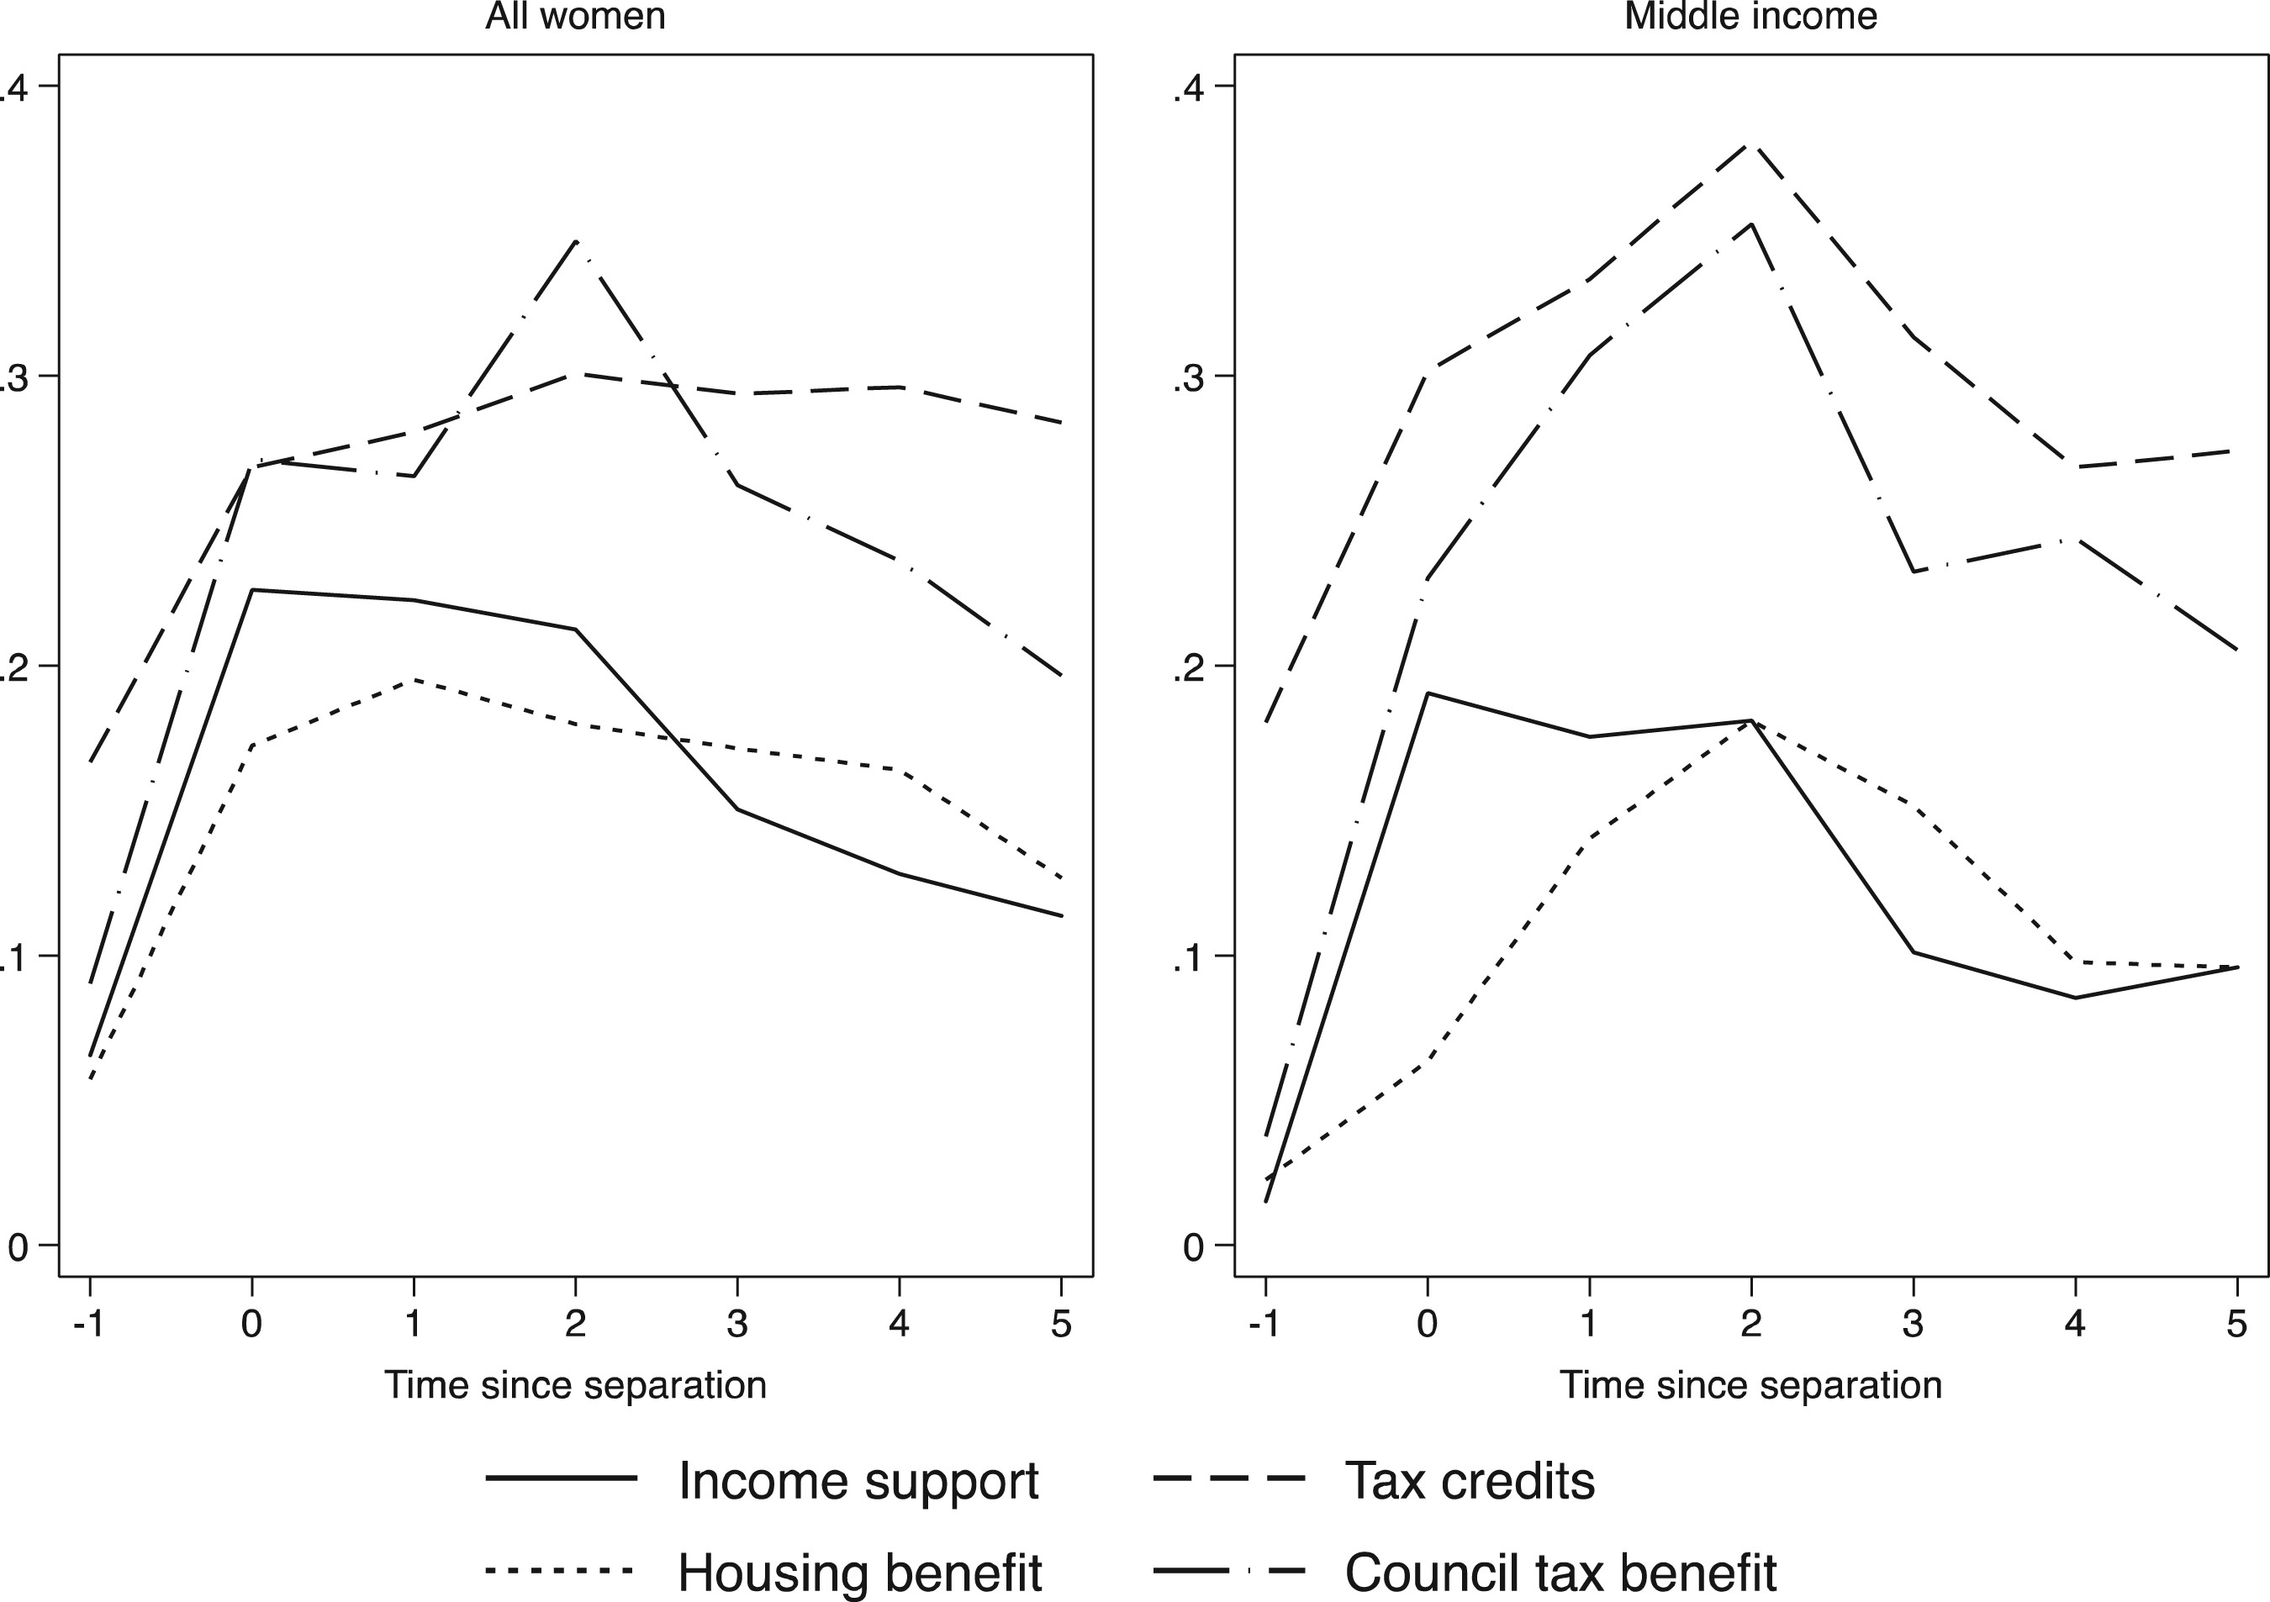
Figure 15. Benefit incomeThe graphs show the proportions of women who receive each type of benefit income. The left ...
Notes:
Figure 15. Benefit incomeThe graphs show the proportions of women who receive each type of benefit income. The left graph shows proportions of all women, the right graph shows the proportions for women in the middle income group.
Unless provided in the caption above, the following copyright applies to the content of this slide: © The Author 2016. Published by Oxford University Press. All rights reserved. For permissions, please email: journals.permissions@oup.com

Slide 16
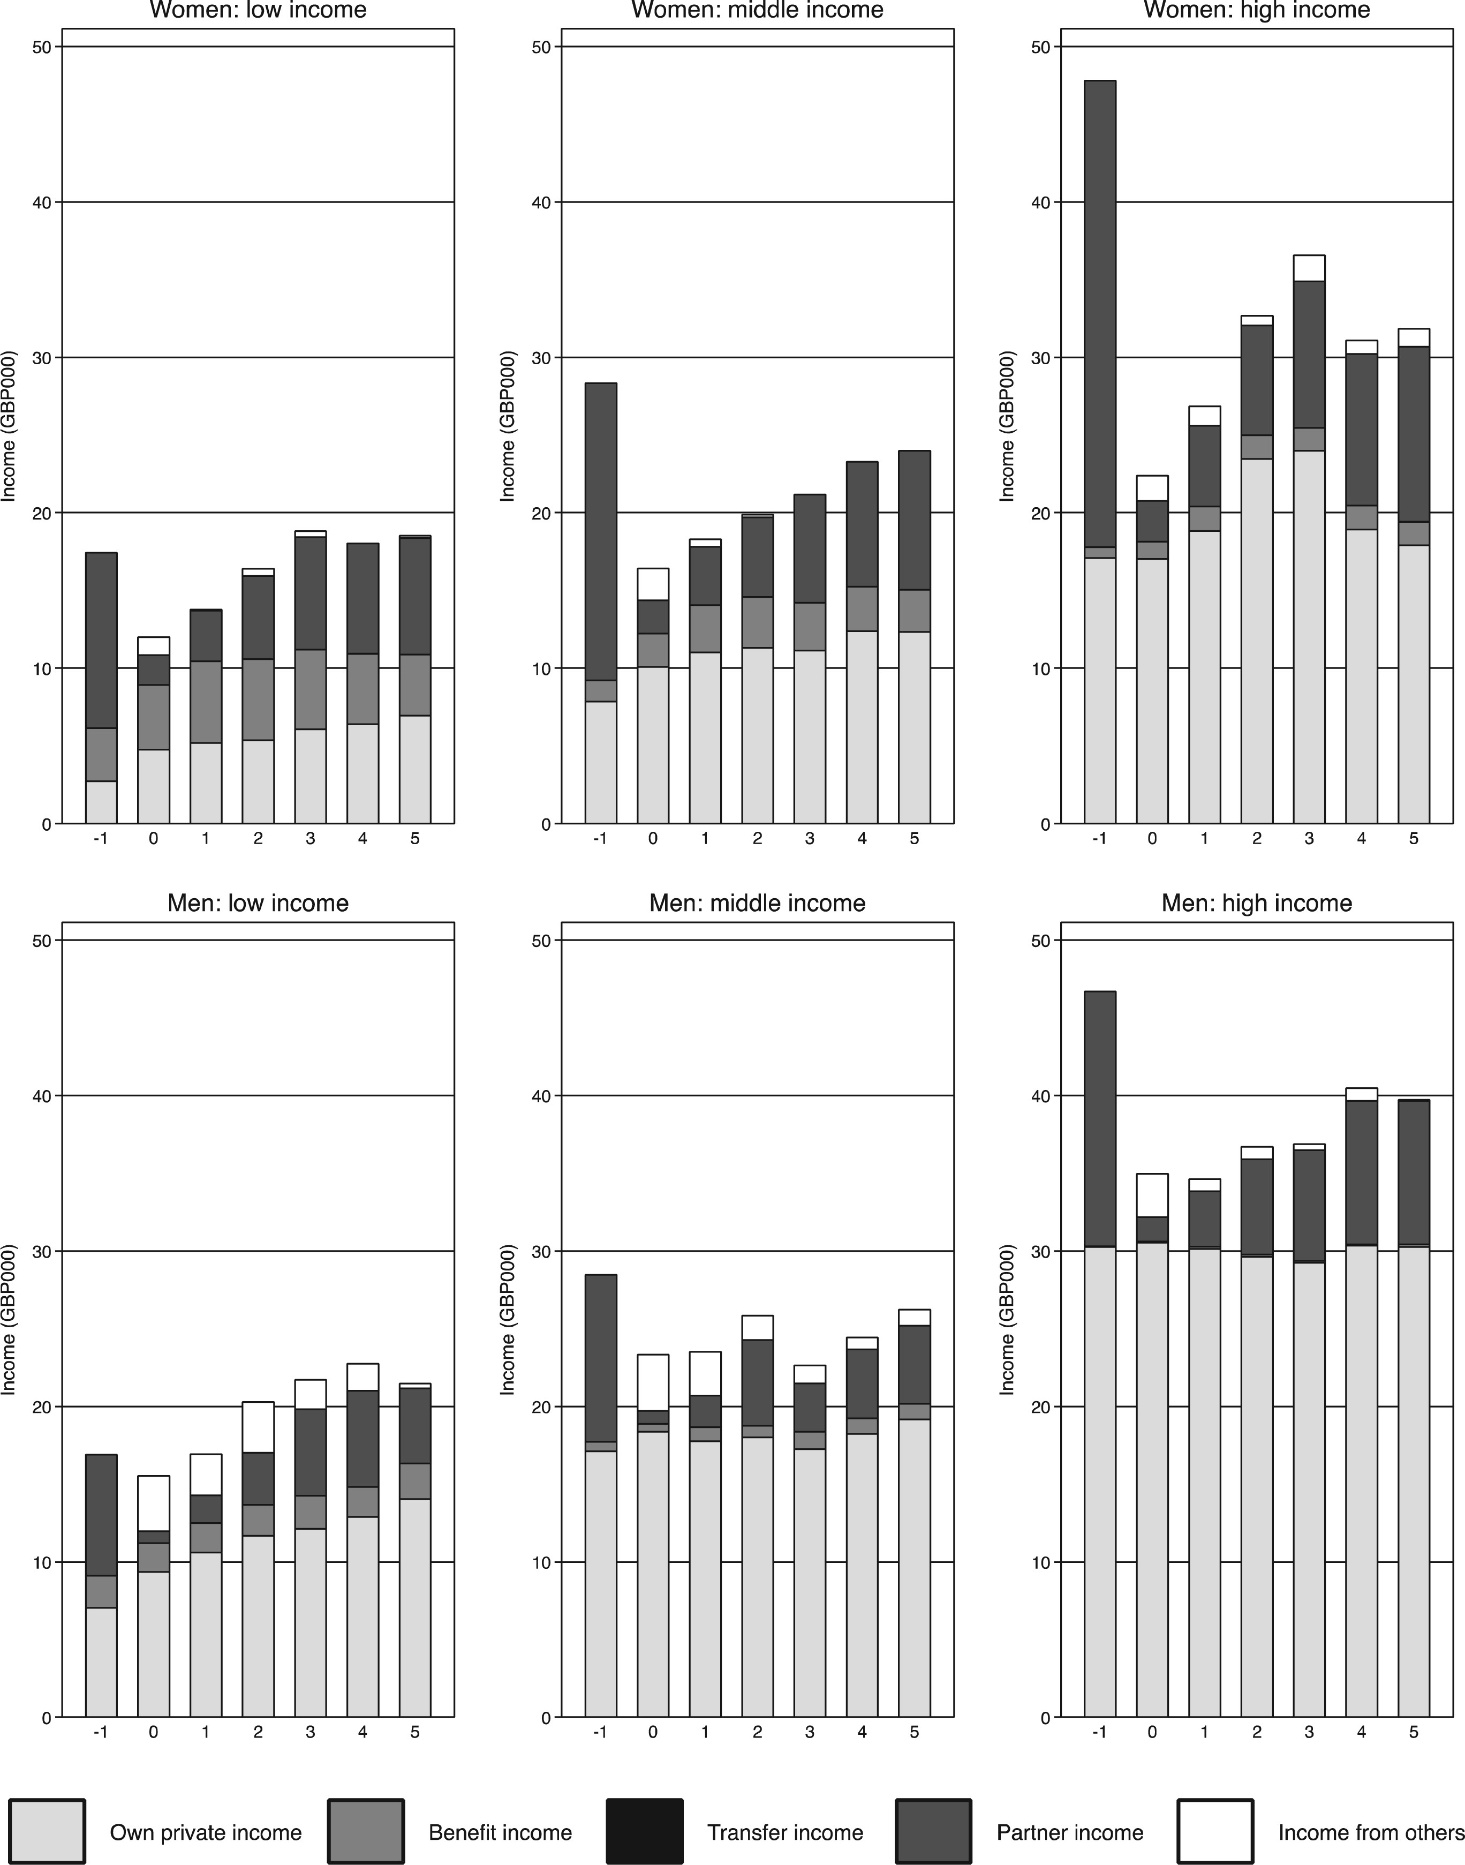
Figure 16. Composition of household income around divorcePartner income is the average amount contributed by any ...
Notes:
Figure 16. Composition of household income around divorcePartner income is the average amount contributed by any co-resident partner. At time -1 this is the former spouse; subsequently it may be a new spouse or a new unmarried co-resident partner. It is averaged over all observations regardless of whether a partner is present or not.
Unless provided in the caption above, the following copyright applies to the content of this slide: © The Author 2016. Published by Oxford University Press. All rights reserved. For permissions, please email: journals.permissions@oup.com

Slide 17
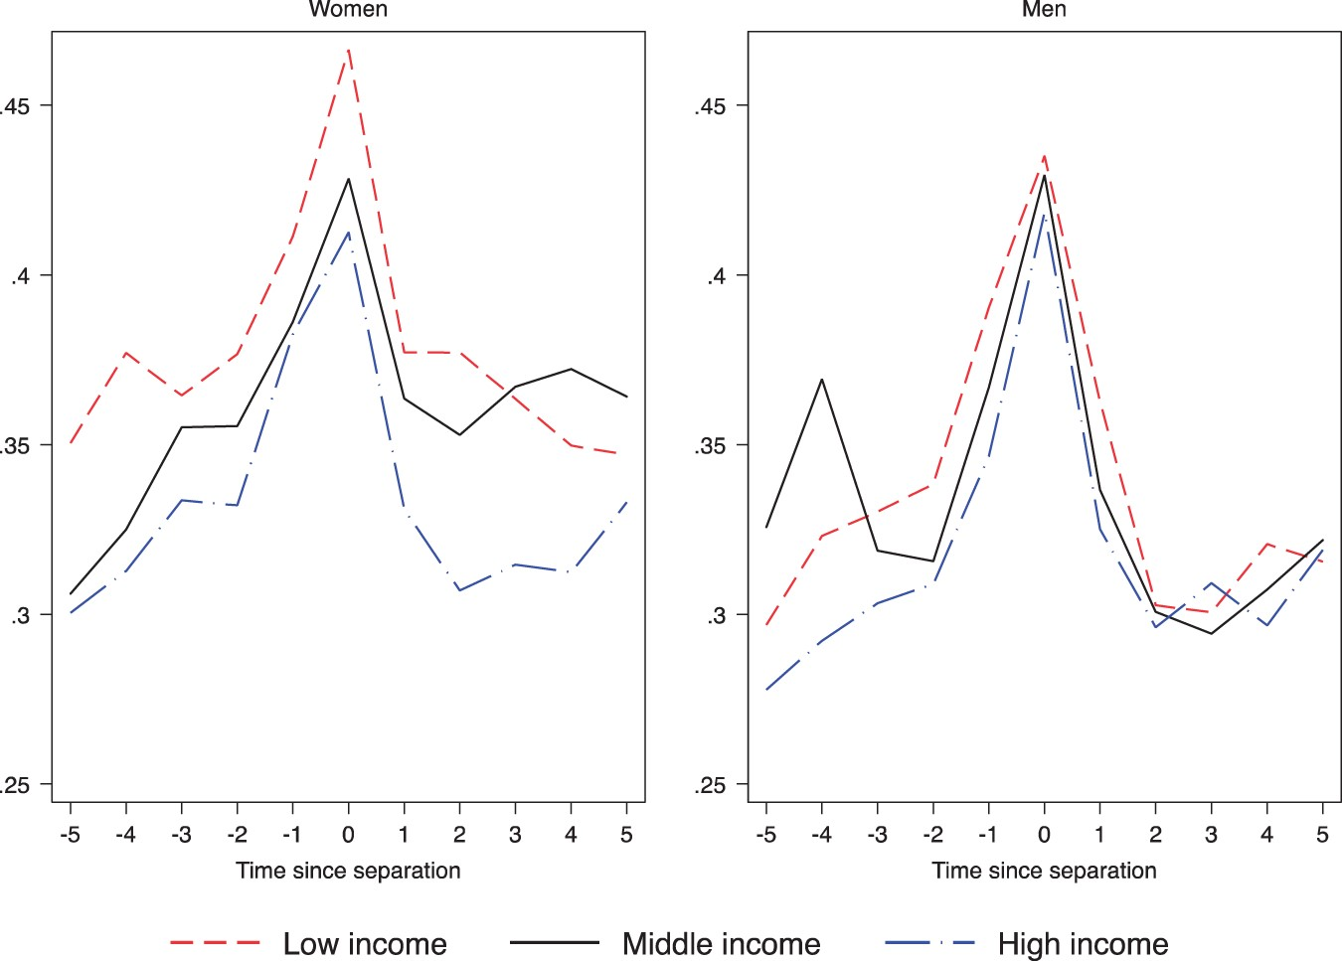
Figure 17. GHQ scores
Notes:
Figure 17. GHQ scores
Unless provided in the caption above, the following copyright applies to the content of this slide: © The Author 2016. Published by Oxford University Press. All rights reserved. For permissions, please email: journals.permissions@oup.com

