Slide 1
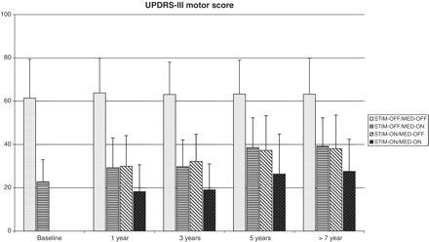
Figure 1 Evolution of the different UPDRS-III motor score CAPSIT-Parkinson’s disease conditions at different time ...
Notes:
Figure 1 Evolution of the different UPDRS-III motor score CAPSIT-Parkinson’s disease conditions at different time points from surgery.
Unless provided in the caption above, the following copyright applies to the content of this slide: © The Author (2011). Published by Oxford University Press on behalf of the Guarantors of Brain. All rights reserved. For Permissions, please email: journals.permissions@oup.com

Slide 2
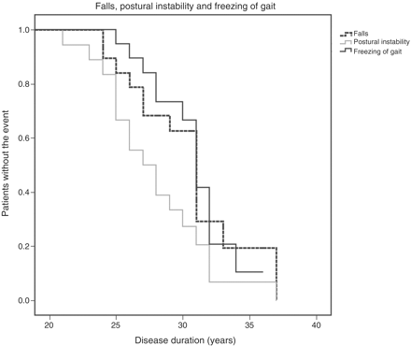
Figure 2 Survival curves for falls, postural instability and non-levodopa-responsive freezing of gait in relation to ...
Notes:
Figure 2 Survival curves for falls, postural instability and non-levodopa-responsive freezing of gait in relation to years of Parkinson’s disease duration.
Unless provided in the caption above, the following copyright applies to the content of this slide: © The Author (2011). Published by Oxford University Press on behalf of the Guarantors of Brain. All rights reserved. For Permissions, please email: journals.permissions@oup.com

Slide 3
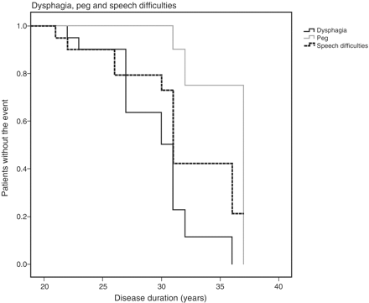
Figure 3 Survival curves for dysphagia, speech difficulties and patients requiring percutaneous gastrostomy in ...
Notes:
Figure 3 Survival curves for dysphagia, speech difficulties and patients requiring percutaneous gastrostomy in relation to years of Parkinson’s disease duration.
Unless provided in the caption above, the following copyright applies to the content of this slide: © The Author (2011). Published by Oxford University Press on behalf of the Guarantors of Brain. All rights reserved. For Permissions, please email: journals.permissions@oup.com

Slide 4
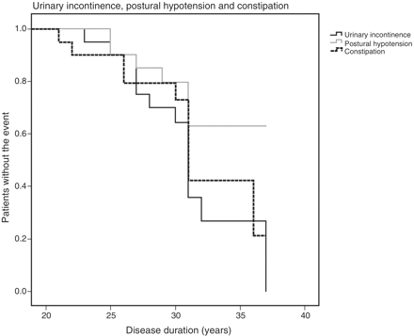
Figure 4 Survival curves for urinary incontinence and need of pharmacological treatments for constipation and postural ...
Notes:
Figure 4 Survival curves for urinary incontinence and need of pharmacological treatments for constipation and postural hypotension in relation to years of Parkinson’s disease duration.
Unless provided in the caption above, the following copyright applies to the content of this slide: © The Author (2011). Published by Oxford University Press on behalf of the Guarantors of Brain. All rights reserved. For Permissions, please email: journals.permissions@oup.com

Slide 5
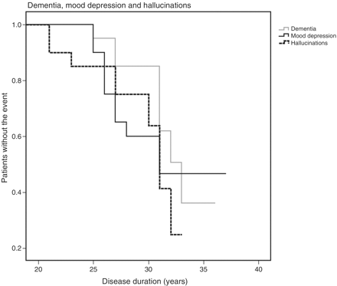
Figure 5 Survival curves for dementia and need of pharmacological treatments for mood depression and hallucinations in ...
Notes:
Figure 5 Survival curves for dementia and need of pharmacological treatments for mood depression and hallucinations in relation to years of Parkinson’s disease duration.
Unless provided in the caption above, the following copyright applies to the content of this slide: © The Author (2011). Published by Oxford University Press on behalf of the Guarantors of Brain. All rights reserved. For Permissions, please email: journals.permissions@oup.com

