Slide 1
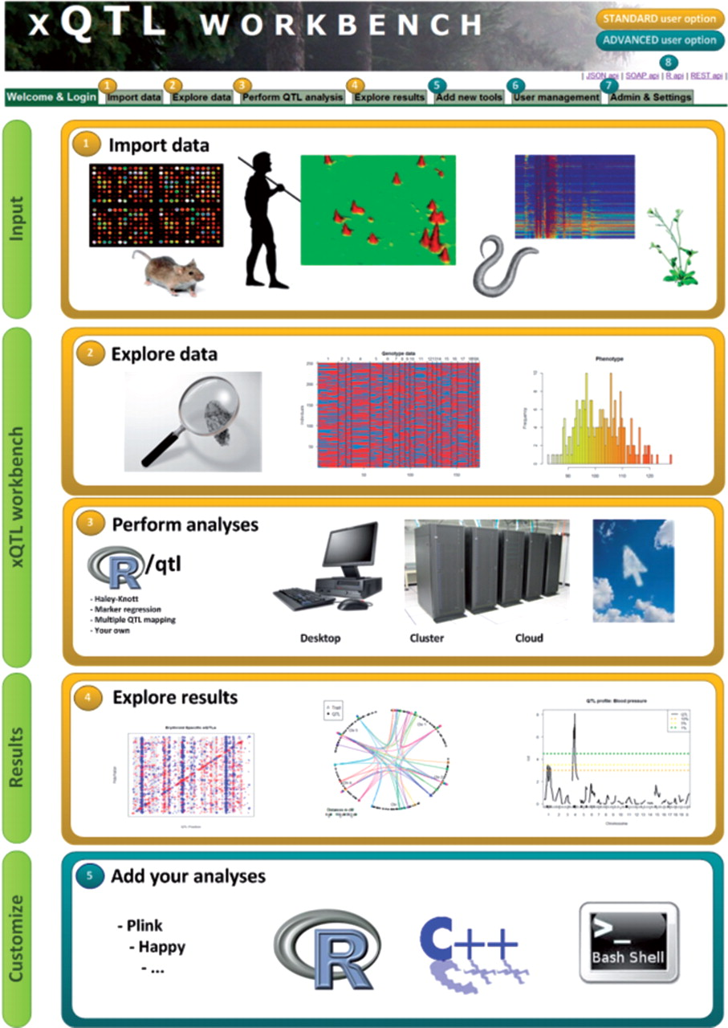
Fig. 1. Screenshot of xQTL workbench with all features enabled; (1) import phenotype, genotype and genetic map data, ...
Notes:
Fig. 1. Screenshot of xQTL workbench with all features enabled; (1) import phenotype, genotype and genetic map data, examples are given per import type; (2) search through the whole database, explore and browse your data using molgenis generated web-interfaces; (3) run R/qtl QTL mapping, the general plugin allows users to perform not only QTL mapping but also other analyze; (4) use default (or custom) plugins to explore results (e.g. Heatmaps, QTL profiles); (5) add new tools to the workbench (for Bio informaticians); (6) user management and access control of the system (Only for admins); (7) expert settings can be altered in the admin tab (Only for admins); (8) connect/share data using generated API's to R statistics, REST/JSON, SOAP.
Unless provided in the caption above, the following copyright applies to the content of this slide: © The Author(s) 2012. Published by Oxford University Press.This is an Open Access article distributed under the terms of the Creative Commons Attribution Non-Commercial License (http://creativecommons.org/licenses/by-nc/3.0), which permits unrestricted non-commercial use, distribution, and reproduction in any medium, provided the original work is properly cited.

