Slide 1
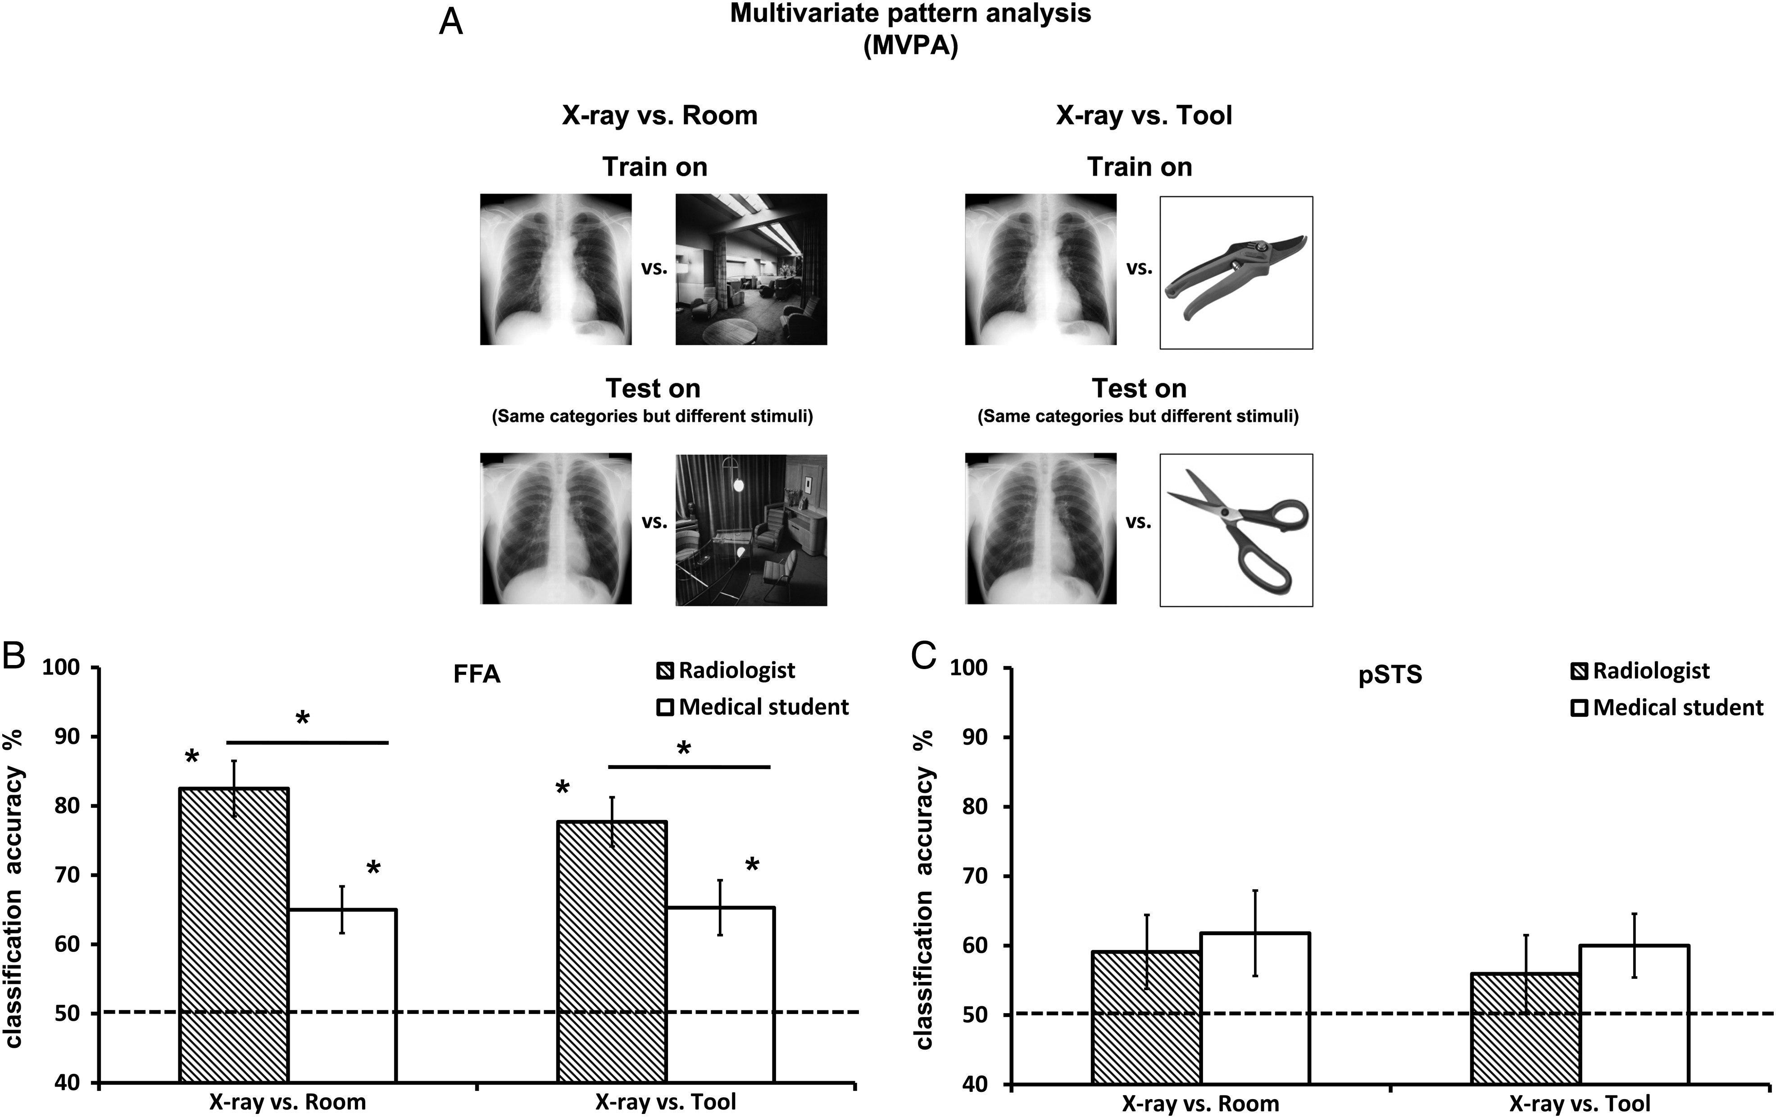
Figure 1. MVPA results. (A) Illustration of the binary comparison employed. FFA and pSTS' sensitivity to radiological ...
Notes:
Figure 1. MVPA results. (A) Illustration of the binary comparison employed. FFA and pSTS' sensitivity to radiological images was tested by 2 binary comparisons: 1) X-ray vs. Room and 2) X-ray versus Tool. The learning process used all stimuli pairs but one that was then used for testing the learned patterns of activation. (B) Classification accuracy presented as percentage of correctly classified instances (50% is a chance level—see the dotted line) of the binary comparisons with rooms and tools for the FFA. (C) Classification accuracy presented as percentage of correctly classified instances (50% is a chance level—see the dotted line) of the binary comparisons with rooms and tools for the pSTS. *P < 0.05. Error bars indicate SEM.
Unless provided in the caption above, the following copyright applies to the content of this slide: © The Author 2014. Published by Oxford University Press. All rights reserved. For Permissions, please e-mail: journals.permissions@oup.com

Slide 2
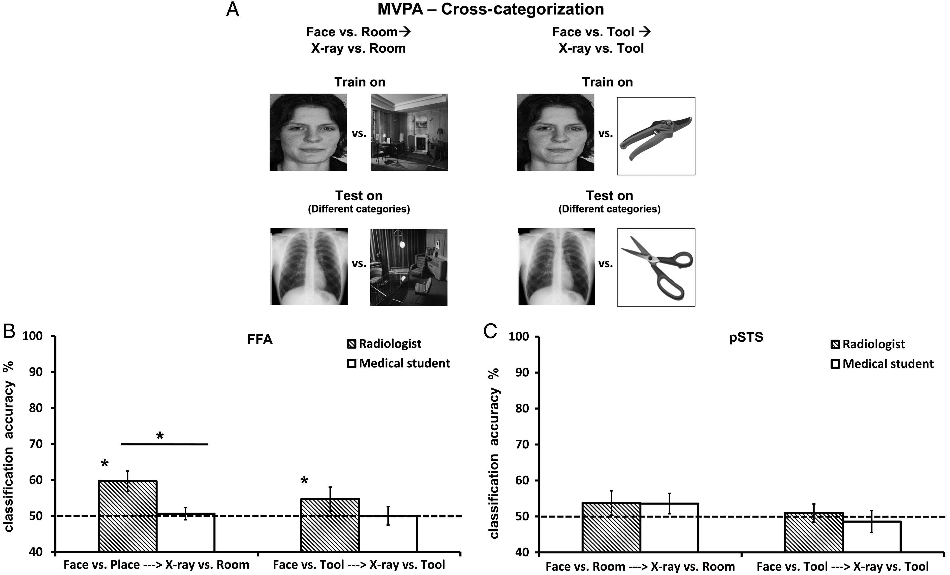
Figure 2. MVPA cross-categorization results. (A) Illustration of the cross-categorization procedure. Instead of ...
Notes:
Figure 2. MVPA cross-categorization results. (A) Illustration of the cross-categorization procedure. Instead of training and testing on the same categories (but different instances of the same categories—see Figure 1A), we trained on one type of category and tested on a different type of category. We first trained the classification algorithm on the binary comparison of faces and rooms. Then, we tested the learned patterns on the binary comparison involving a new category—X-rays. The same procedure was done for the tools (instead of rooms—right hand side) (B) Classification accuracy for cross-categorization procedure presented as percentage of correctly classified instances (50% is a chance level—see the dotted line) of the binary comparisons with rooms and tools for the FFA. (C) Classification accuracy for cross-categorization procedure presented as percentage of correctly classified instances (50% is a chance level—see the dotted line) of the binary comparisons with rooms and tools for the pSTS. *P < 0.05. Error bars indicate SEM.
Unless provided in the caption above, the following copyright applies to the content of this slide: © The Author 2014. Published by Oxford University Press. All rights reserved. For Permissions, please e-mail: journals.permissions@oup.com

Slide 3
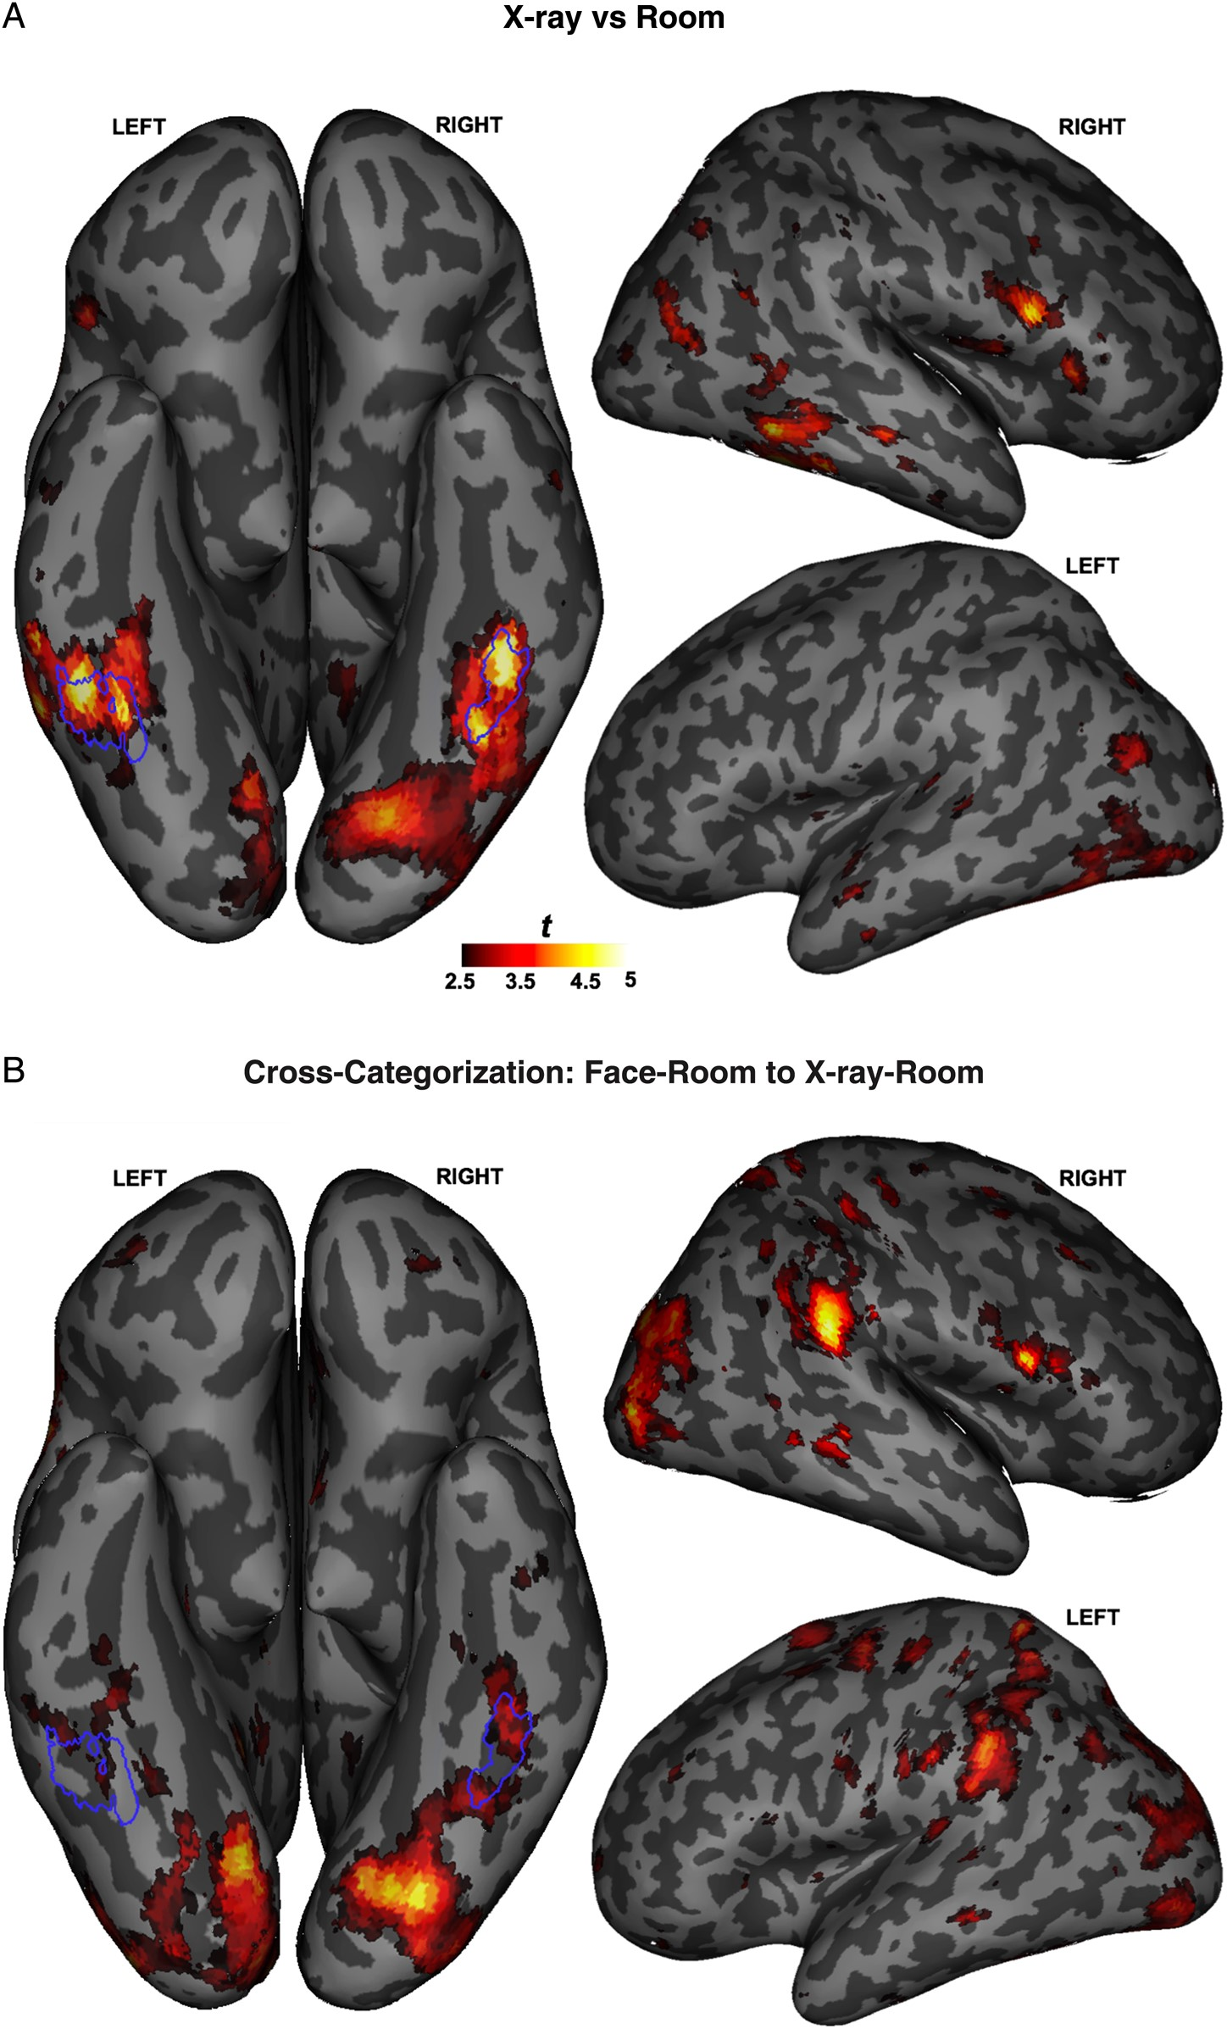
Figure 3. Searchlight maps for radiological expertise effect. (A) Areas in the searchlight procedure that were more ...
Notes:
Figure 3. Searchlight maps for radiological expertise effect. (A) Areas in the searchlight procedure that were more successful in radiologists than medical students in differentiating between X-rays and rooms. The right and left FFA obtained from the localizer (group analysis—see Fig. SM1) were superimposed on the inferior brain searchlight maps (white blue color). The list of all areas can be found in Supplementary Table 1. (B) Areas in the searchlight procedure that were more successful in radiologists than medical students in differentiating the cross-categorization procedure Face–Room to X-ray–Room. The right and left FFA obtained from the localizer (group analysis—see Supplementary Fig. 1) were superimposed on the inferior brain searchlight maps (white blue color). The list of all areas can be found in Supplementary Table 1. Error bars indicate SEM.
Unless provided in the caption above, the following copyright applies to the content of this slide: © The Author 2014. Published by Oxford University Press. All rights reserved. For Permissions, please e-mail: journals.permissions@oup.com

Slide 4
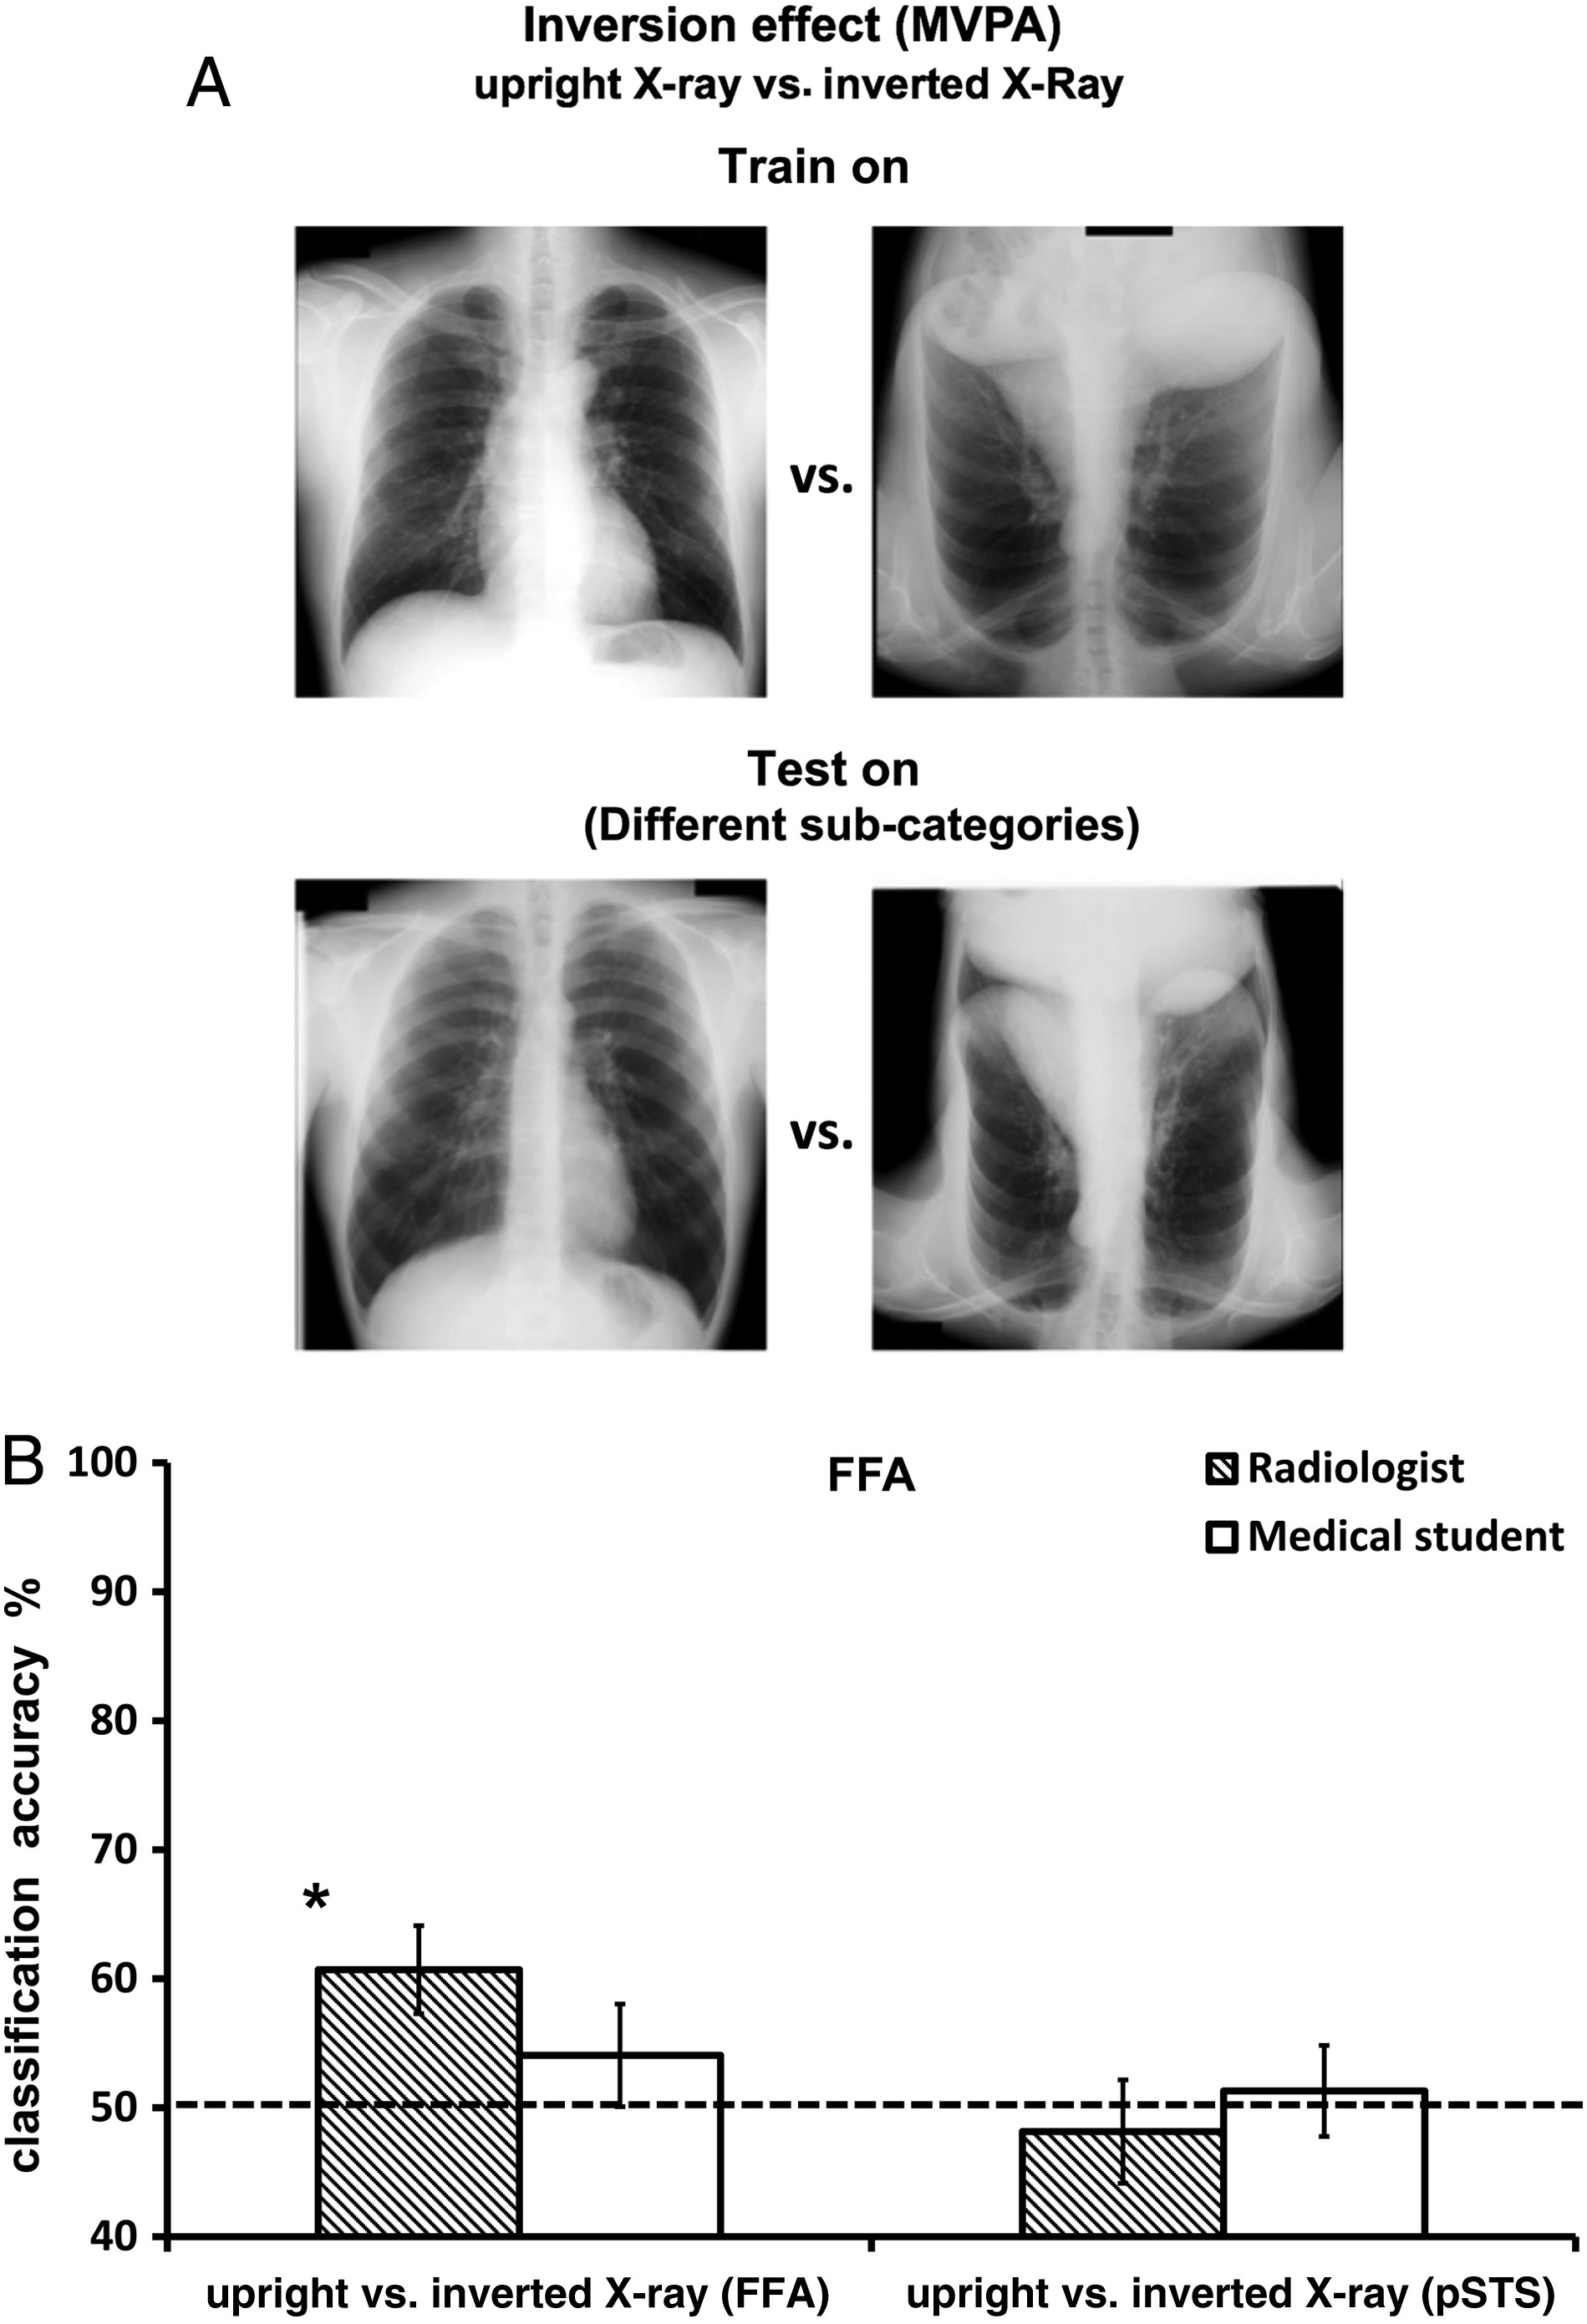
Figure 4. Inversion effect—MVPA results. (A) Illustration of the binary comparison employed to test the inversion ...
Notes:
Figure 4. Inversion effect—MVPA results. (A) Illustration of the binary comparison employed to test the inversion effect. The FFA’s sensitivity to the inversion effect was tested by two binary comparisons between upright and inverted X-rays. The learning process used all stimuli pairs but one that was then used for testing the learned patterns of activation. (B) Classification accuracy for cross-categorization procedure presented as percentage of correctly classified instances (50% is a chance level—see the dotted line) of the binary comparisons with upright and inverted X-ray for the FFA (left) and the pSTS (right). *P < 0.05. Error bars indicate SEM.
Unless provided in the caption above, the following copyright applies to the content of this slide: © The Author 2014. Published by Oxford University Press. All rights reserved. For Permissions, please e-mail: journals.permissions@oup.com

