Slide 1
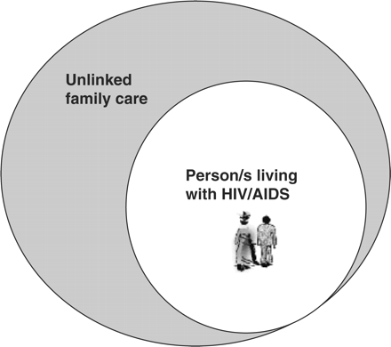
Figure 1. Unlinked household care for HIV and AIDS
Notes:
Figure 1. Unlinked household care for HIV and AIDS
Unless provided in the caption above, the following copyright applies to the content of this slide: © The Author 2006. Published by Oxford University Press in association with The London School of Hygiene and Tropical Medicine. All rights reserved.

Slide 2
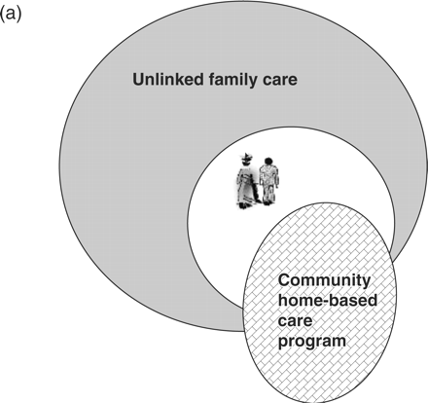
Figure 2a. Person with HIV receiving some support from CHBC programme. Household remains largely unlinked
Notes:
Figure 2a. Person with HIV receiving some support from CHBC programme. Household remains largely unlinked
Unless provided in the caption above, the following copyright applies to the content of this slide: © The Author 2006. Published by Oxford University Press in association with The London School of Hygiene and Tropical Medicine. All rights reserved.

Slide 3
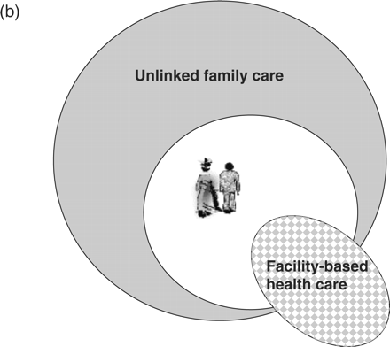
Figure 2b. Person with HIV receiving facility-based care only. Household remains entirely unlinked
Notes:
Figure 2b. Person with HIV receiving facility-based care only. Household remains entirely unlinked
Unless provided in the caption above, the following copyright applies to the content of this slide: © The Author 2006. Published by Oxford University Press in association with The London School of Hygiene and Tropical Medicine. All rights reserved.

Slide 4
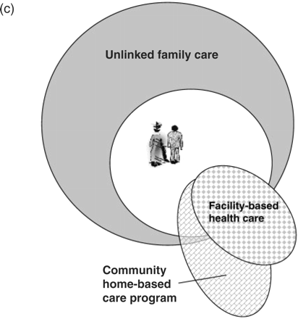
Figure 2c. Person with HIV receiving CHBC and facility care. Household, not receiving support, continues to remain ...
Notes:
Figure 2c. Person with HIV receiving CHBC and facility care. Household, not receiving support, continues to remain largely unlinked
Unless provided in the caption above, the following copyright applies to the content of this slide: © The Author 2006. Published by Oxford University Press in association with The London School of Hygiene and Tropical Medicine. All rights reserved.

Slide 5
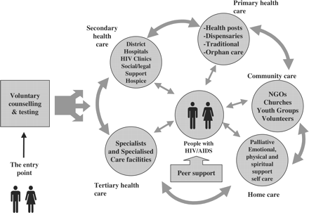
Figure 3. The Comprehensive Continuum of Care. Source: WHO (2000c), Key elements in care, treatment and support.
Notes:
Figure 3. The Comprehensive Continuum of Care. Source: WHO (2000c), Key elements in care, treatment and support.
Unless provided in the caption above, the following copyright applies to the content of this slide: © The Author 2006. Published by Oxford University Press in association with The London School of Hygiene and Tropical Medicine. All rights reserved.

Slide 6
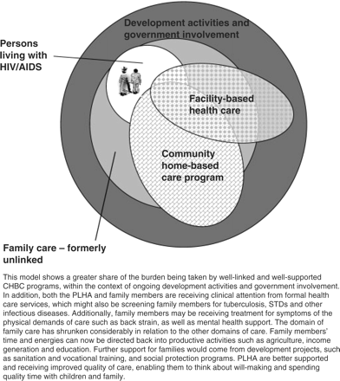
Figure 4. Fully linked-up care provision in context of broader structural interventions
Notes:
Figure 4. Fully linked-up care provision in context of broader structural interventions
Unless provided in the caption above, the following copyright applies to the content of this slide: © The Author 2006. Published by Oxford University Press in association with The London School of Hygiene and Tropical Medicine. All rights reserved.

