Slide 1
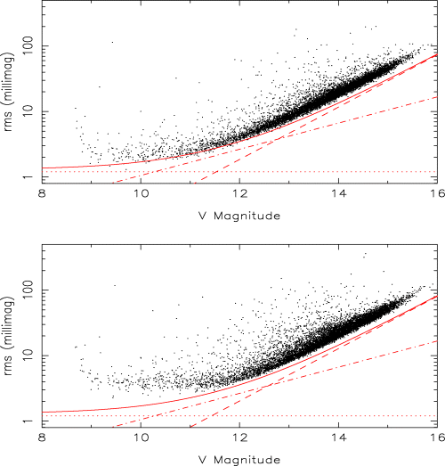
Figure 4 Photometric precision from one night (top panel) and five nights (bottom panel) of APT observations of the ...
Notes:
Figure 4 Photometric precision from one night (top panel) and five nights (bottom panel) of APT observations of the field centred on the open cluster NGC 6633 (2002 August). The solid line is the theoretical estimate, including Poisson noise in the star flux (dot-dashed) and sky flux (dashed), and a magnitude-independent term (dotted). The latter term (1.2 mmag) represents scintillation, as well as any residual errors due to flat-fielding, non-linearity and IPSV. Stars brighter than V≈ 9 are saturated in a 150-s APT image.
Unless provided in the caption above, the following copyright applies to the content of this slide: © 2005 RAS

Slide 2
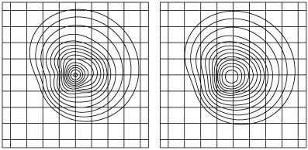
Figure 2 The iPSF of the APT near the centre of the field. Each PSF has been normalized to have a total flux of 1. The ...
Notes:
Figure 2 The iPSF of the APT near the centre of the field. Each PSF has been normalized to have a total flux of 1. The contour levels are identical in both panels, and have uniform logarithmic spacing. The grid spacing corresponds to one CCD pixel. Left panel: the normal, focused iPSF, determined by fitting a multiGaussian model to a set of 150-s, V-band images of a bright star (Toyozumi & Ashley, in preparation). The FWHM is ∼0.7 pixel and the peak intensity ∼1.1. Right panel: the broadened iPSF obtained by the raster-scan technique. This model was calculated by numerically convolving the normal iPSF with the raster-scan pattern followed by the telescope (Ashley et al., in preparation). It has a FWHM of ∼1.5 pixel, and a peak intensity ∼0.5.
Unless provided in the caption above, the following copyright applies to the content of this slide: © 2005 RAS

Slide 3
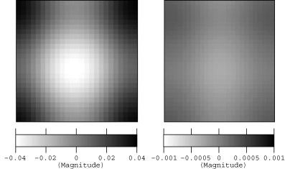
Figure 3 The effect of IPSVs on the photometry from undersampled images taken by the APT. Each image represents one ...
Notes:
Figure 3 The effect of IPSVs on the photometry from undersampled images taken by the APT. Each image represents one CCD pixel, and shows the relative magnitude measured for a star, as a function of its position within the pixel. An accurate model of the iPSF, obtained from real images (Toyozumi & Ashley, in preparation), was convolved with the pixel sensitivity, as measured by scanning the CCD with a spot of light (Toyozumi & Ashley 2005). The two panels correspond to the two iPSF models presented in Fig. 2. Left panel: the result for normal, focused APT images in the V band. Right panel: the reduced effect when the PSF is broadened by the raster-scan technique (Section 4.1). Note the difference in scale.
Unless provided in the caption above, the following copyright applies to the content of this slide: © 2005 RAS

Slide 4
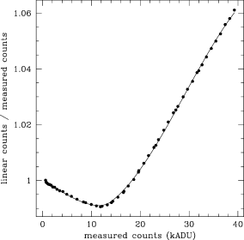
Figure 1 Deviation from linearity of the CCD response, measured from a set of dome flat images taken at a range of ...
Notes:
Figure 1 Deviation from linearity of the CCD response, measured from a set of dome flat images taken at a range of exposure times. The fitted curve (two third-order polynomials joined at ∼13000 ADU) is used to correct images for this effect.
Unless provided in the caption above, the following copyright applies to the content of this slide: © 2005 RAS

Slide 5
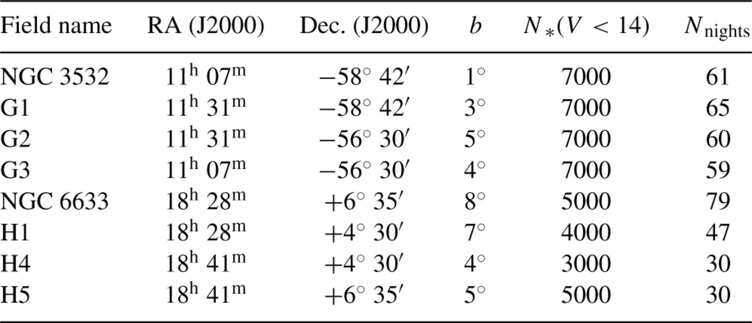
Table 1 Fields targeted in the UNSW planet search.
Notes:
Table 1 Fields targeted in the UNSW planet search.
Unless provided in the caption above, the following copyright applies to the content of this slide: © 2005 RAS

Slide 6
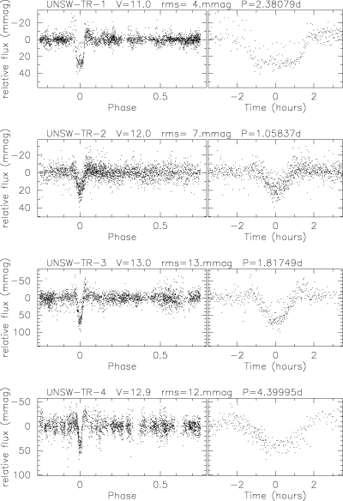
Figure 5 Phase-folded light curves of the four transit candidates found in the NGC 6633 field. The light curves ...
Notes:
Figure 5 Phase-folded light curves of the four transit candidates found in the NGC 6633 field. The light curves include all V-band data of reasonable photometric quality (nightly rms ≲10 mmag and at least 10 points per night) we obtained during 2002–2004. Note that UNSW-TR-2 is folded at its originally estimated period. Follow-up observations have shown that this is a binary system with two nearly identical eclipses, and the true period is twice this value.
Unless provided in the caption above, the following copyright applies to the content of this slide: © 2005 RAS

Slide 7
Table 2 Transit candidates in the NGC 6633 field: coordinates and parameters estimated from APT data. T_{c} ...
Notes:
Table 2 Transit candidates in the NGC 6633 field: coordinates and parameters estimated from APT data. Tc is the time at the centre of the first transit we detected (JD−2450000). Coordinates are from the WCS solution in the APT images, and represent the centroid (to within ∼1 arcsec) of the object, which is generally a blend. Similarly, the given V magnitudes, with errors of ∼0.1 mag, are for the blend as measured by the APT. Errors in the other measured parameters are 5 × 10−5 d for the period, 0.01 d for Tc, 5 mmag for the transit depth (ΔF) and ∼0.5 h for tT and tF (the duration of the complete transit, and of the ‘flat bottom’ part, respectively). Estimates for the radius of the star (R1) and the planet (R2) were derived using the equations of Seager & Mallén-Ornelas (2003). UNSW-TR-1 is a member of the cluster (NGC 6633 141).
Unless provided in the caption above, the following copyright applies to the content of this slide: © 2005 RAS

Slide 8
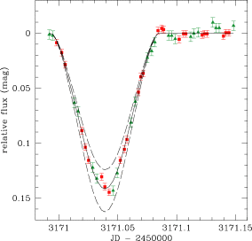
Figure 6 The undiluted eclipse signal from transit candidate UNSW-TR-2, observed at high spatial resolution with the ...
Notes:
Figure 6 The undiluted eclipse signal from transit candidate UNSW-TR-2, observed at high spatial resolution with the 40-inch telescope at SSO. We observed a single transit, and alternated between V band (triangles) and I band (squares). The solid line is the model light curve for an eclipsing system consisting of two K7V stars (with masses 0.58 M⊙ and radii 0.64 M⊙) in a 2.12-d orbit, at an inclination of ∼83°. The dashed lines show the result of varying the radius of the stars by ±5 per cent (keeping other parameters constant).
Unless provided in the caption above, the following copyright applies to the content of this slide: © 2005 RAS

Slide 9
Table 3 Transit candidates in the NGC 6633 field: parameters obtained from follow-up spectroscopy. The error on the ...
Notes:
Table 3 Transit candidates in the NGC 6633 field: parameters obtained from follow-up spectroscopy. The error on the primary mass (M1) was assumed to be 10 per cent. The velocity amplitude of TR-2 was estimated from the separation of double lines in the single spectrum we obtained. As it is a binary system with nearly identical components, the orbital period is twice the value measured from the APT light curves. We assumed the two stars have equal mass. The orbit of TR-4 appears to be eccentric, but we have insufficient data for a rigorous Keplerian fit. Assuming a circular orbit gives the result quoted here.
Unless provided in the caption above, the following copyright applies to the content of this slide: © 2005 RAS

Slide 10
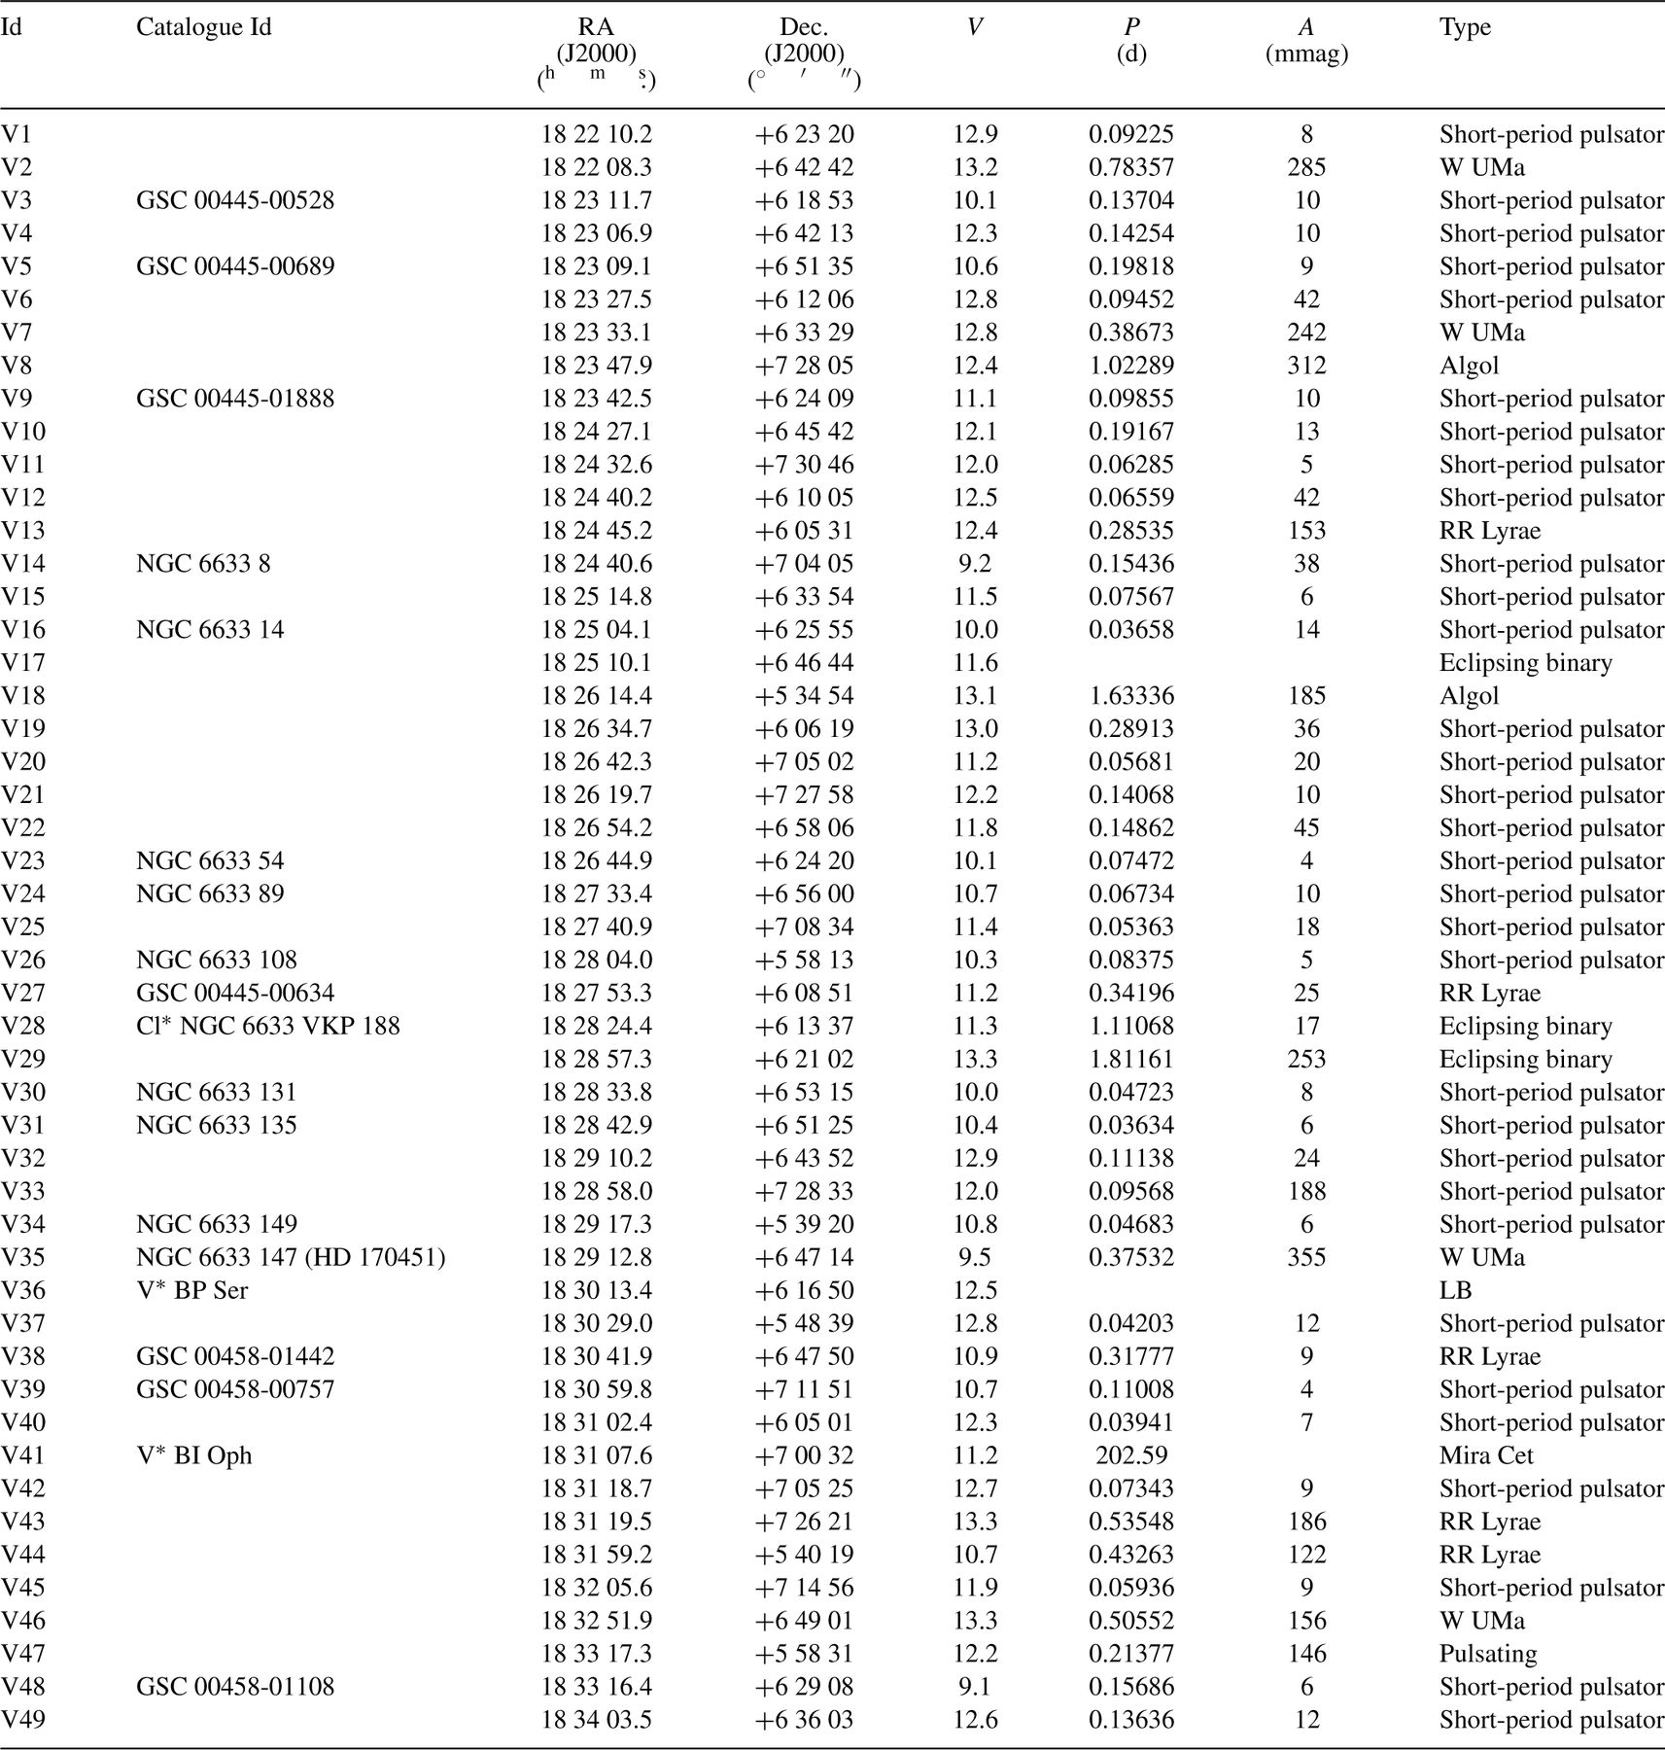
Table 4 Variable stars found in the NGC 6633 field. As this is a relatively crowded field, most objects are blends. ...
Notes:
Table 4 Variable stars found in the NGC 6633 field. As this is a relatively crowded field, most objects are blends. As a consequence: (i) the actual variable star may be another star within ∼30 arcsec of the catalogue star we identify; (ii) the coordinates shown represent the centroid of the blend; (iii) the V magnitudes measure the total flux in the APT photometry aperture; (iv) the amplitudes may be diluted by blended stars, and thus the values shown are only approximate lower limits. Coordinates were calculated from the WCS solution in the APT images, with a precision of ∼1 arcsec. The magnitude zero-point calibration is accurate to ∼0.1 mag.
Unless provided in the caption above, the following copyright applies to the content of this slide: © 2005 RAS

Slide 11
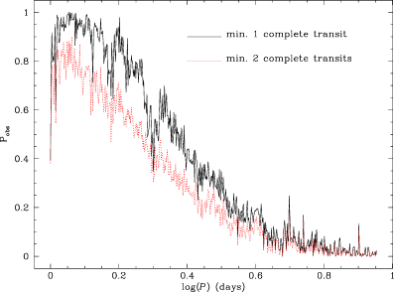
Figure 7 The probability of observing at least one (solid line) or two (dotted line) complete transits of a transiting ...
Notes:
Figure 7 The probability of observing at least one (solid line) or two (dotted line) complete transits of a transiting planet in the light curves we have obtained for the NGC 6633 field. A minimum of 100 in-transit data points are required for a detection (so that 10-mmag precision yields a total S/N ratio of ≥10 for a typical transiting hot Jupiter). A typical transit duration of 0.1 day is assumed. The one-transit probability also includes the requirement of at least one additional partial transit, so that the period can be estimated. The mean probability over this period range (1–9 d, sampled logarithmically) is 0.4 for one transit, and 0.3 for two transits.
Unless provided in the caption above, the following copyright applies to the content of this slide: © 2005 RAS

Slide 12
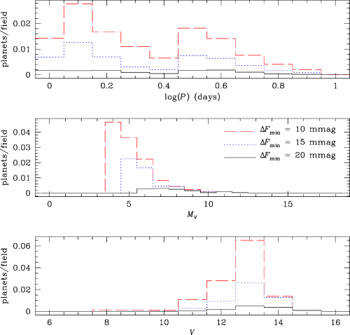
Figure 8 Distribution of period (top panel), host star absolute magnitude (middle panel) and apparent magnitude ...
Notes:
Figure 8 Distribution of period (top panel), host star absolute magnitude (middle panel) and apparent magnitude (bottom panel) for detected extrasolar planets in the Monte Carlo simulation. The histograms were generated by weighting each simulated planet by the probability of detecting it (PtrPobs). The simulation parameters were set to match those of our observations of the NGC 6633 field in 2002–2004. In each panel we show the distribution for three different values of the minimum detectable transit depth.
Unless provided in the caption above, the following copyright applies to the content of this slide: © 2005 RAS

Slide 13
Table 5 The total number of detected planets per APT field (minimum two complete observed transits) as a function of ...
Notes:
Table 5 The total number of detected planets per APT field (minimum two complete observed transits) as a function of the minimum detectable transit depth (ΔFmin, given in the first row in mmag). We compare two simulations: our NGC 6633 observations (2002–2004, V band, Section 6.1) and higher-cadence observations at a Galactic latitude of 25° in the I band over two months (Section 7.5).
Unless provided in the caption above, the following copyright applies to the content of this slide: © 2005 RAS

Slide 14
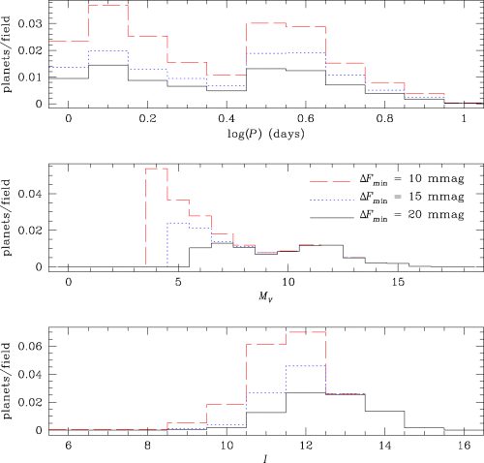
Figure 9 Distribution of the properties of detected systems for a model of our optimal observing strategy. Compare to ...
Notes:
Figure 9 Distribution of the properties of detected systems for a model of our optimal observing strategy. Compare to Fig. 8, representing our initial strategy. We are confident that with future improvements in our trend filtering and detection software, the ΔFmin= 10 mmag case will become a realistic one.
Unless provided in the caption above, the following copyright applies to the content of this slide: © 2005 RAS

