Slide 1
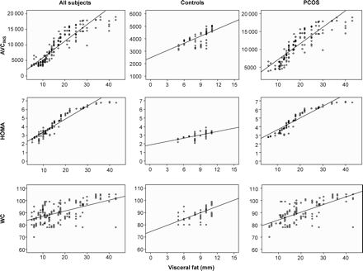
Figure 1: Scatter plots of the relationships between visceral fat and HOMA, AUC_{INS} and WC, in each group ...
Notes:
Figure 1: Scatter plots of the relationships between visceral fat and HOMA, AUCINS and WC, in each group separately, and in the entire population combined
Unless provided in the caption above, the following copyright applies to the content of this slide: © The Author 2007. Published by Oxford University Press on behalf of the European Society of Human Reproduction and Embryology. All rights reserved. For Permissions, please email: journals.permissions@oxfordjournals.org

Slide 2
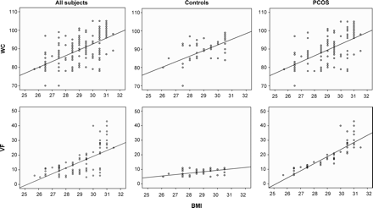
Figure 2: Scatter plots of the relationships between BMI and WC and VF in each group separately, and in the entire ...
Notes:
Figure 2: Scatter plots of the relationships between BMI and WC and VF in each group separately, and in the entire population combined
Unless provided in the caption above, the following copyright applies to the content of this slide: © The Author 2007. Published by Oxford University Press on behalf of the European Society of Human Reproduction and Embryology. All rights reserved. For Permissions, please email: journals.permissions@oxfordjournals.org

