Slide 1
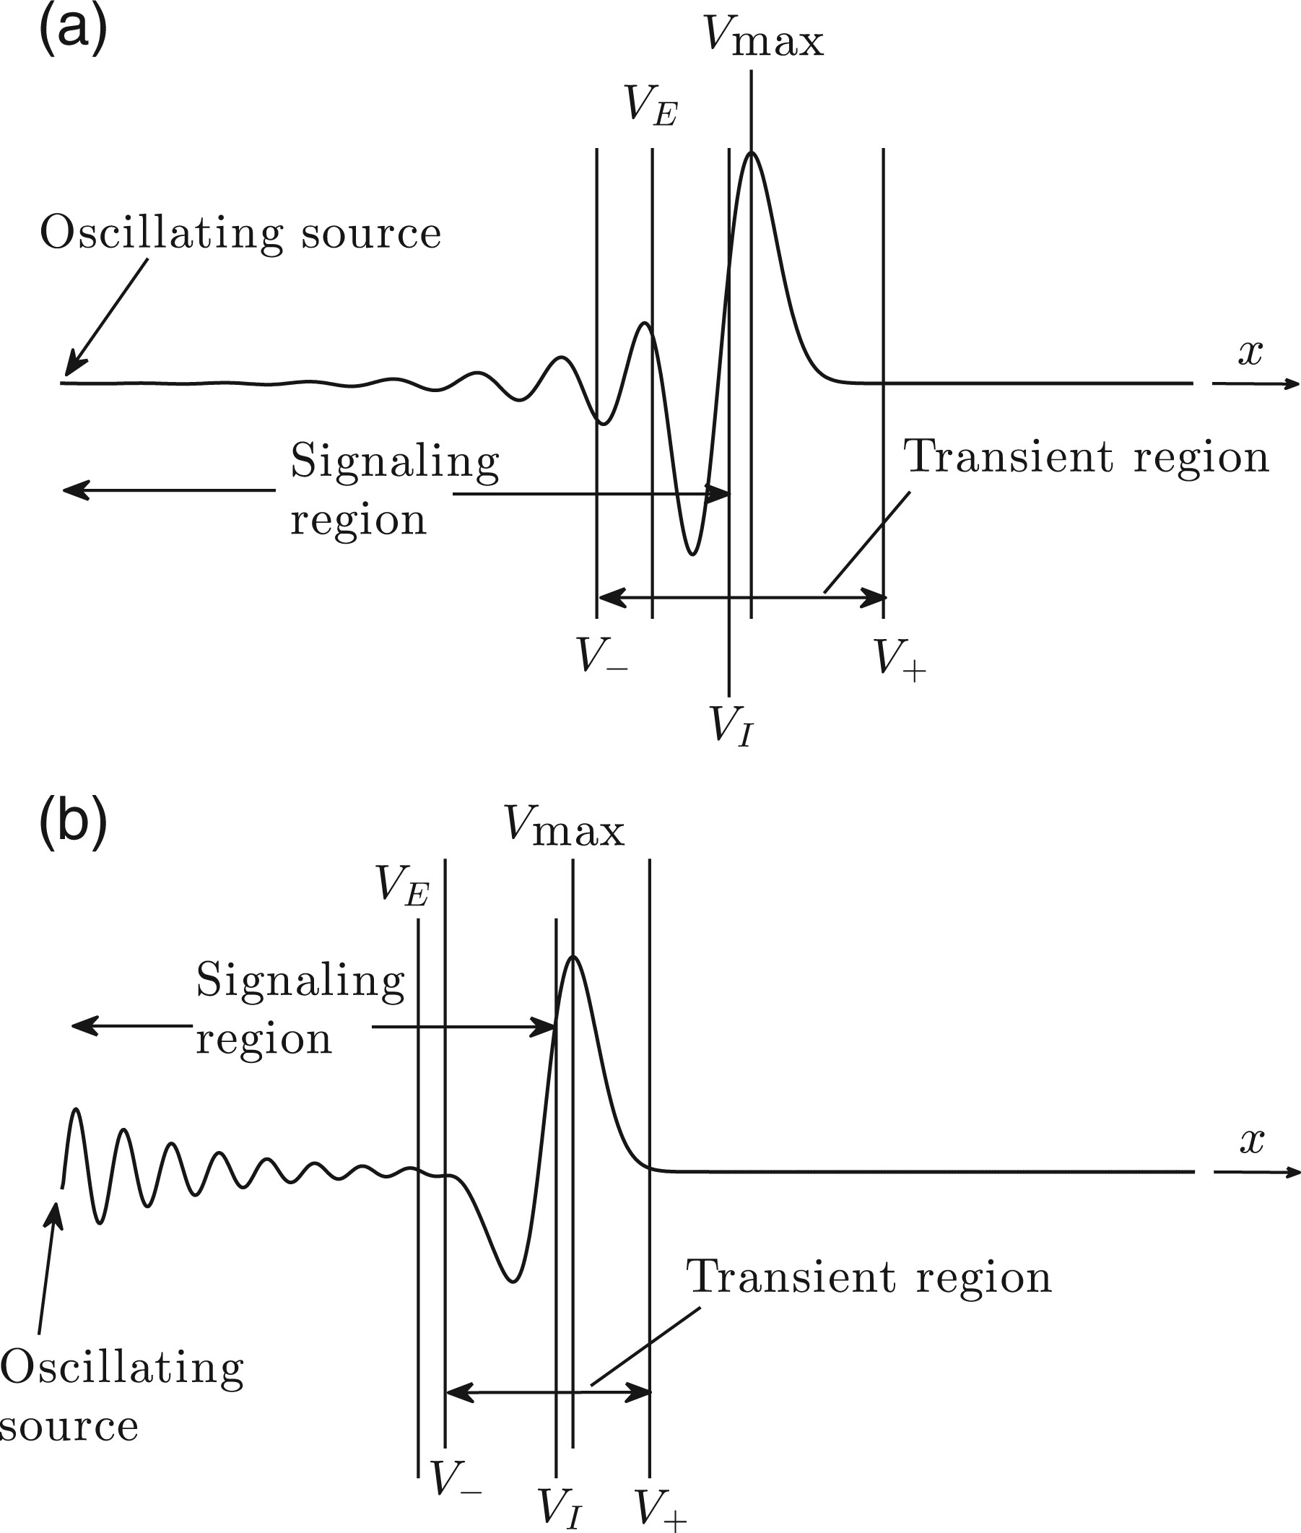
(1.1a) A schematic of signalling behaviour at a fixed time for (a) spatially unstable and (b) spatially stable ...
Notes:
(1.1a) A schematic of signalling behaviour at a fixed time for (a) spatially unstable and (b) spatially stable forcing. Key regions of the response are delimited by velocities $V$ (with various subscripts) that move downstream with the wave packet.
Unless provided in the caption above, the following copyright applies to the content of this slide: © The authors 2015. Published by Oxford University Press on behalf of the Institute of Mathematics and its Applications. All rights reserved.

Slide 2
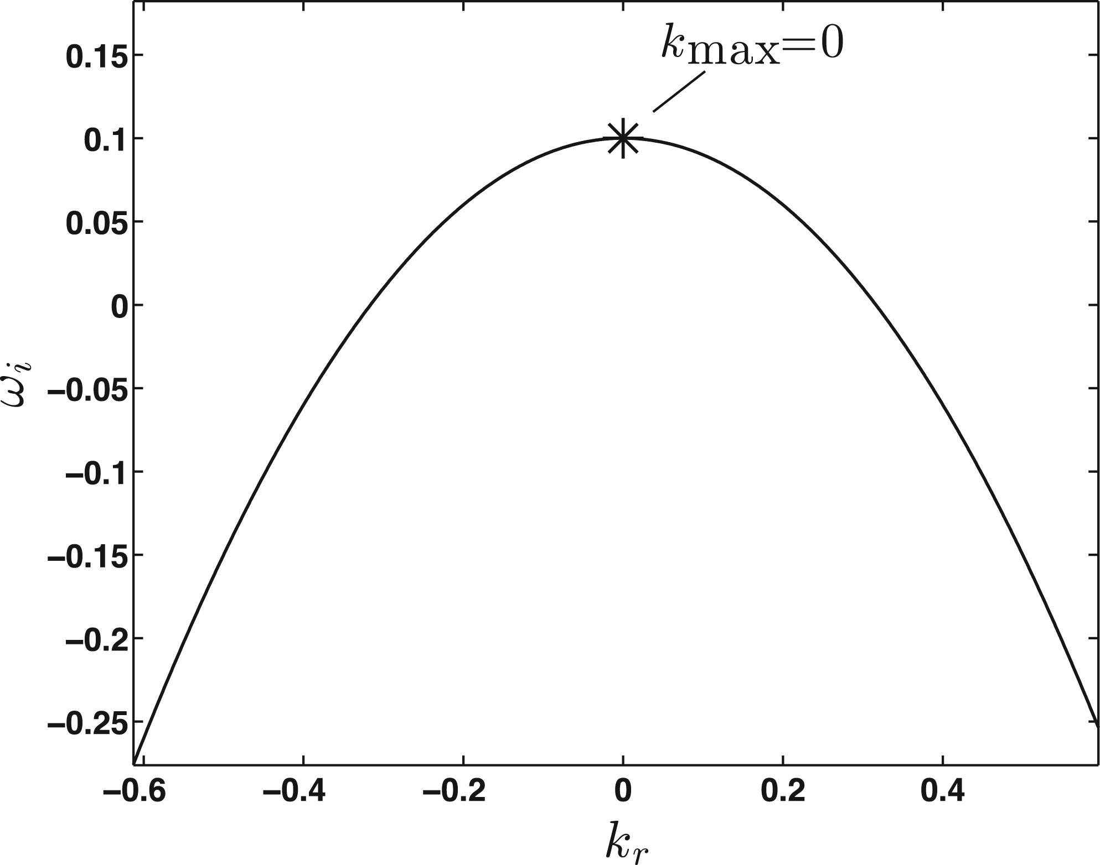
Fig. 2. Temporal stability plot for the dispersion relation (2.3) with $a=3$, $b=0.1$ and $c=1$.
Notes:
Fig. 2. Temporal stability plot for the dispersion relation (2.3) with $a=3$, $b=0.1$ and $c=1$.
Unless provided in the caption above, the following copyright applies to the content of this slide: © The authors 2015. Published by Oxford University Press on behalf of the Institute of Mathematics and its Applications. All rights reserved.

Slide 3
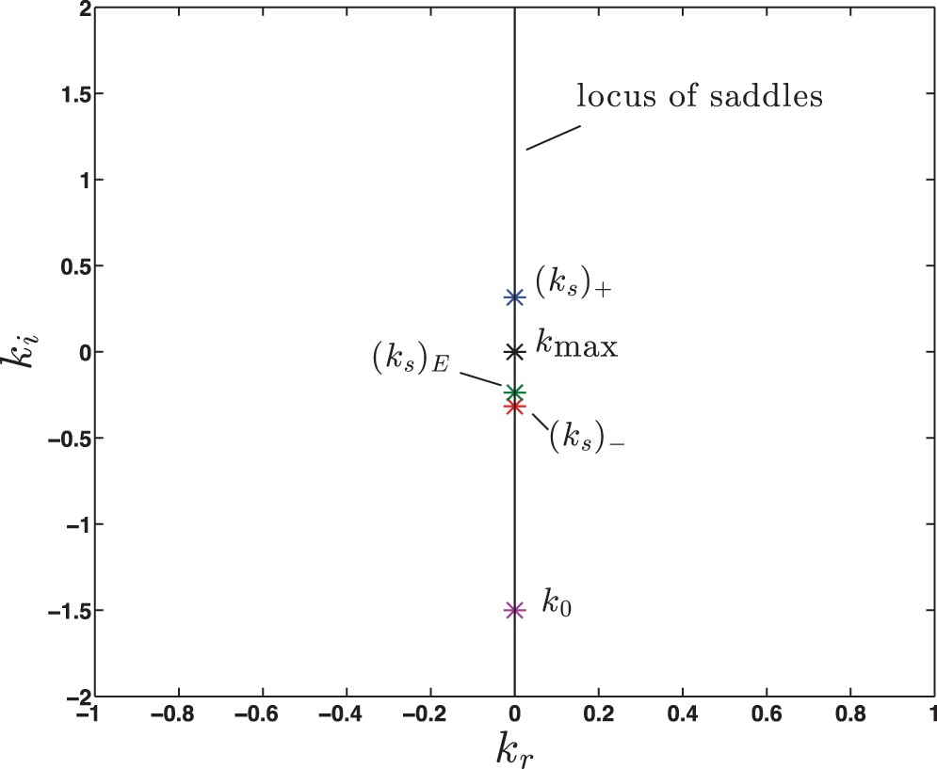
(2.9) The locus of $k_{\rm max}$ and nearby saddles for the integrals $h_A$ and $h_C$ in (2.5) with $a=3$, $b=0.1$ ...
Notes:
(2.9) The locus of $k_{\rm max}$ and nearby saddles for the integrals $h_A$ and $h_C$ in (2.5) with $a=3$, $b=0.1$ and $c=1$. $(k_s)_E$ is determined using $\omega _f=0.65$.
Unless provided in the caption above, the following copyright applies to the content of this slide: © The authors 2015. Published by Oxford University Press on behalf of the Institute of Mathematics and its Applications. All rights reserved.

Slide 4
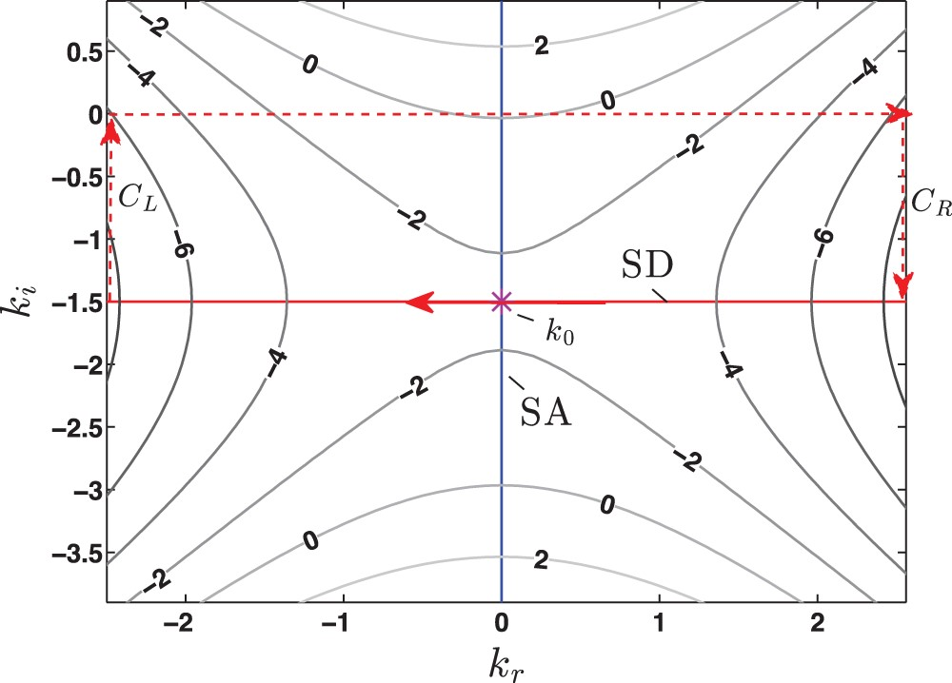
Fig. 4. Steepest descent (SD) and ascent (SA) paths through the saddle $k_0$ ($\ast $) for the integral solution of ...
Notes:
Fig. 4. Steepest descent (SD) and ascent (SA) paths through the saddle $k_0$ ($\ast $) for the integral solution of (2.1) with $a=3$, $b=0.1$ and $c=1$. Parameters are chosen such that the flow is convectively unstable. The SD path is closed back to the $k_r$-axis through vertical links $C_R$ and $C_L$. Isocontours are shown for values of ${\rm Re}[\varphi ]$.
Unless provided in the caption above, the following copyright applies to the content of this slide: © The authors 2015. Published by Oxford University Press on behalf of the Institute of Mathematics and its Applications. All rights reserved.

Slide 5
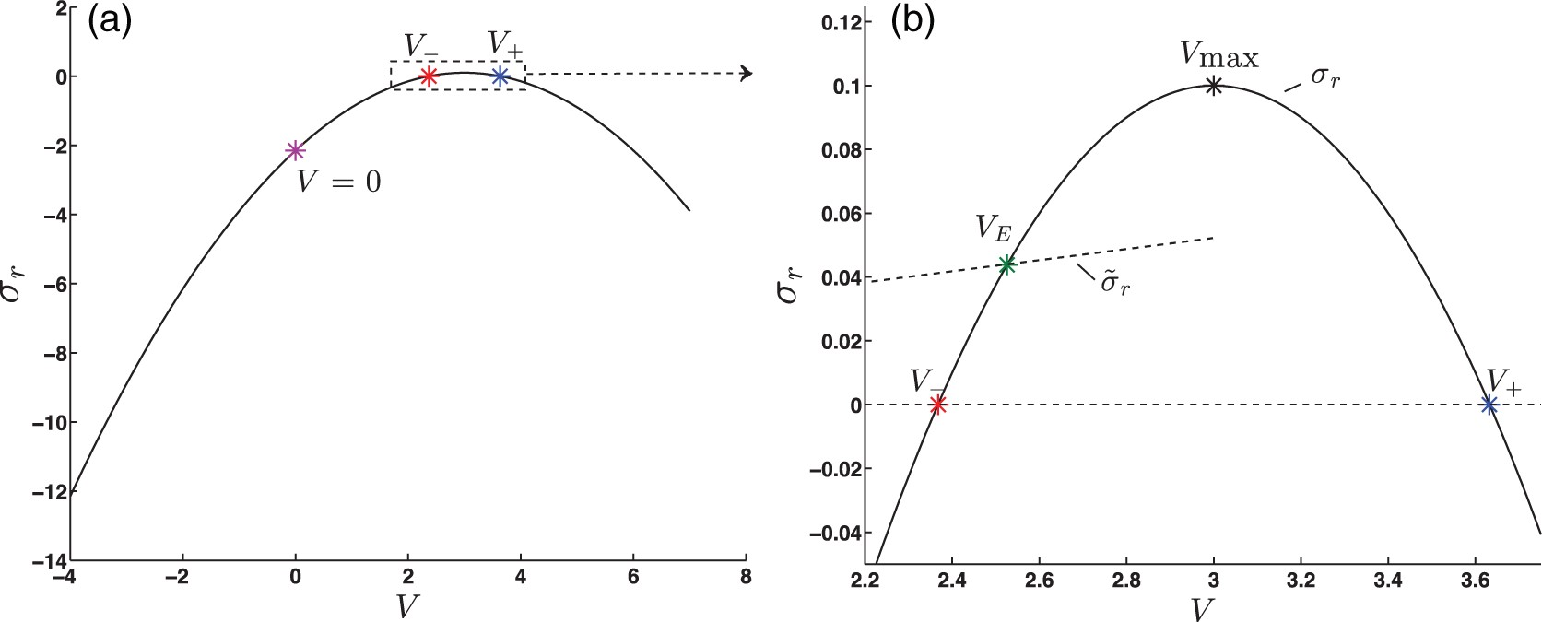
(2.13) Temporal growth rates $\sigma _r={\rm Re}[\varphi (k_s)]$ for velocities $V\equiv x/t$ in the integral ...
Notes:
(2.13) Temporal growth rates $\sigma _r={\rm Re}[\varphi (k_s)]$ for velocities $V\equiv x/t$ in the integral solution of (2.1) with $a=3$, $b=0.1$ and $c=1$. Parameters are chosen such that the flow is convectively unstable; $\tilde {\sigma }_r$ is determined using $\omega _f=0.65$. Subfigure (b) is an enlarged view of the boxed region shown in subfigure (a).
Unless provided in the caption above, the following copyright applies to the content of this slide: © The authors 2015. Published by Oxford University Press on behalf of the Institute of Mathematics and its Applications. All rights reserved.

Slide 6
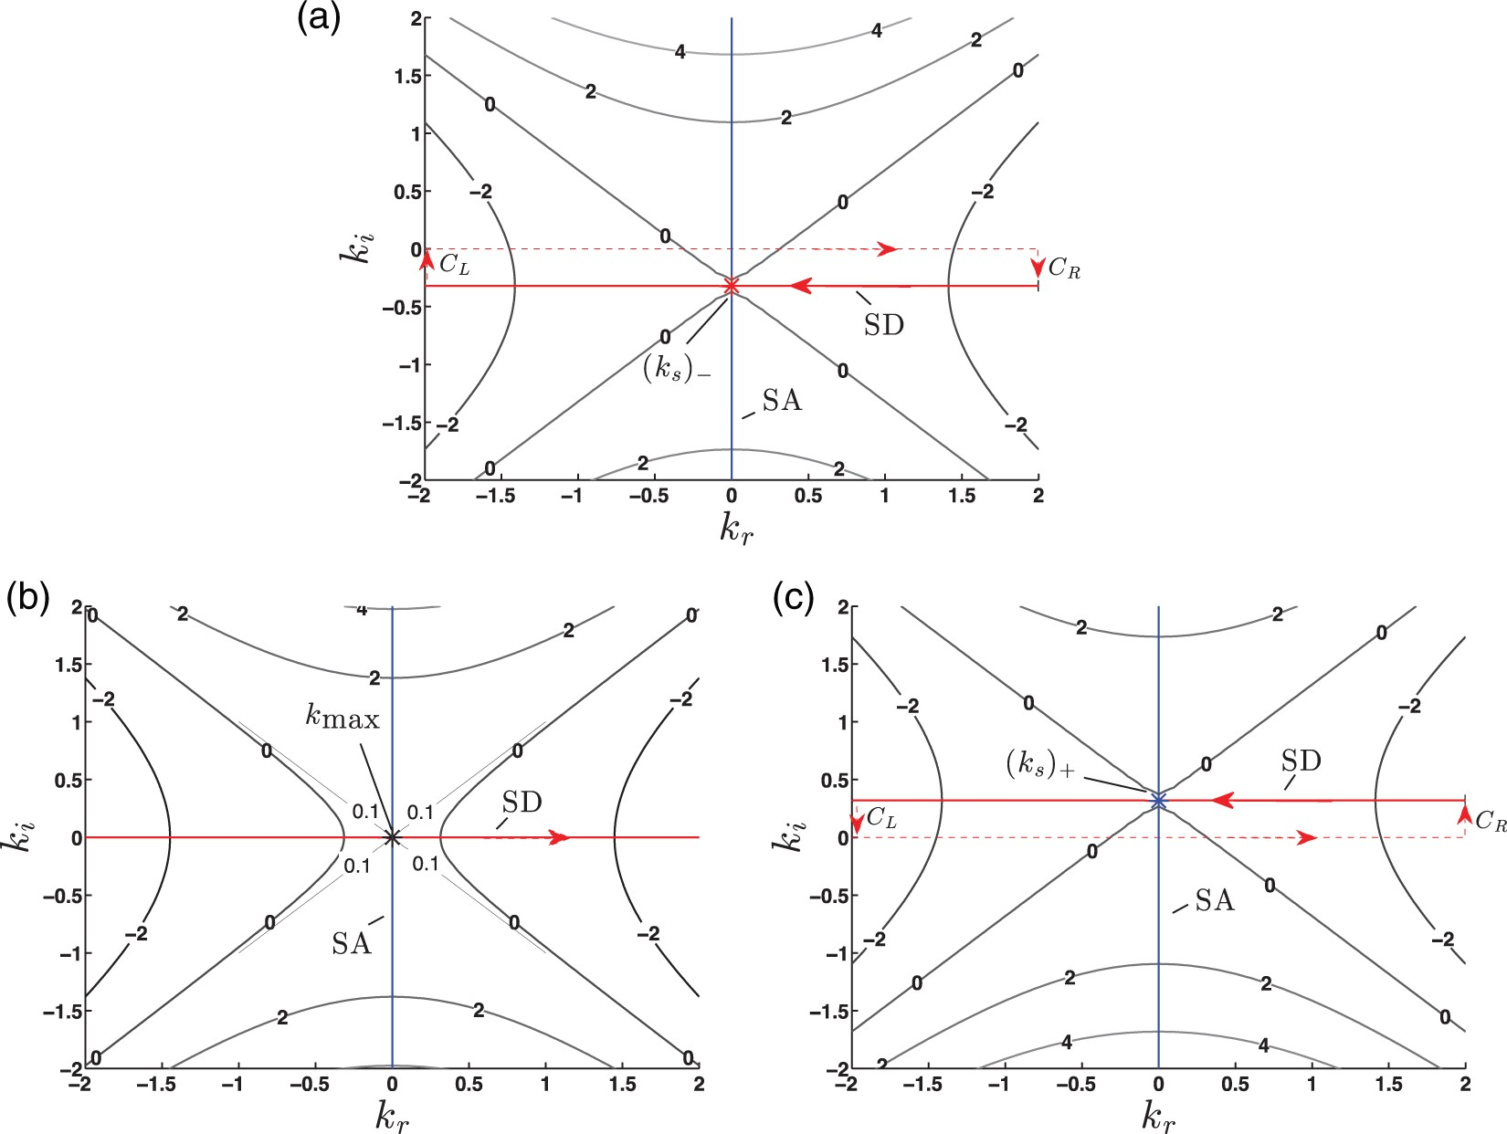
Fig. 6. Steepest descent (SD) and ascent (SA) paths through the saddles $(k_s)_-$, $k_{\rm max}$ and $(k_s)_+$ for ...
Notes:
Fig. 6. Steepest descent (SD) and ascent (SA) paths through the saddles $(k_s)_-$, $k_{\rm max}$ and $(k_s)_+$ for the velocities (a) $V_-$, (b) $V_{\rm max}$ and (c) $V_+$, superimposed onto contours of Re[$\varphi $] for the integral solution of (2.1) with $a=3$, $b=0.1$ and $c=1$. Note that in (b) the SD path is coincident with the $k_r$-axis and so no contour integration is needed for evaluation. Parameters are chosen such that the flow is convectively unstable.
Unless provided in the caption above, the following copyright applies to the content of this slide: © The authors 2015. Published by Oxford University Press on behalf of the Institute of Mathematics and its Applications. All rights reserved.

Slide 7
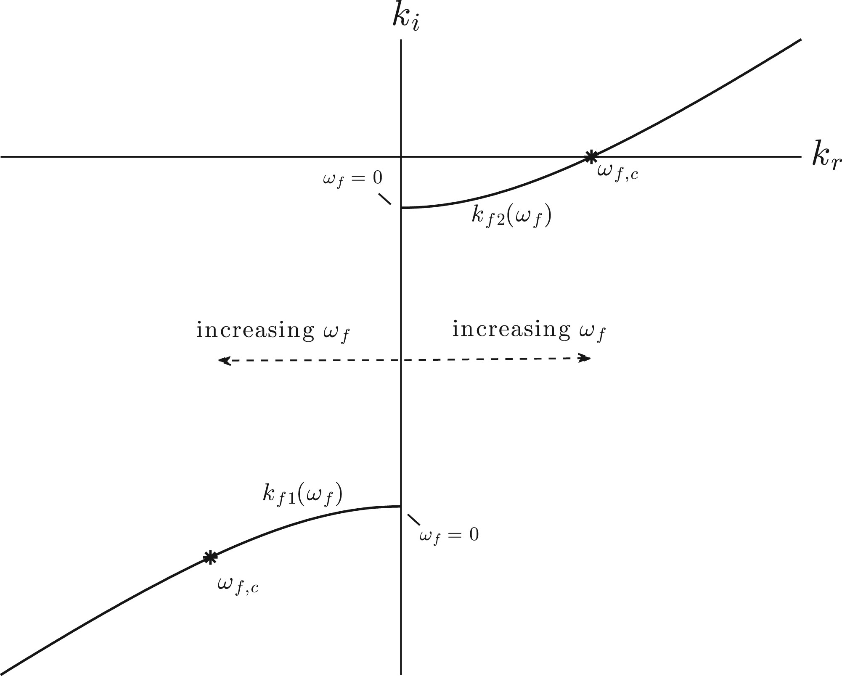
(2.15) Schematic of pole location in $h_B$, given by (2.6) with the constraint $0<b<a^2/(4c)$ such that the system ...
Notes:
(2.15) Schematic of pole location in $h_B$, given by (2.6) with the constraint $0<b<a^2/(4c)$ such that the system (2.1) is convectively unstable. The real positive forcing frequency increases from $\omega _f=0$ in the direction of the arrows, eventually reaching $\omega _{f, c}=a\sqrt {b/c}$ where forcing transitions from spatial growth to spatial decay.
Unless provided in the caption above, the following copyright applies to the content of this slide: © The authors 2015. Published by Oxford University Press on behalf of the Institute of Mathematics and its Applications. All rights reserved.

Slide 8
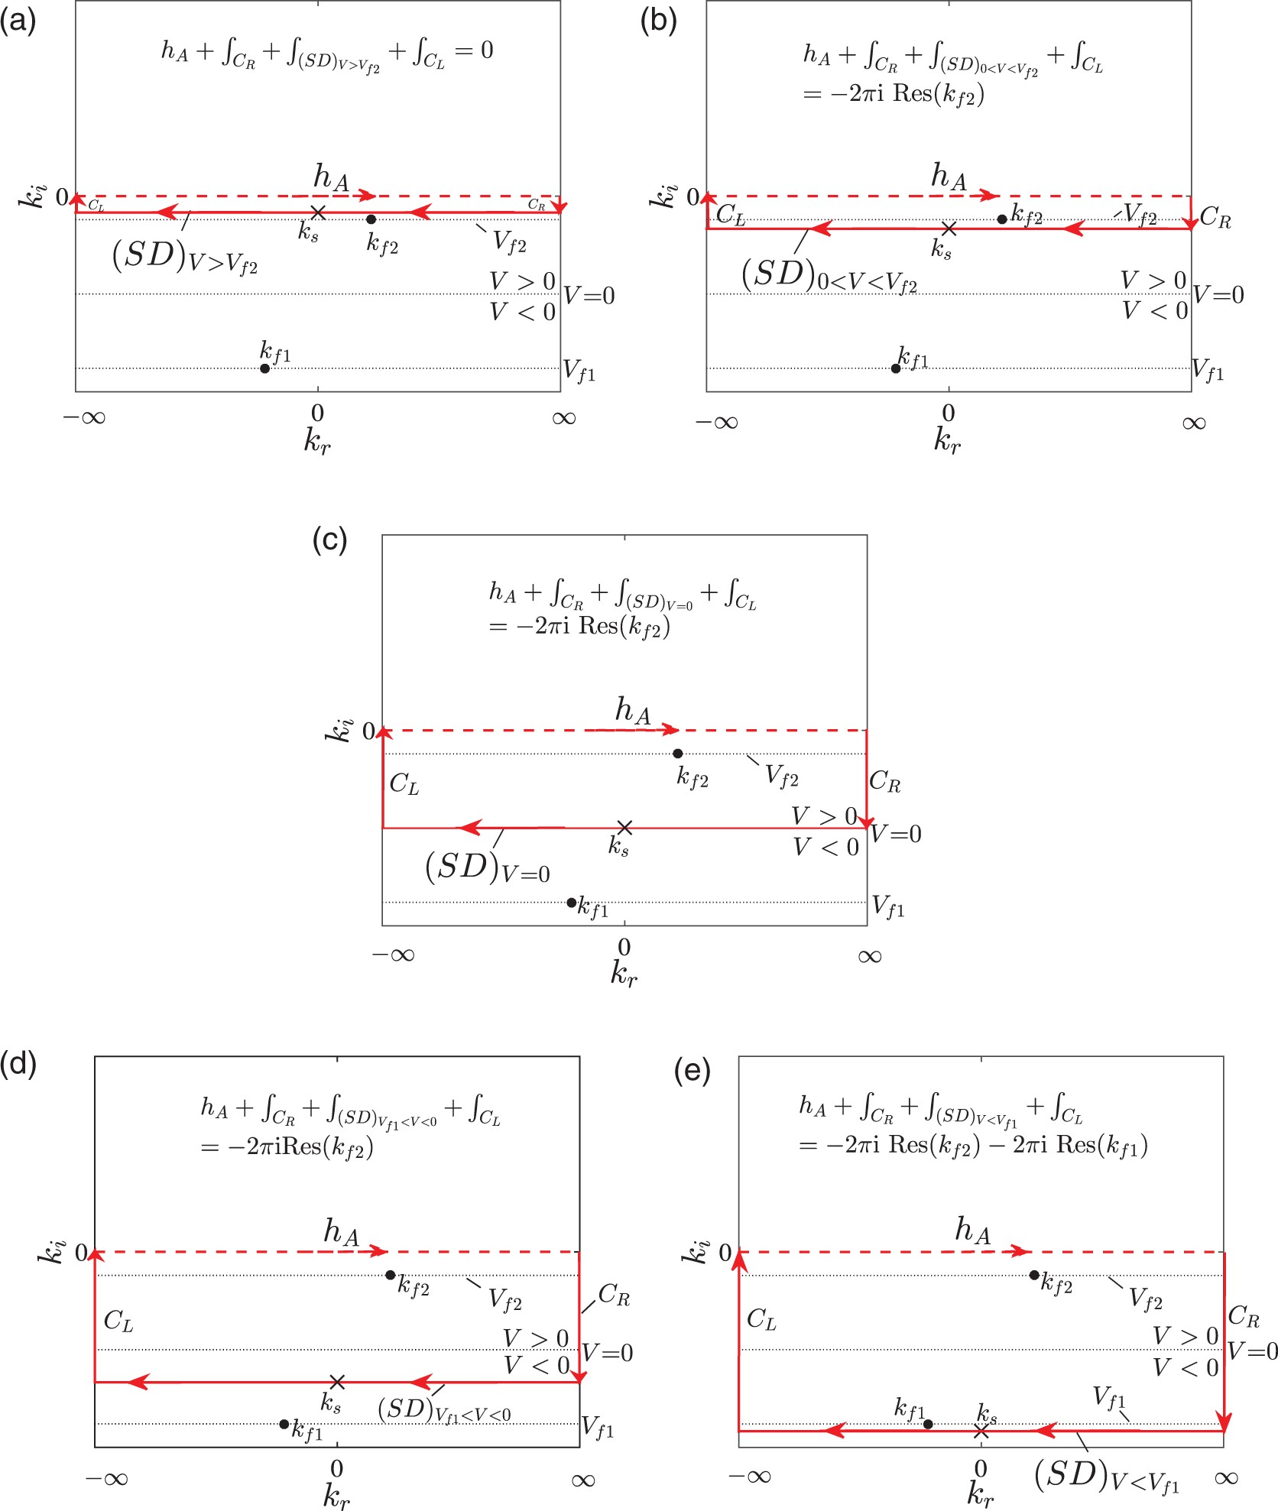
Fig. 8. Paths for evaluating the integral $h_A$ given in (2.5), taking into account poles ($\bullet $) from forcing ...
Notes:
Fig. 8. Paths for evaluating the integral $h_A$ given in (2.5), taking into account poles ($\bullet $) from forcing of the type $\omega _fV_{f2}$; (b) $0<V<V_{f2}$; (c) $V=0$; (d) $V_{f1}<V<0$; (e) $V<V_{f1}$. In constructing the above figure, parameters are chosen such that (2.1) describes a convectively unstable flow.
Unless provided in the caption above, the following copyright applies to the content of this slide: © The authors 2015. Published by Oxford University Press on behalf of the Institute of Mathematics and its Applications. All rights reserved.

Slide 9
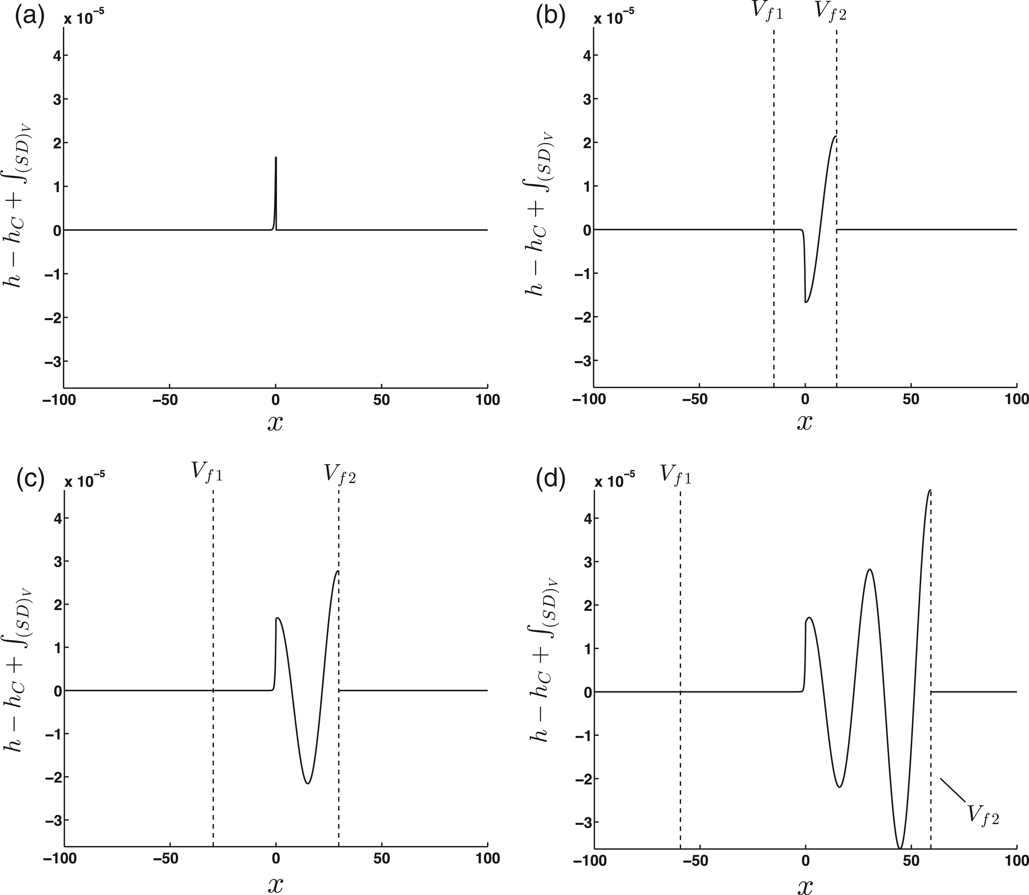
(2.20) The response solely due to the residues (i.e. $h-h_C+\int _{({\rm SD})_V}$) in (2.20) for (a) $t=0.1$, (b) ...
Notes:
(2.20) The response solely due to the residues (i.e. $h-h_C+\int _{({\rm SD})_V}$) in (2.20) for (a) $t=0.1$, (b) $t=5$. (c) $t=10$, (d) $t=20$. Parameters ($a=3$, $b=0.1$, $c=1$) chosen in (2.1) for convective instability and spatial growth ($\omega _f=0.65<\omega _{f,c}$). Note that only the real components of the signal are shown above.
Unless provided in the caption above, the following copyright applies to the content of this slide: © The authors 2015. Published by Oxford University Press on behalf of the Institute of Mathematics and its Applications. All rights reserved.

Slide 10
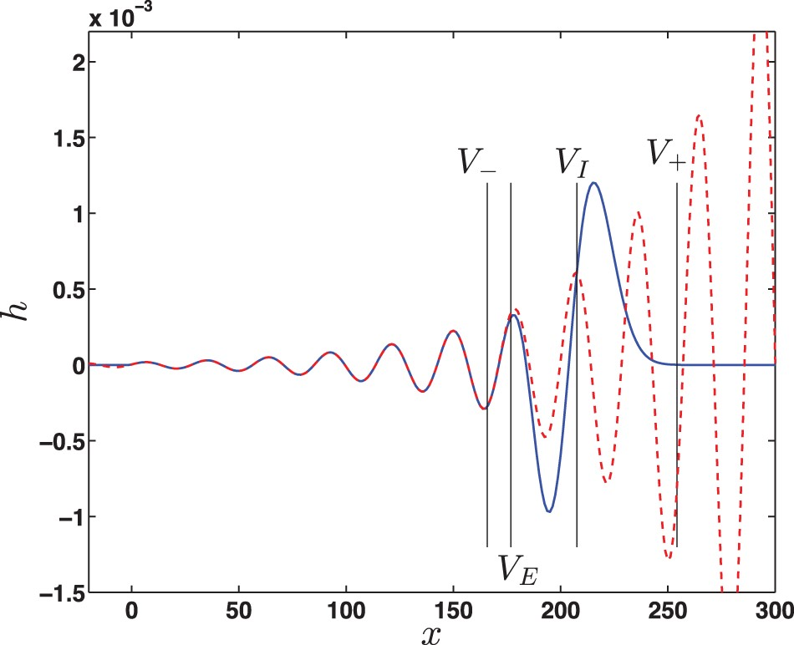
(2.22) Fourier series solution (solid line) of (2.1) (with $h_0=0$) at $t=70$ using $a=3$, $b=0.1$, $c=1$, $\omega ...
Notes:
(2.22) Fourier series solution (solid line) of (2.1) (with $h_0=0$) at $t=70$ using $a=3$, $b=0.1$, $c=1$, $\omega _f=0.65$ and $A=5\times 10^{-5}$. Residue given by (2.23) (dashed line), shown beyond its region of applicability $(V > V_E)$. Note that only the real components of the signal are shown above; this is the solution to (2.1) with a forcing of $A\delta (x)\cos (\omega _f t)$.
Unless provided in the caption above, the following copyright applies to the content of this slide: © The authors 2015. Published by Oxford University Press on behalf of the Institute of Mathematics and its Applications. All rights reserved.

Slide 11
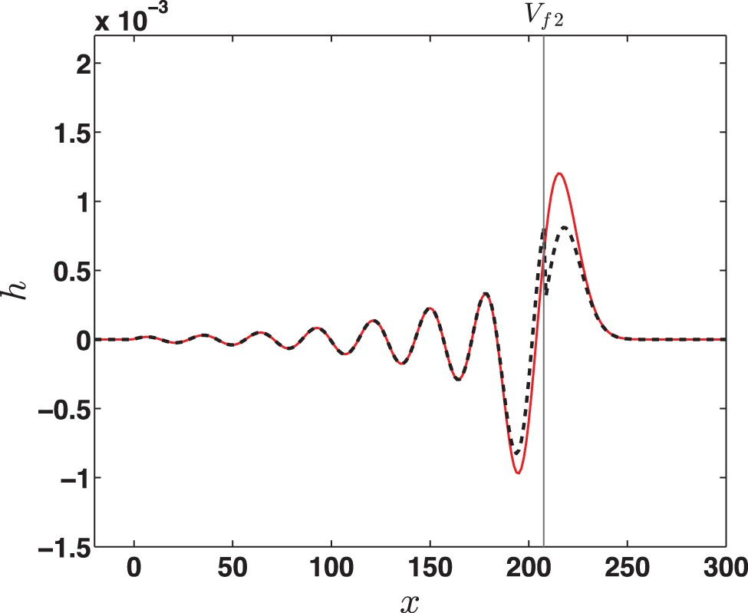
Fig. 11. Asymptotic Fourier integral solution of (2.1) as given by (2.21) with $h_0=0$ (- - - -) compared with a ...
Notes:
Fig. 11. Asymptotic Fourier integral solution of (2.1) as given by (2.21) with $h_0=0$ (- - - -) compared with a Fourier series solution (——) with $a=3$, $b=0.1$, $c=1$, $\omega _f=0.65$ and $A=5\times 10^{-5}$, shown for $t=70$. Note that only the real components of the signal are shown above; this is the solution to (2.1) with a forcing of $A\delta (x)\cos (\omega _f t)$.
Unless provided in the caption above, the following copyright applies to the content of this slide: © The authors 2015. Published by Oxford University Press on behalf of the Institute of Mathematics and its Applications. All rights reserved.

Slide 12
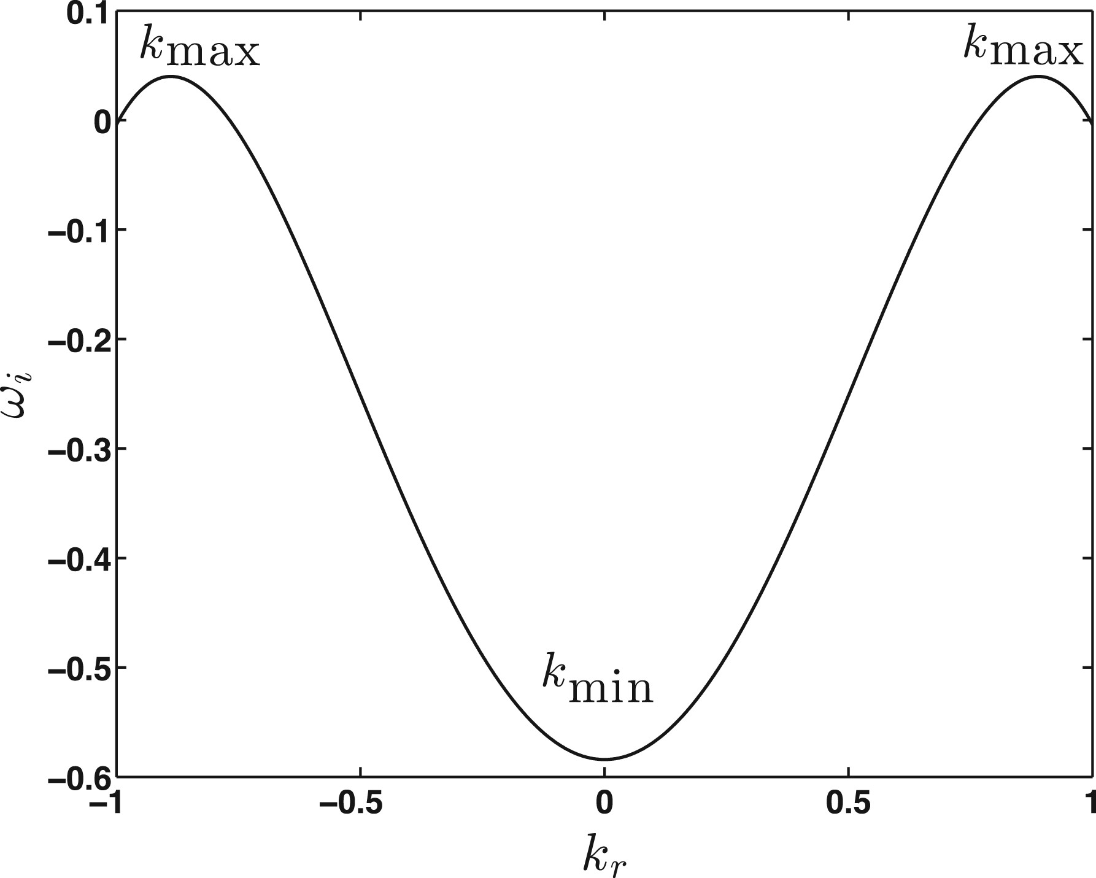
(4.3) Temporal stability plot for dispersion relation (4.2b) with $\alpha =-1/2$, $\beta =1/5$, $\gamma =1/2$.
Notes:
(4.3) Temporal stability plot for dispersion relation (4.2b) with $\alpha =-1/2$, $\beta =1/5$, $\gamma =1/2$.
Unless provided in the caption above, the following copyright applies to the content of this slide: © The authors 2015. Published by Oxford University Press on behalf of the Institute of Mathematics and its Applications. All rights reserved.

Slide 13
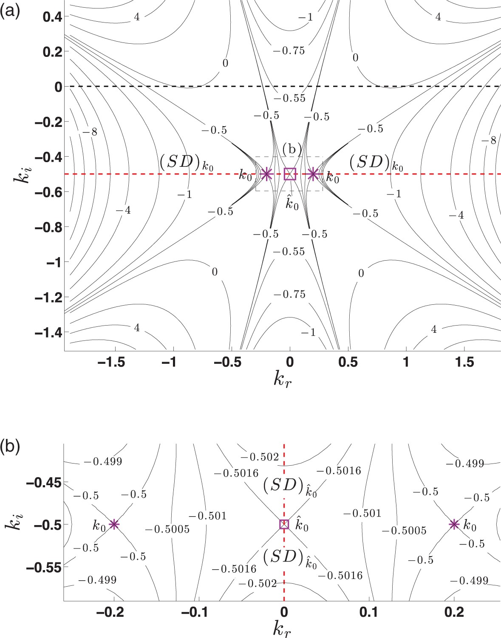
Fig. 13. Re($\varphi $) contours for $V=0$ (i.e. contours of constant $\omega _i$) for (4.1), showing contributing ...
Notes:
Fig. 13. Re($\varphi $) contours for $V=0$ (i.e. contours of constant $\omega _i$) for (4.1), showing contributing ($k_0$) and non-contributing ($\hat {k}_0$) saddles. The steepest descent (SD) contour for $V=0$ (– –) is shown in (a) for $k_0$ and (b) for $\hat {k}_0$. Parameter values of $\alpha = - 1/2$, $\beta =1/5$ and $\gamma =1/2$ are chosen for convective instability.
Unless provided in the caption above, the following copyright applies to the content of this slide: © The authors 2015. Published by Oxford University Press on behalf of the Institute of Mathematics and its Applications. All rights reserved.

Slide 14
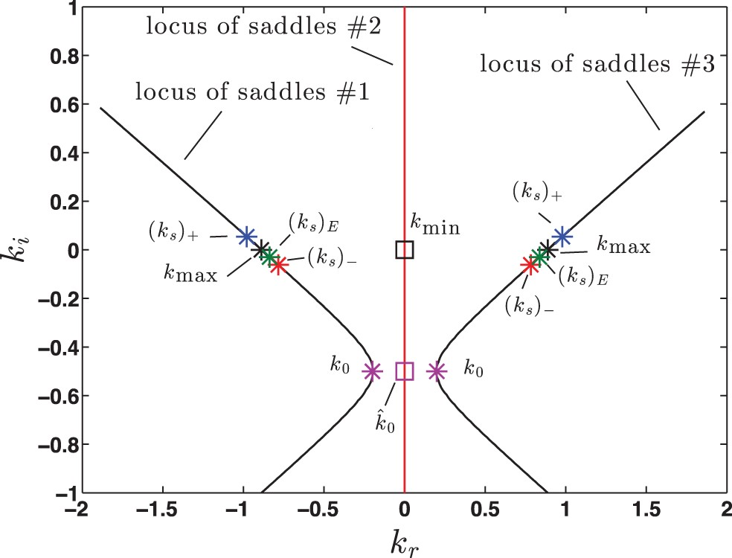
Fig. 14. Saddle points of (4.1) with $\alpha = - 1/2$, $\beta =1/5$, $\gamma =1/2$. $(k_s)_E$ found using $\omega ...
Notes:
Fig. 14. Saddle points of (4.1) with $\alpha = - 1/2$, $\beta =1/5$, $\gamma =1/2$. $(k_s)_E$ found using $\omega _f=1$.
Unless provided in the caption above, the following copyright applies to the content of this slide: © The authors 2015. Published by Oxford University Press on behalf of the Institute of Mathematics and its Applications. All rights reserved.

Slide 15
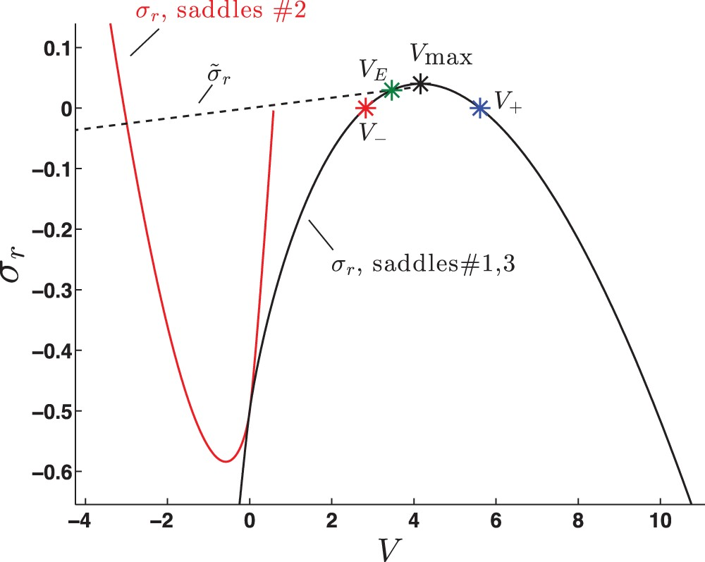
Fig. 15. Growth rate of saddles as a function of $V$ for (4.1). Parameter values of $\alpha = - 1/2$, $\beta =1/5$ and ...
Notes:
Fig. 15. Growth rate of saddles as a function of $V$ for (4.1). Parameter values of $\alpha = - 1/2$, $\beta =1/5$ and $\gamma =1/2$ are chosen for convective instability; $\tilde {\sigma }_r$ is found using $\omega _f=1$.
Unless provided in the caption above, the following copyright applies to the content of this slide: © The authors 2015. Published by Oxford University Press on behalf of the Institute of Mathematics and its Applications. All rights reserved.

Slide 16
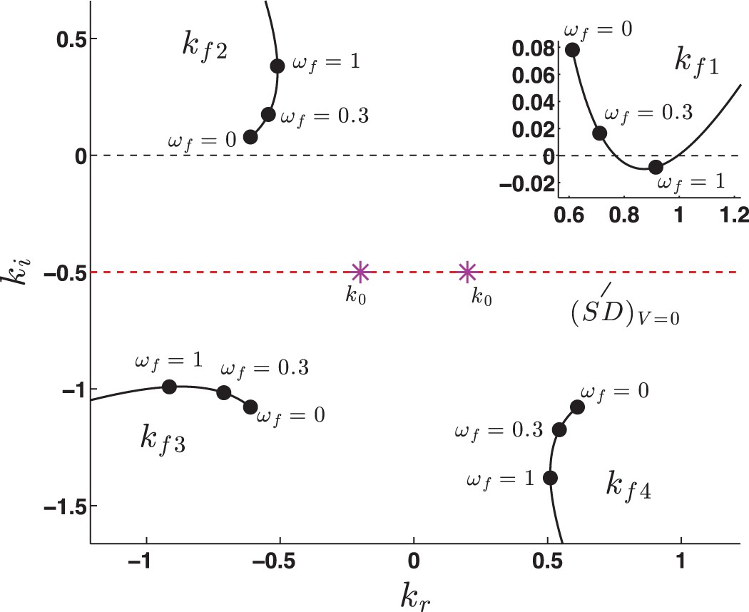
Fig. 16. Forcing poles of (4.1) with $\alpha = - 1/2$, $\beta =1/5$, and $\gamma =1/2$.
Notes:
Fig. 16. Forcing poles of (4.1) with $\alpha = - 1/2$, $\beta =1/5$, and $\gamma =1/2$.
Unless provided in the caption above, the following copyright applies to the content of this slide: © The authors 2015. Published by Oxford University Press on behalf of the Institute of Mathematics and its Applications. All rights reserved.

Slide 17
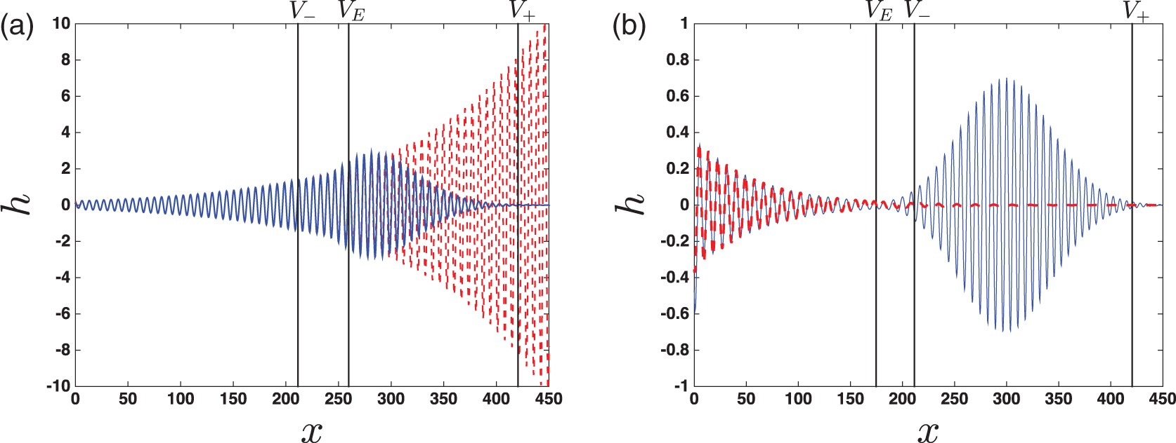
(4.4) Fourier series solution (solid line) of (4.1) at $t=75$ using $\alpha = - 1/2$, $\beta =1/5$ and $\gamma ...
Notes:
(4.4) Fourier series solution (solid line) of (4.1) at $t=75$ using $\alpha = - 1/2$, $\beta =1/5$ and $\gamma =1/2$ for (a) $\omega _f=1$ (spatial growth) and (b) $\omega _f=0.3$ (spatial decay). Residue given by (3.1) (dashed line), shown beyond its region of applicability ($V>V_E$), with the dominant pole $k_{f1}$ from Fig. 16. Note that only the real components of the signal are shown above; this is the solution to (4.1) with a forcing of $A\delta (x)\cos (\omega _f t)$.
Unless provided in the caption above, the following copyright applies to the content of this slide: © The authors 2015. Published by Oxford University Press on behalf of the Institute of Mathematics and its Applications. All rights reserved.

Slide 18
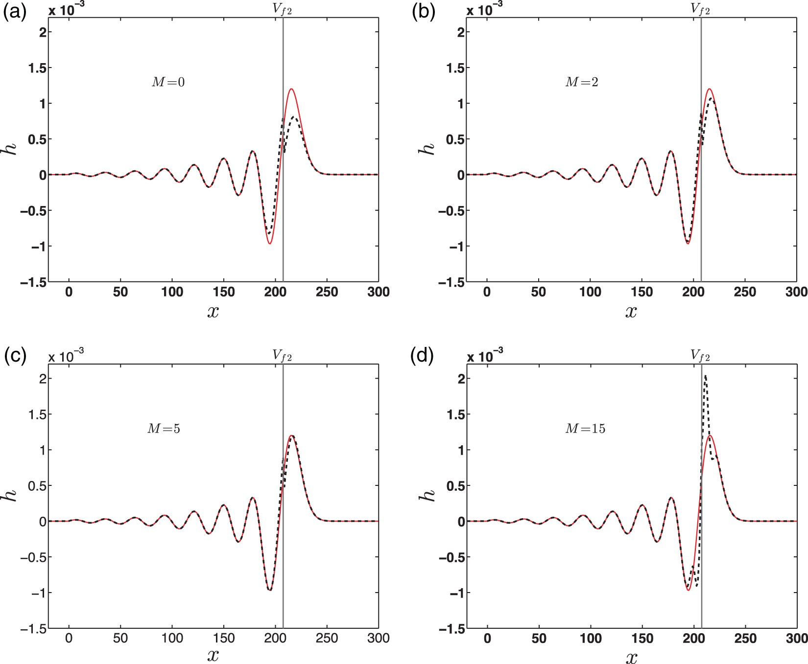
Fig. B1. Asymptotic Fourier integral solution of (2.1) with $a=3$, $b=0.1$, $c=1$, $\omega _f=0.65$ and $A=5\times ...
Notes:
Fig. B1. Asymptotic Fourier integral solution of (2.1) with $a=3$, $b=0.1$, $c=1$, $\omega _f=0.65$ and $A=5\times 10^{-5}$, shown for $t=70$. The solution is obtained using (2.20) with $\int _{({\rm SD})_V}$ given by either (B.3) (– –, $M$ indicated in plot) or (B.4) (——, including the first term in the (10$^5$)th denominator). Note that only the real components of the signal are shown above; this is the solution to (2.1) with a forcing of $A\delta (x)\cos (\omega _f t)$.
Unless provided in the caption above, the following copyright applies to the content of this slide: © The authors 2015. Published by Oxford University Press on behalf of the Institute of Mathematics and its Applications. All rights reserved.

