Slide 1
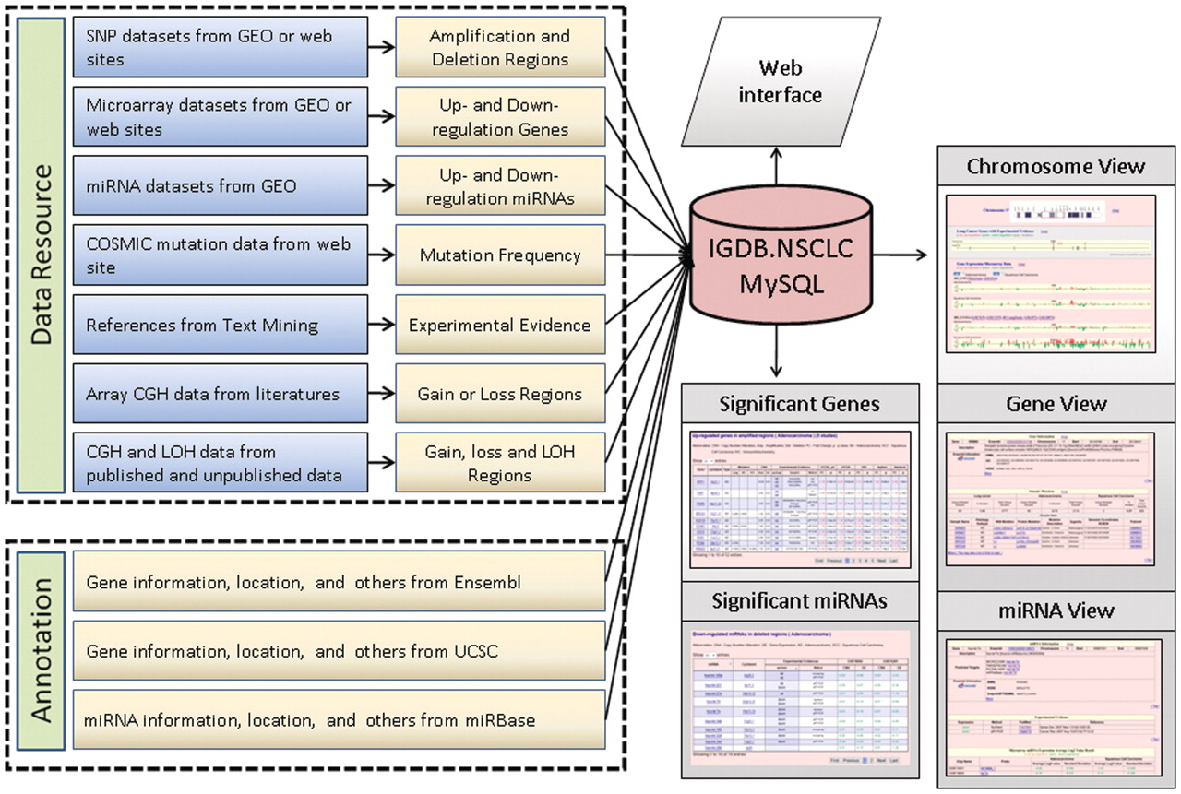
Figure 1. The framework of IGDB.NSCLC.
Notes:
Figure 1. The framework of IGDB.NSCLC.
Unless provided in the caption above, the following copyright applies to the content of this slide: © The Author(s) 2011. Published by Oxford University Press.This is an Open Access article distributed under the terms of the Creative Commons Attribution Non-Commercial License (http://creativecommons.org/licenses/by-nc/3.0), which permits unrestricted non-commercial use, distribution, and reproduction in any medium, provided the original work is properly cited.

Slide 2
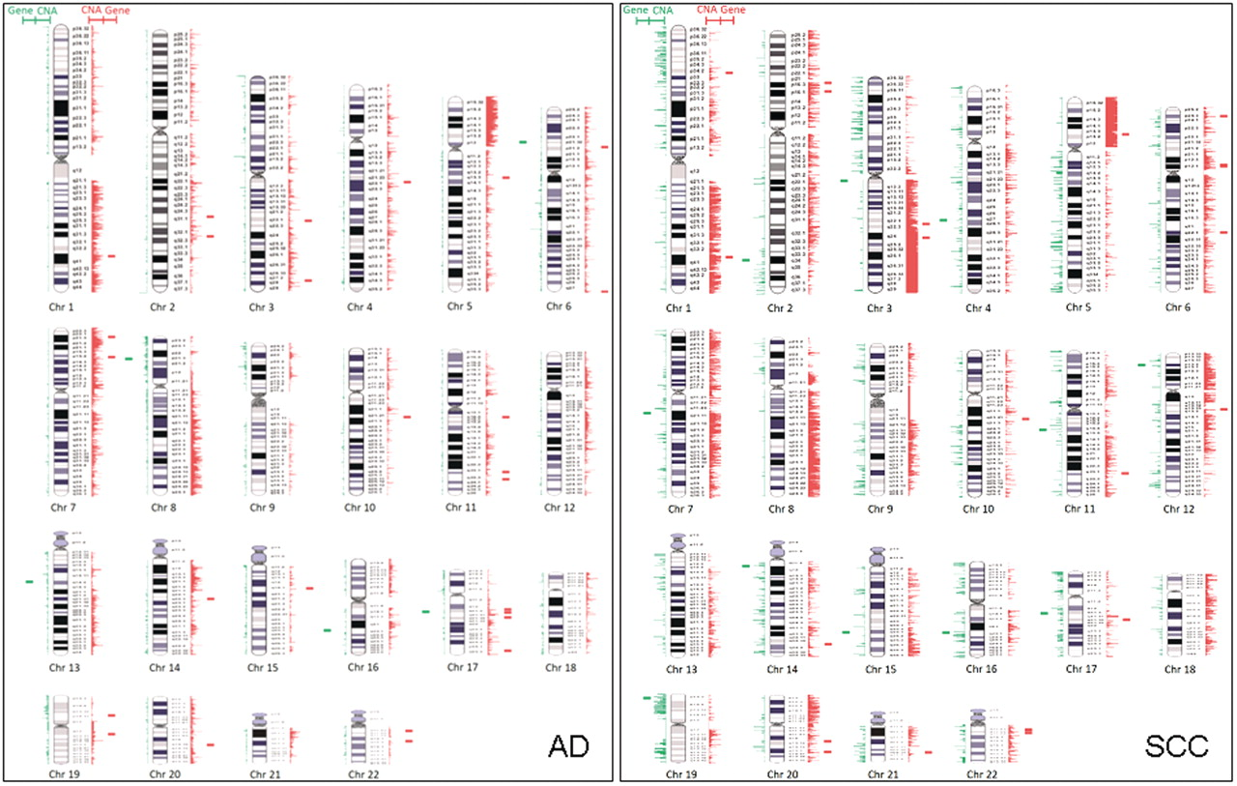
Figure 2. The graphic integration of CNAs with altered expression genes in lung AD and SCC. The red lines represent the ...
Notes:
Figure 2. The graphic integration of CNAs with altered expression genes in lung AD and SCC. The red lines represent the amplification regions for CNA and up-regulation genes. The green lines stand for the deletion regions for CNA and down-regulated genes. The lines are relatively corresponding to the physical position along the chromosomes.
Unless provided in the caption above, the following copyright applies to the content of this slide: © The Author(s) 2011. Published by Oxford University Press.This is an Open Access article distributed under the terms of the Creative Commons Attribution Non-Commercial License (http://creativecommons.org/licenses/by-nc/3.0), which permits unrestricted non-commercial use, distribution, and reproduction in any medium, provided the original work is properly cited.

