Slide 1
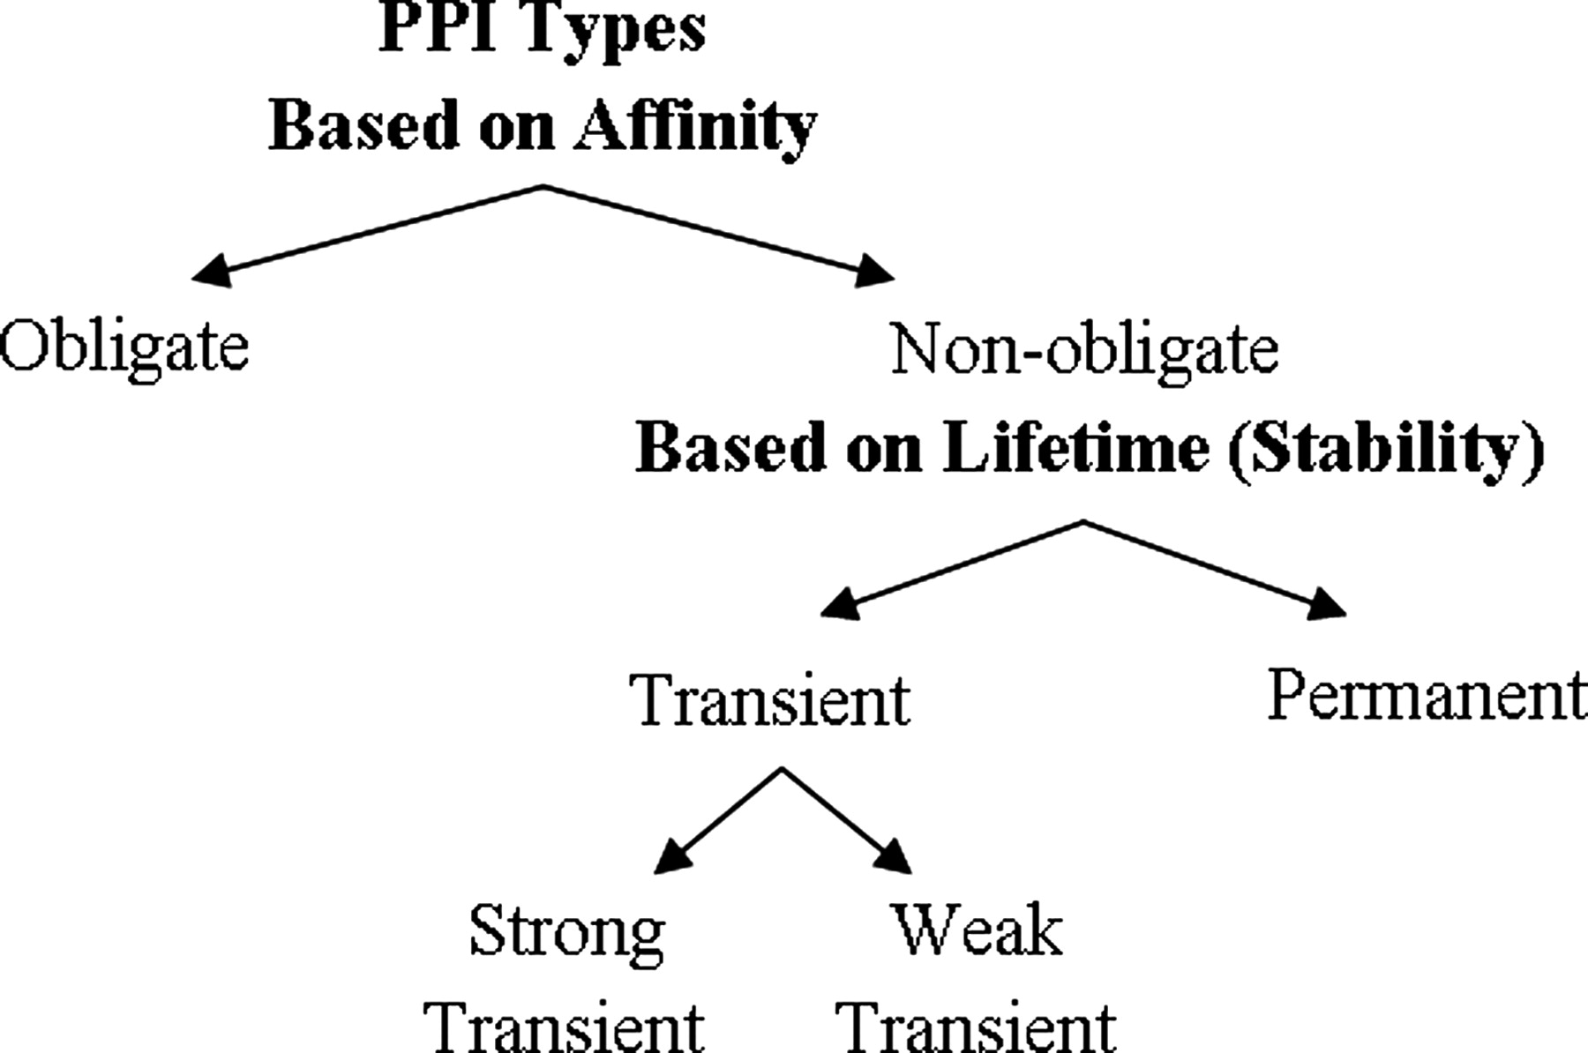
Fig. 1. Relation of protein–protein interaction types based on affinity and stability. Non-obligate interactions are ...
Notes:
Fig. 1. Relation of protein–protein interaction types based on affinity and stability. Non-obligate interactions are transient but there are some examples of permanent non-obligate interactions such as enzyme−inhibitor interactions (e.g. thrombin–rhodnin inhibitor interaction).
Unless provided in the caption above, the following copyright applies to the content of this slide: © The Author 2011. Published by Oxford University Press. All rights reserved. For Permissions, please e-mail: journals.permissions@oup.com

Slide 2
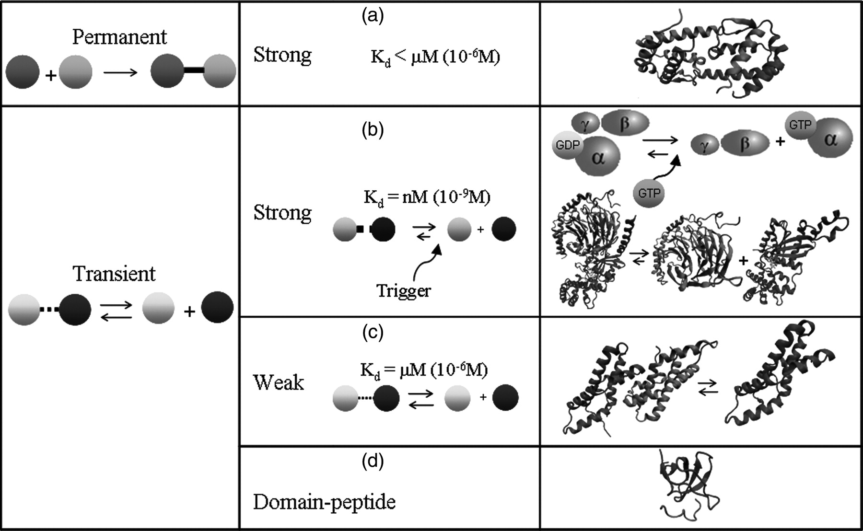
Fig. 2. Classification of protein–protein interaction types based on stability and fold. The mechanisms of ...
Notes:
Fig. 2. Classification of protein–protein interaction types based on stability and fold. The mechanisms of association and dissociation processes are shown for strong and weak transient protein–protein complexes, along with the structures of example cases. (a) Permanent protein–protein interaction: Components are stable only in complex form, e.g. IL-5 cytokine dimer (PDB ID: 3b5k). (b) Strong transient protein–protein interaction: association/dissociation takes place under certain triggers such as chemical modification, conformational change and colocalization; dissociation constant (Kd) is in nanomolar range, e.g. Heterotrimeric G protein (PDB ID: 1got), in which Gα is in complex with guanosine diphosphate (GDP) and interacts transiently with Gβγ, dissociates into Gα (PDB ID: 3ffb) and Gβγ (PDB ID: 1tbg) subunits upon guanosine triphosphate (GTP) (PDB ID: 3ffb) binding. (c)Weak transient protein–protein interaction: Complexes are broken and formed continuously and Kd is in micromolar range, e.g. Red abalone lysin dimer (PDB ID: 2lyn) dissociates into Red abalone lysin monomer (PDB ID: 2lis). (d)Domain–peptide interaction: a globular domain recognizes a short linear motif, e.g. SH3 domain of tyrosine kinase Fyn in complex with a proline-rich peptide (PDB ID: 1fyn).
Unless provided in the caption above, the following copyright applies to the content of this slide: © The Author 2011. Published by Oxford University Press. All rights reserved. For Permissions, please e-mail: journals.permissions@oup.com

Slide 3
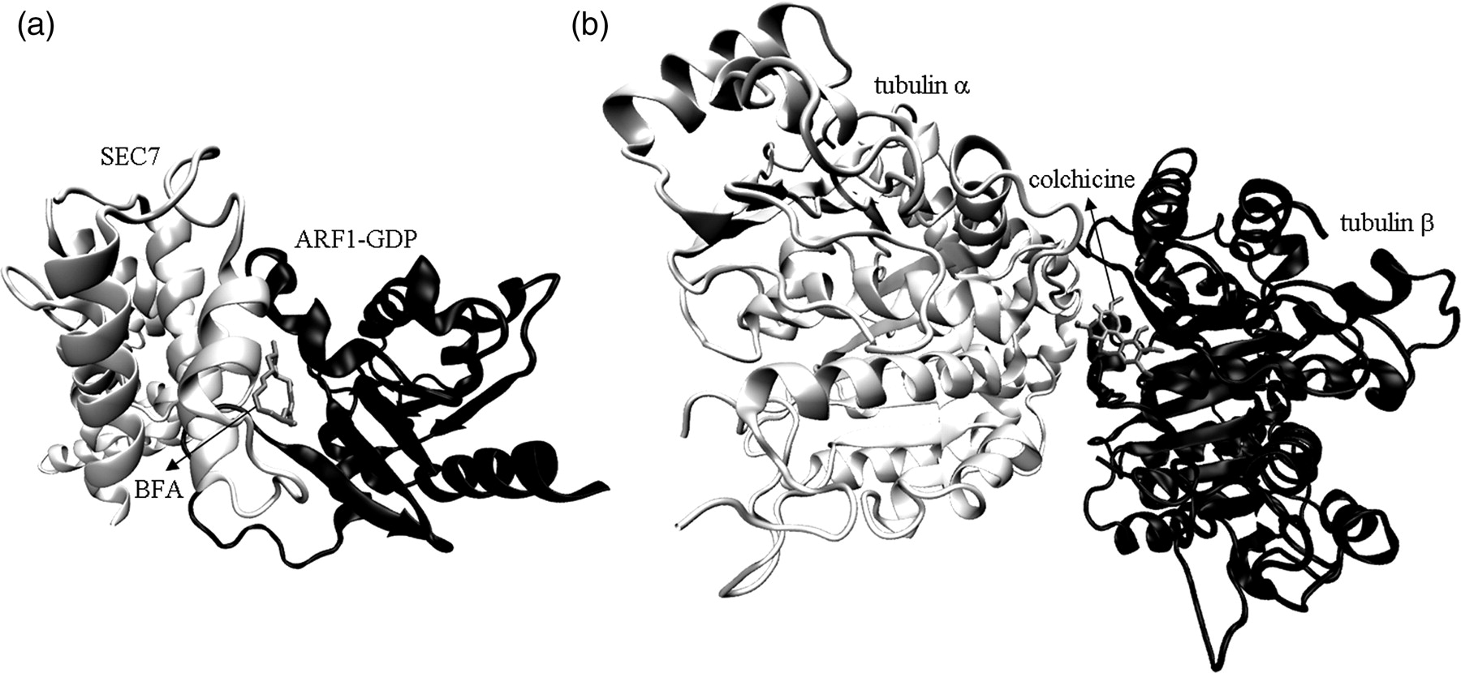
Fig. 3. Examples of drugs acting on transient protein–protein interactions. (a) Structure of ARF1-GDP bound to SEC7 ...
Notes:
Fig. 3. Examples of drugs acting on transient protein–protein interactions. (a) Structure of ARF1-GDP bound to SEC7 domain complexed with Brefeldin A (BFA) (PDB ID: 1re0). (b) Structure of tubulin α and tubulin β dimer complexed with colchicine (PDB ID: 1sa0)
Unless provided in the caption above, the following copyright applies to the content of this slide: © The Author 2011. Published by Oxford University Press. All rights reserved. For Permissions, please e-mail: journals.permissions@oup.com

Slide 4
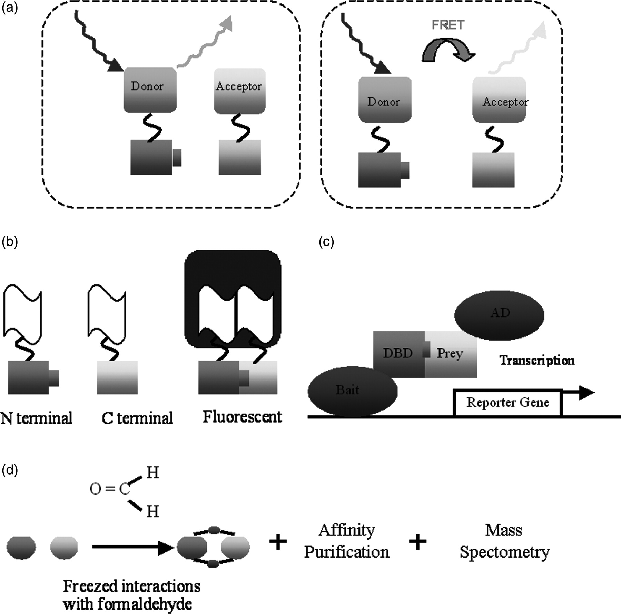
Fig. 4. Experimental methods used for the detection of transient protein-protein interactions. (a)Fluorescence ...
Notes:
Fig. 4. Experimental methods used for the detection of transient protein-protein interactions. (a)Fluorescence resonance energy transfer: this procedure, in which energy is transferred from an excited molecular flurophore (the donor) to another fluorophore (the acceptor) via intermolecular long-range dipole–dipole coupling, detects the interactions based on the physical distance (Sekar and Periasamy, 2003). (b) Bimolecular fluorescence complementation: in the BFC method, N and C terminals of YFP/GFP are fused to two distinct proteins; in the case of meeting again, they fluorophore. (c)Yeast two-hybrid method: this method is based on the molecular dissection of transcription activators. Since a particular structural contact is not required between DNA binding and transcriptional activation domains, the physical connection among them can be substituted with a non-covalent interaction settled by interacting proteins (Seraphin, 2002). (d)Chemical cross-linking: with the help of formaldehyde, chemical cross-linking is used to stabilize interactions through covalent bond constructions in weak and/or transient native cells or tissues, during the purification processes.
Unless provided in the caption above, the following copyright applies to the content of this slide: © The Author 2011. Published by Oxford University Press. All rights reserved. For Permissions, please e-mail: journals.permissions@oup.com

Slide 5
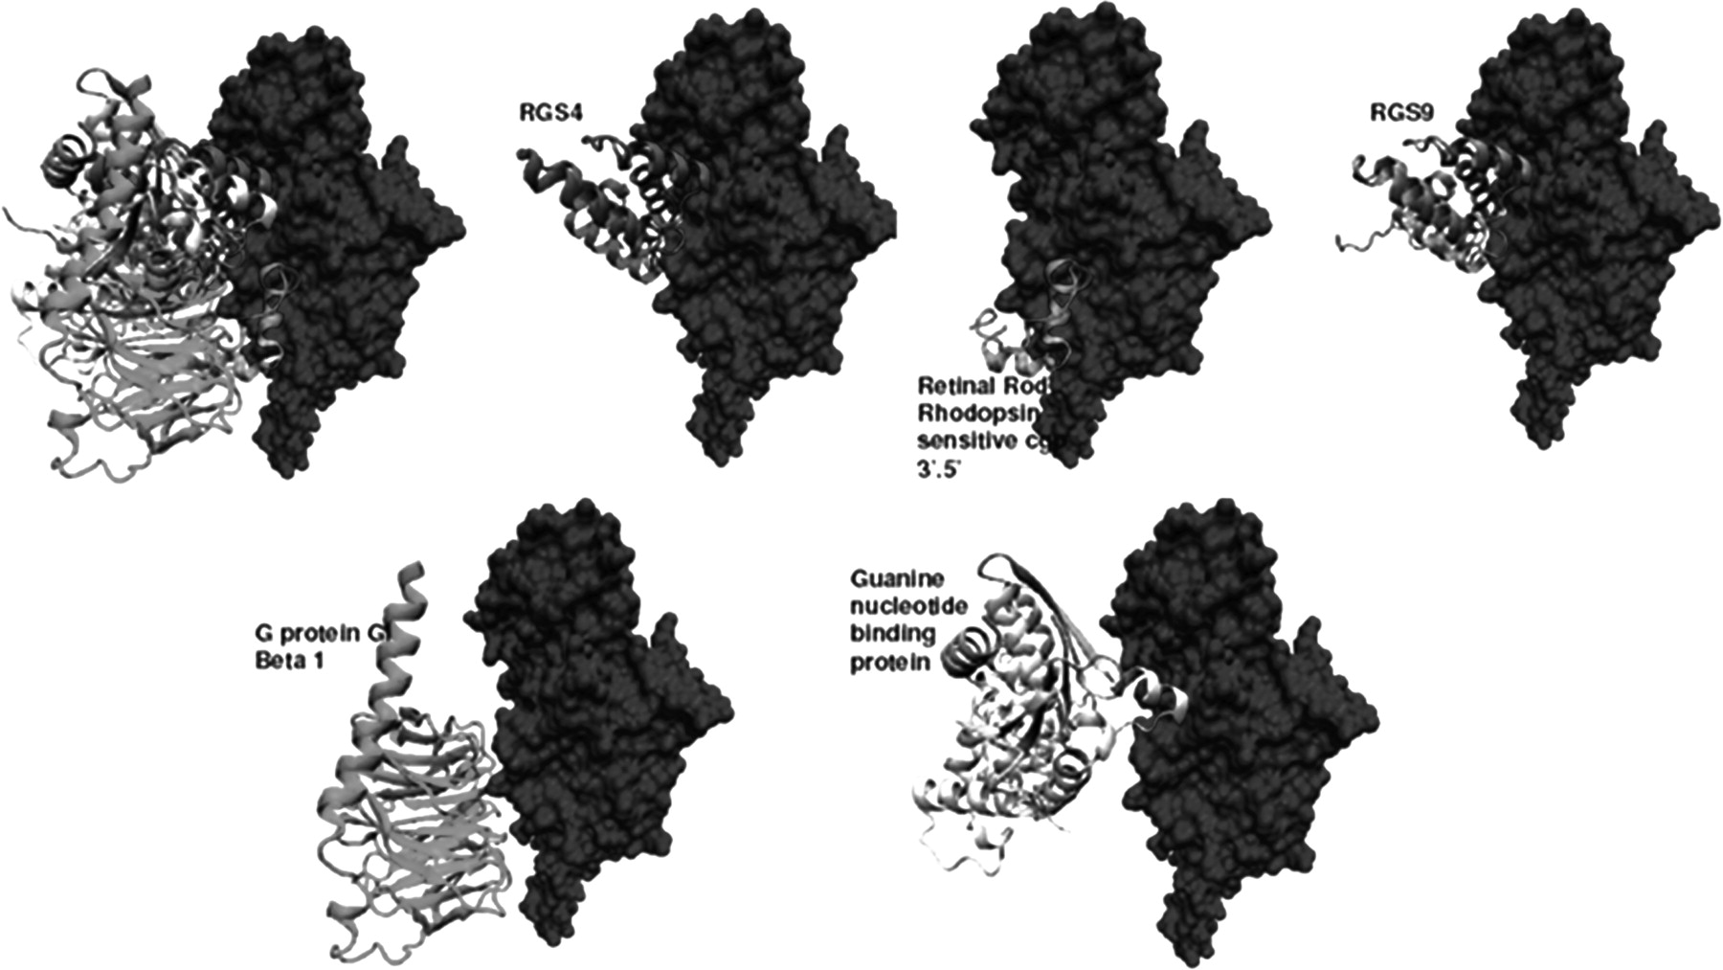
Fig. 5. Multipartnered and transient interfaces of a protein. Actin complexes are examples of type III interfaces ...
Notes:
Fig. 5. Multipartnered and transient interfaces of a protein. Actin complexes are examples of type III interfaces (Tuncbag et al., 2008), which are transient and multipartnered. The individual interactions of the partners of Guanine nucleotide binding protein are not possible simultaneously. Although the binding regions of some partners are not overlapping, the rest of the partner proteins interpenetrate each other.
Unless provided in the caption above, the following copyright applies to the content of this slide: © The Author 2011. Published by Oxford University Press. All rights reserved. For Permissions, please e-mail: journals.permissions@oup.com

