Slide 1
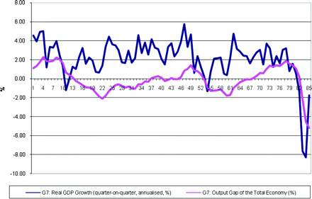
Figure 1 Slack in the G7 Source: Organization for Economic Cooperation and Development.
Notes:
Figure 1 Slack in the G7 Source: Organization for Economic Cooperation and Development.
Unless provided in the caption above, the following copyright applies to the content of this slide: © Oxford University Press 2010

