Slide 1
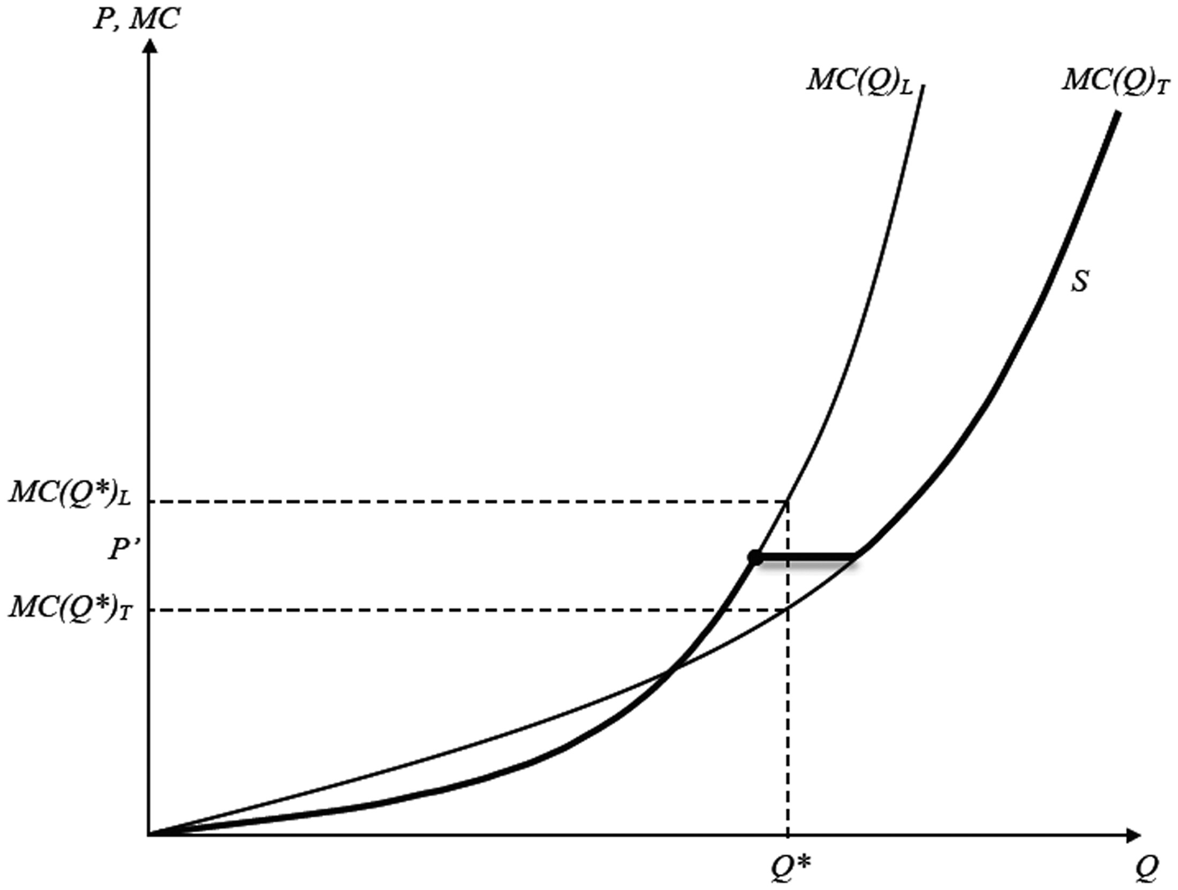
Figure 1. Derivation of the firm's supply curve
Notes:
Figure 1. Derivation of the firm's supply curve
Unless provided in the caption above, the following copyright applies to the content of this slide: © The Author 2015. Published by Oxford University Press on behalf of Associazione ICC. All rights reserved.

