Slide 1
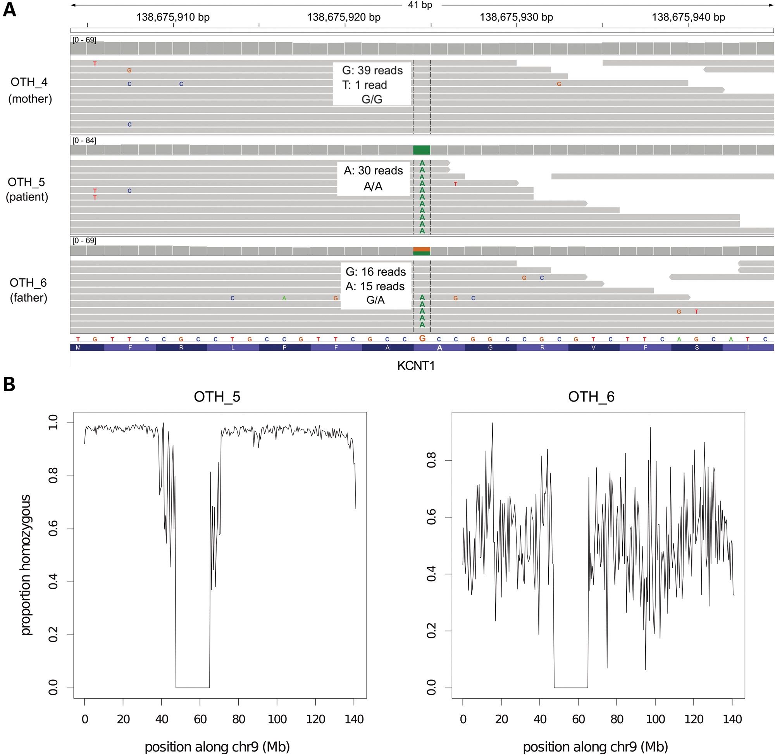
Figure 1. Paternal isodisomy in Patient 2. (A) We observed multiple Mendelian errors on chromosome 9 which led us to ...
Notes:
Figure 1. Paternal isodisomy in Patient 2. (A) We observed multiple Mendelian errors on chromosome 9 which led us to suspect uniparental disomy (UPD). All variants in the patient (OTH_5) appeared to have been inherited from his father (OTH_6). The KCNT1 variant is illustrated here as an example. Grey bars represent individual sequencing reads from the sample indicated on the left, and colored letters divergences from the reference sequence. The grey ‘pile-up’ along the top indicates the sequence coverage. The genotype of each individual is shown. (B) These plots show the proportion of variants that are homozygous in 500 kb windows across chr9. OTH_5 was completely homozygous, apart from a few spurious calls; the pattern is similar to that seen on chromosome X in males. His father, OTH_6, is shown for comparison. Note that the dip in the middle represents the centromere.
Unless provided in the caption above, the following copyright applies to the content of this slide: © The Author 2014. Published by Oxford University Press.This is an Open Access article distributed under the terms of the Creative Commons Attribution License (http://creativecommons.org/licenses/by/3.0/), which permits unrestricted reuse, distribution, and reproduction in any medium, provided the original work is properly cited.

Slide 2
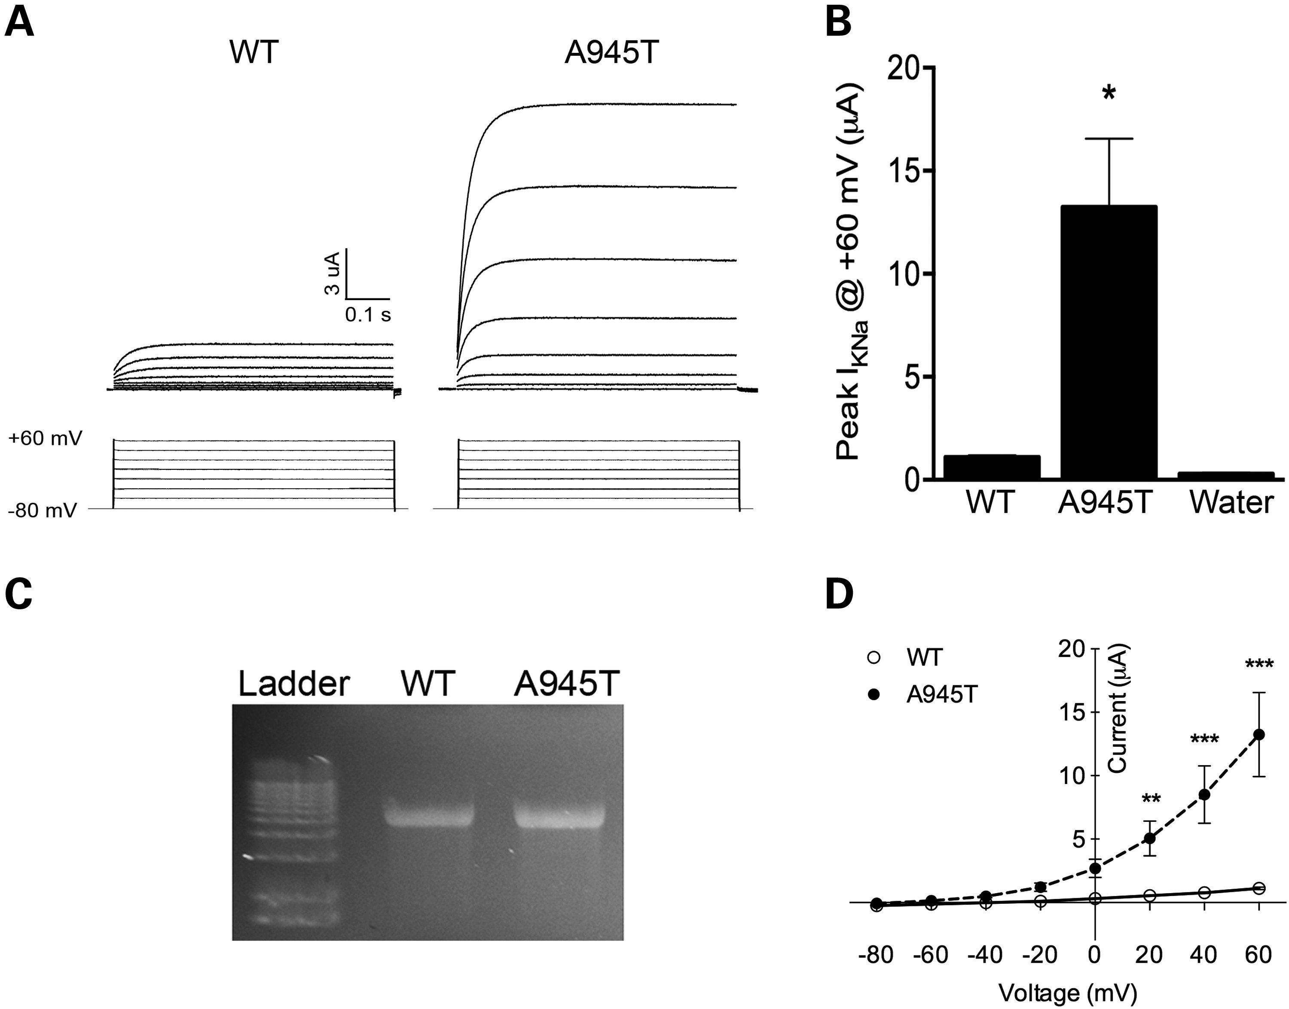
Figure 2. Electrophysiological and channel expression analysis of KCNT1 mutation found in Patient 2. WT or A945T mutant ...
Notes:
Figure 2. Electrophysiological and channel expression analysis of KCNT1 mutation found in Patient 2. WT or A945T mutant Slack channel was expressed in Xenopus laevis oocytes, and two-electrode voltage clamping (TEVC) performed. (A) A representative trace of current activity recorded from an oocyte expressing WT or A945T is shown on top, with the voltage-clamping protocol displayed underneath. (B) Averaged quantitation of the peak current is compared at +60 mV (P < 0.001, n = 5, Student's t-test; representative of three independent experiments). (C) The quality of RNA injected into Xenopus oocytes was checked on a 1% formaldehyde agarose gel. (D) Current–voltage relations for the WT or A945T channels. Channel activity as measured at peak current amplitude and normalized to the value at +60 mV is plotted against voltage (**P < 0.01, ***P < 0.001, n = 5, two-way ANOVA, Sidak's multiple comparisons test).
Unless provided in the caption above, the following copyright applies to the content of this slide: © The Author 2014. Published by Oxford University Press.This is an Open Access article distributed under the terms of the Creative Commons Attribution License (http://creativecommons.org/licenses/by/3.0/), which permits unrestricted reuse, distribution, and reproduction in any medium, provided the original work is properly cited.

Slide 3
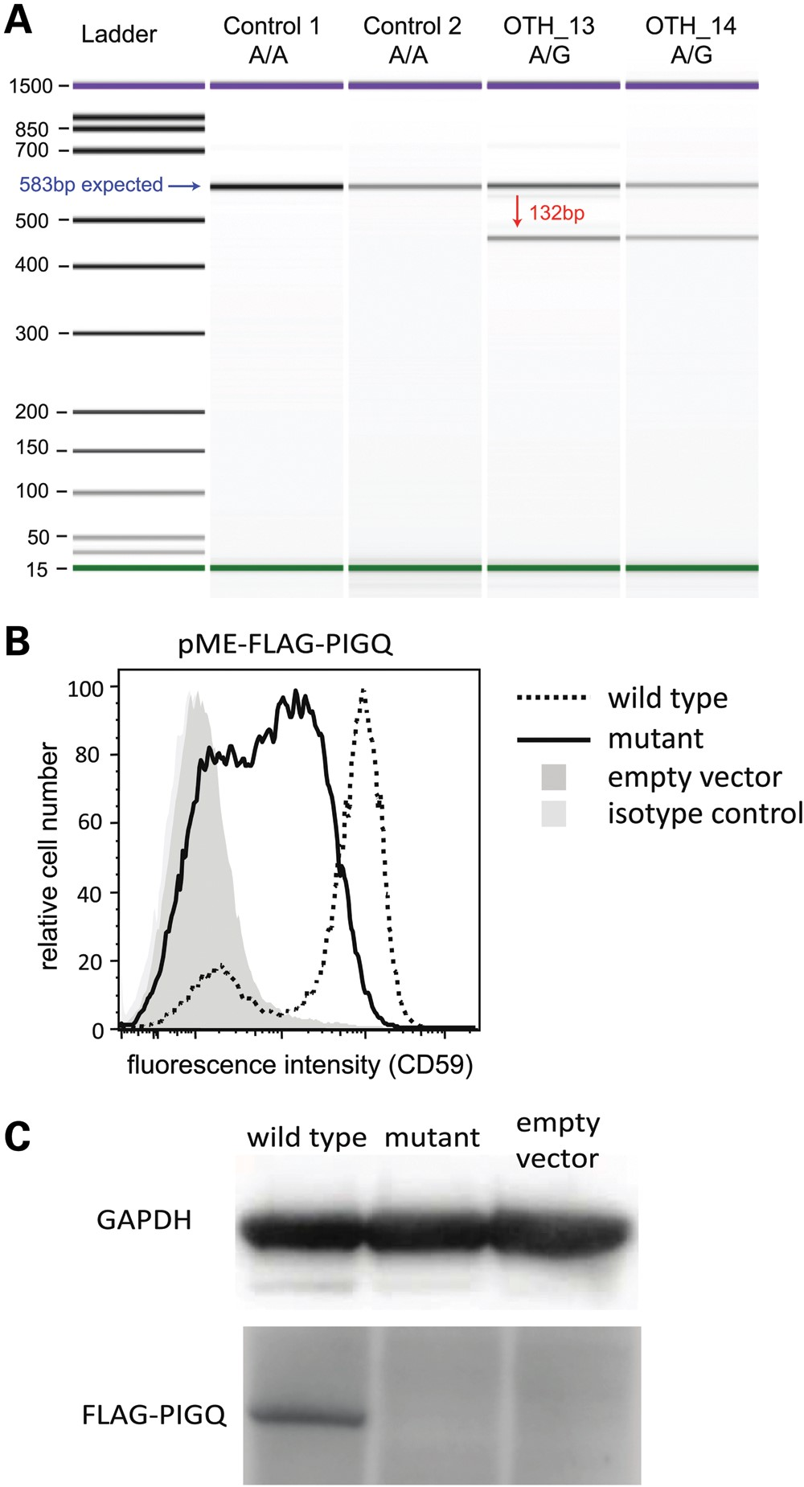
Figure 3. PIGQ splicing mutation in Patient 4. (A) The variant causes skipping of exon 3. This image shows the ...
Notes:
Figure 3. PIGQ splicing mutation in Patient 4. (A) The variant causes skipping of exon 3. This image shows the Bioanalyzer gel from an RT-PCR (see Materials and Methods) and demonstrates the presence of two PIGQ transcripts in the heterozygous parents (OTH_13, OTH_14). The blue arrow indicates the band expected from the annotated transcript, and the red arrow that expected from the skipping of exon 3. (B) Severely decreased functional activity of the mutant PIGQ. PIGQ-deficient CHO cells were transiently transfected with WT or mutant PIGQ cDNA (lacking exon 3). Restoration of the surface expression of CD59, a GPI-anchored protein, was assessed by flow cytometry after staining with anti-CD59 antibody. The mutant PIGQ did not restore the surface expression of CD59 as efficiently as the WT. X axis, fluorescence intensity corresponding to CD59 expression level per cell; Y axis, relative cell number. (C) The expression of mutant protein was greatly decreased and could not be detected by western blotting.
Unless provided in the caption above, the following copyright applies to the content of this slide: © The Author 2014. Published by Oxford University Press.This is an Open Access article distributed under the terms of the Creative Commons Attribution License (http://creativecommons.org/licenses/by/3.0/), which permits unrestricted reuse, distribution, and reproduction in any medium, provided the original work is properly cited.

