Slide 1
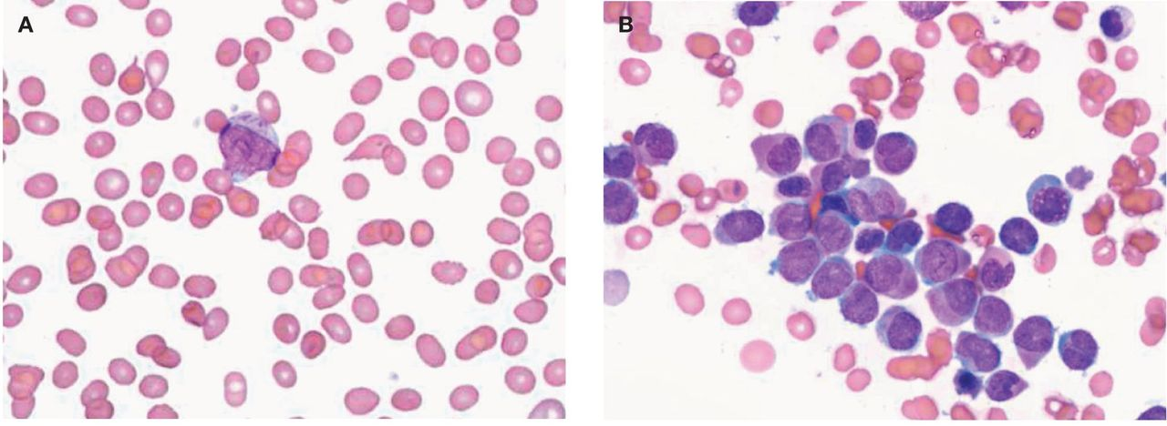
Image 1 The diagnosis of microgranular-variant, acute procyelocytic leukemia. A, Peripheral blood smear showing a ...
Notes:
Image 1 The diagnosis of microgranular-variant, acute procyelocytic leukemia. A, Peripheral blood smear showing a large blast with Auer rods in the cytoplasm (hematoxylin-eosin staining, ×1000). B, Bone marrow aspiration showing abnormal myelocytes and promyelocytes with sparse or fine granulation; the image depicts microgranular-variantacute promyelocytic leukemia (M3) (hematoxylin-eosin staining, ×1000).
Unless provided in the caption above, the following copyright applies to the content of this slide: © American Society of Clinical Pathologists

Slide 2
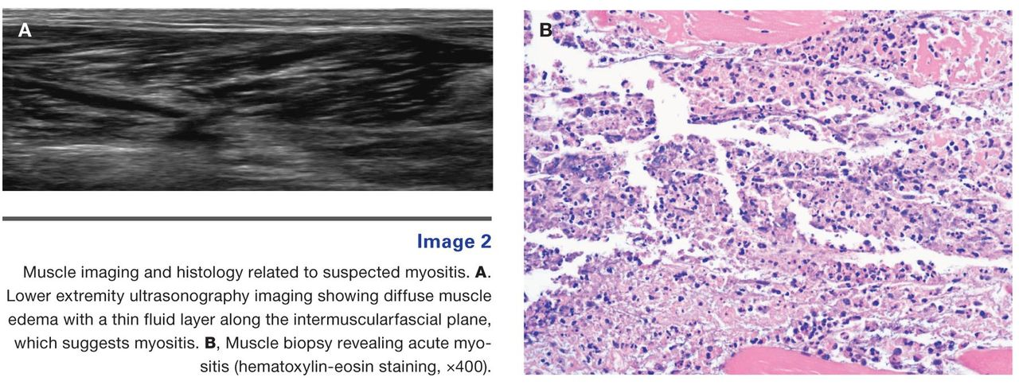
Image 2 Muscle imaging and histology related to suspected myositis. A. Lower extremity ultrasonography imaging ...
Notes:
Image 2 Muscle imaging and histology related to suspected myositis. A. Lower extremity ultrasonography imaging showing diffuse muscle edema with a thin fluid layer along the intermuscularfascial plane, which suggests myositis. B, Muscle biopsy revealing acute myositis (hematoxylin-eosin staining, ×400).
Unless provided in the caption above, the following copyright applies to the content of this slide: © American Society of Clinical Pathologists

Slide 3
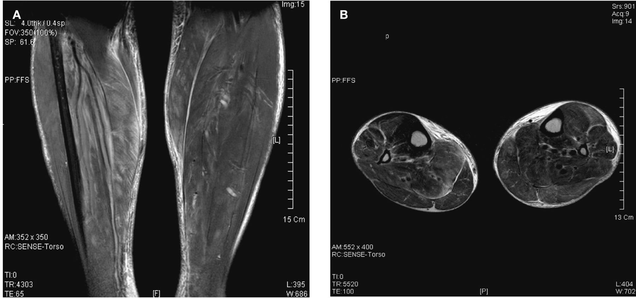
Image 3 Lower extremity magnetic resonance imaging (MRI). Multifocal inflammatory and hemorrhagic nodular lesions ...
Notes:
Image 3 Lower extremity magnetic resonance imaging (MRI). Multifocal inflammatory and hemorrhagic nodular lesions with edema on the lower legs, particularly involving the right soleus, the left gastrocnemius, and both tibialis anterior muscles. A, Coronal view. B, Axial view.
Unless provided in the caption above, the following copyright applies to the content of this slide: © American Society of Clinical Pathologists

Slide 4
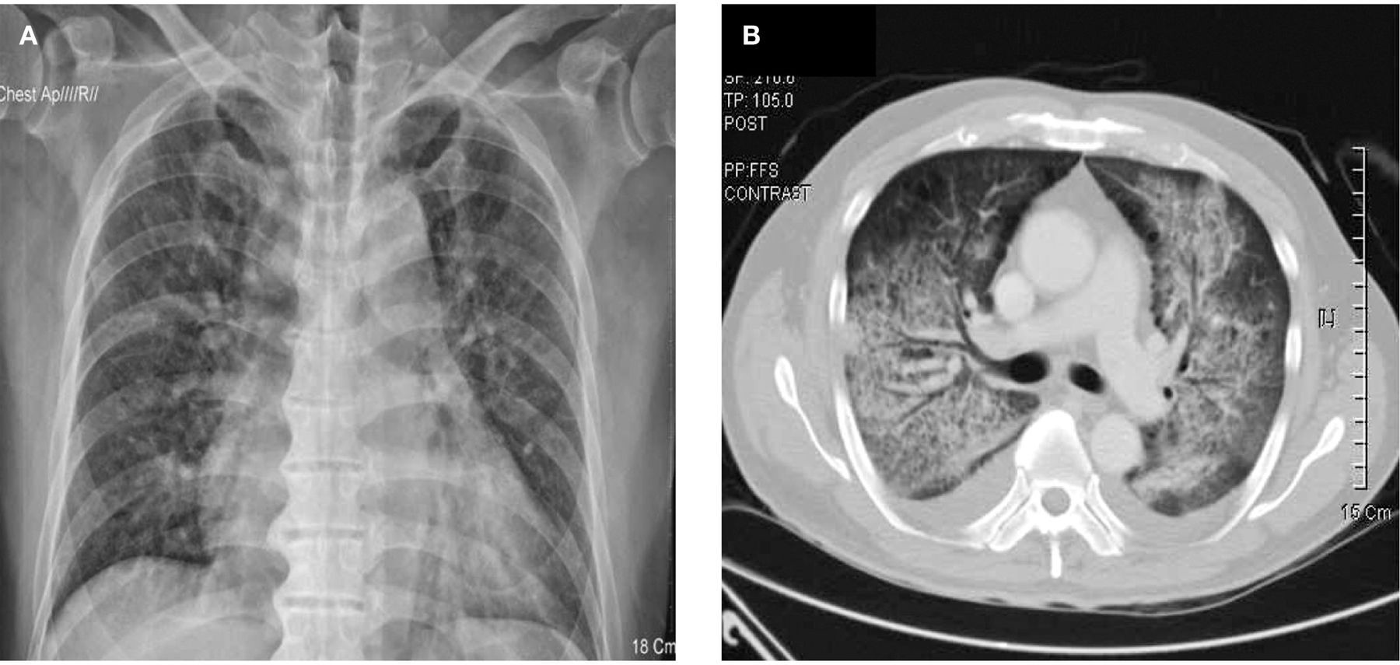
Image 4 Lung image suggesting retinoic acid syndrome. A, Chest X-ray, pulmonary edema. B, chest computed tomography. ...
Notes:
Image 4 Lung image suggesting retinoic acid syndrome. A, Chest X-ray, pulmonary edema. B, chest computed tomography. Diffuse ground-glass opacity and consolidation on both lungs. Bilateral pleural effusions can also be seen.
Unless provided in the caption above, the following copyright applies to the content of this slide: © American Society of Clinical Pathologists

