Slide 1
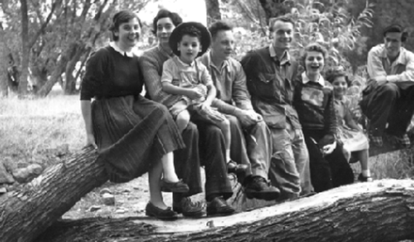
FIGURE 1. A young Chris (4th from left) with friends.
Notes:
FIGURE 1. A young Chris (4th from left) with friends.
Unless provided in the caption above, the following copyright applies to the content of this slide: © The Author 2008. Published by Oxford University Press on behalf of The British Computer Society. All rights reserved. For Permissions, please email: journals.permissions@oxfordjournals.org

Slide 2
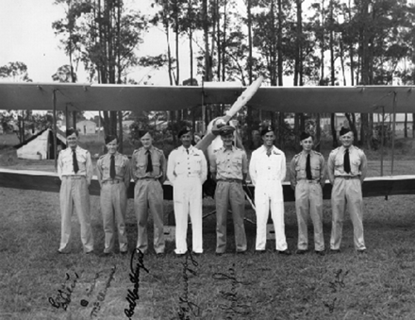
FIGURE 2. Chris (2nd from right) in front of a De Havilland Tiger Moth during his national service in the ...
Notes:
FIGURE 2. Chris (2nd from right) in front of a De Havilland Tiger Moth during his national service in the 1950s.
Unless provided in the caption above, the following copyright applies to the content of this slide: © The Author 2008. Published by Oxford University Press on behalf of The British Computer Society. All rights reserved. For Permissions, please email: journals.permissions@oxfordjournals.org

Slide 3
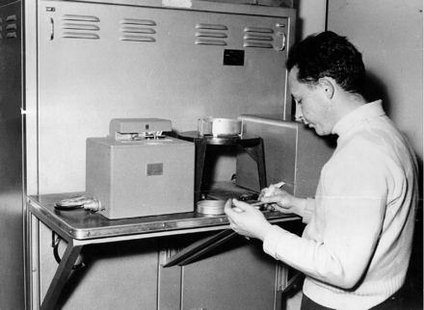
FIGURE 3. Chris as a student.
Notes:
FIGURE 3. Chris as a student.
Unless provided in the caption above, the following copyright applies to the content of this slide: © The Author 2008. Published by Oxford University Press on behalf of The British Computer Society. All rights reserved. For Permissions, please email: journals.permissions@oxfordjournals.org

Slide 4
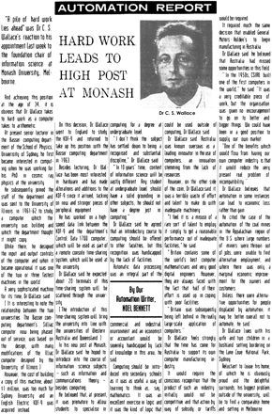
FIGURE 4. Article in “The Australian” newspaper (re-constructed verbatim from original) from the 1960s (ca. 1967) re ...
Notes:
FIGURE 4. Article in “The Australian” newspaper (re-constructed verbatim from original) from the 1960s (ca. 1967) re Chris's appointment to Monash, also showing his views on education and social impact of automation.
Unless provided in the caption above, the following copyright applies to the content of this slide: © The Author 2008. Published by Oxford University Press on behalf of The British Computer Society. All rights reserved. For Permissions, please email: journals.permissions@oxfordjournals.org

Slide 5
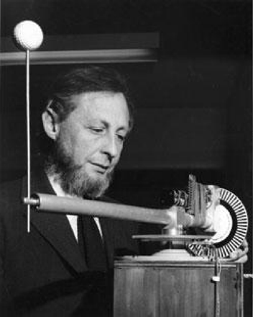
FIGURE 5. Chris and “waving arm”, ca. 1977.
Notes:
FIGURE 5. Chris and “waving arm”, ca. 1977.
Unless provided in the caption above, the following copyright applies to the content of this slide: © The Author 2008. Published by Oxford University Press on behalf of The British Computer Society. All rights reserved. For Permissions, please email: journals.permissions@oxfordjournals.org

Slide 6
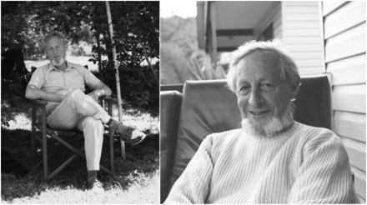
FIGURE 6. 6(a) Chris at home 6(b) Chris smiling.
Notes:
FIGURE 6. 6(a) Chris at home 6(b) Chris smiling.
Unless provided in the caption above, the following copyright applies to the content of this slide: © The Author 2008. Published by Oxford University Press on behalf of The British Computer Society. All rights reserved. For Permissions, please email: journals.permissions@oxfordjournals.org

