Slide 1
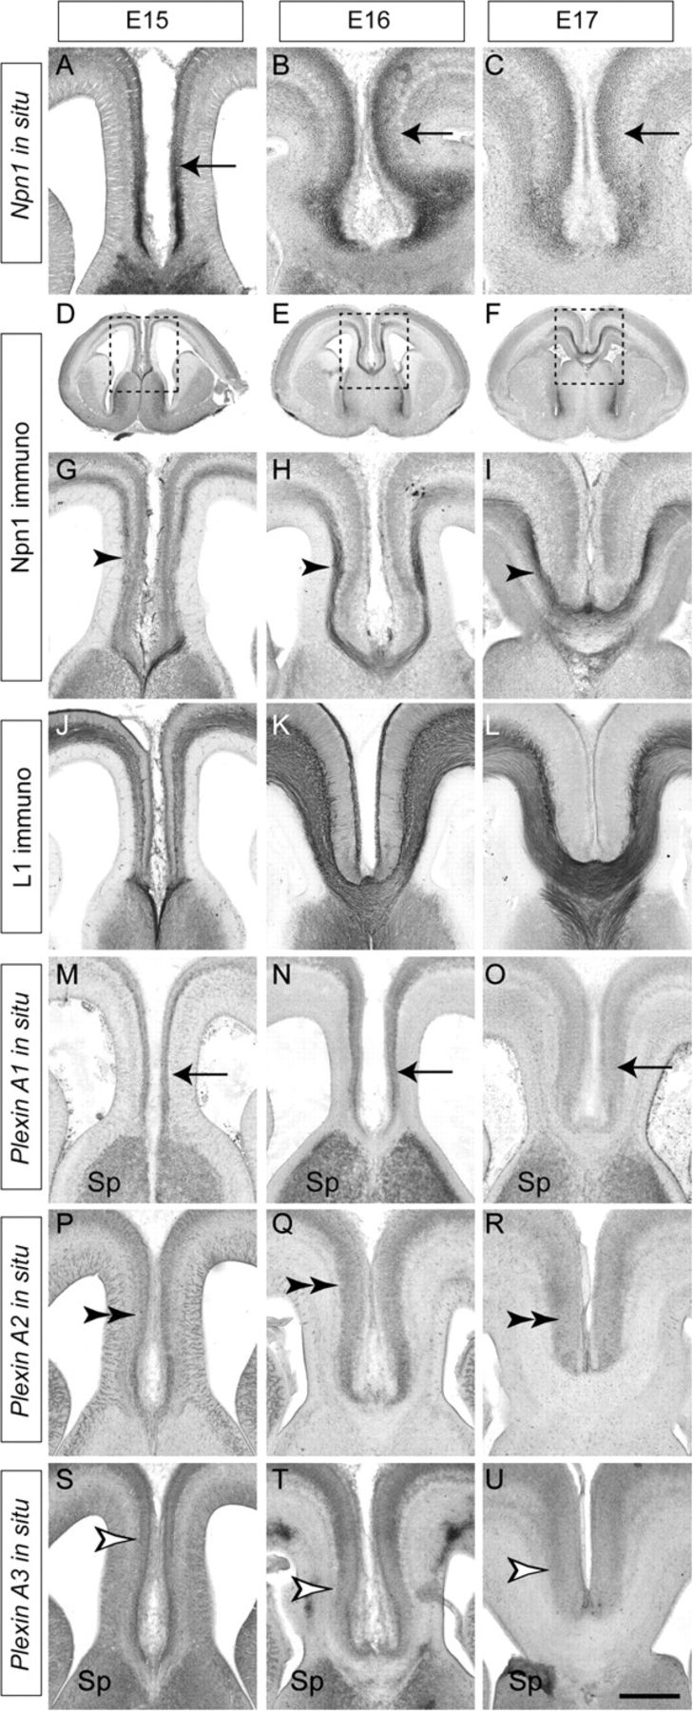
Figure 1. Npn1 and plexin expression in the cingulate cortex. Coronal sections of wild-type brains. Npn1 mRNA is ...
Notes:
Figure 1. Npn1 and plexin expression in the cingulate cortex. Coronal sections of wild-type brains. Npn1 mRNA is expressed by cells in the cingulate cortex at E15, E16, and E17 (arrows, A–C). Npn1 protein is expressed on the axons of cingulate pioneer neurons (arrowheads) at E15 (D, G), E16 (E, H), and E17 (F, I). Panels G, H, and I are higher magnification views of the boxed regions in D, E, and F, respectively. L1, a coreceptor for Sema signaling, is expressed by all axons crossing the CC at E15 (J), E16 (K), and E17 (L). Plexin A1 mRNA is expressed in the cingulate cortex (arrows) and septum at E15, E16, and E17 (M–O), whereas plexin A2 mRNA expression is restricted to the cingulate cortex (double arrowheads, P–R). Plexin A3 mRNA is expressed in the cingulate cortex (open arrowheads) and the septum between E15 and E17 (S–U). Sp, septum. Scale bar: 600 μm (D), 550 μm (E), 500 μm (F), 250 μm (A, G, J, M, P, and S), 235 μm (B, H, K, N, Q, and T), and 200 μm (C, I, L, O, R, and U).
Unless provided in the caption above, the following copyright applies to the content of this slide: © The Author 2009. Published by Oxford University Press. All rights reserved. For permissions, please e-mail: journals.permissions@oxfordjournals.org

Slide 2
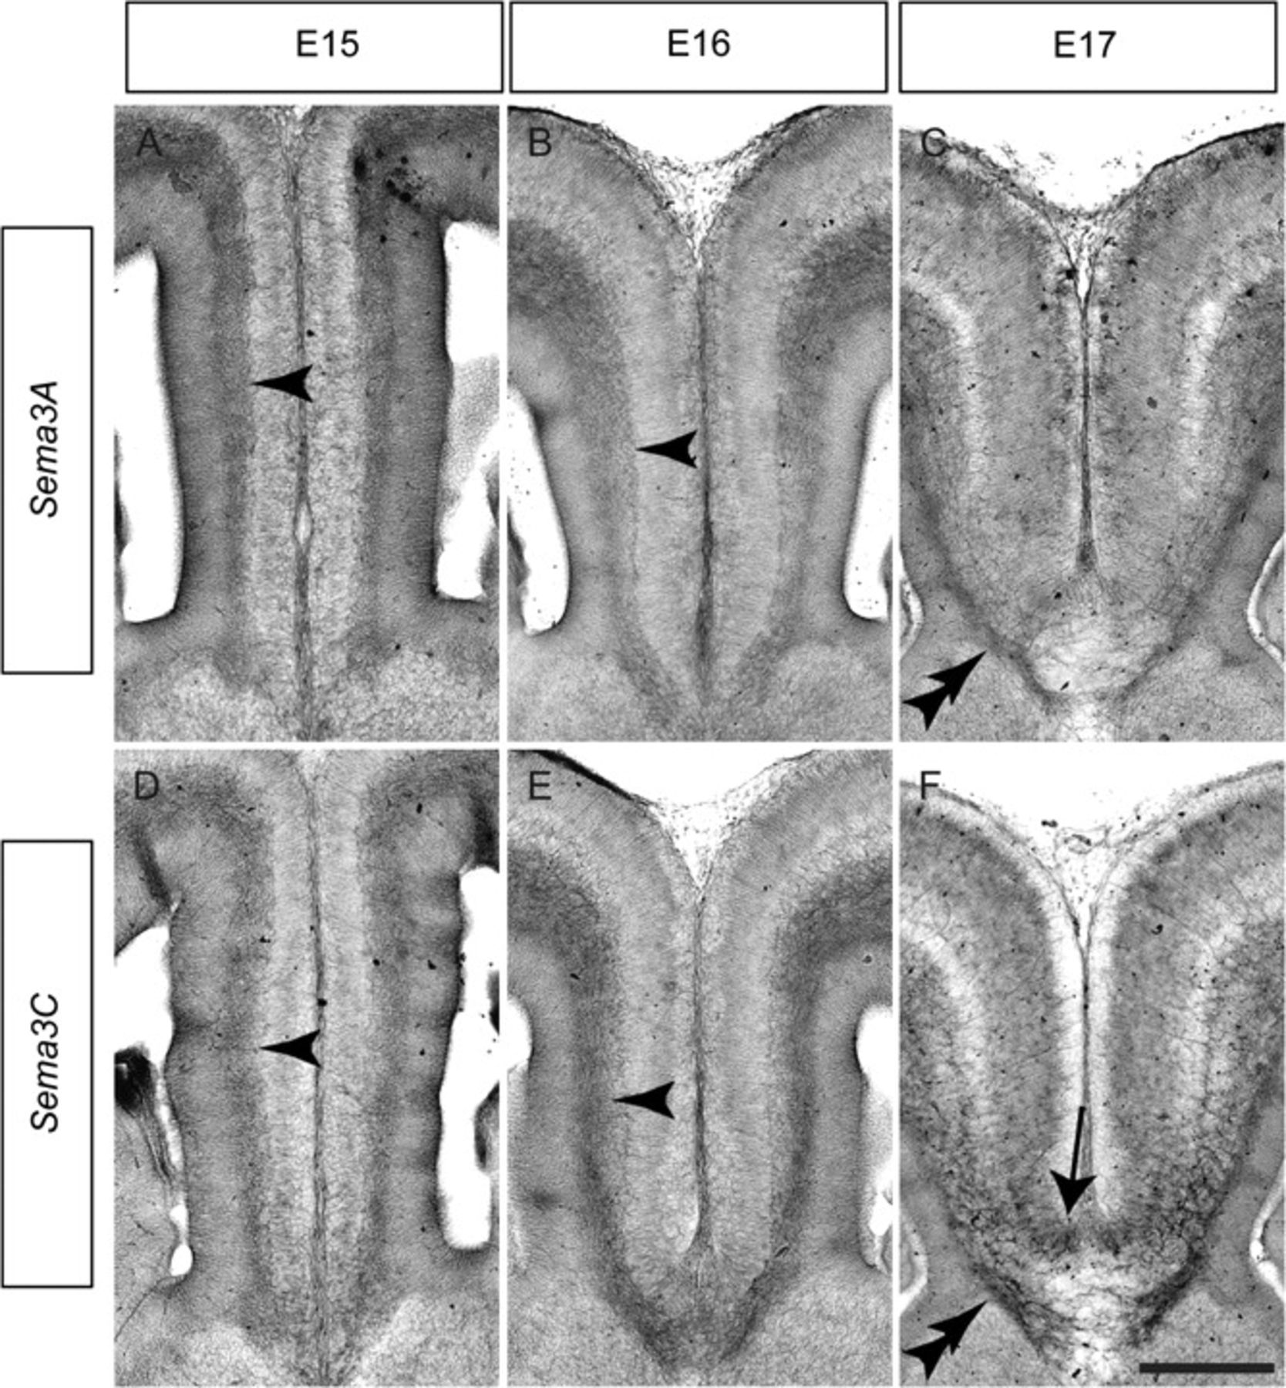
Figure 2. Expression of class 3 Semas in the cingulate cortex. Coronal sections of wild-type brains demonstrating ...
Notes:
Figure 2. Expression of class 3 Semas in the cingulate cortex. Coronal sections of wild-type brains demonstrating expression of Sema3A (A–C) and Sema3C (D–F) mRNA at the cortical midline. Sema3A is expressed in the IZ (arrowheads) at E15 (A) and E16 (B) and is expressed in the subcallosal sling (double arrowhead) at E17 (C). Sema3C is highly expressed in the IZ (arrowheads) at E15 (D) and E16 (E) and is expressed in both the subcallosal sling (double arrowhead) and the indusium griseum glia (arrow) at E17 (F). Scale bar: 250 μm (A and D), 235 μm (B and E), and 200 μm (C and F).
Unless provided in the caption above, the following copyright applies to the content of this slide: © The Author 2009. Published by Oxford University Press. All rights reserved. For permissions, please e-mail: journals.permissions@oxfordjournals.org

Slide 3
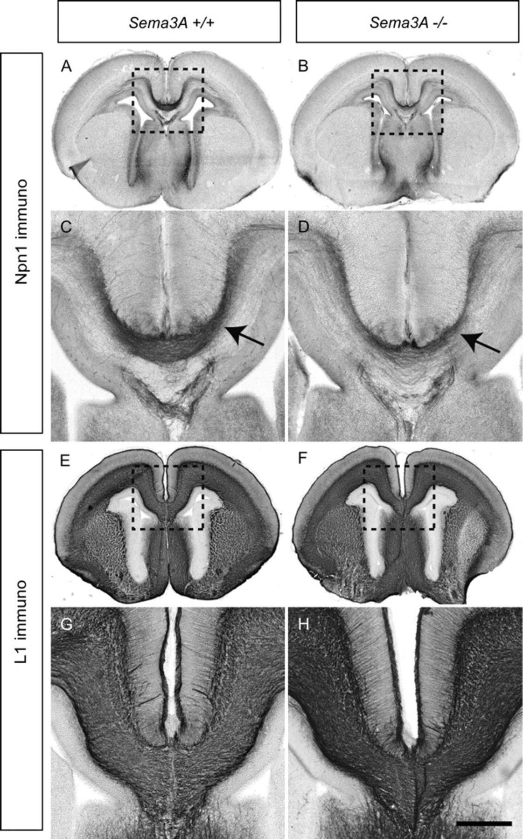
Figure 3. The CC forms normally in Sema3A-deficient mice. Coronal sections of wild-type and Sema3A-deficient brains at ...
Notes:
Figure 3. The CC forms normally in Sema3A-deficient mice. Coronal sections of wild-type and Sema3A-deficient brains at E17. Npn1 is expressed on the axons of cingulate pioneers in both wild-type (A; arrow in C) and Sema3A mutants (B; arrow in D), although a possible reduction in Npn1-expressing axons in the mutant is evident. The CC in Sema3A-deficient mice appears grossly normal in comparison to wild-type controls as assessed by L1 expression (E–H). Panels C, D, G, and H are higher magnification views of the boxed regions A, B, E, and F, respectively. Scale bar: 500 μm (A, B, E, and F) and 200 μm (C, D, G, and H).
Unless provided in the caption above, the following copyright applies to the content of this slide: © The Author 2009. Published by Oxford University Press. All rights reserved. For permissions, please e-mail: journals.permissions@oxfordjournals.org

Slide 4
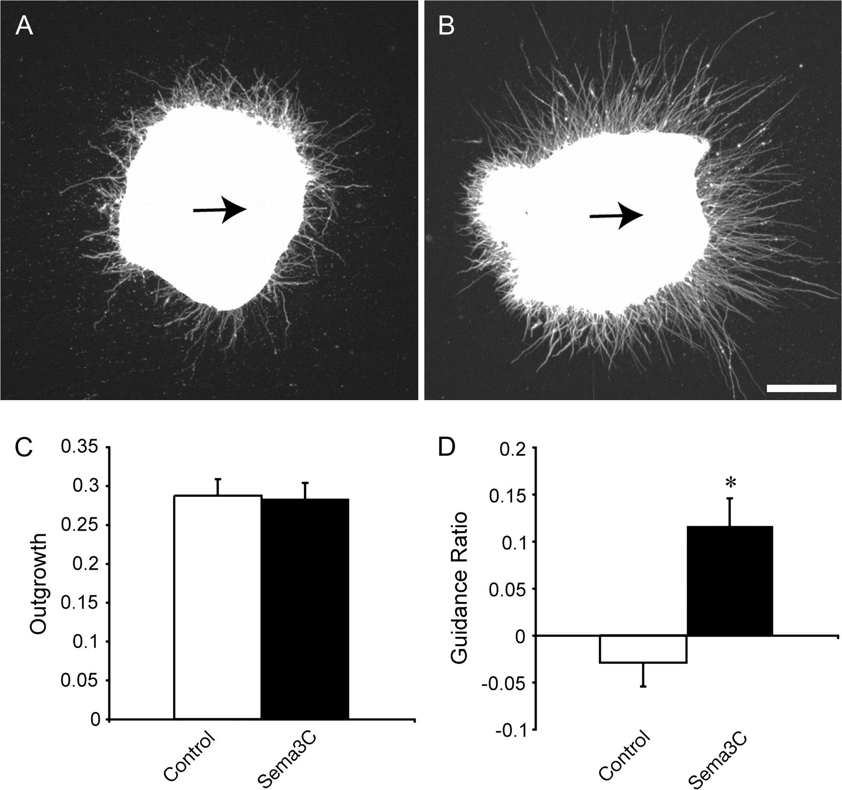
Figure 4. Sema3C attracts cingulate cortex neurites in vitro. Cingulate cortex explants grown next to mock-transfected ...
Notes:
Figure 4. Sema3C attracts cingulate cortex neurites in vitro. Cingulate cortex explants grown next to mock-transfected cell blocks (A) or Sema3C-expressing cell blocks (B) for 48 h. Explants have been stained with antineuronal-specific βIII tubulin to visualize neurites. There is no significant difference in neurite outgrowth from explants from either group (C). However, the GR (defined as [(proximal neurite pixels − distal neurite pixels)/(total neurite pixels)) was significantly greater in explants grown next to Sema3C-expressing cell blocks in comparison to controls (*P < 0.0005), indicating that Sema3C acts as an attractant for neurites from cingulate cortex explants. The arrows in A and B indicate the direction of the cell block relative to the explant. Scale bar: 200 μm.
Unless provided in the caption above, the following copyright applies to the content of this slide: © The Author 2009. Published by Oxford University Press. All rights reserved. For permissions, please e-mail: journals.permissions@oxfordjournals.org

Slide 5
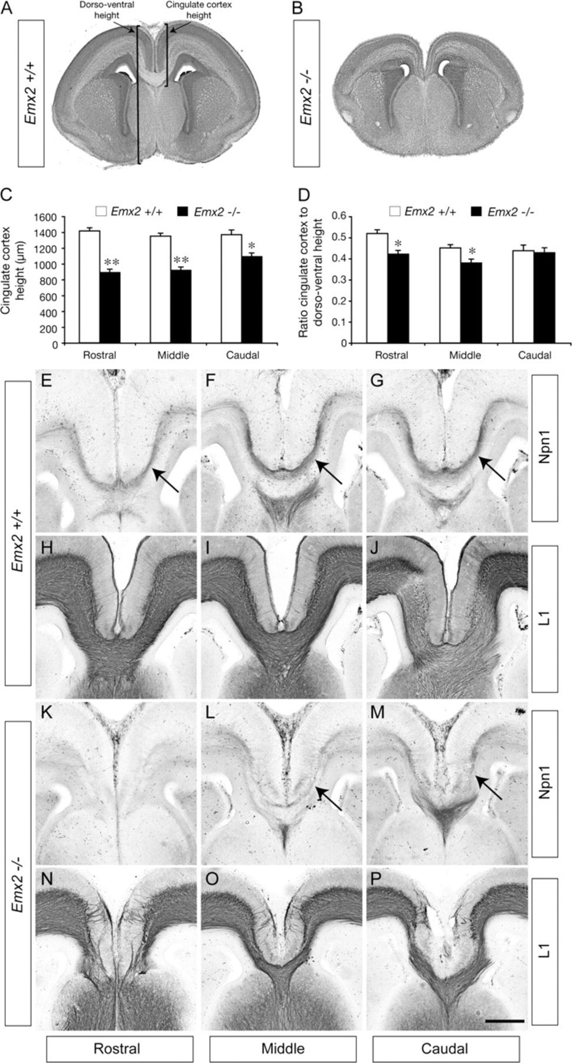
Figure 5. Expression of Npn1 correlates with the presence of the CC in Emx2 mutants. Coronal sections of E17 wild-type ...
Notes:
Figure 5. Expression of Npn1 correlates with the presence of the CC in Emx2 mutants. Coronal sections of E17 wild-type (A) and Emx2 knockout (B) brains stained with hematoxylin. (C) The dorsoventral size of the cingulate cortex in Emx2 mutants at rostral, middle, and caudal levels is significantly reduced in comparison to wild-type controls. (D) At rostral and middle levels, the ratio of the cingulate cortex dorsoventral size to the total dorsoventral size is significantly reduced in comparison to the control (**P < 0.0001, *P < 0.005). (E–P) Coronal sections of E17 wild-type (E–J) or Emx2 mutant (K–P) brains. Npn1 expression is observed on cingulate pioneer axons at rostral, middle, and caudal levels of the wild type (arrows in E–G), and L1-expressing axons are seen crossing the CC (H–J). In the mutant, no Npn1 expression is observed in rostral sections (K), and no axons can be seen crossing the CC using L1 staining (N). At more caudal levels in the mutant, Npn1 expression becomes detectable (arrows in L, M) and L1-expressing axons can be seen crossing the midline through the CC (O, P). Scale bar: 500 μm (A, B) and 200 μm (E–P).
Unless provided in the caption above, the following copyright applies to the content of this slide: © The Author 2009. Published by Oxford University Press. All rights reserved. For permissions, please e-mail: journals.permissions@oxfordjournals.org

Slide 6
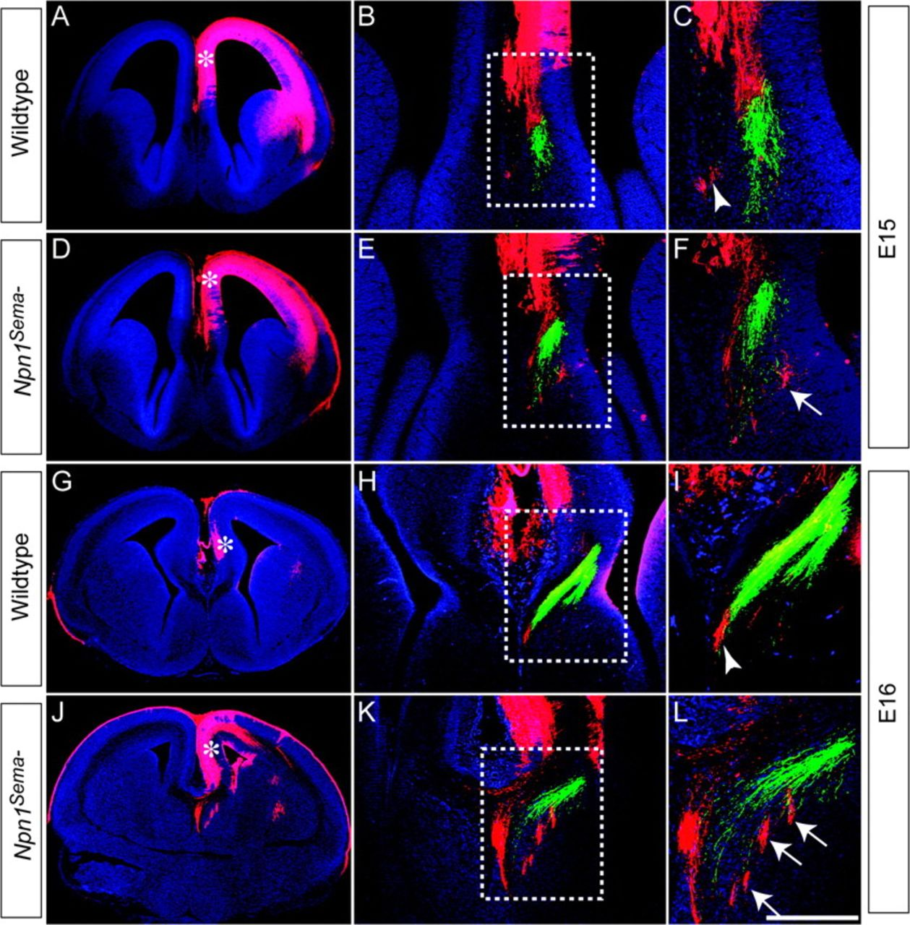
Figure 6. Cingulate axons are misguided in Npn1^{Sema-} mutants. Carbocyanine tract tracing in wild-type (A–C, ...
Notes:
Figure 6. Cingulate axons are misguided in Npn1Sema- mutants. Carbocyanine tract tracing in wild-type (A–C, G–I) and Npn1Sema- knockin mice (D–F, J–L) at E15 (A–F) and E16 (G–L). Axons from the cingulate cortex were labeled with DiI in the cingulate cortex (red), whereas hippocampal axons were labeled with DiA in the dentate gyrus (green). Low-magnification images in A, D, G, and J show the injection site for DiI (asterisks). (B, C) In the wild type at E15, cingulate cortex axons are found close to the site of the presumptive CC (arrowhead in C). (E, F) In the mutant at E15, cingulate axons are misguided, being found laterally to the hippocampal axons (arrow in F). (H, I) At E16 in the wild type, cingulate axons are located just medially to the hippocampal axons (arrowhead in I). (K, L) In Npn1Sema- mutants at E16 however, cingulate axons are observed lateral to hippocampal axons, projecting into the septum (arrows in L). Panels C, F, I, and L are higher magnification views of the boxed regions B, E, H, and K, respectively. Scale bar: 600 μm (A and D), 550 μm (G and J), 250 μm (H and K), 200 μm (B and E), 75 μm (I and L), and 50 μm (C and F).
Unless provided in the caption above, the following copyright applies to the content of this slide: © The Author 2009. Published by Oxford University Press. All rights reserved. For permissions, please e-mail: journals.permissions@oxfordjournals.org

