Slide 1
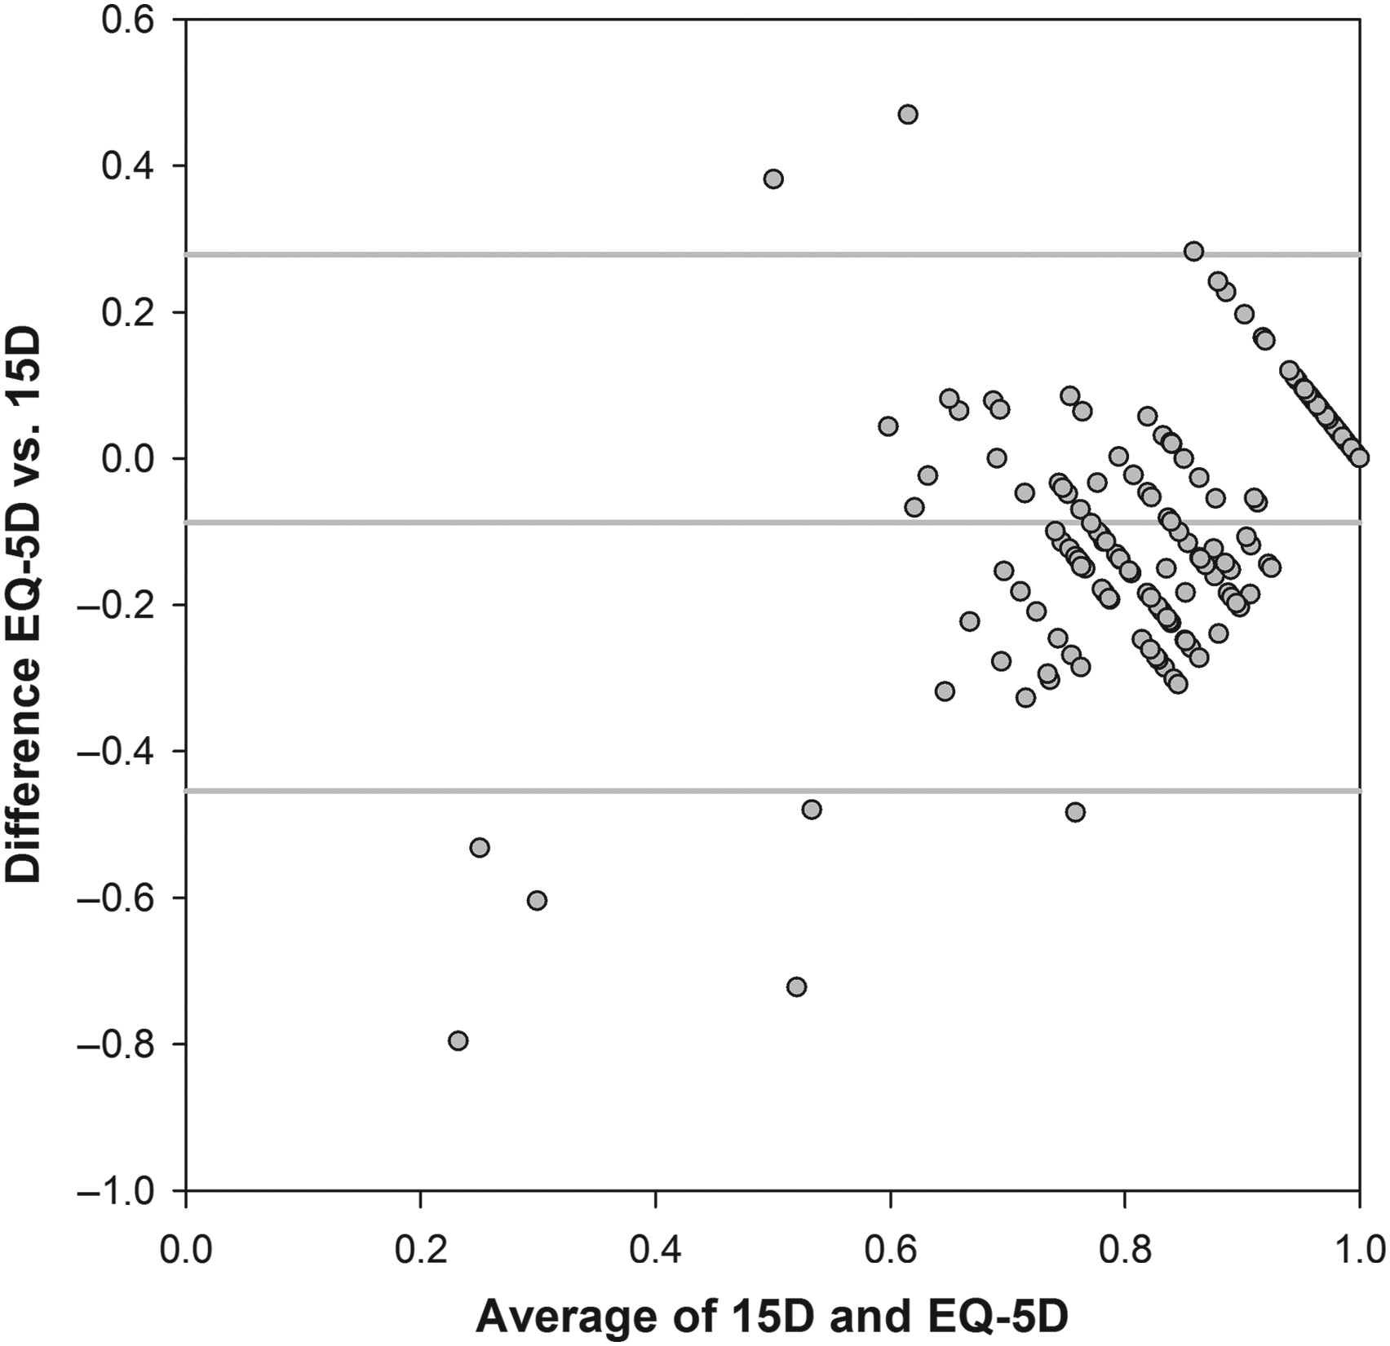
Figure 1 Bland–Altman plot for EQ-5D and 15D scores at baseline.
Notes:
Figure 1 Bland–Altman plot for EQ-5D and 15D scores at baseline.
Unless provided in the caption above, the following copyright applies to the content of this slide: Published on behalf of the European Society of Cardiology. All rights reserved. © The Author 2016. For permissions please email: journals.permissions@oup.com.

Slide 2
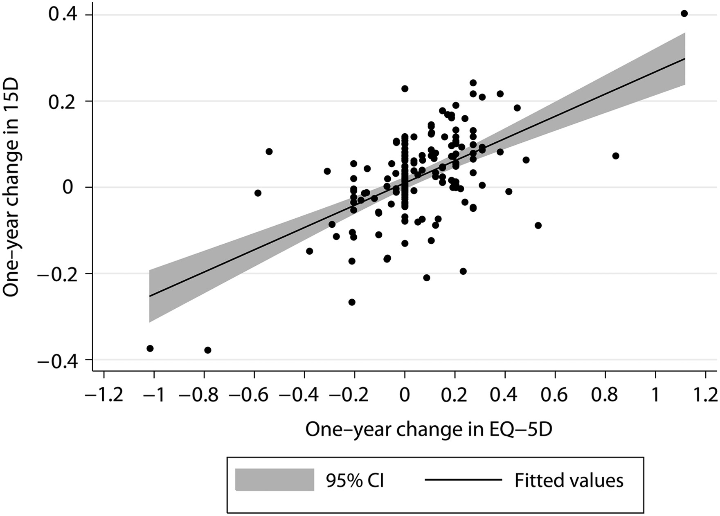
Figure 2 Correlation between 1-year change in 15D and EQ-5D.
Notes:
Figure 2 Correlation between 1-year change in 15D and EQ-5D.
Unless provided in the caption above, the following copyright applies to the content of this slide: Published on behalf of the European Society of Cardiology. All rights reserved. © The Author 2016. For permissions please email: journals.permissions@oup.com.

