Slide 1
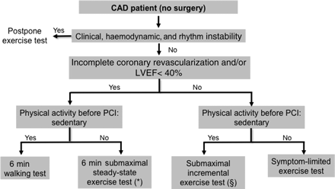
Figure 1 Proposed algorithm for functional evaluation in exercise prescription in coronary artery disease (CAD) ...
Notes:
Figure 1 Proposed algorithm for functional evaluation in exercise prescription in coronary artery disease (CAD) patients not treated with cardiac surgery. The following general criteria should be considered in planning an exercise testing modality for exercise prescription. Safety: stability of clinical, haemodynamic, and rhythmic parameters (e.g. symptomatic Brady-arrhythmias, persistent or paroxysmal atrial flutter/fibrillation with inadequate rate control, exercise-induced persistent or paroxysmal supraventricular tachycardia, exercise-induced ventricular premature contractions, ventricular tachycardia/fibrillation), ischaemic and angina threshold (in case of incomplete revascularization), degree of left ventricular impairment. Associated factors: sedentary habits, orthopaedic limitations, occupational and recreational needs. *Upper limit for terminating submaximal 6 min single stage (steady-state) exercise testing: rating of perceived exertion (Borg scale) 11–13/20 or maximal heart rate = heart rate at standing rest + 20–30 b.p.m.54§Upper limit for terminating sub maximal incremental testing: maximal heart rate = 70% HR reserve or 85% of age-predicted maximal heart rate.55
Unless provided in the caption above, the following copyright applies to the content of this slide: Published on behalf of the European Society of Cardiology. All rights reserved. © The Author 2010. For permissions please email: journals.permissions@oxfordjournals.org

Slide 2
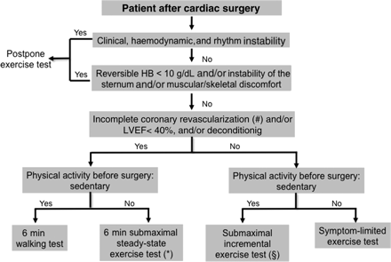
Figure 2 Proposed algorithm for functional evaluation in exercise prescription after cardiac surgery, i.e. coronary ...
Notes:
Figure 2 Proposed algorithm for functional evaluation in exercise prescription after cardiac surgery, i.e. coronary artery bypass graft (CABG), valve repair interventions. The following general criteria should be considered in planning exercise testing modality for exercise prescription: Safety; Co-morbidities: haemoglobin concentration (HB) values; muscular-skletal discomfort, healing issues at the incision sites; Associated factors: deconditioning due to prolonged hospitalization, sedentary habits, orthopedic limitations, occupational and recreational needs. #Incomplete revascularization in case of CABG (see also legend to Figure 1).
Unless provided in the caption above, the following copyright applies to the content of this slide: Published on behalf of the European Society of Cardiology. All rights reserved. © The Author 2010. For permissions please email: journals.permissions@oxfordjournals.org

Slide 3
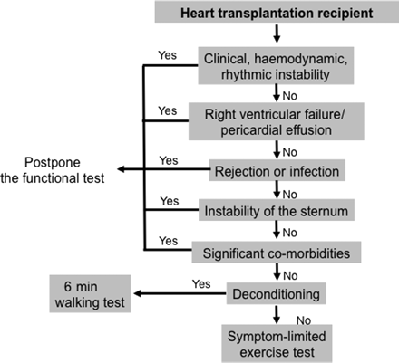
Figure 3 Proposed algorithm for functional evaluation in exercise prescription after heart transplantation. The ...
Notes:
Figure 3 Proposed algorithm for functional evaluation in exercise prescription after heart transplantation. The following general criteria should be considered in planning an exercise testing modality for exercise prescription: Safety; Co-morbidities [anaemia (HB 3 mg/dL), neurological disorders, haematological disorders, diaphragmatic failure]; associated factors (see also legends to Figures 1 and 2).
Unless provided in the caption above, the following copyright applies to the content of this slide: Published on behalf of the European Society of Cardiology. All rights reserved. © The Author 2010. For permissions please email: journals.permissions@oxfordjournals.org

