Slide 1
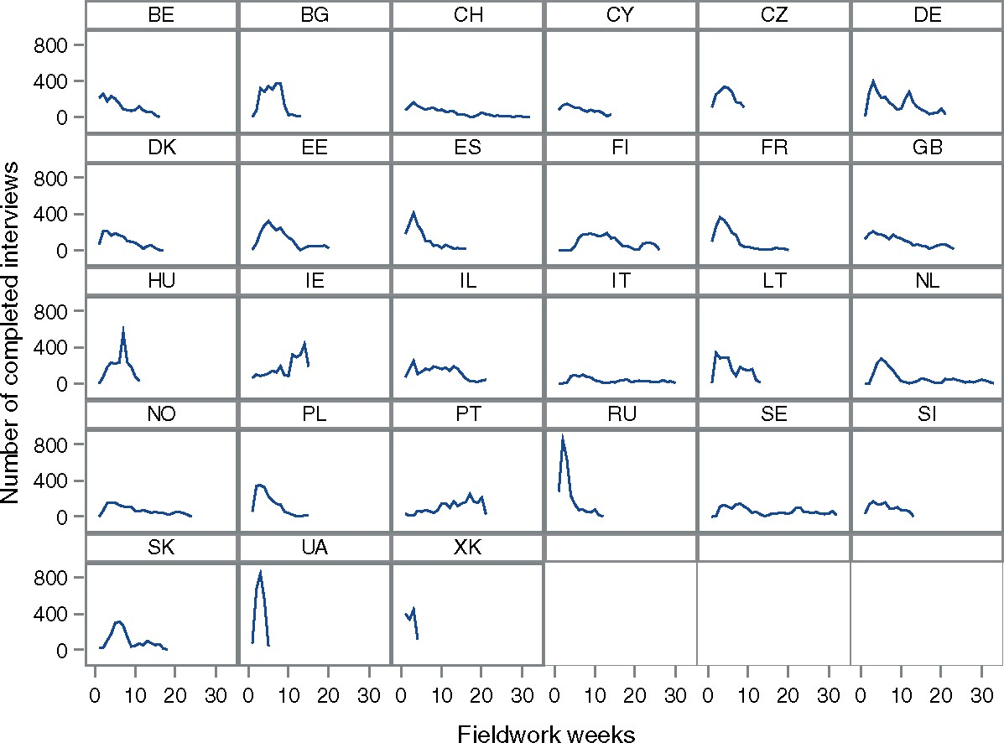
Figure 1. Evolution of the Weekly Number of Completed Interviews.
Notes:
Figure 1. Evolution of the Weekly Number of Completed Interviews.
Unless provided in the caption above, the following copyright applies to the content of this slide: © The Author 2017. Published by Oxford University Press on behalf of the American Association for Public Opinion Research. All rights reserved. For Permissions, please email: journals.permissions@oup.com

Slide 2
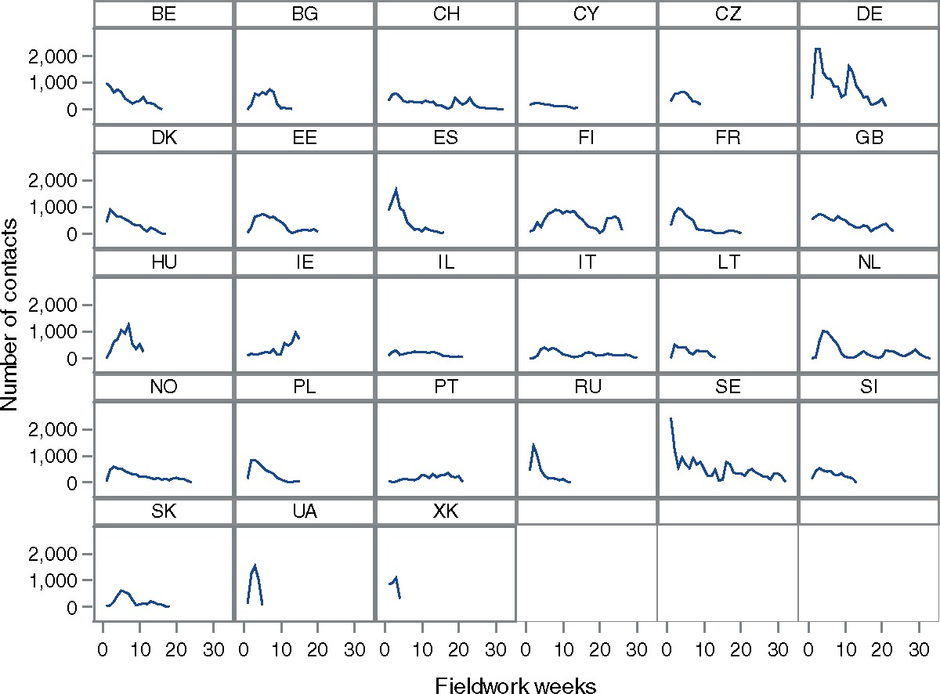
Figure 2. Evolution of the Weekly Number of Contacts.
Notes:
Figure 2. Evolution of the Weekly Number of Contacts.
Unless provided in the caption above, the following copyright applies to the content of this slide: © The Author 2017. Published by Oxford University Press on behalf of the American Association for Public Opinion Research. All rights reserved. For Permissions, please email: journals.permissions@oup.com

Slide 3
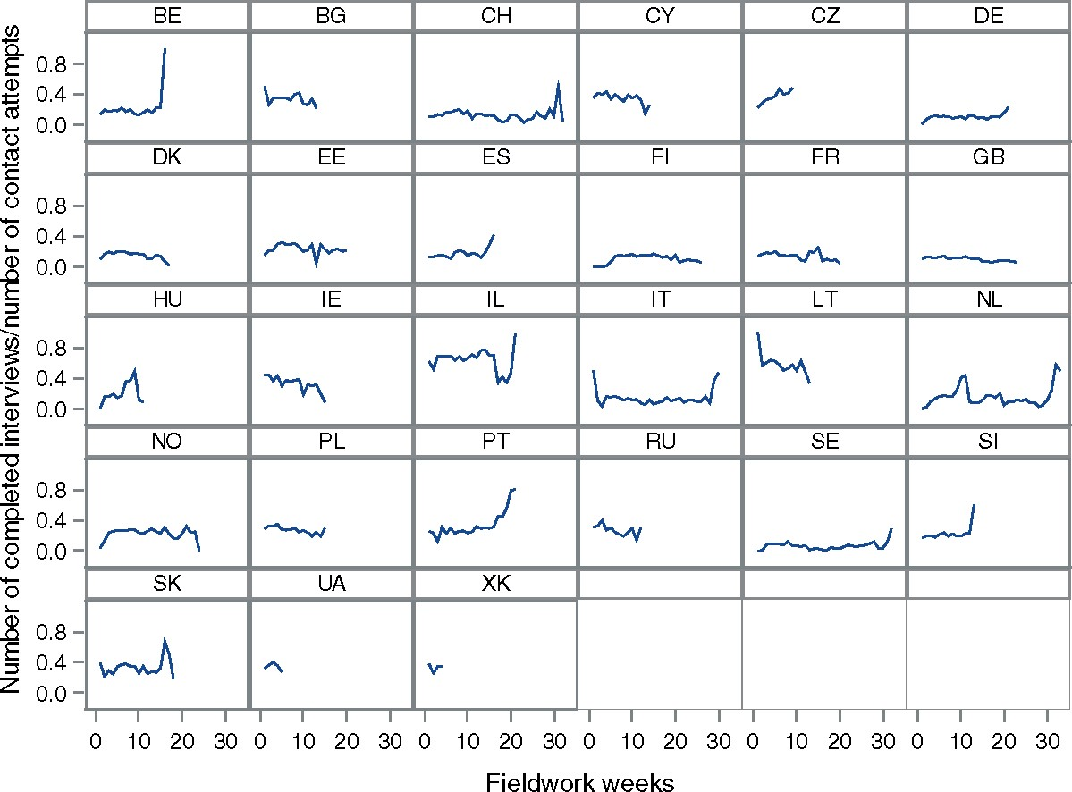
Figure 3. Evolution of the Productivity.
Notes:
Figure 3. Evolution of the Productivity.
Unless provided in the caption above, the following copyright applies to the content of this slide: © The Author 2017. Published by Oxford University Press on behalf of the American Association for Public Opinion Research. All rights reserved. For Permissions, please email: journals.permissions@oup.com

Slide 4
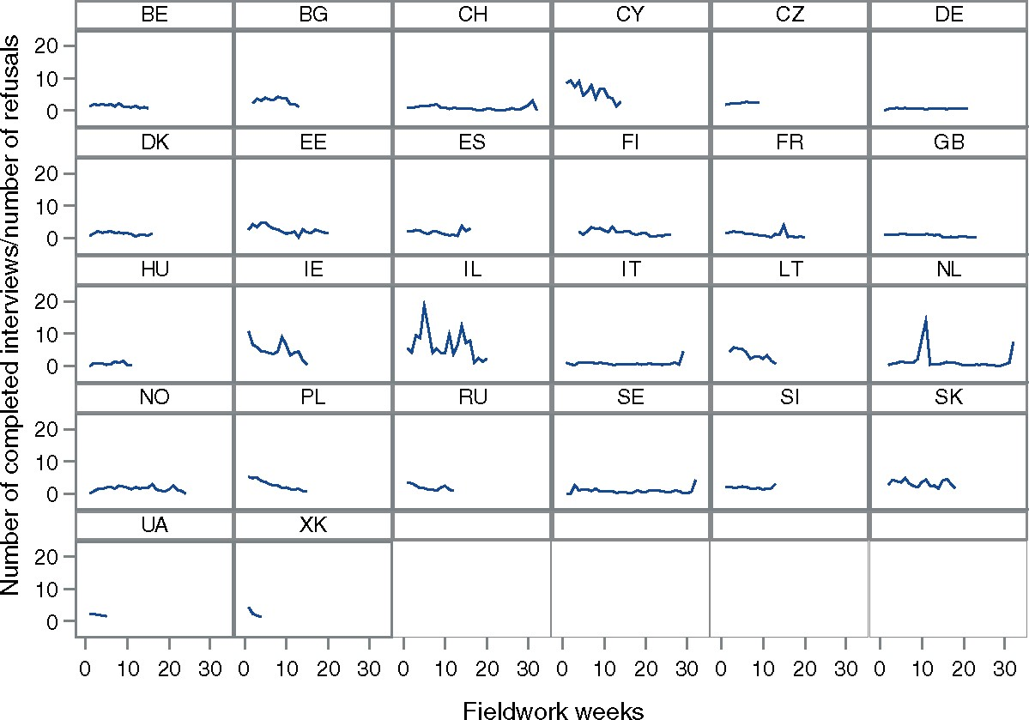
Figure 4. Evolution of the Performance.
Notes:
Figure 4. Evolution of the Performance.
Unless provided in the caption above, the following copyright applies to the content of this slide: © The Author 2017. Published by Oxford University Press on behalf of the American Association for Public Opinion Research. All rights reserved. For Permissions, please email: journals.permissions@oup.com

Slide 5
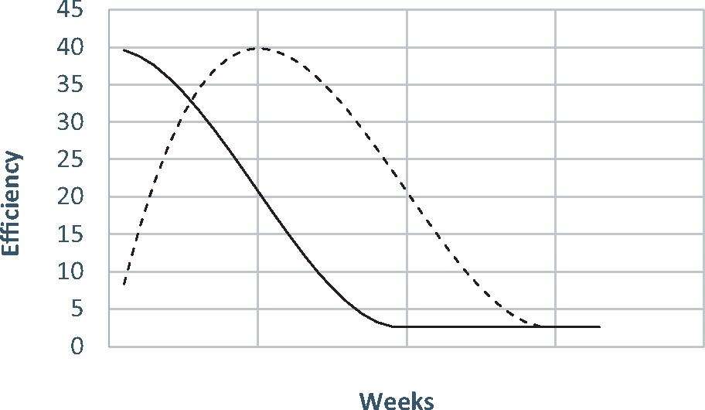
Figure 5. The Theoretical Shapes of the Weekly Data Collection Efficiency.
Notes:
Figure 5. The Theoretical Shapes of the Weekly Data Collection Efficiency.
Unless provided in the caption above, the following copyright applies to the content of this slide: © The Author 2017. Published by Oxford University Press on behalf of the American Association for Public Opinion Research. All rights reserved. For Permissions, please email: journals.permissions@oup.com

Slide 6
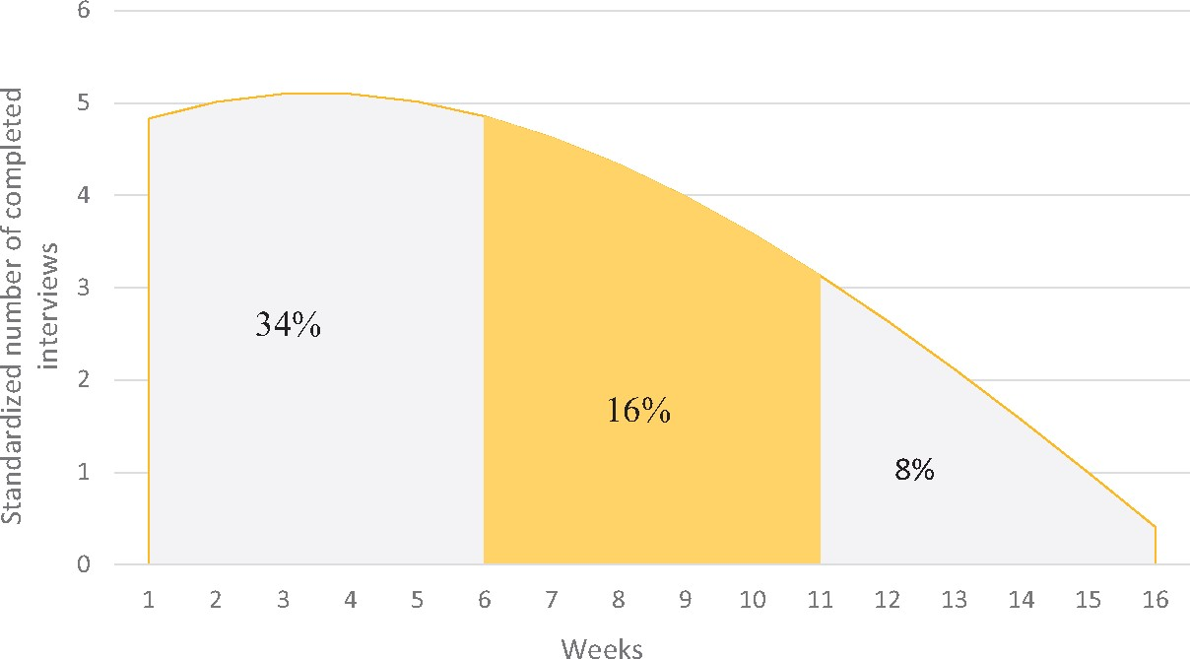
Figure 6. The Time Course of the Weekly Number of Completed Interviews.
Notes:
Figure 6. The Time Course of the Weekly Number of Completed Interviews.
Unless provided in the caption above, the following copyright applies to the content of this slide: © The Author 2017. Published by Oxford University Press on behalf of the American Association for Public Opinion Research. All rights reserved. For Permissions, please email: journals.permissions@oup.com

Slide 7
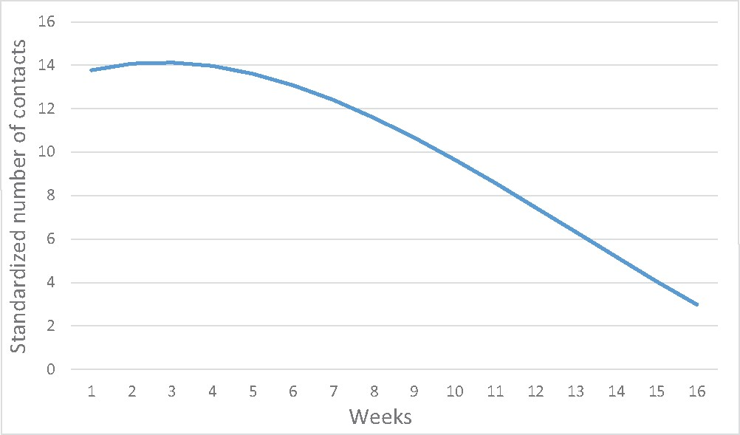
Figure 7. The Time Course of the Weekly Number of Established Contacts.
Notes:
Figure 7. The Time Course of the Weekly Number of Established Contacts.
Unless provided in the caption above, the following copyright applies to the content of this slide: © The Author 2017. Published by Oxford University Press on behalf of the American Association for Public Opinion Research. All rights reserved. For Permissions, please email: journals.permissions@oup.com

Slide 8
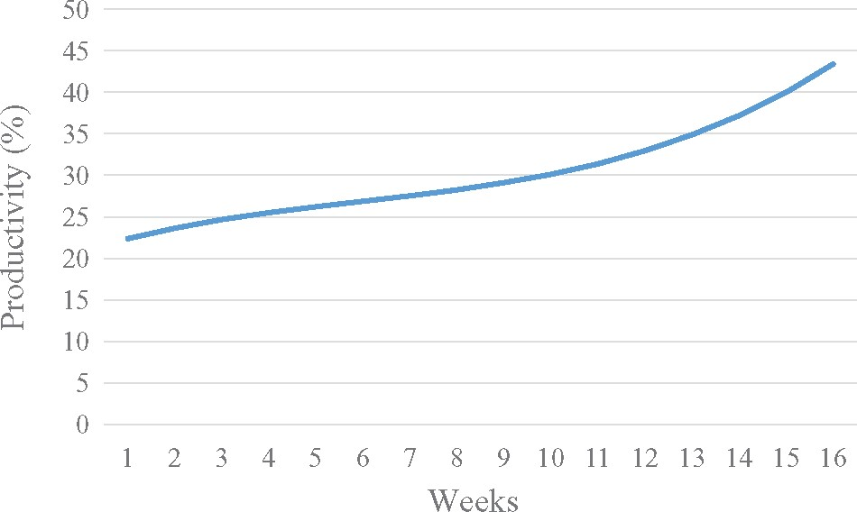
Figure 8. Evolution of the Weekly Productivity.
Notes:
Figure 8. Evolution of the Weekly Productivity.
Unless provided in the caption above, the following copyright applies to the content of this slide: © The Author 2017. Published by Oxford University Press on behalf of the American Association for Public Opinion Research. All rights reserved. For Permissions, please email: journals.permissions@oup.com

Slide 9
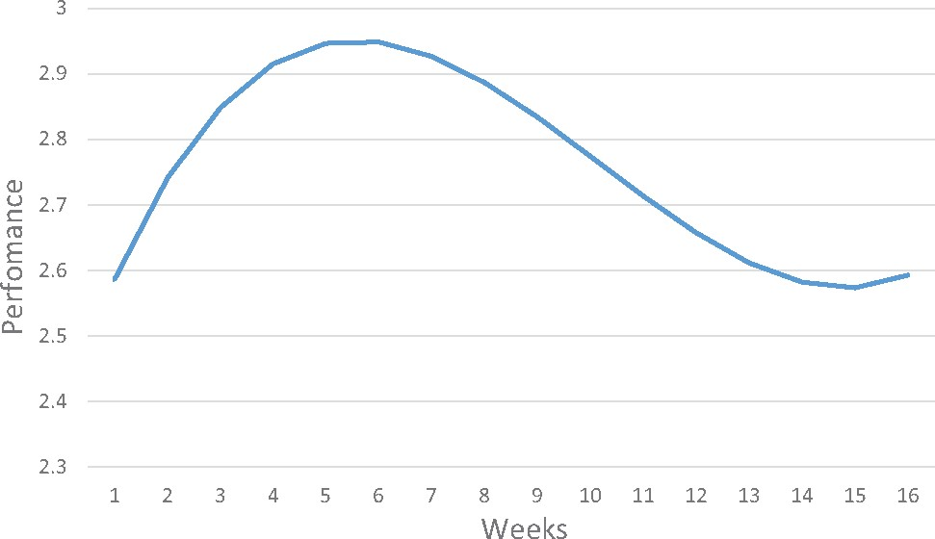
Figure 9. Evolution of the Weekly Performance.
Notes:
Figure 9. Evolution of the Weekly Performance.
Unless provided in the caption above, the following copyright applies to the content of this slide: © The Author 2017. Published by Oxford University Press on behalf of the American Association for Public Opinion Research. All rights reserved. For Permissions, please email: journals.permissions@oup.com

