Slide 1
Fig. 1. A fundamental domain of the Kleinian group $\Gamma _1$.
Notes:
Fig. 1. A fundamental domain of the Kleinian group $\Gamma _1$.
Unless provided in the caption above, the following copyright applies to the content of this slide: © 2016 London Mathematical Society

Slide 2
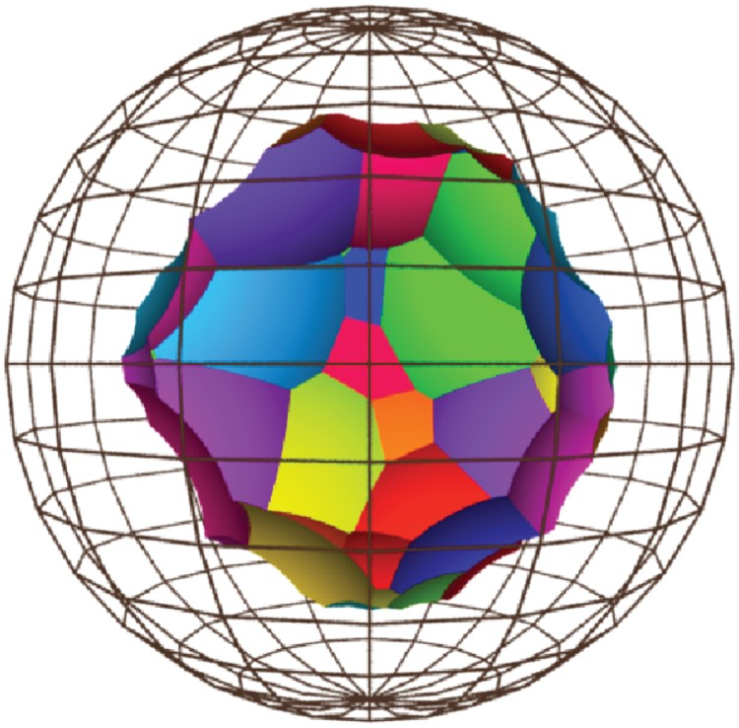
Fig. 2. A fundamental domain of the Kleinian group $\Gamma _2$.
Notes:
Fig. 2. A fundamental domain of the Kleinian group $\Gamma _2$.
Unless provided in the caption above, the following copyright applies to the content of this slide: © 2016 London Mathematical Society

Slide 3
Fig. 3. A fundamental domain of the Kleinian group $\Gamma _3$.
Notes:
Fig. 3. A fundamental domain of the Kleinian group $\Gamma _3$.
Unless provided in the caption above, the following copyright applies to the content of this slide: © 2016 London Mathematical Society

