Slide 1
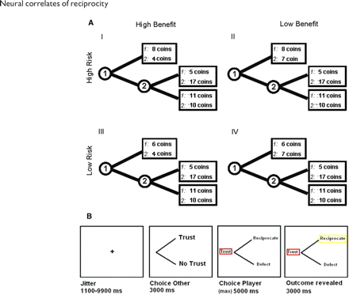
Fig. 1 (A) Presentation of task conditions. In four different conditions the risk that the trustor took when ...
Notes:
Fig. 1 (A) Presentation of task conditions. In four different conditions the risk that the trustor took when trusting and the benefit that the trustee received when being trusted were manipulated independently (Malhotra, 2004). (B) Timing of the events in the scanner task in milliseconds.
Unless provided in the caption above, the following copyright applies to the content of this slide: © The Author(s) (2009). Published by Oxford University Press.This is an Open Access article distributed under the terms of the Creative Commons Attribution Non-Commercial License (http://creativecommons.org/licenses/by-nc/4.0/), which permits non-commercial re-use, distribution, and reproduction in any medium, provided the original work is properly cited. For commercial re-use, please contact journals.permissions@oup.com

Slide 2
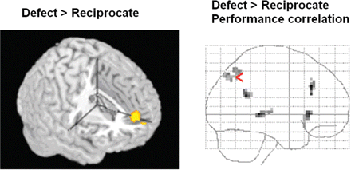
Fig. 2 (A) The contrast defect > reciprocate resulted in activation in aMPFC (MNI −6, 51, 15). (B) A regression ...
Notes:
Fig. 2 (A) The contrast defect > reciprocate resulted in activation in aMPFC (MNI −6, 51, 15). (B) A regression analysis for the defect > reciprocate contrast for reciprocity levels resulted in activation in rTPJ (MNI: 45, −43, 32), ACC (MNI: −3, 27, 33) and bilateral insula (MNI: 36, 24, 0 and −33, 21, 1).
Unless provided in the caption above, the following copyright applies to the content of this slide: © The Author(s) (2009). Published by Oxford University Press.This is an Open Access article distributed under the terms of the Creative Commons Attribution Non-Commercial License (http://creativecommons.org/licenses/by-nc/4.0/), which permits non-commercial re-use, distribution, and reproduction in any medium, provided the original work is properly cited. For commercial re-use, please contact journals.permissions@oup.com

Slide 3
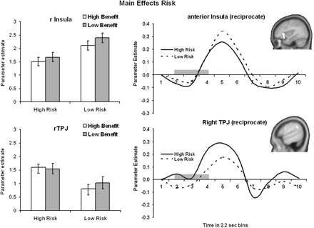
Fig. 4 ROI parameter estimates and time series for regions that were sensitive to the risk manipulation (error bars ...
Notes:
Fig. 4 ROI parameter estimates and time series for regions that were sensitive to the risk manipulation (error bars represent standard error). rTPJ (MNI: 45, −43, 32) was more active for reciprocate choices when the risk that the first player took by trusting was high rather than low. In contrast, the right anterior Insula (MNI: 36, 24, 0) was more active for reciprocate choices when the risk that the first player took was low relative to high. The time-series plots show the data collapsed over conditions, gray areas represent the decision window of participant.
Unless provided in the caption above, the following copyright applies to the content of this slide: © The Author(s) (2009). Published by Oxford University Press.This is an Open Access article distributed under the terms of the Creative Commons Attribution Non-Commercial License (http://creativecommons.org/licenses/by-nc/4.0/), which permits non-commercial re-use, distribution, and reproduction in any medium, provided the original work is properly cited. For commercial re-use, please contact journals.permissions@oup.com

Slide 4
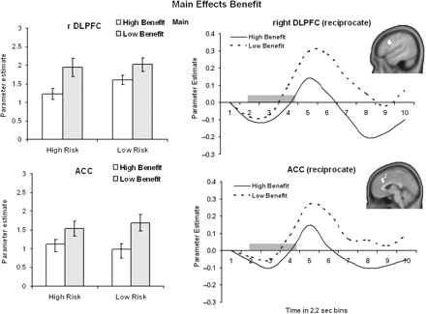
Fig. 3 ROI parameter estimates and time series for regions that were sensitive to the benefit manipulation (error ...
Notes:
Fig. 3 ROI parameter estimates and time series for regions that were sensitive to the benefit manipulation (error bars represent standard error). ACC (MNI: −3, 27, 33) and right DLPFC (MNI 51, 18, 30) were more active for reciprocate choices where the benefit of being trusted was low relative to high. The time-series plots show the data collapsed over conditions, gray areas represent the decision window of participant.
Unless provided in the caption above, the following copyright applies to the content of this slide: © The Author(s) (2009). Published by Oxford University Press.This is an Open Access article distributed under the terms of the Creative Commons Attribution Non-Commercial License (http://creativecommons.org/licenses/by-nc/4.0/), which permits non-commercial re-use, distribution, and reproduction in any medium, provided the original work is properly cited. For commercial re-use, please contact journals.permissions@oup.com

