Slide 1
Figure 1. Schematics of the applied EM systems. (a) The DASI–Vulcan system of the University of Southampton consisting ...
Notes:
Figure 1. Schematics of the applied EM systems. (a) The DASI–Vulcan system of the University of Southampton consisting of a 50 m horizontal electric dipole source and two, three-component Vulcan EM receivers towed in-line behind the transmitter [image is modified from Rona (2008) and references within; Hannington et al. (1995) and Weitemeyer et al. (2006)]. (b) Marine horizontal loop application (courtesy of Malte Sommer) and (c) MARTEMIS system designed and built at GEOMAR. A 6.3 × 6.3 m2 square transmitter loop was utilized as the exciting source. The induced voltage is measured by a coincident horizontal receiver coil.
Unless provided in the caption above, the following copyright applies to the content of this slide: © The Author(s) 2018. Published by Oxford University Press on behalf of The Royal Astronomical Society.This article is published and distributed under the terms of the Oxford University Press, Standard Journals Publication Model (https://academic.oup.com/journals/pages/open_access/funder_policies/chorus/standard_publication_model)

Slide 2
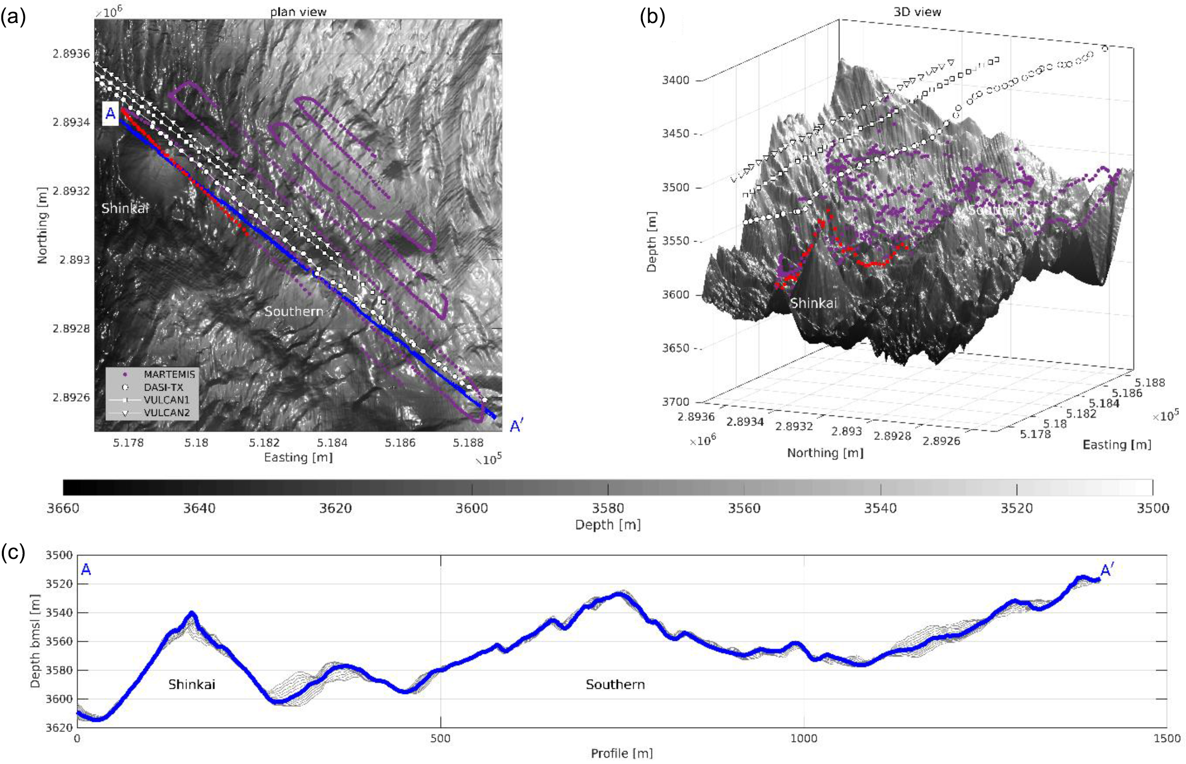
Figure 2. (a) High-resolution bathymetry acquired by the autonomous underwater vehicle (AUV) ABYSS (GEOMAR) gridded at ...
Notes:
Figure 2. (a) High-resolution bathymetry acquired by the autonomous underwater vehicle (AUV) ABYSS (GEOMAR) gridded at a resolution of 2 m overlain by the locations of the MARTEMIS data (purple), the DASI transmitter dipole (white circles) and VULCAN receivers (squares and triangles for first and second receiver, respectively). The red markers highlight the MARTEMIS stations that are investigated and compared to synthetic models in the extent of this study. (b) 3D representation of the bathymetry model shown in (a) to exemplify the expected 3D effect of the bathymetry. Note that the vertical exaggeration of the bathymetry in (b) is 4:1. Bathymetry data are courtesy of S. Petersen and the AUV ABYSS team (GEOMAR). (c) Bathymetry along profile A-A´ for better representation. Grey lines represent parallel off-axes profiles of ±10 m.
Unless provided in the caption above, the following copyright applies to the content of this slide: © The Author(s) 2018. Published by Oxford University Press on behalf of The Royal Astronomical Society.This article is published and distributed under the terms of the Oxford University Press, Standard Journals Publication Model (https://academic.oup.com/journals/pages/open_access/funder_policies/chorus/standard_publication_model)

Slide 3
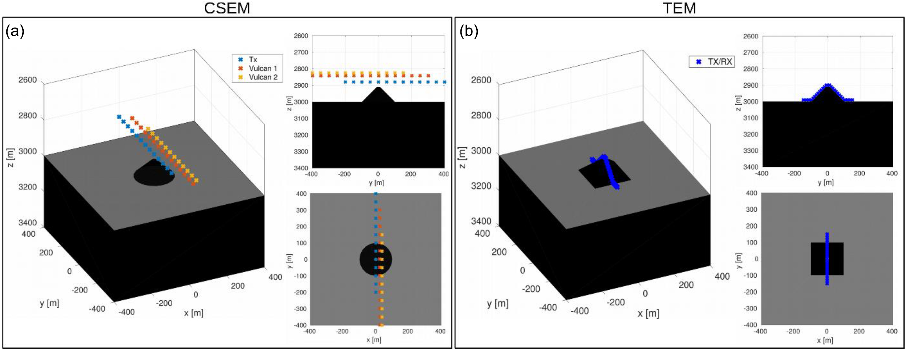
Figure 3. General 3D model and transmitter/receiver geometry applied in the 3D forward modelling study. (a) A truncated ...
Notes:
Figure 3. General 3D model and transmitter/receiver geometry applied in the 3D forward modelling study. (a) A truncated cone of 100 m base radius and height of 90 m utilized for the CSEM forward modelling. (b) Pyramid with side lengths of 200 m and height of 90 m for TEM forward modelling. The coloured markers indicate the position of the transmitter/receivers as indicated by the legend. Each panel shows a 3D representation along with a 2D cross-section (upper right) and 2D plan view (lower right).
Unless provided in the caption above, the following copyright applies to the content of this slide: © The Author(s) 2018. Published by Oxford University Press on behalf of The Royal Astronomical Society.This article is published and distributed under the terms of the Oxford University Press, Standard Journals Publication Model (https://academic.oup.com/journals/pages/open_access/funder_policies/chorus/standard_publication_model)

Slide 4
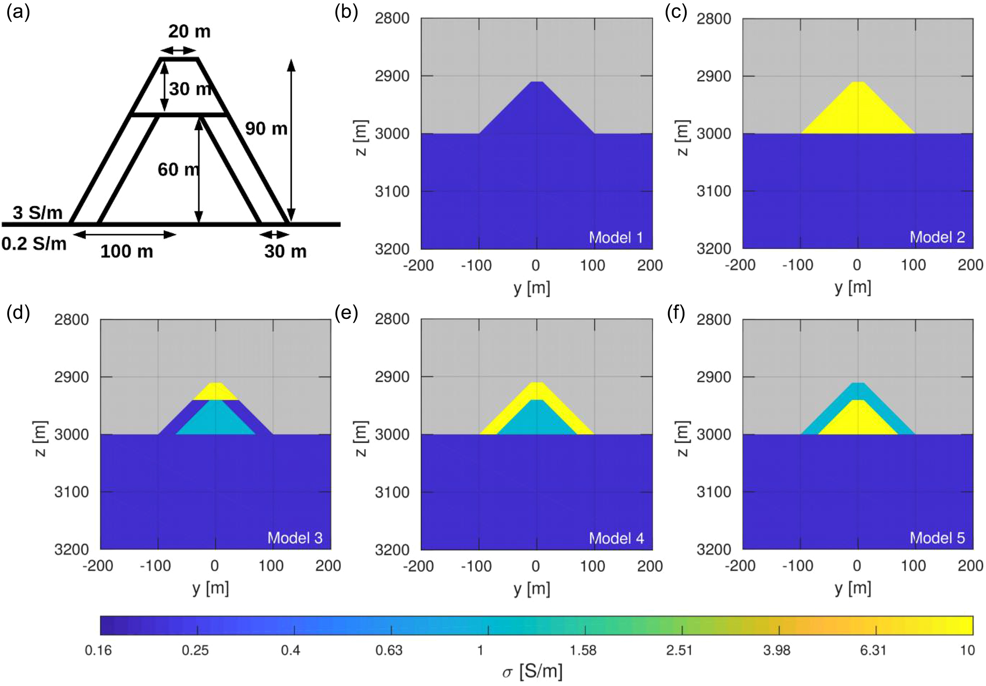
Figure 4. 2D cross-section of the investigated 3D conductivity models. (a) Schematic of the mound dimensions and fixed ...
Notes:
Figure 4. 2D cross-section of the investigated 3D conductivity models. (a) Schematic of the mound dimensions and fixed conductivity values of the host rock and seawater. The five considered conductivity distributions are illustrated in b through f.
Unless provided in the caption above, the following copyright applies to the content of this slide: © The Author(s) 2018. Published by Oxford University Press on behalf of The Royal Astronomical Society.This article is published and distributed under the terms of the Oxford University Press, Standard Journals Publication Model (https://academic.oup.com/journals/pages/open_access/funder_policies/chorus/standard_publication_model)

Slide 5
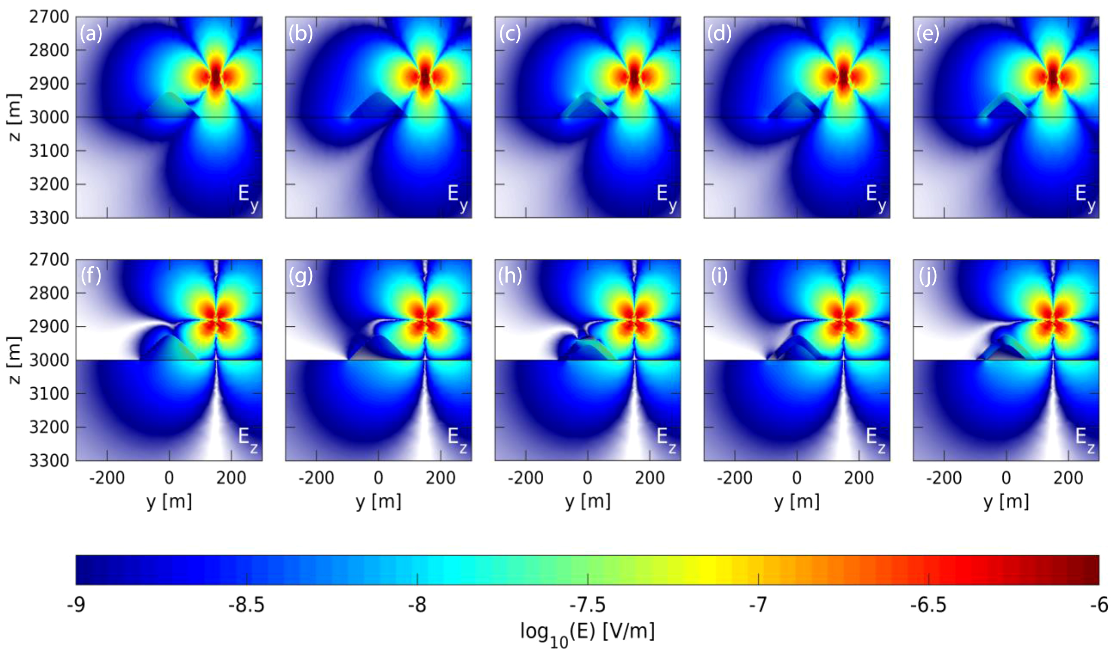
Figure 5. Absolute electric field amplitude of the E_{y} (top panel) and E_{z} (bottom panel) component ...
Notes:
Figure 5. Absolute electric field amplitude of the Ey (top panel) and Ez (bottom panel) component in the yz-plane at 1 Hz for a horizontal electrical dipole located at y = 150 m. Note, yz-plane is shown as a cross-section in the plane of the first Vulcan receiver (x = 24 m). Images are sorted according to their corresponding models (1 through 5) illustrated in Fig. 4 from left to right. Amplitudes below 10−9 V m−1 are blanked.
Unless provided in the caption above, the following copyright applies to the content of this slide: © The Author(s) 2018. Published by Oxford University Press on behalf of The Royal Astronomical Society.This article is published and distributed under the terms of the Oxford University Press, Standard Journals Publication Model (https://academic.oup.com/journals/pages/open_access/funder_policies/chorus/standard_publication_model)

Slide 6
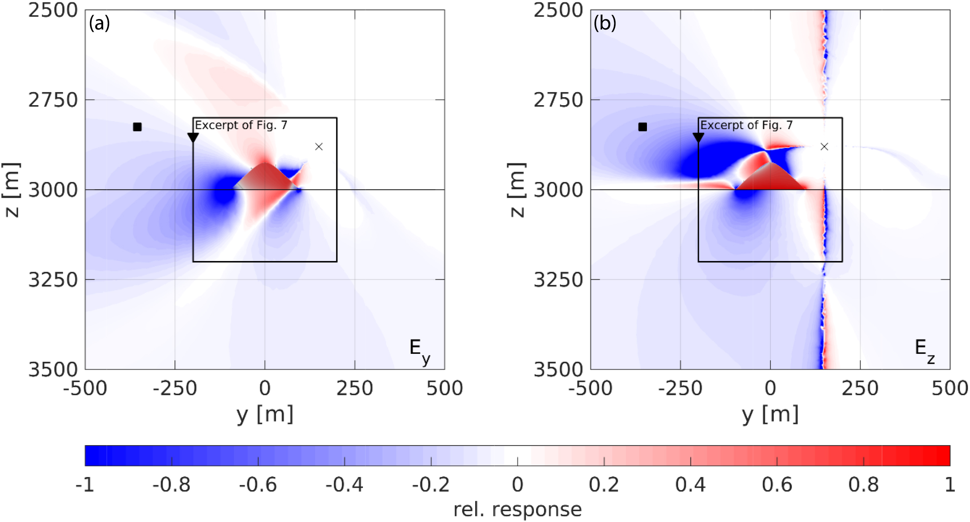
Figure 6. Relative response of Model 1 with respect to Models 2 is calculated for (a) E_{y} and (b) ...
Notes:
Figure 6. Relative response of Model 1 with respect to Models 2 is calculated for (a) Ey and (b) Ez. The location of the transmitter is highlighted by the cross, whereas mean receiver locations during the measurement survey are shown by a triangle and square for the first and second Vulcan, respectively. The relative response is plotted for values between 1 and −1, which corresponds to a relative difference in signal amplitude of ± 100 per cent. The axis ranges are increased compared to Fig. 5 to display the Vulcan receiver locations.
Unless provided in the caption above, the following copyright applies to the content of this slide: © The Author(s) 2018. Published by Oxford University Press on behalf of The Royal Astronomical Society.This article is published and distributed under the terms of the Oxford University Press, Standard Journals Publication Model (https://academic.oup.com/journals/pages/open_access/funder_policies/chorus/standard_publication_model)

Slide 7
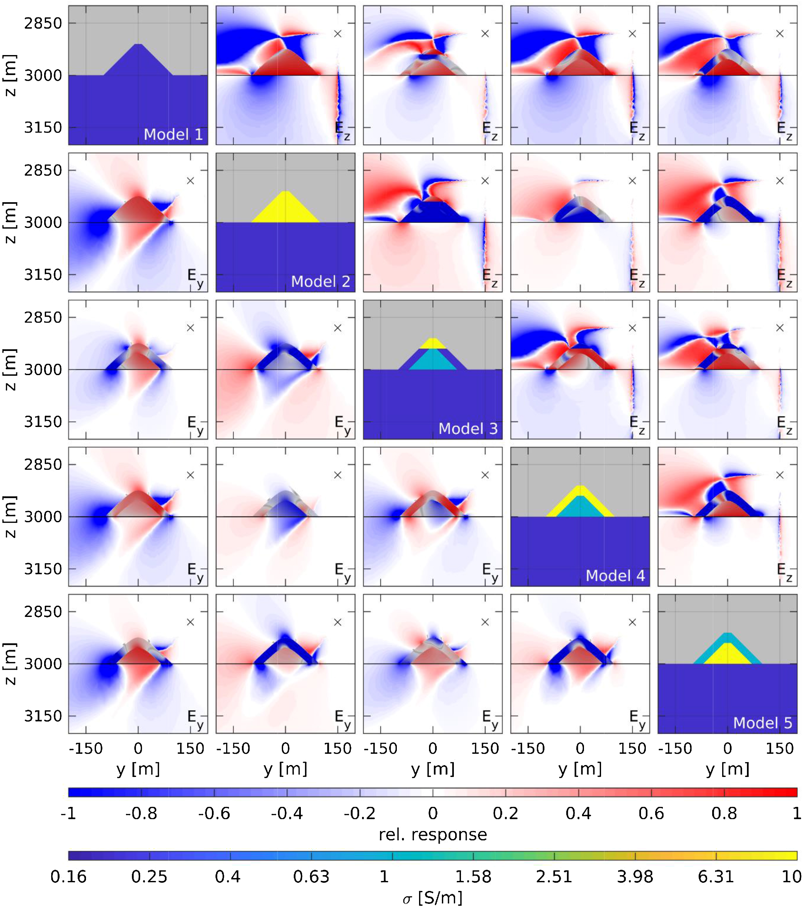
Figure 7. Relative response and 2D cross-sections of the investigated 3D models shown in Fig. 4. The image is organized ...
Notes:
Figure 7. Relative response and 2D cross-sections of the investigated 3D models shown in Fig. 4. The image is organized as a matrix. The main diagonal illustrates the investigated models. The upper triangular section shows the relative response in the Ez component of the corresponding models located in the respective row and column. The lower triangular section is analogous, but for the Ey component. The relative response is plotted for values between 1 and −1, which corresponds to a relative difference in signal amplitude of ±100 per cent. The transmitter position is marked by a cross in each image.
Unless provided in the caption above, the following copyright applies to the content of this slide: © The Author(s) 2018. Published by Oxford University Press on behalf of The Royal Astronomical Society.This article is published and distributed under the terms of the Oxford University Press, Standard Journals Publication Model (https://academic.oup.com/journals/pages/open_access/funder_policies/chorus/standard_publication_model)

Slide 8
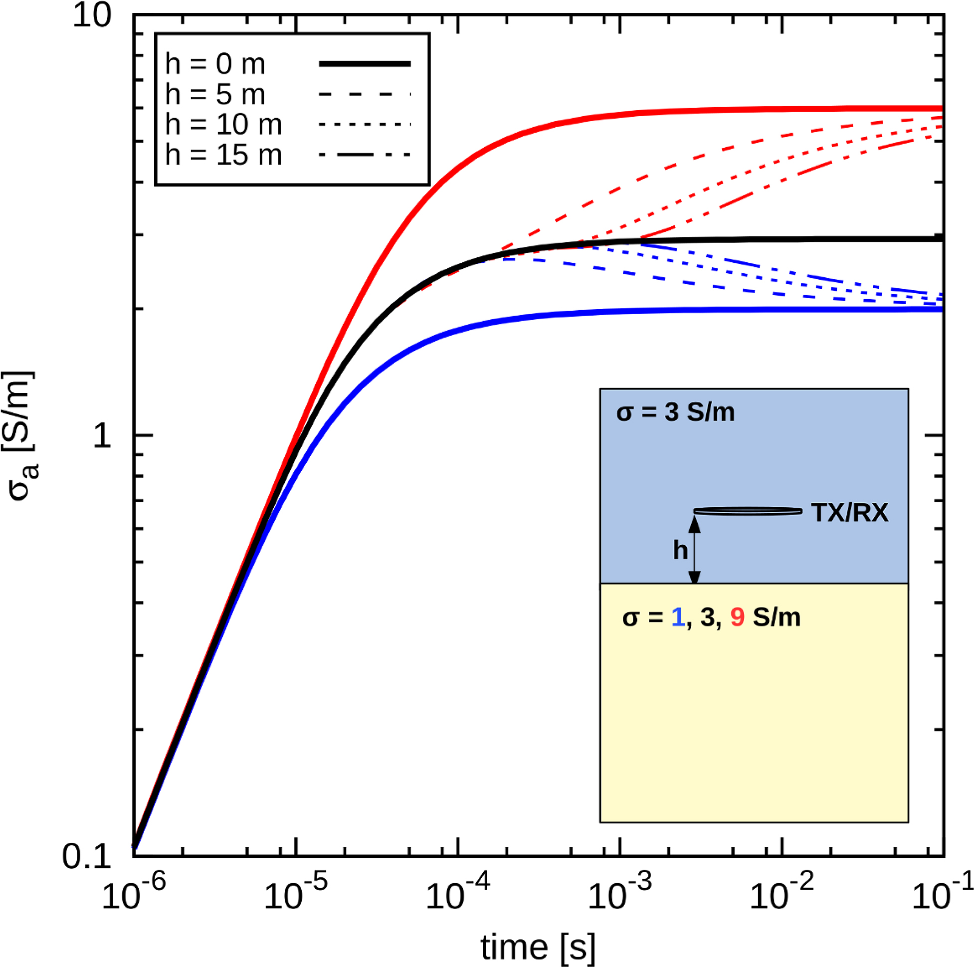
Figure 8. Apparent conductivity curves of a coincident loop TEM system calculated for specific transmitter/receiver ...
Notes:
Figure 8. Apparent conductivity curves of a coincident loop TEM system calculated for specific transmitter/receiver elevations in a double half-space environment. The conductivity of the lower half-space is varied between values of 1, 3 and 9 S m-1 represented by the blue, black and red colours, respectively. Different elevations are illustrated by the different line styles.
Unless provided in the caption above, the following copyright applies to the content of this slide: © The Author(s) 2018. Published by Oxford University Press on behalf of The Royal Astronomical Society.This article is published and distributed under the terms of the Oxford University Press, Standard Journals Publication Model (https://academic.oup.com/journals/pages/open_access/funder_policies/chorus/standard_publication_model)

Slide 9
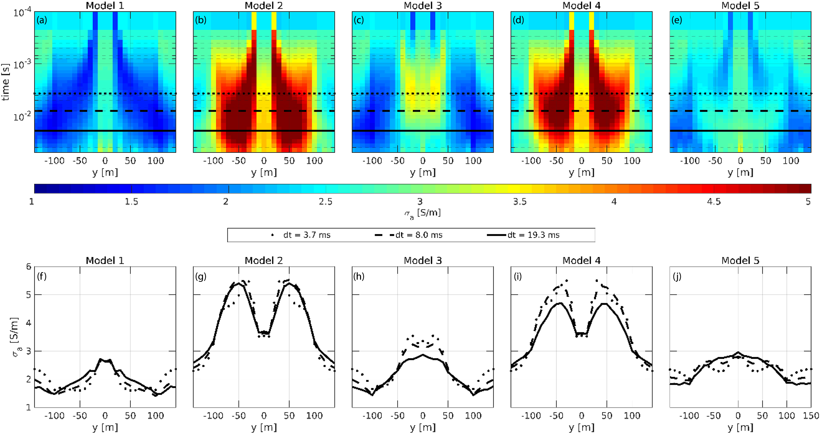
Figure 9. Apparent conductivity pseudo-sections and corresponding profile curves for Model 1 through 5 displayed in ...
Notes:
Figure 9. Apparent conductivity pseudo-sections and corresponding profile curves for Model 1 through 5 displayed in Fig. 4b through f. The sub-figures show apparent conductivities along the profile for a TEM system located 10 m above the seafloor. The curves shown in the bottom panel represent values at selected time delays of 3.7, 8.0 and 19.3 ms in dotted, dashed and solid lines, respectively.
Unless provided in the caption above, the following copyright applies to the content of this slide: © The Author(s) 2018. Published by Oxford University Press on behalf of The Royal Astronomical Society.This article is published and distributed under the terms of the Oxford University Press, Standard Journals Publication Model (https://academic.oup.com/journals/pages/open_access/funder_policies/chorus/standard_publication_model)

Slide 10
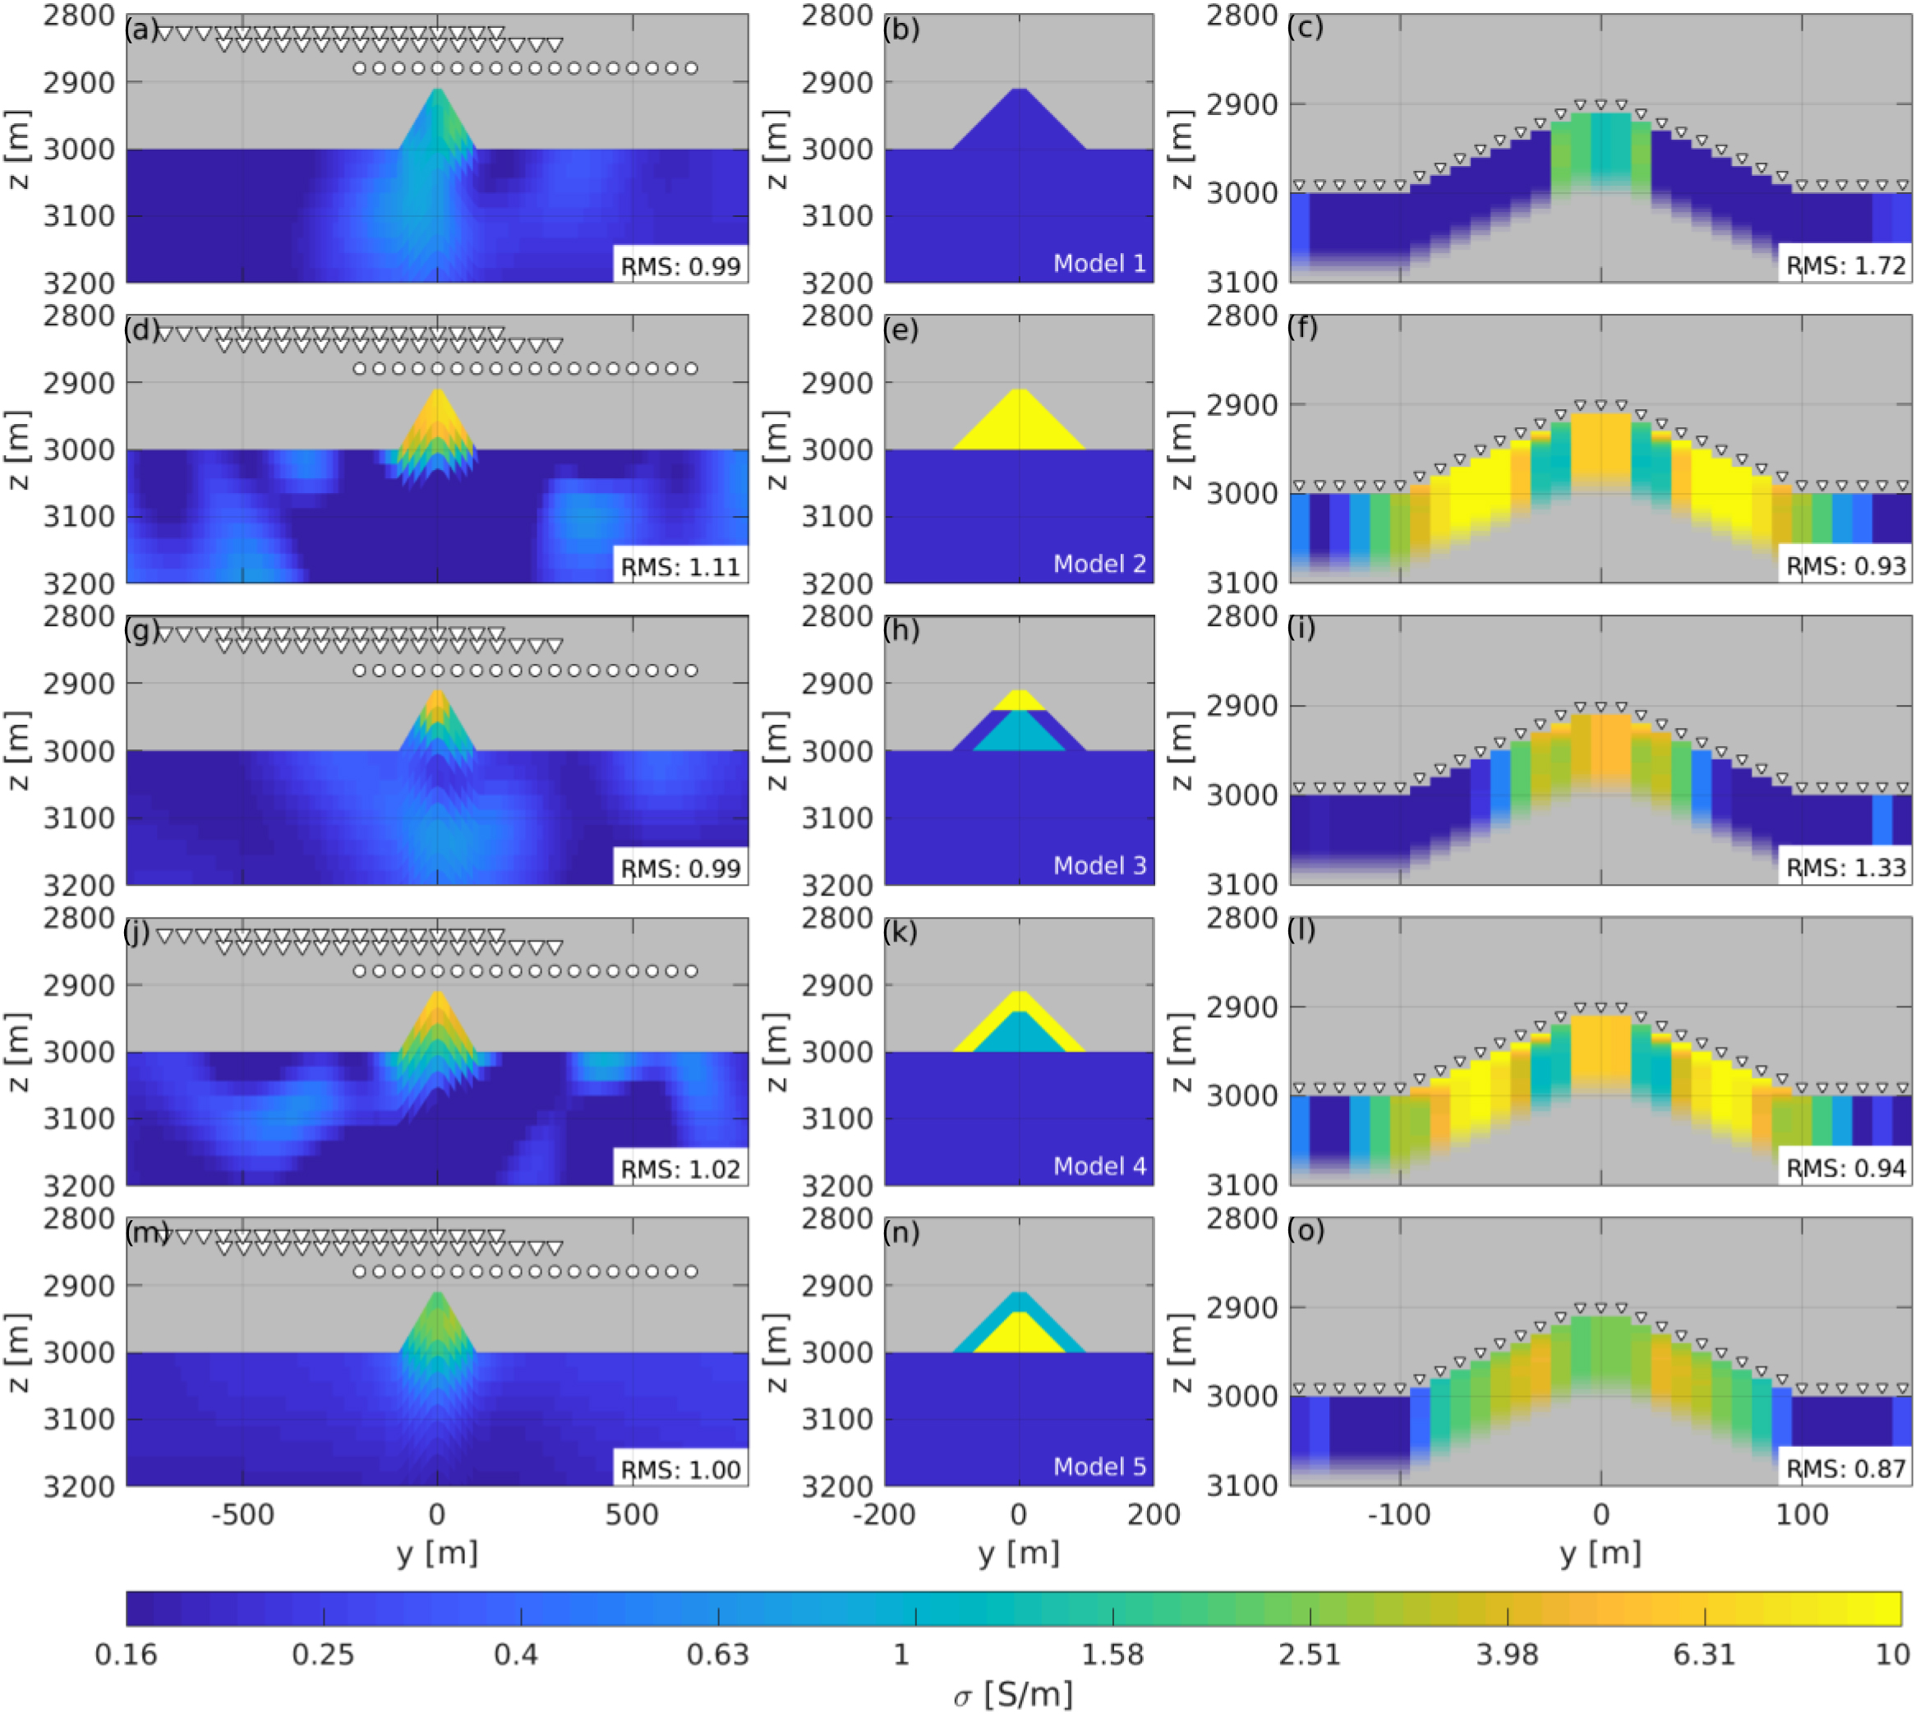
Figure 10. Inversion models for the synthetic 3D data presented in the sections above. (Left column) 2D Inversion models ...
Notes:
Figure 10. Inversion models for the synthetic 3D data presented in the sections above. (Left column) 2D Inversion models for CSEM sorted from top to bottom by the corresponding 3D model displayed in the centre column. Triangles represent receiver positions, whereas circles illustrate transmitter locations. (Right column) 1D inversion models of synthetic 3D TEM data. Triangular markers represent the position of both transmitter and receiver. Note that the conductivity of the seawater is not shown in these models, but is included in the inversion process as a fixed parameter at 3 S m−1. Also, we assume the projected bathymetry underneath the transmitter to be the true 2D bathymetry. Vertical and lateral axis are not consistent between CSEM and TEM. Data misfit of the final inversion models are displayed in for of rms.
Unless provided in the caption above, the following copyright applies to the content of this slide: © The Author(s) 2018. Published by Oxford University Press on behalf of The Royal Astronomical Society.This article is published and distributed under the terms of the Oxford University Press, Standard Journals Publication Model (https://academic.oup.com/journals/pages/open_access/funder_policies/chorus/standard_publication_model)

Slide 11
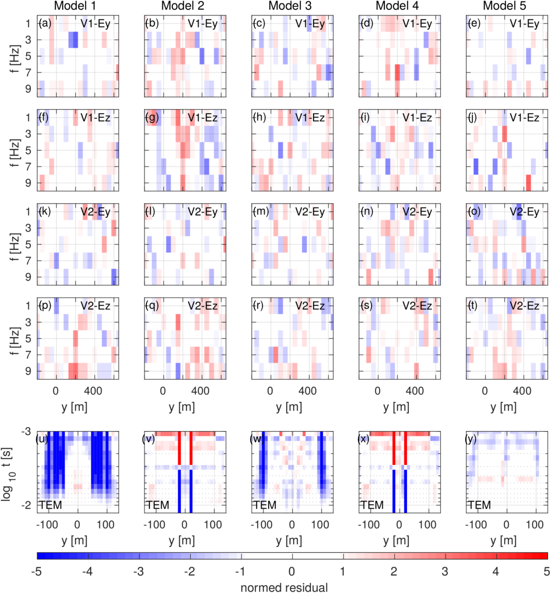
Figure 11. (a–t) Normed residual of the CSEM data misfit at odd frequencies between 1 and 9 Hz for each of the five ...
Notes:
Figure 11. (a–t) Normed residual of the CSEM data misfit at odd frequencies between 1 and 9 Hz for each of the five models (left to right) displayed in Fig. 4. Normed residuals are displayed for the Ey and the Ez field component at Vulcan 1 (V1) and Vulcan 2 (V2) receiver. (u–y) Normed residuals of TEM transient misfit between 10−3 and 2 × 10−2 s. Misfits between −1 and 1 are blanked, as they are fitted within the assumed error bars of the data.
Unless provided in the caption above, the following copyright applies to the content of this slide: © The Author(s) 2018. Published by Oxford University Press on behalf of The Royal Astronomical Society.This article is published and distributed under the terms of the Oxford University Press, Standard Journals Publication Model (https://academic.oup.com/journals/pages/open_access/funder_policies/chorus/standard_publication_model)

Slide 12
Figure 12. Inversion models of measured EM data for selected profiles highlighted in Fig. 2. (a) 2D inversion model of ...
Notes:
Figure 12. Inversion models of measured EM data for selected profiles highlighted in Fig. 2. (a) 2D inversion model of the DASI-Vulcan data. Transmitter positions are illustrated with circles, receivers, with triangles. The extent of the MARTEMIS profile shown in (b) is highlighted by the white box. (b) Stitched 1D inversion models for data obtained by the MARTEMIS system. Triangular markers represent the position of the coincident-loop antenna. Note, profiles are projected onto their corresponding easting coordinate and are not completely parallel (Fig. 2).
Unless provided in the caption above, the following copyright applies to the content of this slide: © The Author(s) 2018. Published by Oxford University Press on behalf of The Royal Astronomical Society.This article is published and distributed under the terms of the Oxford University Press, Standard Journals Publication Model (https://academic.oup.com/journals/pages/open_access/funder_policies/chorus/standard_publication_model)

