Slide 1
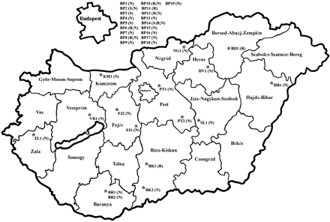
Figure 1 Map of Hungary showing the locations of the 35 centres. The PTs detected in each centre are presented in ...
Notes:
Figure 1 Map of Hungary showing the locations of the 35 centres. The PTs detected in each centre are presented in brackets.
Unless provided in the caption above, the following copyright applies to the content of this slide: © The Author 2008. Published by Oxford University Press on behalf of the British Society for Antimicrobial Chemotherapy. All rights reserved. For Permissions, please e-mail: journals.permissions@oxfordjournals.org

Slide 2
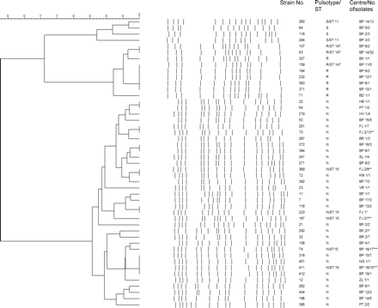
Figure 2 Cluster analysis of 196 K. pneumoniae macrorestriction profiles from 35 centres and STs of selected isolates. ...
Notes:
Figure 2 Cluster analysis of 196 K. pneumoniae macrorestriction profiles from 35 centres and STs of selected isolates. *Prototype isolate of HEC from 2003. **Isolates from April and October 2005 from the outbreak in the FJ2 centre. ***Isolates from April and August 2005 from the outbreak in the BP18 centre.
Unless provided in the caption above, the following copyright applies to the content of this slide: © The Author 2008. Published by Oxford University Press on behalf of the British Society for Antimicrobial Chemotherapy. All rights reserved. For Permissions, please e-mail: journals.permissions@oxfordjournals.org

Slide 3
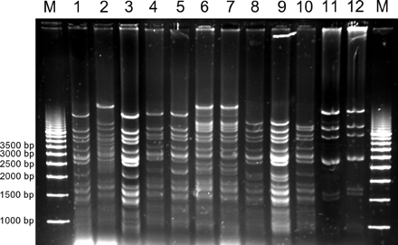
Figure 3 PstI fingerprints of plasmids isolated from transconjugants (TCs) and transformants (Ts) of different ECs. ...
Notes:
Figure 3 PstI fingerprints of plasmids isolated from transconjugants (TCs) and transformants (Ts) of different ECs. Lane M, molecular weight marker; lane 1, TC79 (HEC, PT N/ST 15); lane 2, TC242 (HEC, PT N/ST 15); lane 3, TC411 (HEC, PT N/ST 15); lane 4, TC401 (HEC, PT N/ST 15); lane 5, TC12 (HEC, PT N/ST 15); lane 6, TC280 (HEC, PT N/ST 15); lane 7, TC366 (HEC, PT N/ST 15); lane 8, TC93 (EC II, PT R/ST 147); lane 9, TC159 (EC II, PT R/ST 147); lane 10, TC107 (EC II, PT R/ST 147); lane 11, T260 (EC III, PT S/ST 11); lane 12, T294 (EC III, PT S/ST 11).
Unless provided in the caption above, the following copyright applies to the content of this slide: © The Author 2008. Published by Oxford University Press on behalf of the British Society for Antimicrobial Chemotherapy. All rights reserved. For Permissions, please e-mail: journals.permissions@oxfordjournals.org

